Slide 1
COMPUTATION:
Theory, METHODS, LIMITATIONS, and the Future an Introduction to Quantum Computing
Chris Lomont, 2019
Notes:
Picture us

Slide 2
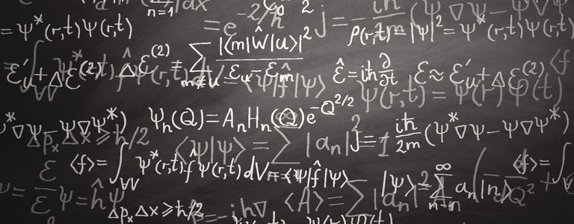
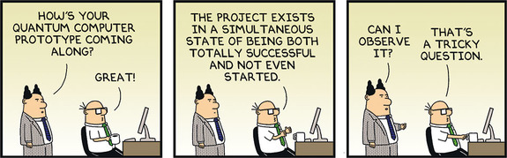
Intro
Quantum Computing is NOT
  faster at everything
  able to crack all codes
  able to send information faster than light
  able to save Moore’s Law
  able to solve problems classical computers cannot
Quantum Computing is
  able to do a very few problems
  exponentially faster than
  classical computers
Implications on nature of reality…..

Slide 3
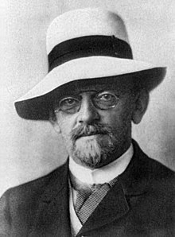
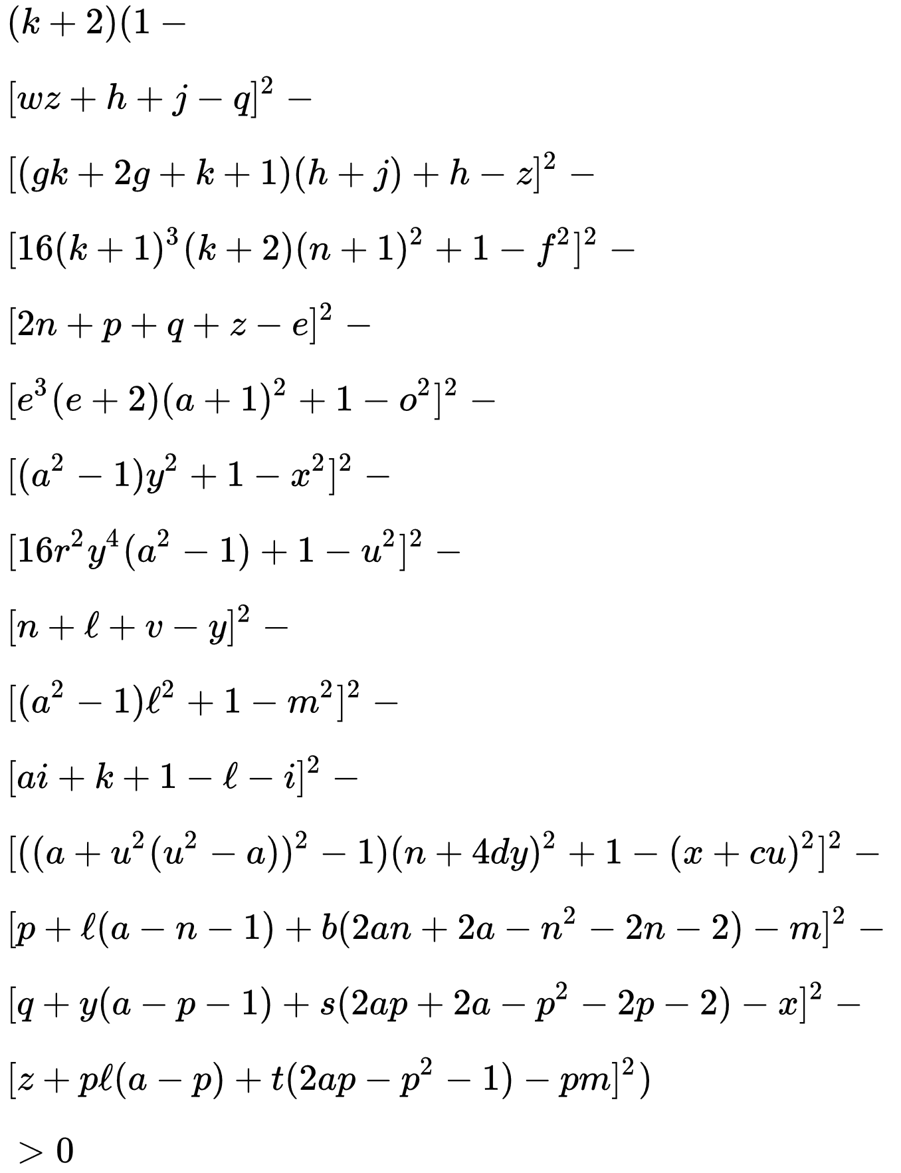
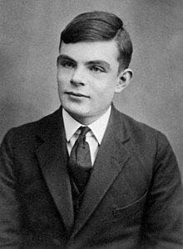
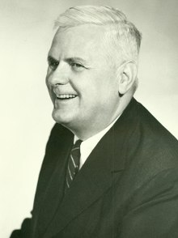
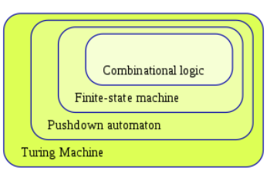
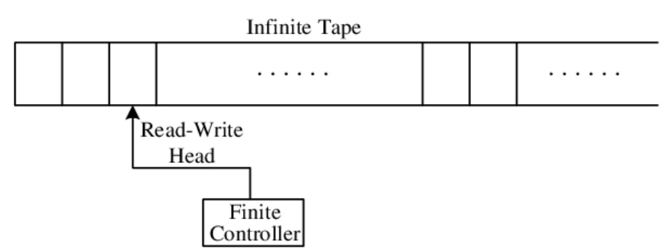
Classical Computation 1/4
Computation is rooted in “what can be done mechanically..”
David Hilbert posed 23 math problems in 1900
  #10 – find an algorithm for Diophantine Equations
    Shown impossible in 1970
Turing, 1936, working on #10
  “On computable numbers…”
  Turing machine, UTM
  Halting problem (Turing Hierarchy)
Church, 1936, on #10, lambda calculus
  Lives in functional programming
Notes:
Prime generating polynomial

Slide 4
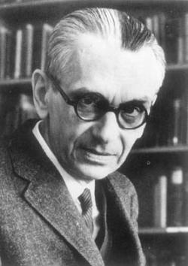
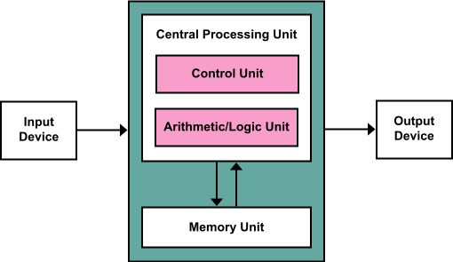
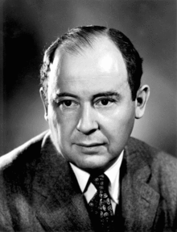
Classical Computation 2/4
Church-Turing Thesis “All computers are created equal”
  A hypothesis on the nature of computable functions
  Proved UTM, Lambda, Gödel general recursive functions equivalent
  Holds till now – quantum computing seems to jump to a new level
von Neumann Architecture, 1945
  Showed how to put simple electronic parts together to make a
  computer
Limits of computation
  Halting problem, Turing Hierarchy
  Gödel implications?

Slide 5
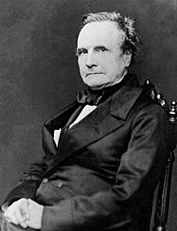
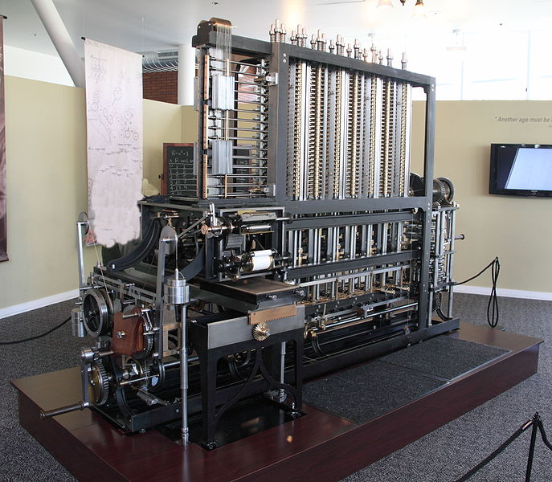
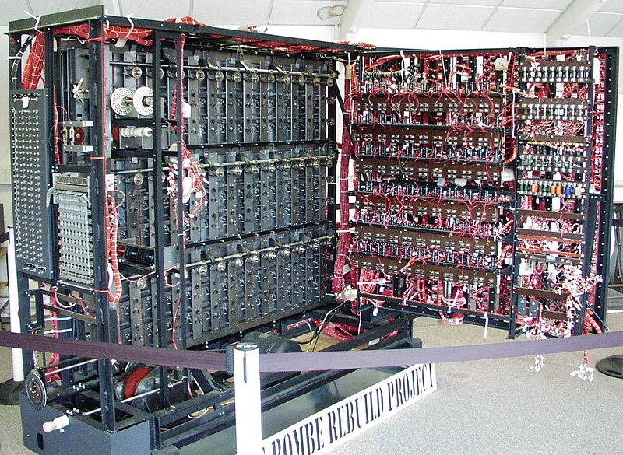
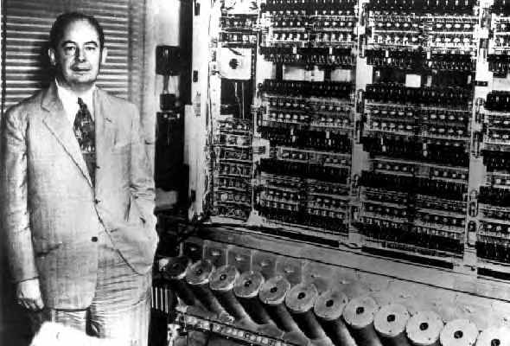
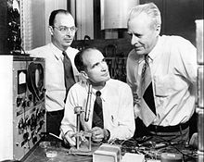
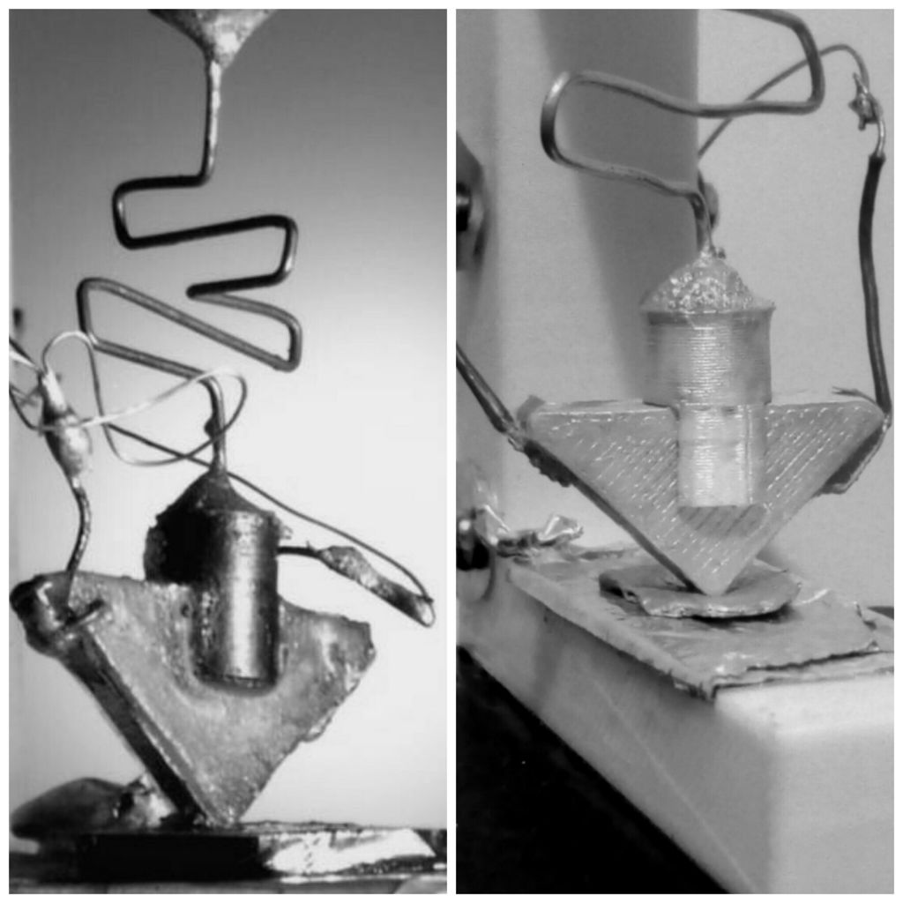
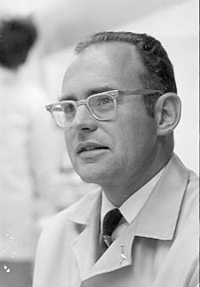
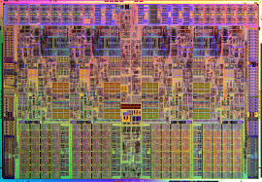
Classical Computation 3/4
Babbage: Difference Engine, designed 1820ish,
built 1985-1991
Turing: Bombe to crack codes in WWII
von Neumann: EDVAC, ENIAC
Transistor: (switch turned on/off by other signal)
  Bardeen, Shockley, Brattain 1947
  Replaced faulty, big, hot relays and tubes as switches
  Bardeen got 2 Physics Nobel prizes (only person)
    1956 for transistor
    1972 for superconductor theory with Cooper, Schrieffer
Moore: Intel 1965
  Moore’s law – “The number of transistors in a dense IC will
  double every …[1-3]… years”
Notes:
Machines needed a physical realization to be useful as computers

Slide 6
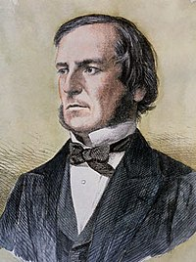
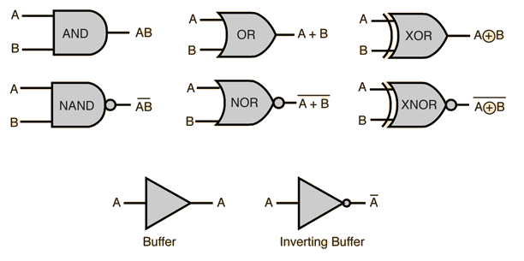
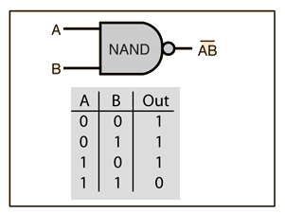
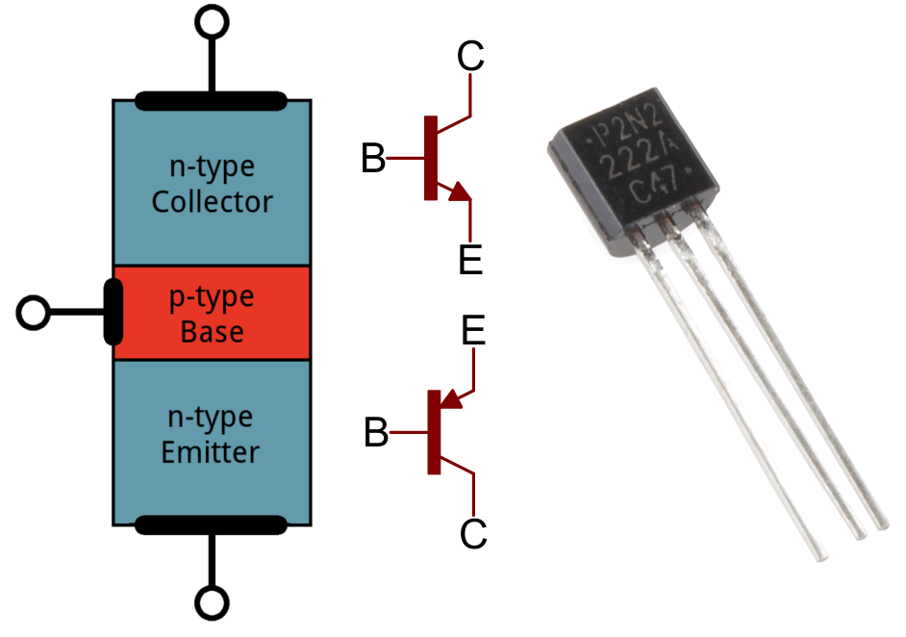
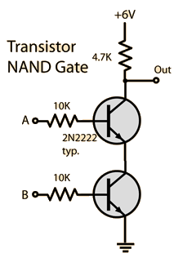
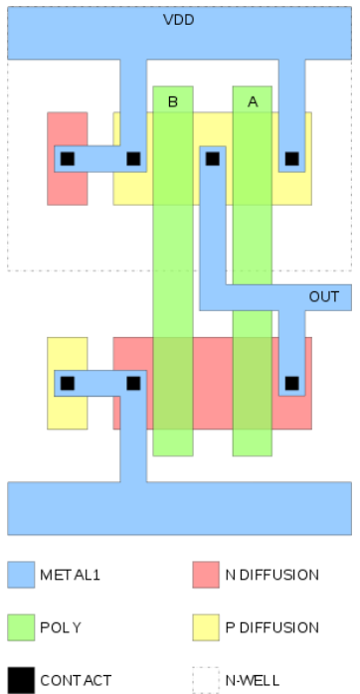
Classical Computation 4/4
Any Boolean function can be computed by 2 input,
1 output functions
  16 basic Boolean functions on 2 inputs to one output
  George Boole, 1847, 1854
NAND is one such function, turns out enough to use
only NAND gates
  Called functional completeness. NOR is another.
  (8/16 such are complete? Lomont once checked)
Transistor is a basic switch used to implement basic
gates.
Hard puzzle
  Level 1: Invert three signals using only 2 NOT gates,
  and as many AND and OR gates as you need.
  Level Wizard: Invert as many signals as you want
  using the same
  restriction.
Notes:
Machines needed a physical realization to be useful as computers

Slide 7
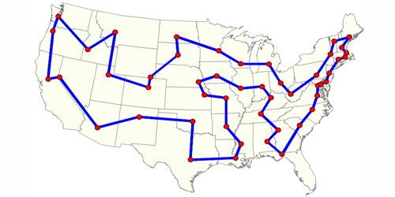
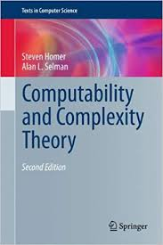
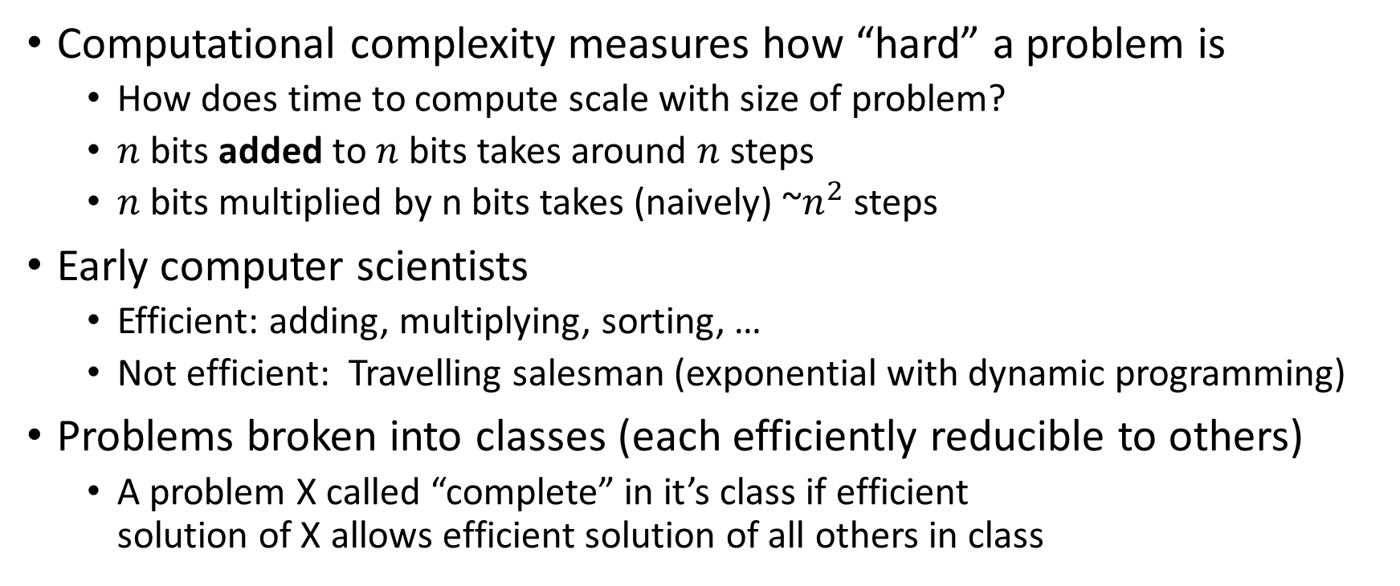
Complexity Theory 1/3
Computational complexity measures how “hard” a problem is
  How does time to compute scale with size of problem?
  $n$ bits added to $n$ bits takes around $n$ steps
  $n$ bits multiplied by n bits takes (naively) ~$n^{2}$ steps
Early computer scientists
  Efficient: adding, multiplying, sorting, …
  Not efficient: Travelling salesman (exponential with dynamic programming)
Problems broken into classes (each efficiently reducible to others)
  A problem X called “complete” in it’s class if efficient
  solution of X allows efficient solution of all others in class

Slide 8
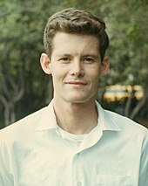
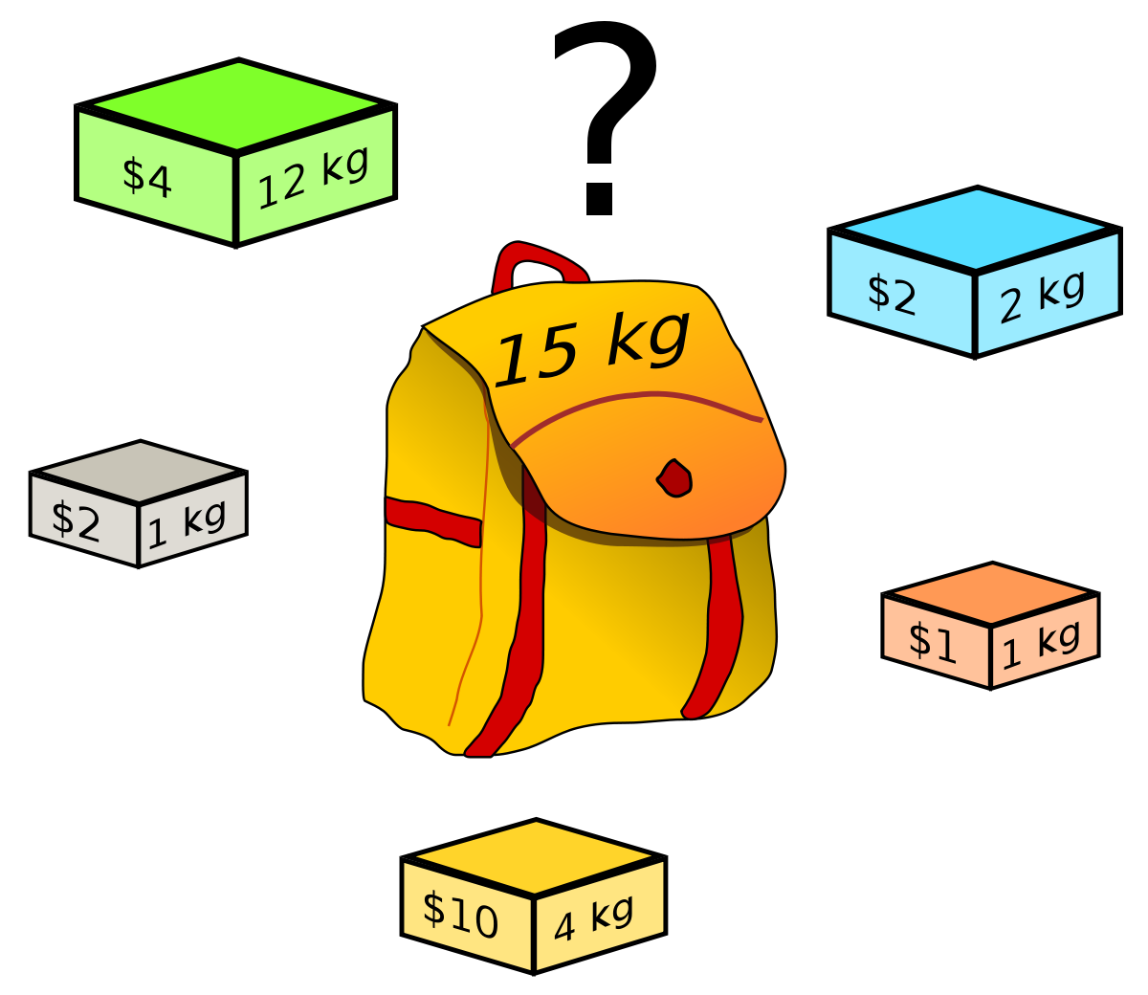
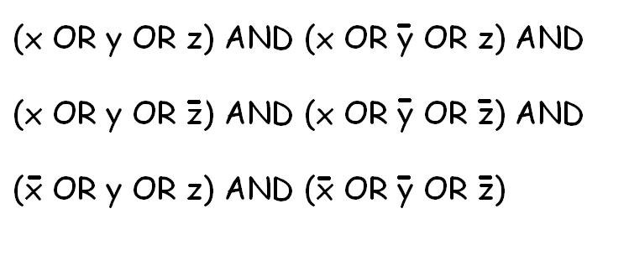
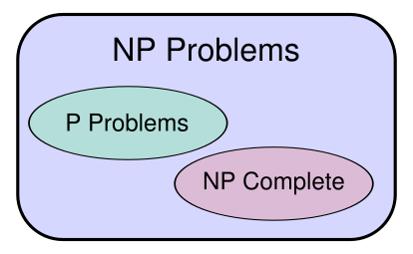
Complexity Theory 2/3
Cook 1971, 21 problems equivalent, none had
efficient solutions
  Boolean satisfiability NP-complete
  Set packing
  Knapsack
  18 more
P = problems with polynomial time solutions
NP = problems whose solution can be checked in polynomial time
Does P != NP? Most important problem in computer science
  $1,000,000 Millennium prize, among others, for solution
  Finding one P algorithm to solve a NP problem would
  revolutionize all sorts of shipping, pricing, and other problems.
  Would result in billions to trillions of reduced costs

Slide 9
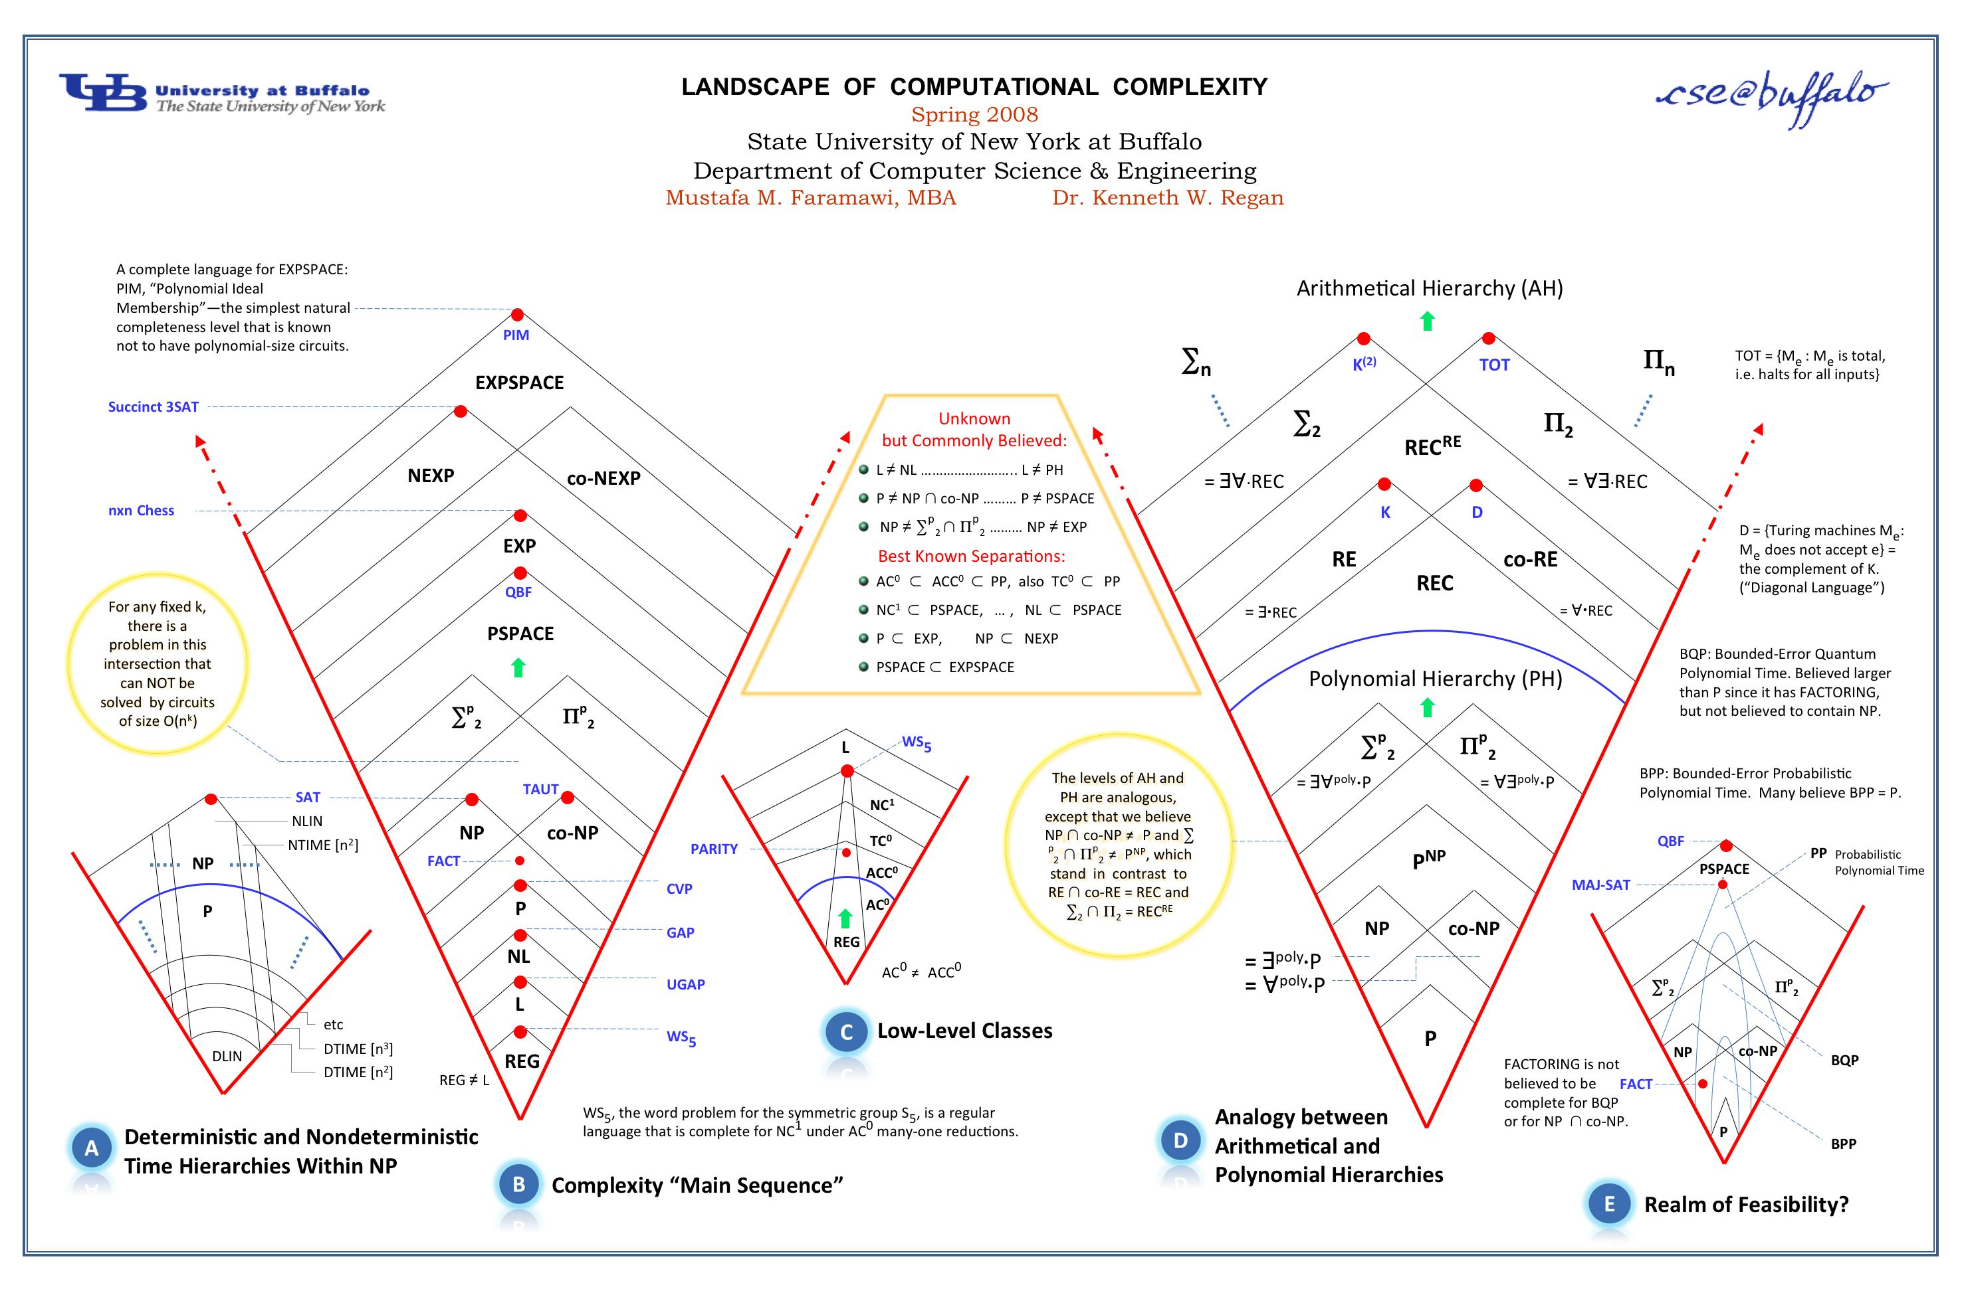
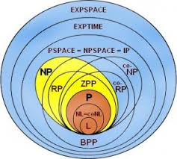
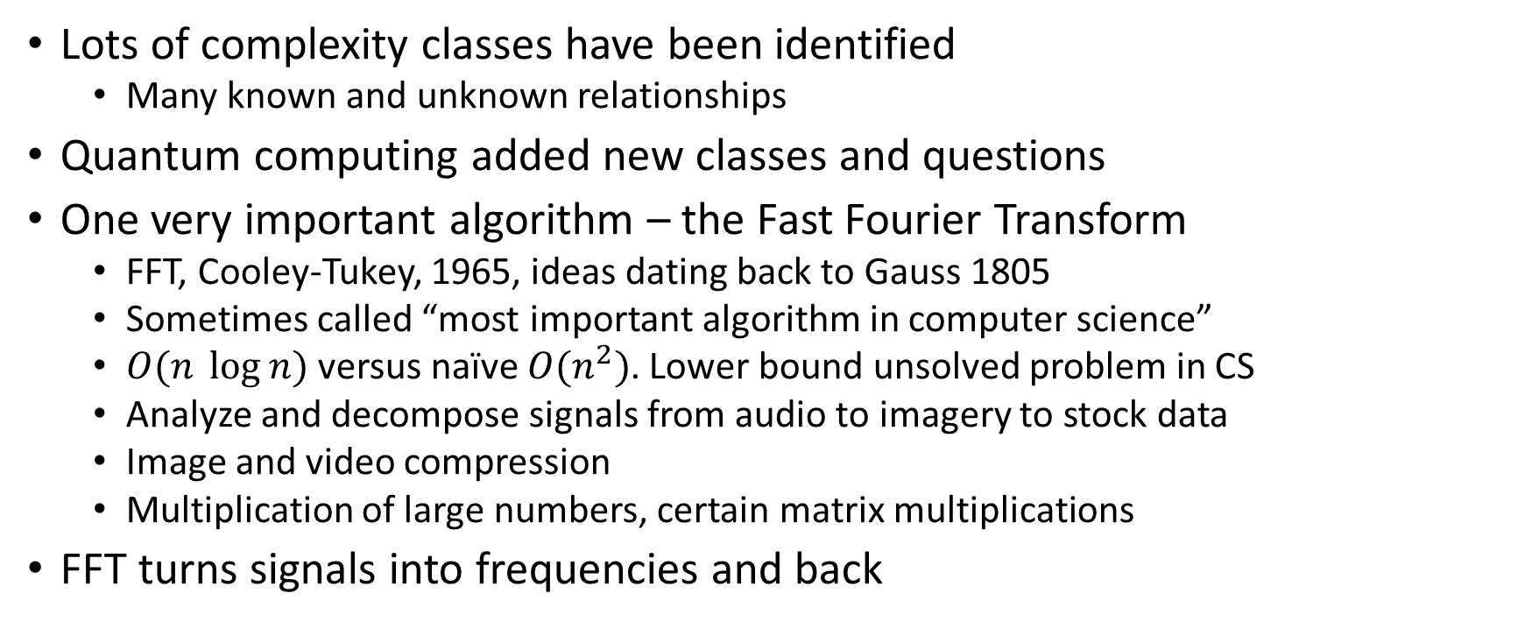
Complexity Theory 3/3
Lots of complexity classes have been identified
  Many known and unknown relationships
Quantum computing added new classes and questions
One very important algorithm – the Fast Fourier Transform
  FFT, Cooley-Tukey, 1965, ideas dating back to Gauss 1805
  Sometimes called “most important algorithm in computer science”
  $O(n \log{n})$ versus naïve $O(n^{2})$. Lower bound unsolved problem in CS
  Analyze and decompose signals from audio to imagery to stock data
  Image and video compression
  Multiplication of large numbers, certain matrix multiplications
FFT turns signals into frequencies and back

Slide 10
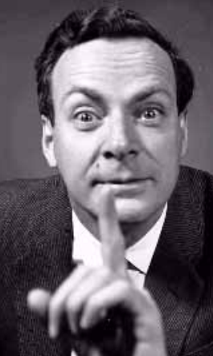
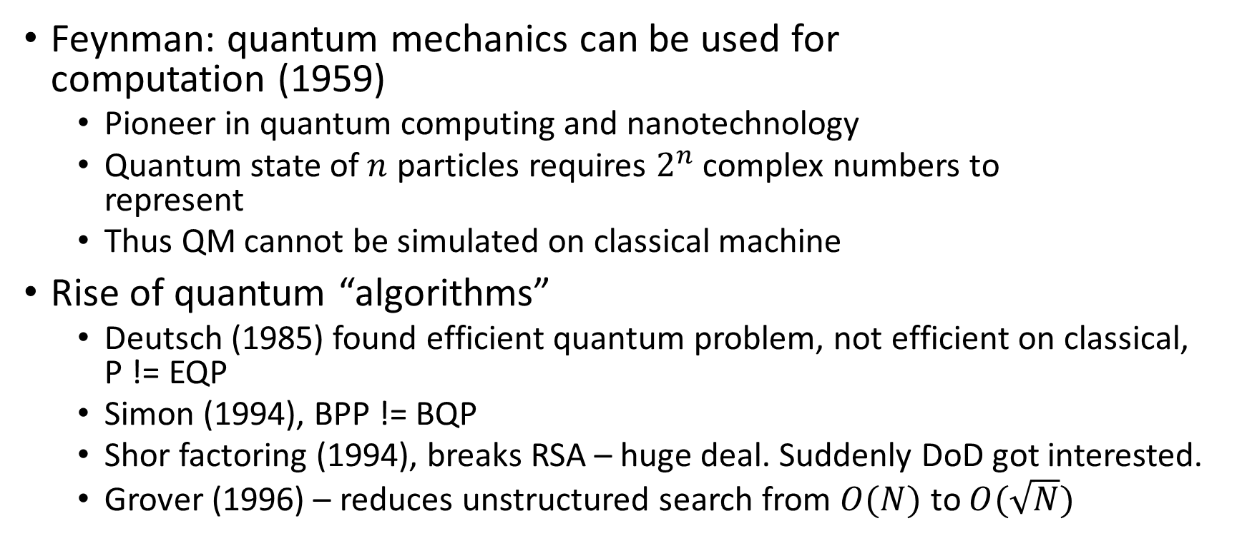
The Road to Quantum Computing 1/3
Feynman: quantum mechanics can be used for
computation (1959)
  Pioneer in quantum computing and nanotechnology
  Quantum state of $n$ particles requires $2^{n}$ complex numbers to
  represent
  Thus QM cannot be simulated on classical machine
Rise of quantum “algorithms”
  Deutsch (1985) found efficient quantum problem, not efficient on classical,
  P != EQP
  Simon (1994), BPP != BQP
  Shor factoring (1994), breaks RSA – huge deal. Suddenly DoD got interested.
  Grover (1996) – reduces unstructured search from $O(N)$ to $O(\sqrt{N})$

Slide 11
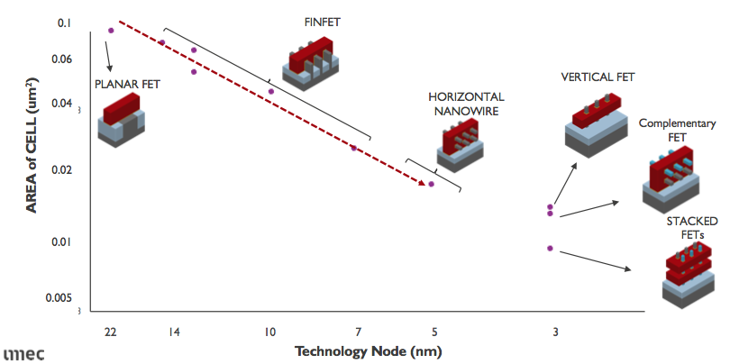
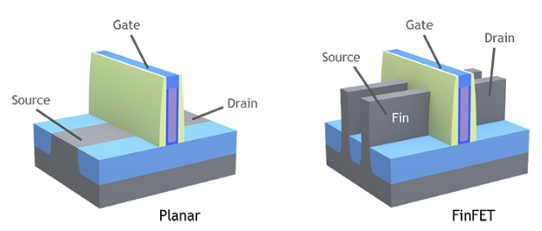
The Road to Quantum Computing 2/3
Moore’s law coming to an end:
Transistors
  stop shrinking likely < 2030, much slower change now
  Limits – quantum tunneling under 7nm =
  Currently ~10nm features is cutting edge released
  1nm single electron transistor in R&D, hard to say if will be useful
  Silicon lattice spacing ~0.2nm
  Source to drain leaking increases
  Limited gate metals, channel material to use
Heat (current creates into heat destroys materials)
Limits of optics (need wavelength small to make
features, 13.5nm is extreme UV)
Materials (diamond 22x better at heat transfer than silicon)
Notes:
https://arstechnica.com/gadgets/2016/07/itrs-roadmap-2021-moores-law/
https://arxiv.org/ftp/arxiv/papers/1511/1511.05956.pdf
http://escholar.web.unc.edu/limits-of-moores-law/
https://semiengineering.com/transistor-options-beyond-3nm/
Moore’s Law: “# of transistors in a dense IC doubles every 1 years” (1965-1975)
“Doubles every 2 years” (1975-1985)
“Doubles every 18 months” – David House, Intel Exec
Rouglhy held 1965-2012, dropped to 2.5 years,

Slide 12
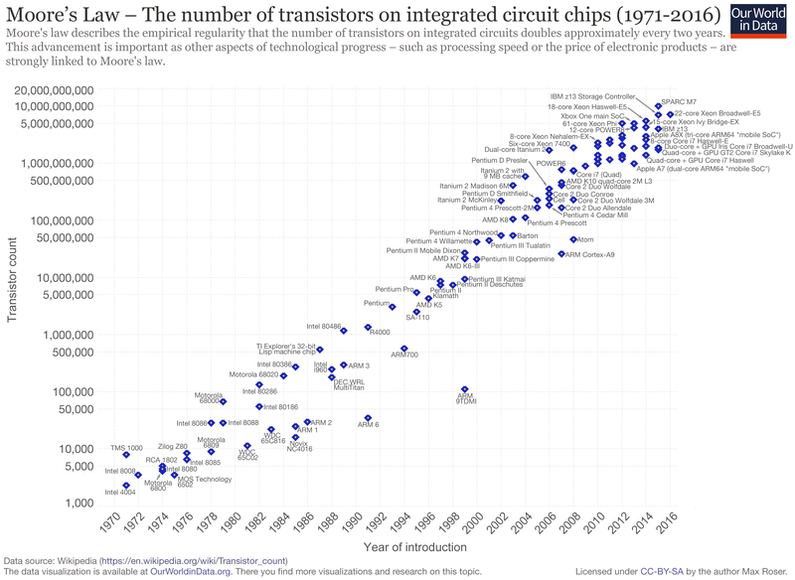
The Road to Quantum Computing 3/3
Moore’s Law:
  held from 1965-2012 (for some value of doubling
  in 1-3 years)
  Since slowed dramatically as transistors hit physical
  QM limits
Physical machines are hitting quantum effects
Economics limits:
  cost to scale each time makes it harder and harder to recoup investment.
“A 2011 study in the journal Science showed that the peak of the rate of change of the world's capacity to compute information was in 1998, when the world's technological capacity to compute information on general-purpose computers grew at 88% per year”
Notes:
https://arstechnica.com/gadgets/2016/07/itrs-roadmap-2021-moores-law/
https://arxiv.org/ftp/arxiv/papers/1511/1511.05956.pdf
http://escholar.web.unc.edu/limits-of-moores-law/
https://semiengineering.com/transistor-options-beyond-3nm/
Moore’s Law: “# of transistors in a dense IC doubles every 1 years” (1965-1975)
“Doubles every 2 years” (1975-1985)
“Doubles every 18 months” – David House, Intel Exec
Rouglhy held 1965-2012, dropped to 2.5 years,

Slide 13
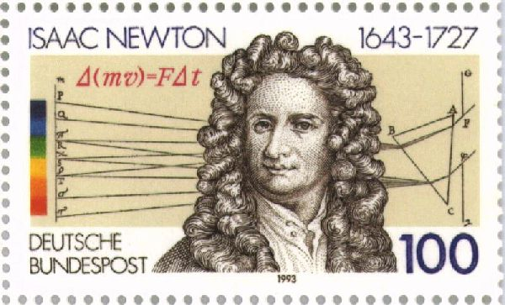
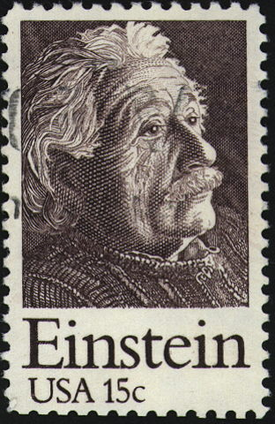
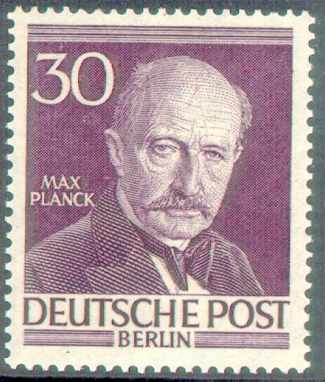
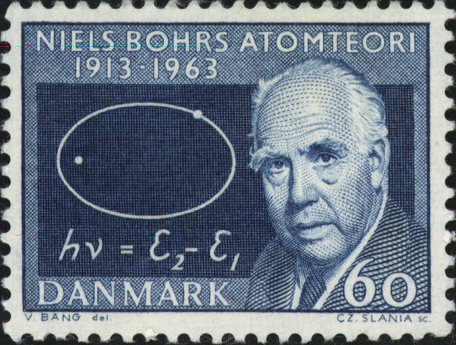
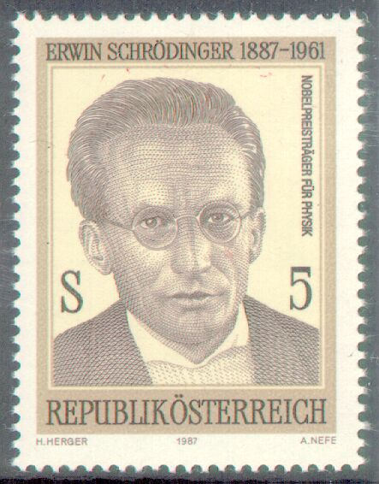
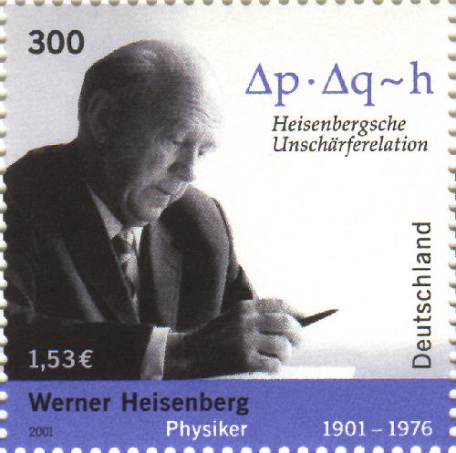
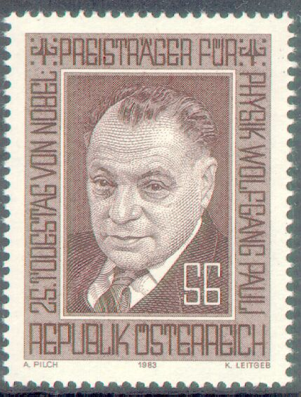
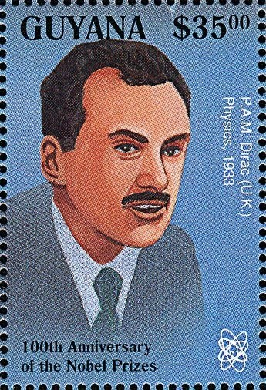
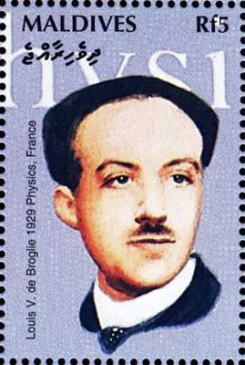
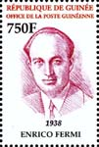


Physics 1/2
Underlying all is rules of physics, 2 strands
Relativity: Einstein (replaces Newton)
  Faster things age slower, shrink
  Space and time twisted together and “bendy”
  Space tells mass how to move, mass tells space
  how to bend
Quantum Mechanics (since replaced with QFTs)
  Plank (quantize), Bohr (atoms), Schrodinger
  (time-evolution), Heisenberg (uncertainty), Pauli
  (exclusion), Dirac (spin, positron), de Broglie
  (e- waves), Fermi (stats), von Neumann (lots!)

Slide 14



Physics 2/2
Quantum evolution given by Schrodinger
  Tells how a state $Ψ$ evolves (mixing of observables)
  Hamiltonian $H$ describes time evolution
  Complex # wedded to reality
Quantum effects learned from many experiments, many defy common intuition.
  State is a sum of observables, with phase and amplitudes giving probability of observation
  Bell theorem: “No physical theory of local hidden variables can ever reproduce all of the predictions of quantum mechanics.”
Heisenberg Uncertainty related to Fourier Transform:
  Faster sampling rate means less known about direction, and
  vice versa
  Frequency resolution versus time resolution tradeoff

Slide 15


Quantum Computing Basics 1/7
Classical bit
  state is one of 0 or 1
  Bit is exactly one of these at a time
Quantum bit (qubit)
  two basis states, called $\left.\left|0\right.\right\rangle$ or $\left.\left|1\right.\right\rangle$
    $\left.\left|0\right.\right\rangle$ ,$\left.\left|1\right.\right\rangle$ = photon state in cavity, or electron spin up/down, or energy state low/high, etc.
  A qubit can be a combination of these, each with some probability
  Experiments force these to behave as $α_{0}\left.\left|0\right.\right\rangle +α_{1}\left.\left|1\right.\right\rangle$, where the $α_{i}$ are complex numbers
  When measured, this results in outcome $\left.\left|0\right.\right\rangle$ with probability ${\left|α_{0}\right|}^{2}$, similarly for $\left.\left|1\right.\right\rangle$
Notes:
List of physical implementations:
photon (polarization, number, time-bin encoding), coherent light, electrons (spin, electron number), nucleus (NMR), optical lattices (optical spin), josephson junction (superconducting charge, flux, phase), quantum dot (electron localization), gapped topological system (non-abelian anyons)
TODO Bloch sphere, bell states, bell theorem

Slide 16

Quantum Computing Basics 2/7
Superposition: concatenate two qubits
  $$\left(α_{0}\left.\left|0\right.\right\rangle +α_{1}\left.\left|1\right.\right\rangle \right)\left(β_{0}\left.\left|0\right.\right\rangle +β_{1}\left.\left|1\right.\right\rangle \right)=α_{0}\left.β_{0}\left|00\right.\right\rangle +α_{0}β_{1}\left.\left|01\right.\right\rangle +α_{1}\left.β_{0}\left|10\right.\right\rangle +α_{1}β_{1}\left.\left|11\right.\right\rangle$$
  Now have 4 basis states $\left.\left|0\right.0\right\rangle ,\left.\left|0\right.1\right\rangle$, $\left.\left|10\right.\right\rangle$, $\left.\left|11\right.\right\rangle$
  $N$ qubits need $2^{N}$ complex numbers
  In general $α_{00}\left.\left|00\right.\right\rangle +α_{01}\left.\left|01\right.\right\rangle +α_{10}\left.\left|10\right.\right\rangle +α_{11}\left.\left|11\right.\right\rangle$, probability of $\left.\left|ij\right.\right\rangle$ is ${\left|α_{ij}\right|}^{2}$
Entanglement: content of one qubit influences others
  quantum mechanics allows the coefficients to be anything (satisfying the probability requirements), including values which do not factor into 2 distinct qubits
  Example: $\frac{1}{√2}\left.\left|00\right.\right\rangle +\frac{1}{√2}\left.\left|11\right.\right\rangle$

Slide 17

Quantum Computing Basics 3/7
Time evolution:
  Must conserve total probability
  Treat states as vectors, $\left.\left|0\right.\right\rangle =\left({1 \atop 0}\right)$ and $\left.\left|1\right.\right\rangle =\left({0 \atop 1}\right)$
  Evolution is multiplying by a 2x2 complex valued matrix
  Unitary: all operations on states are reversible, $U^{∗}U=UU^{∗}=I$
Measurement: collapse state into the one returned

Slide 18
Quantum Computing Basics 4/7
Partial measurements: measure some bits out of entangled state
Quantum vs classical computing
Classical vs quantum: copy, erase, changed by measure, can be partially measured
Oddities
  States cannot be cloned (no-cloning theorem, basically would lose information, not unitary)
  Environmental interference (decoherence)
    measurements collapse waveform, hard to not be “measured”
    States fragile, collapse. Record length now ~40 minutes, but most systems last incredibly short times

Slide 19





Quantum Computing Basics 5/7
Hadamard gate: takes $\left.\left|0\right.\right\rangle$ to ($\left.\left|0\right.\right\rangle$+$\left.\left|1\right.\right\rangle )/\sqrt{2}$ and $\left.\left|1\right.\right\rangle$ to ($\left.\left|0\right.\right\rangle$-$\left.\left|1\right.\right\rangle )/\sqrt{2}$
  Let $\left.\left|0\right.\right\rangle =\left(\begin{matrix}1 \\ 0\end{matrix}\right)$ , $\left.\left|1\right.\right\rangle =\left(\begin{matrix}0 \\ 1\end{matrix}\right)$ as vectors, then $H =\frac{1}{\sqrt{2}}\left[\begin{matrix}1 & 1 \\ 1 & −1\end{matrix}\right]$
  Mixes (or unmixes) states
Phase shift gate
Controlled NOT (CNOT) gate
Classical operations are simply permutation matrices – permute columns

Slide 20



Quantum Computing Basics 6/7
Toffoli (CCNOT – Controlled-controlled NOT)
  can represent any classical Boolean function
Square root of NOT = $\frac{1}{2}\left[\begin{matrix}1+i & 1−i \\ 1−i & 1+i\end{matrix}\right]$
  Not possible classically
Elementary gates – can build any quantum function
  One universal 2-qubit set is Hadamard$H$, phase rotation $R_{\frac{π}{4}}$, controlled NOT
  Used to engineer physical quantum computers

Slide 21



Quantum Computing Basics 7/7
Example:
  classical adder
  quantum adder
Example: QFT
  Quantum Fourier Transform
  Hadamard and phase
  gates to mix states
  State is complex superposition
  of all binary strings
  Foundational to QC

Slide 22





Quantum Algorithms 1/6
Use exponentially many parallel computations to perform something
Deutsch (1985), separates classes P and EQP
  Was trying to derive Church-Turing thesis from physics
1. Given a black box that takes 0 or 1 as input and outputs 0 or 1 deterministically, decide if the box outputs the same value for different inputs
2. Classically, this box needs interrogated twice
3. If it is a quantum box, handling superpositions of states, it only needs interrogated once

Slide 23





Quantum Algorithms 2/6
Simon (1994)
  Took Deutsch idea to $n$ qubits, found problem that
  a quantum computer uses exponentially less queries
  than a classical computer
  Separates classes BPP and BQP
  Inspired Shor factoring in 1994
Grover (1996)
  Can search unstructured N items in O(sqrtN)

Slide 24




Quantum Algorithms 3/6
$2^{67}−1=193707721 × 761838257287$
  Mersenne Prime, Mersenne claimed it prime in 1644
  Took American Mathematician Frank Nelson Cole 20 years of
  Sunday afternoons to compute in 1903
  Wrote on board to standing ovation , Mathematica takes 0.031 seconds to do now
Factoring is basis of RSA, most widely used (public-key)
cryptosystem
Peter Shor (1994) : quantum algorithm to factor integers
exponentially faster than any known classical algorithm
  Immediately got US government interest, lots of funding for
  quantum computation, opened lots of conspiracy pathways
  Factoring 4096 bit # requires 10^29 years on 1000 workstations,
  but only 4.8 hours on 100 MHz quantum computer.
Notes:
https://crypto.stackexchange.com/questions/59795/largest-integer-factored-by-shors-algorithm

Slide 25


Quantum Algorithms 4/6
Shor algorithm to factor $N$
  Pick random integer $a < N$
  Compute $gcd⁡(a,N)$
  If != 1, have factor, done
  Use quantum to find period $r$ of $f(x)=a^{x} mod N$
  If r odd, go to 1
  If $a^{r/2}=−1 mod N$, go to 1
  Now $gcd⁡(a^{r/2}+1,N)$ is a nontrivial factor
That this works requires proof.

Slide 26
Quantum Algorithms 5/6
Note: factoring classical complexity is not known, possible there is an efficient classical algorithm
Shor algorithm
  Also breaks a few other crypto systems, anything based on discrete log problems
  Many crypto immune break
  Not currently practical by a long shot
  Records using Shor on hardware: 15=3x5 in 2001 (7 qubits), 21=3x7 in 2012 (2 qubits, recycled)
Interestingly: complexity of checking if a number is prime was not known for a long time
  Primes needed in RSA, most tests probabilistic (Miller-Rabin)
  2002 – “PRIMES is in P” by Agrawal, Kayal, Saxena (AKS test)

Slide 27






Quantum Algorithms 6/6
Quantum RNGs (used a long time)
  Shot noise, nuclear decay, partial mirror,
  https://www.fourmilab.ch/hotbits/
  Princeton Engineering Anomalies Lab
Quantum dense coding (superdense coding)
  Can send 2 classical bits of information with only 1 qubit using pre-shared entangled state
  Invented 1992, tested experimentally 1996
Quantum teleportation
  Can send exact state from one place to another using pre-shared
  entangled qubits and a classical channel
  Cannot enable FTL communication
Quantum Key Distribution QKD
(Bennet and Brassard, 1984)
  Allows secure sharing of private key
  Any eavesdropping can be detected, relies on
  no-cloning theorem
  Current commercially available (MagiQ Technoligies, others)
Notes:
https://www.amazon.com/Million-Random-Digits-Normal-Deviates/dp/0833030477
https://en.wikipedia.org/wiki/A_Million_Random_Digits_with_100,000_Normal_Deviates
John Walker, hotbits, founder of AutoDesk
QKD
Currently send 1 Mbits/s over 20km optical fiber
Have sent over 150km fibers more slowly, and 1200km ground stations
2004 – first bank transfer performed

Slide 28





Quantum Computing Machines

Slide 29

Advanced Quantum Computing 1/5
Quantum complexity theory
  BQP complexity class
Quantum Info Processing
Quantum information theory:
  how much per qubit?
Quantum Church-Turing-Deutsch principle (1985)
  “a universal computing device can simulate
  every physical process.”
QC not believed to be able to solve
NP items

Slide 30
Advanced Quantum Computing 2/5
QFT detects periods, similar to classical FFT
  Shor exploited this for factoring
  QFT (and FFT) can be applied over arbitrary abstract groups
  Same finding idea breaks all Discrete Log Problem (DLP) crypto, like ECC
QFT generalizes to Hidden Subgroup Problem (HSP)
  Uses period finding to reconstruct strucutre.
  Determine generators for a subgroup hidden behind a function via sampling
Notes:
https://arxiv.org/abs/quant-ph/0411037
The Hidden Subgroup Problem - Review and Open Problems, Lomont, 2004

Slide 31


Advanced Quantum Computing 3/5
Graph isomorphism
  Are two graphs the same?
  Unknown if in P or NP-complete
  Seems QC not able to solve
Shortest vector problem (SVP)
  Useful in many applications
  Crypto

Slide 32


Advanced Quantum Computing 4/5
Error correction
  No-cloning prevents usual error correction codes
  QEC uses entanglement
  Quantum Shor code fixes one qubit in 7 for
  bit flip or sign flip or both
Other quantum technologies
  Quantum cash (requires stable quantum memory)
  Quantum Digital Signatures (requires quantum computer)
  Quantum secret sharing
  Multi-party QC
Takeaway: limits of computation tied intricately to
rules of the universe
Notes:
Requirements: DiVincenzo 1996:
* Existence of qubits
* 1 and 2 qubit unitary gates
* Measurable bits
* Low intrinsic decoherence
* Other ways: adiabatic QC, cluster state QC
more
* Quantum random walk
* Quantum lower bounds
* Good notes in qcnotes.pdf

Slide 33



Advanced Quantum Computing 5/5
Annealer – weakest
  D-Wave company
  Not really any better than classical
  In news a lot, what Google and others have
Analog – stronger
  50-100 qubits
  Useful for some simulations
Universal – strongest
  Able to compute arbitrary quantum algorithms

Slide 34
Quantum Security
Quantum malware
Quantum virus
Quantum backdoor – entangled states allow new attacks at design time
DARPA has put a lot of R&D into both sides of this arms race
Notes:
http://qserver.usc.edu/wp-content/uploads/2013/07/qip5692006.pdf

Slide 35


Future of Computation 1/2
Speculation about using other areas of physics to affect computation
QM does not include (general) relativity
  Closed Time-like Curves (CTCs) (time loops): proven if they exist, classical and quantum computers are equivalently powerful
  Time travel not ruled out by physics, ample research into methods
  Freedman (2000) (MSR, Fields medalist)
    Topological Quantum Field Theory (TQFT) computation
Physics time-invariance leads to weird time effects
  QFTs computed with forwards and backwards time flow to get accurate results
String computing
Notes:
TQFT https://arxiv.org/abs/quant-ph/0001071

Slide 36
Future of Computation 2/2
NP problems can be solved efficiently if we allow non-physical items:
  Arbitrarily small components
  Arbitrarily accurate measurements
  Non-local operations (can touch unlimited bits at once)
Ex: chaos computers: multiply small effects to large measurable ones
Other approaches:
  Photonics, spintronics, DNA computing, biological computing

Slide 37

The Nature of Reality 1/3
The most incomprehensible thing about the universe is that it is comprehensible.
- Einstein
Many strands of computation and physics point to…
  The universe can be conceived as the output of a deterministic
  or probabilistic computer program
  Area called “Digital Physics”
Computation must be compatible with principles of
  Information theory
  Statistical thermodynamics
    Stat mech now recast as information theory
  Quantum mechanics
Computation, computational complexity, etc. may be as fundamental
as physics. It’s becoming more and more apparent they’re deeply
intertwined
Notes:
https://en.wikipedia.org/wiki/Digital_physics

Slide 38

The Nature of Reality 2/3
Disclaimer: what follows is quite speculative, but has some really big names in science in it
Unreasonable Effectiveness of Mathematics in the Natural Sciences
  Wigner, 1960, Nobel 1963 for atomic nucleus and elementary particles
  Mathematics oddly often points to new things which are later found empirically
It from Bit: Wheeler, 1980s (also coined “black holes”, worked out nucleosynthesis,
much more)
  Information sits at the core of physics, and every "it", whether a particle or field, derives
  its existence from observations
  Scientists may "regard the physical world as made of information, with energy and matter
  as incidentals”
Math led to lots of predictions (and some post-dictions) about reality:
  Maxwell implied light
  Noether symmetries, positron from spin, neutrinos from mass,
  Quark # and properties, gravity and space-time oddities, Higgs (future talk?) all from the math
Lowest level of reality seems to be numbers evolving, nothing else underlying it all

Slide 39
The Nature of Reality 3/3
Many think P != NP is fundamental law of universe
Simulation Hypothesis (Bostrom, 2003). Either:
  The fraction of human level civilizations reaching post human is very close to 0, or
  The fraction of posthuman interested in running ancestor-simulations is very close to 0, or
  The fraction of all people with our kind of experiences that are living in a sim is close to 1.
One set of experiments looks for computational lattice artifacts in reality:
  2012 paper Beane, Davoudi, Savage – some tests to attempt, underway
  Signatures in anisotropy of strong interactions (QCD)
  Tests, checking QCD lattices, holographic universe
  Hogan – some 2011 gamma ray bursts looks for holographic noise
    As of 2011, noise is absent to a scale of 10^-48 meters.
  Berkenstein claims to be able to test with a tabletop experiment.
Free Will Theorem – Conway 2006:
  “If we have free will so do sub-atomic particles”

Slide 40


Conclusion
Quantum computation
  Is NOT better at many things
  Will NOT save Moore’s Law
  Can NOT communicate faster than light
  Is exponentially better at integer factoring
  Is able to break RSA and ECC
  Is NOT able to break all crypto
  Is used to share secret keys securely

Slide 41



Questions?

Slide 42



Sources
Good textbook:
  “Quantum Computation and Quantum Information”,
  Nielsen and Chuang (Nielsen has since done nice AI work)
Anything by Scott Aaronson
  Leading figure for a long time
  Blog very good reading

