Slide 1
30 Algorithms and Data Structures in 60 Minutes
Chris Lomont, May 2019

Slide 2
Introduction
Don’t learn all details at once; simply learn they exist
Algorithms in blue
Techniques in green – general principles for algorithm design
Challenges in red
In practice, most problems solved with language and library features
When something hard, need more tools
Items start easy, get harder
Notes:
Side on Constant Overhead Byte Stuffing ideas – can pack 254 bytes with bitmask of seen to find the missing one
Timsort 𝑂(𝑛 log⁡𝑛) worst, 𝑂(𝑛) best, is mixture of insertion sort and merge sort

Slide 3
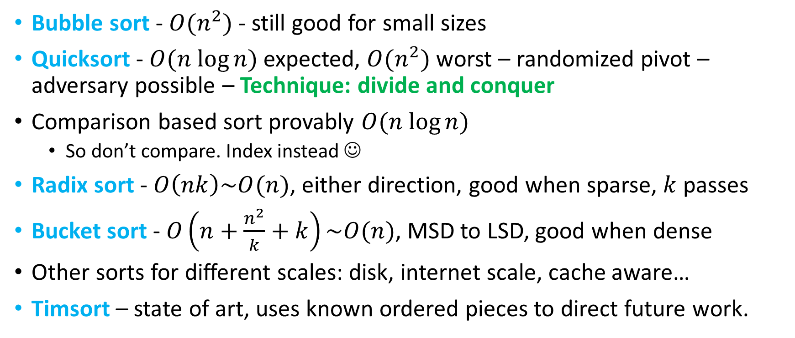
Sorting
Bubble sort - $O(n^{2})$ - still good for small sizes
Quicksort - $O(n log⁡n)$expected, $O(n^{2})$ worst – randomized pivot – adversary possible – Technique: divide and conquer
Comparison based sort provably $O(n log⁡n)$
  So don’t compare. Index instead ☺
Radix sort - $O\left(nk\right)\sim O(n)$, either direction, good when sparse, $k$ passes
Bucket sort - $O\left(n+\frac{n^{2}}{k}+k\right)\sim O(n)$, MSD to LSD, good when dense
Other sorts for different scales: disk, internet scale, cache aware…
Timsort – state of art, uses known ordered pieces to direct future work.
Notes:
Side on Constant Overhead Byte Stuffing ideas – can pack 254 bytes with bitmask of seen to find the missing one
Timsort 𝑂(𝑛 log⁡𝑛) worst, 𝑂(𝑛) best, is mixture of insertion sort and merge sort

Slide 4
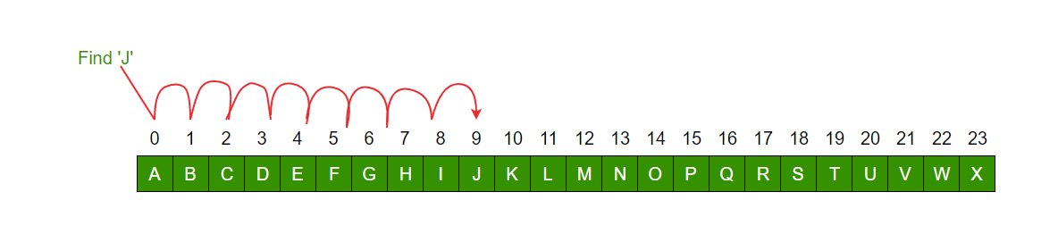
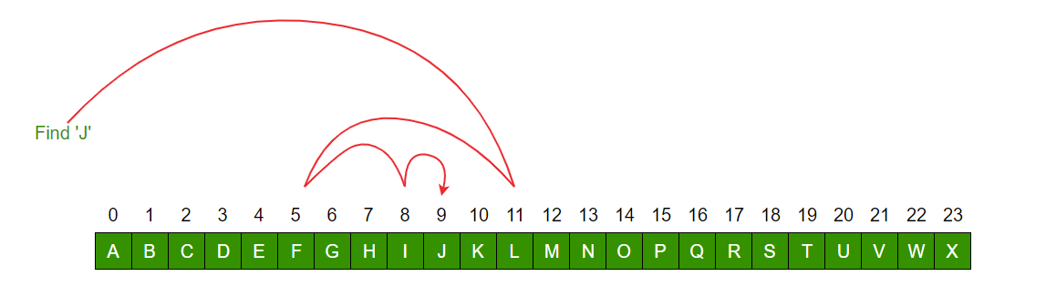
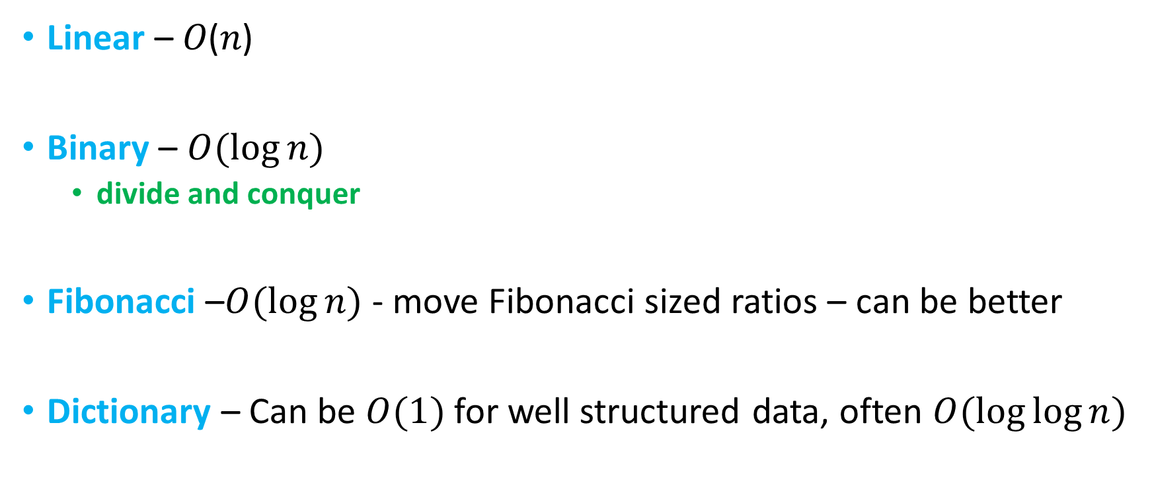
Searching sorted array
Linear – 𝑂(𝑛)
Binary – $O(log⁡n)$
  divide and conquer
Fibonacci –$O(log⁡n)$ - move Fibonacci sized ratios – can be better
Dictionary – Can be $O(1)$for well structured data, often $O(\log{\log{n}})$
Notes:
Images https://www.geeksforgeeks.org/linear-search-vs-binary-search/
Fib adds 4% more comparisons, only uses add/sub for indices, binary needs div, shift, mult…

Slide 5
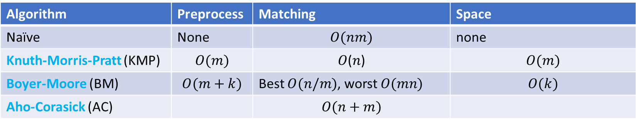
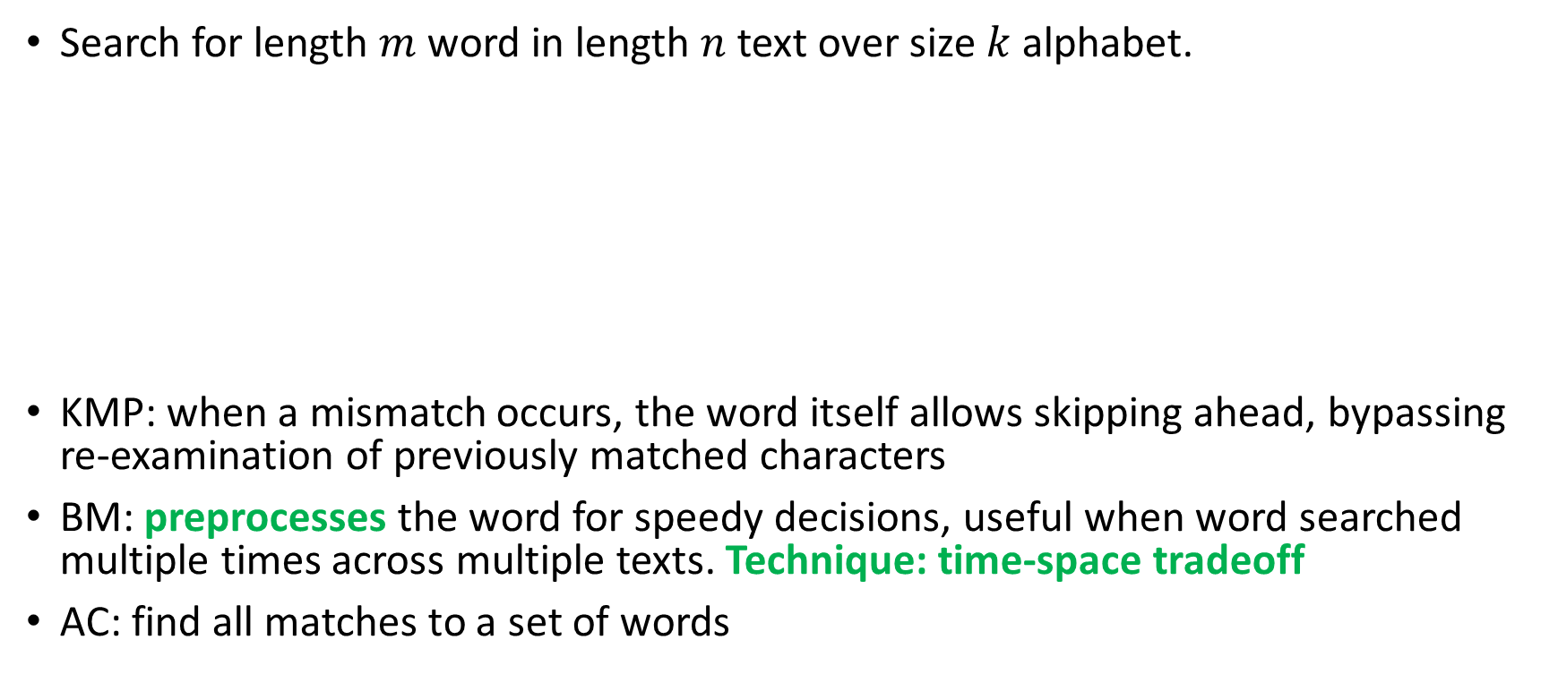
String searching
Search for length $m$ word in length $n$ text over size $k$ alphabet.
KMP: when a mismatch occurs, the word itself allows skipping ahead, bypassing re-examination of previously matched characters
BM: preprocesses the word for speedy decisions, useful when word searched multiple times across multiple texts. Technique: time-space tradeoff
AC: find all matches to a set of words
Algorithm | Preprocess | Matching | Space
Naïve | None | $$O(nm)$$ | none
Knuth-Morris-Pratt (KMP) | $$O(m)$$ | 𝑂(𝑛) | $$O(m)$$
Boyer-Moore (BM) | $$O(m+k)$$ | Best $O(n/m)$, worst $O(mn)$ | $$O(k)$$
Aho-Corasick (AC) |  | $$O(n+m)$$

Slide 6
Sound matching
Soundex – matches English words phonetically, patented 1918 and 1922
  In SQL, many languages
Algorithm
  Keep first letter of word
  Drop all other a, e, i, o, u, y, h, w
  Except first, Replace with numbers:
    b,f,p,v -> 1
    c,g,j,k,q,s,x,z -> 2
    d,t -> 3
    L -> 4
    m,n->5
    r->6
  Collapse certain duplicate numbers
  Truncate to three numbers, or extend with zeroes
Ex: Robert and Rupert -> R163, Rubin ->R150
Notes:
Many variants and better, newer algorithms

Slide 7
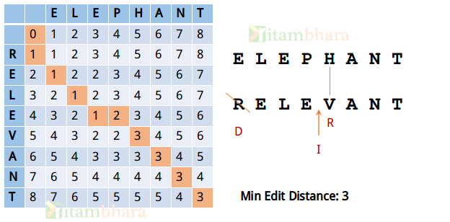
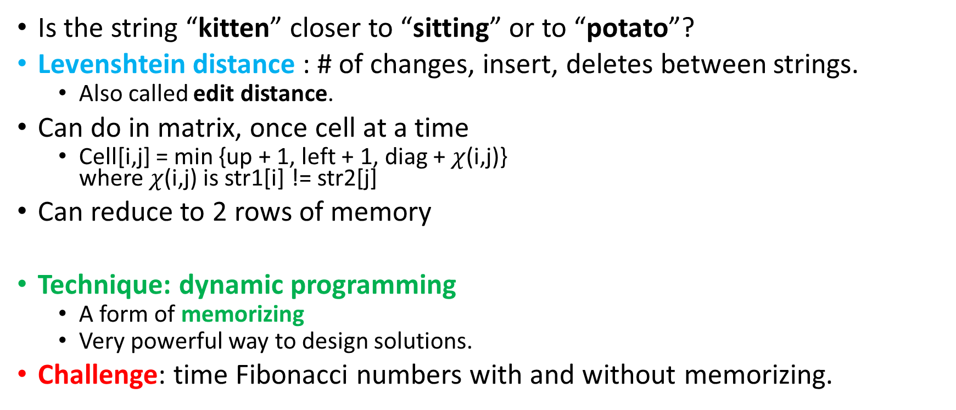
String similarity
Is the string “kitten” closer to “sitting” or to “potato”?
Levenshtein distance : # of changes, insert, deletes between strings.
  Also called edit distance.
Can do in matrix, once cell at a time
  Cell[i,j] = min {up + 1, left + 1, diag + $χ$(i,j)}
  where $χ$(i,j) is str1[i] != str2[j]
Can reduce to 2 rows of memory
Technique: dynamic programming
  A form of memorizing
  Very powerful way to design solutions.
Challenge: time Fibonacci numbers with and without memorizing.
Notes:
Used in mp3 tagger

Slide 8
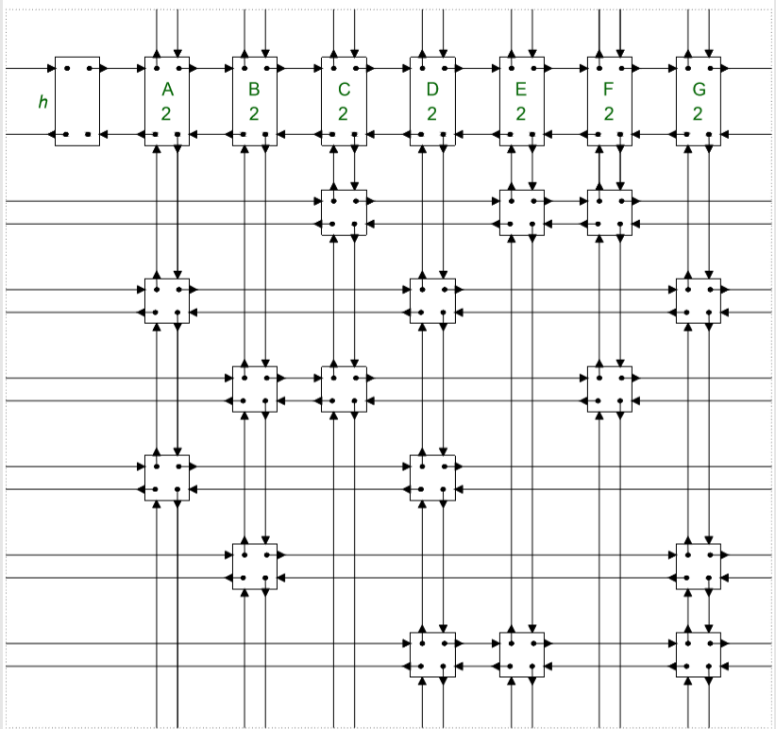
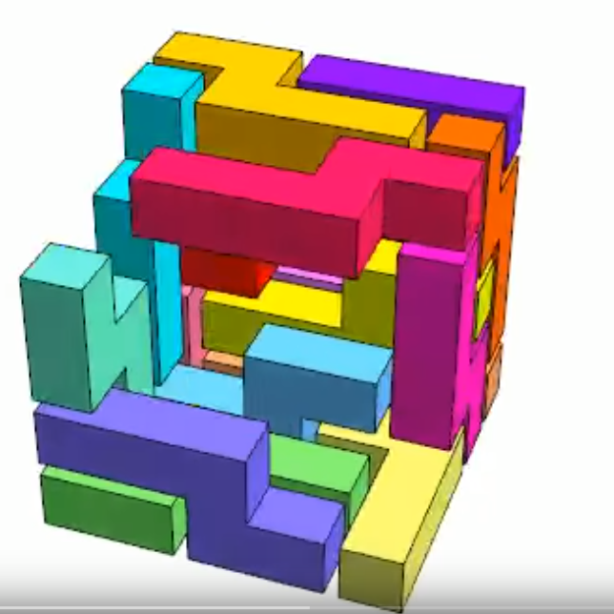
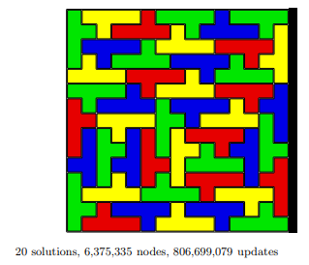
Backtracking search
void Solve(State state, int depth) {
if (Solved(state)) {
Log(state, depth);
return; }
auto moves = GenerateMoves(state);
for (auto m : moves) {
DoMove(state, m);
Solve(state, depth + 1);
UndoMove(state, m); }
}
Want to search some finite space,
discrete moves
Dancing Links (Knuth popularized, 1979)
  Items represented as grid of doubly linked nodes
  DoMove/UndoMove each two pointer changes
  Sudoku solver, combinatorial solvers
  Heuristic S – choose branch with fewest subproblems
  ~exponential gain on depth, linear in cost
    Technique: trim choices heuristic
Ex
Notes:
https://arxiv.org/pdf/cs/0011047.pdf
https://www.youtube.com/watch?v=kWiMnXP7g-4

Slide 9
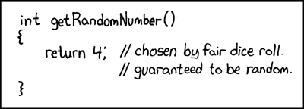
Randomness
Understand your use cases
C/C++ rand() generally not very good or fast
Mersenne Twister outdated and has bad properties
PCG series for non-crypto pretty good, small, many tunable sizes, very fast
Be careful:
  rand()%n is not uniform
  (int)(rand01()*N ) is not uniform
  To pick [0,N-1] uniformly, take rand and randMax, sample till in multiple of range, then mod
  Assumes rand() uniform over randMax, not always true!
Challenge: implement rand3 from rand2.
Challenge: implement a fair coin toss from a biased coin.
Challenge: implement uniform rand 1 to N.
Notes:
https://xkcd.com/221/
http://www.pcg-random.org/
PCG = Permuted Congruential Generator

Slide 10


Shuffle and sample
Common error: shuffle all 1 to N. Not uniform
for (int i = 0; i < max; ++i)
int j = rand() % max;
swap(item[i], item[j]);
Fischer-Yates shuffle
for (int i = 0; i < n-1; ++i)
int j = randN(i, n); // i ≤ j < n
swap(item[i], item[j]);
Psychological issues
  Shuffle bag, Fibonacci shuffle (not sure of name)
  Sphere sampling, area sampling (blue noise)
Notes:
Psych for colors, game rolls, tetris, playlists,
https://blog.demofox.org/2017/10/20/generating-blue-noise-sample-points-with-mitchells-best-candidate-algorithm/

Slide 11
Sampling
Problem: stream of data, want uniform random sample size k, don’t know length, cannot store.
Reservoir sampling:
  Keep first k
  For each following sample, random to see if it should be in reservoir
    J = rand(1,i) inclusive on seeing ith sample.
    If j <= k then R[j] = S[i]
Challenge: can do with exponentially fewer rand calls.
  anecdote of solving something yourself
Notes:
Google interview, wanted to improve, did, found already done ☺

Slide 12
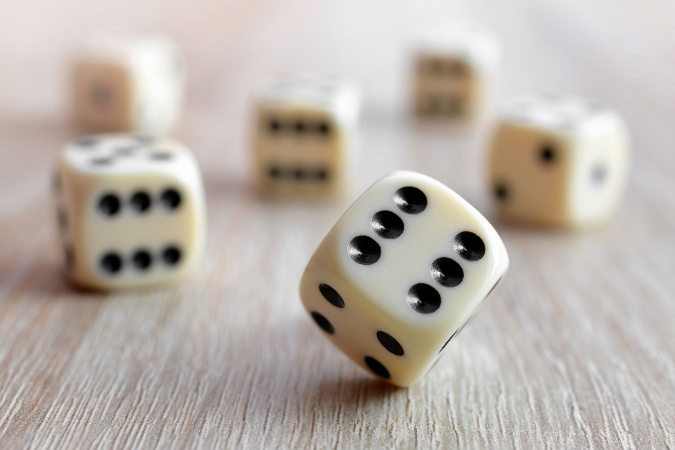
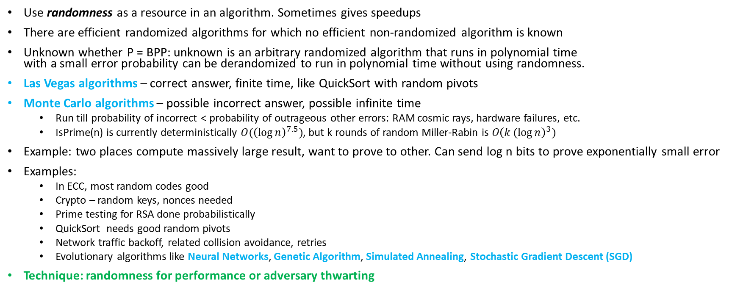
Randomized algorithms
Use randomness as a resource in an algorithm. Sometimes gives speedups
There are efficient randomized algorithms for which no efficient non-randomized algorithm is known
Unknown whether P = BPP: unknown is an arbitrary randomized algorithm that runs in polynomial time
with a small error probability can be derandomized to run in polynomial time without using randomness.
Las Vegas algorithms – correct answer, finite time, like QuickSort with random pivots
Monte Carlo algorithms – possible incorrect answer, possible infinite time
  Run till probability of incorrect < probability of outrageous other errors: RAM cosmic rays, hardware failures, etc.
  IsPrime(n) is currently deterministically $O({\left(\log{n}\right)}^{7.5})$, but k rounds of random Miller-Rabin is $O{\left(k(log{n}\right)}^{3})$
Example: two places compute massively large result, want to prove to other. Can send log n bits to prove exponentially small error
Examples:
  In ECC, most random codes good
  Crypto – random keys, nonces needed
  Prime testing for RSA done probabilistically
  QuickSort needs good random pivots
  Network traffic backoff, related collision avoidance, retries
  Evolutionary algorithms like Neural Networks, Genetic Algorithm, Simulated Annealing, Stochastic Gradient Descent (SGD)
Technique: randomness for performance or adversary thwarting

Slide 13
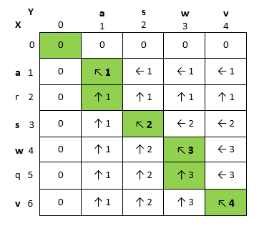
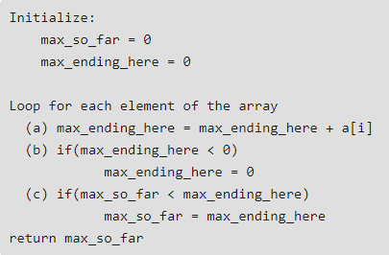
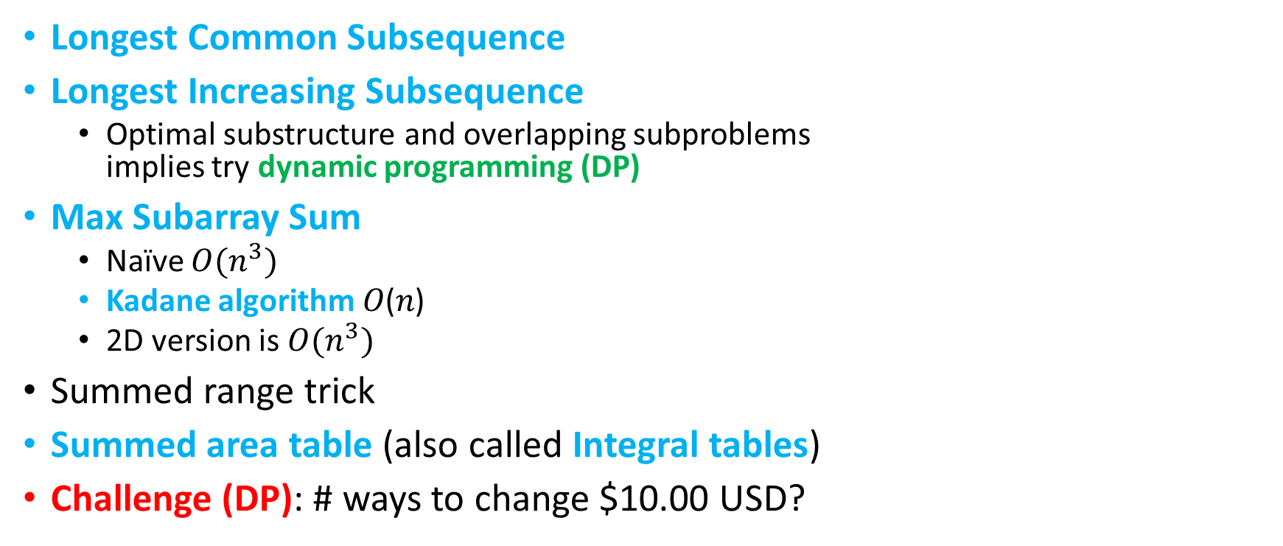
Sequences
Longest Common Subsequence
Longest Increasing Subsequence
  Optimal substructure and overlapping subproblems
  implies try dynamic programming (DP)
Max Subarray Sum
  Naïve $O(n^{3})$
  Kadane algorithm 𝑂(𝑛)
  2D version is $O(n^{3})$
Summed range trick
Summed area table (also called Integral tables)
Challenge (DP): # ways to change $10.00 USD?
Notes:
Computational biology, DNA matching, linguistics,

Slide 14
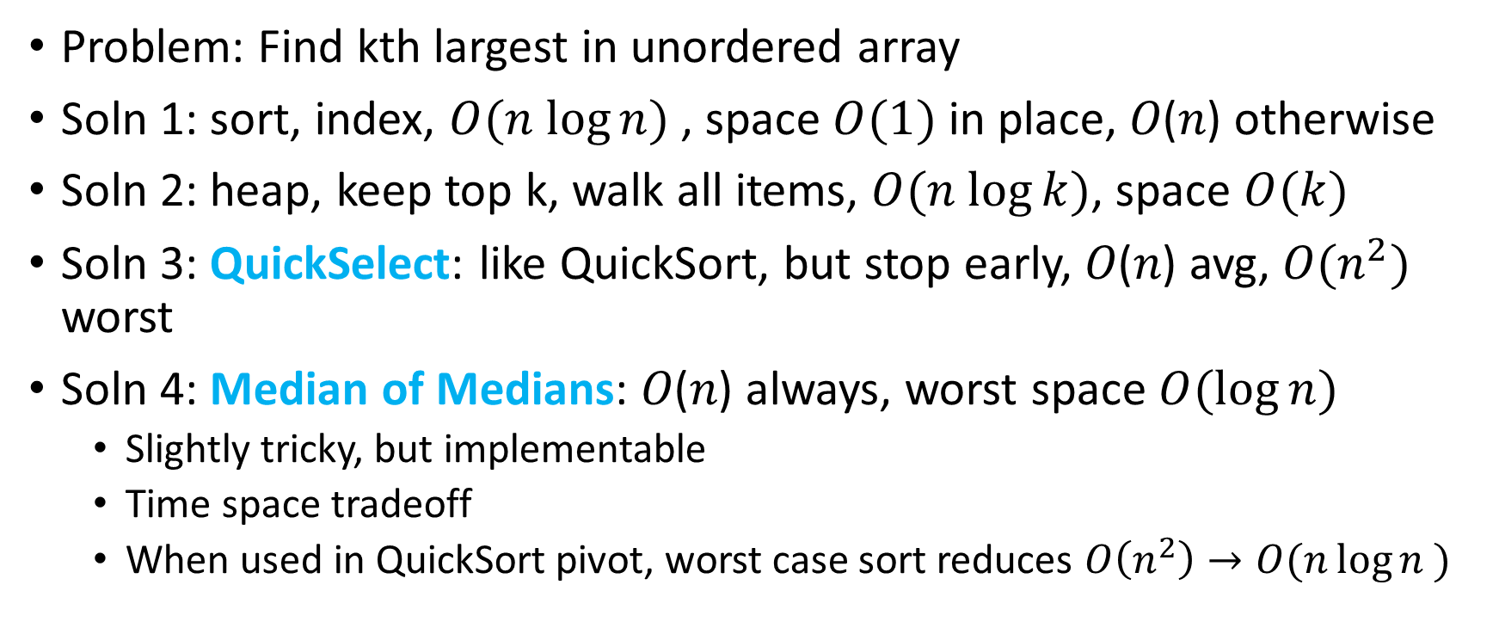
Sequence element
Problem: Find kth largest in unordered array
Soln 1: sort, index, $O(n log⁡n)$ , space $O(1)$ in place, 𝑂(𝑛) otherwise
Soln 2: heap, keep top k, walk all items, $O(n log⁡k)$, space $O(k)$
Soln 3: QuickSelect: like QuickSort, but stop early, 𝑂(𝑛) avg, $O(n^{2})$ worst
Soln 4: Median of Medians: 𝑂(𝑛) always, worst space $O(\log{n})$
  Slightly tricky, but implementable
  Time space tradeoff
  When used in QuickSort pivot, worst case sort reduces $O\left(n^{2}\right)→O(n\log{n })$
Notes:
https://en.wikipedia.org/wiki/Median_of_medians
Recurses on n/5 size groups, gets medians of them, then median of result….

Slide 15
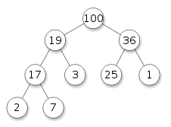
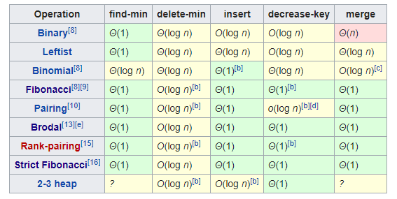
Heaps
Also called priority queues
Tree: parents >= children (max-heap)
Binary tree – simple code, bad merge
  Can be stored efficiently in array
Binomial heap – quick heap merges
Pairing heap – simple to code
Fibonacci heaps (complicated to code)
Brodal queue (not good in practice)
Many, many more
Notes:
https://en.wikipedia.org/wiki/Heap_(data_structure)

Slide 16
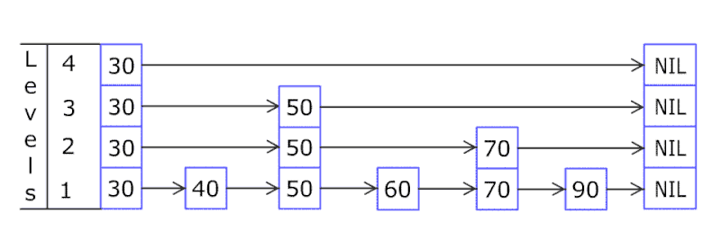
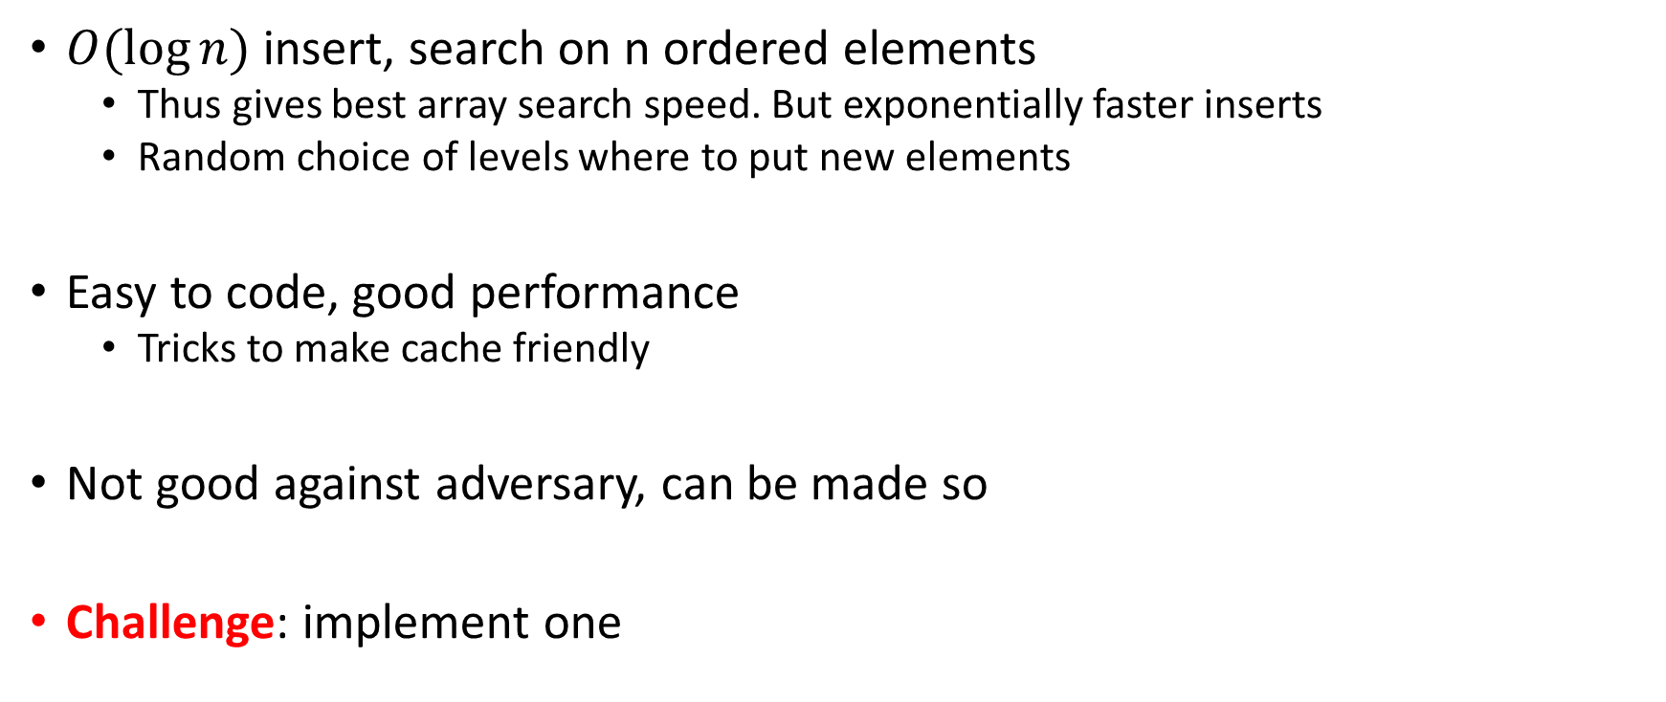
Skip list
$O(log⁡n)$ insert, search on n ordered elements
  Thus gives best array search speed. But exponentially faster inserts
  Random choice of levels where to put new elements
Easy to code, good performance
  Tricks to make cache friendly
Not good against adversary, can be made so
Challenge: implement one
Notes:
http://ticki.github.io/blog/skip-lists-done-right/

Slide 17
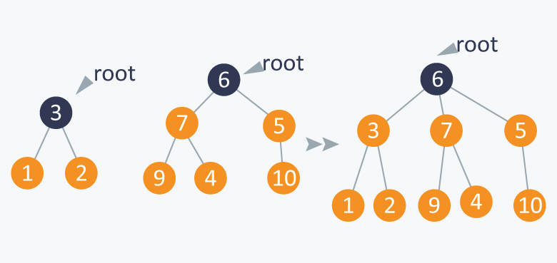
Disjoint Set
Want to track used items from fixed set of items
  Memory pages
  FAT allocation
  Allocation Bitmap nice method, uses 0/1
More states than 0/1?
Disjoint-set data structure (1964)
  Tracks set of elements partitioned into disjoint sets
  Near constant time add new set, merge sets, determine if elements in same set
  Each item a node with parent pointer, can be array, also rank of item (depth)
  Find path compression – walk pointers up over time
    Technique: opportunistic data structure updating
  Union merges smaller tree to root of larger tree
Notes:
Time complexity inverse Ackermann function. Describe Ackermann function:

Slide 18
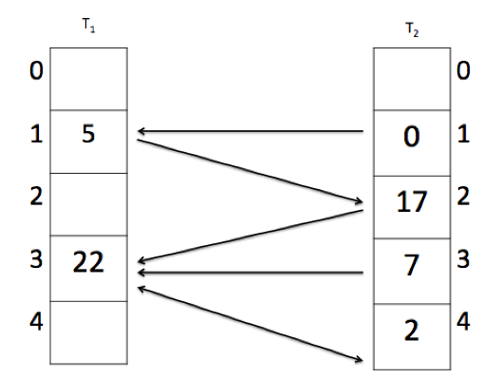
Hashing
Hash table: array of values indexed by hashing keys.
Hash collision: many ways to resolve
  Linear probing – look for next free. Delete requires moving items.
Cuckoo hashing: 2 hash functions, check both places first, easier to delete.
  Collisions push items from one value to the other until stops.
  Based on cuckoo pushing eggs around.
  Need load factor at most 50%
Perfect hashing: given fixed N items, can construct a hash that fits into N slots.
Hopscotch hashing: Each bucket in a neighborhood (think cache line). If neighborhood full, resize table. Well suited for concurrent hashing.
Notes:
https://stepik.org/lesson/31226/step/8?unit=11592

Slide 19
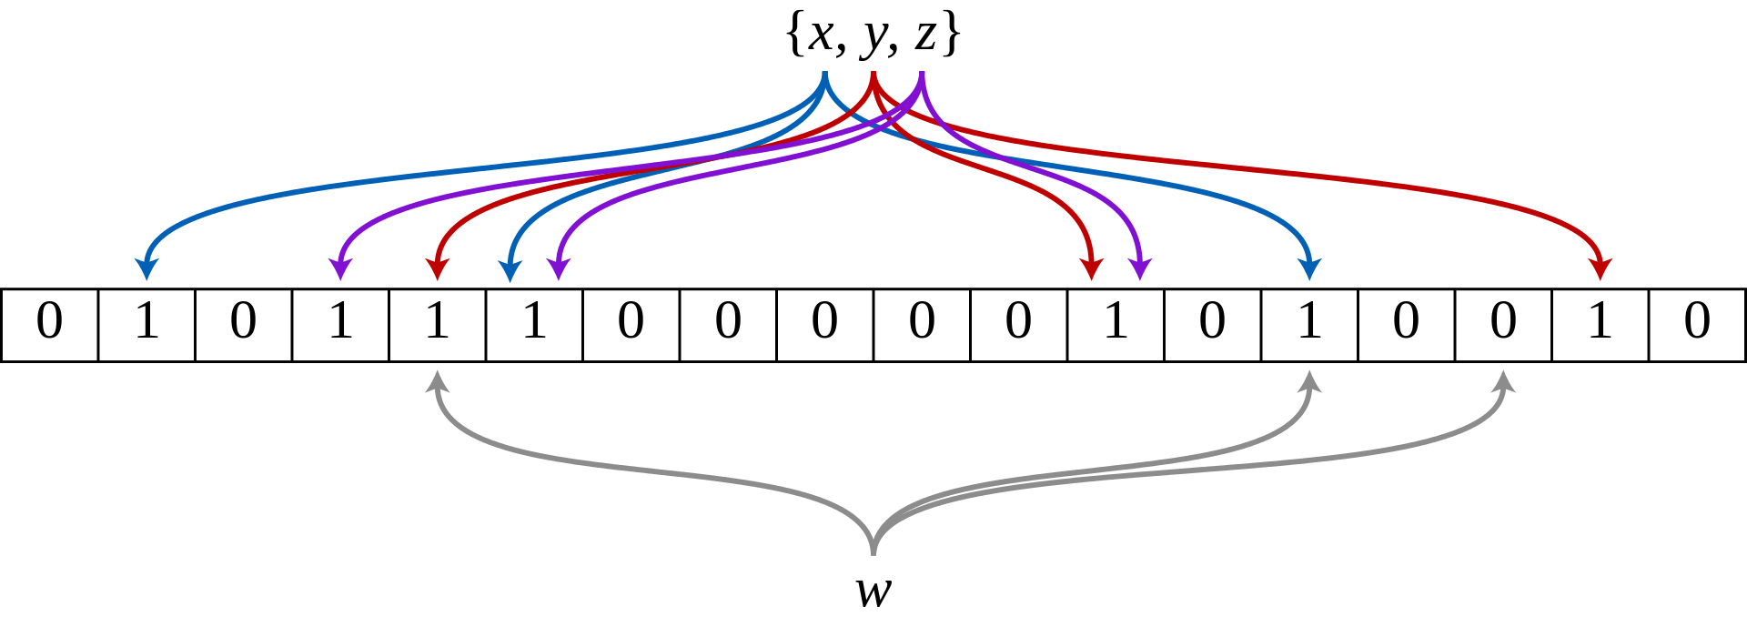
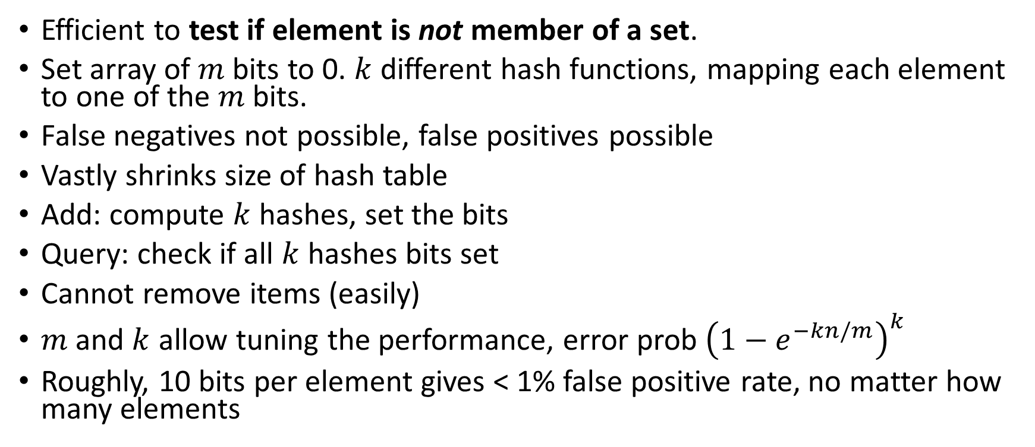
Bloom Filters
Efficient to test if element is not member of a set.
Set array of $m$ bits to 0. $k$ different hash functions, mapping each element to one of the $m$ bits.
False negatives not possible, false positives possible
Vastly shrinks size of hash table
Add: compute $k$ hashes, set the bits
Query: check if all $k$ hashes bits set
Cannot remove items (easily)
$m$ and $k$ allow tuning the performance, error prob ${\left(1−e^{−kn/m}\right)}^{k}$
Roughly, 10 bits per element gives < 1% false positive rate, no matter how many elements
Notes:
“More generally, fewer than 10 bits per element are required for a 1% false positive probability, independent of the size or number of elements in the set” https://en.wikipedia.org/wiki/Bloom_filter
Akamai uses to prevent one hit wonders from being cached
Google BigTable uses
Chrome uses to identify malicious URLs
Bitcoin to speed up wallet sunchronization
SPIN model checker to speed up verification

Slide 20
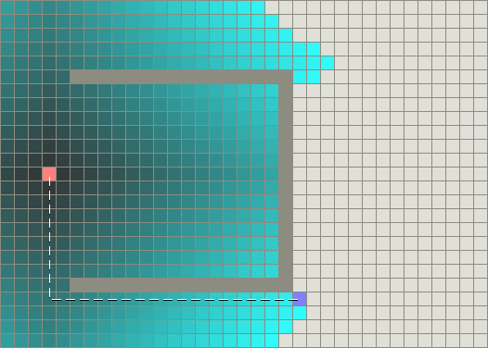
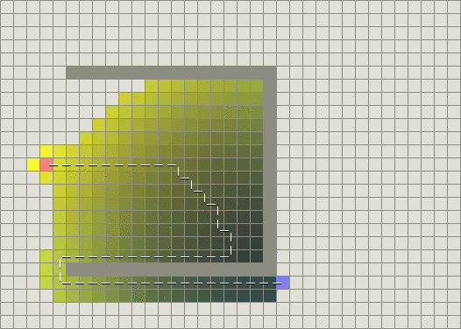
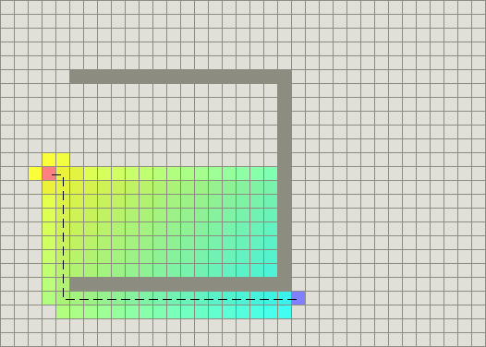
Pathfinding
Find optimal path through discrete space
Modeled as graph search
A* search (pronounced “A star”) very popular
  Have list of paths so far
  Use heuristic to find which to extend
  Repeat
Lots of tricks and rules to find best heuristics
Very common in games, simple robotics, industrial optimization
Notes:
http://theory.stanford.edu/~amitp/GameProgramming/AStarComparison.html
Pics: depth first search, greedy, A*

Slide 21
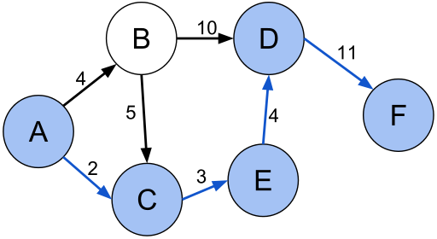
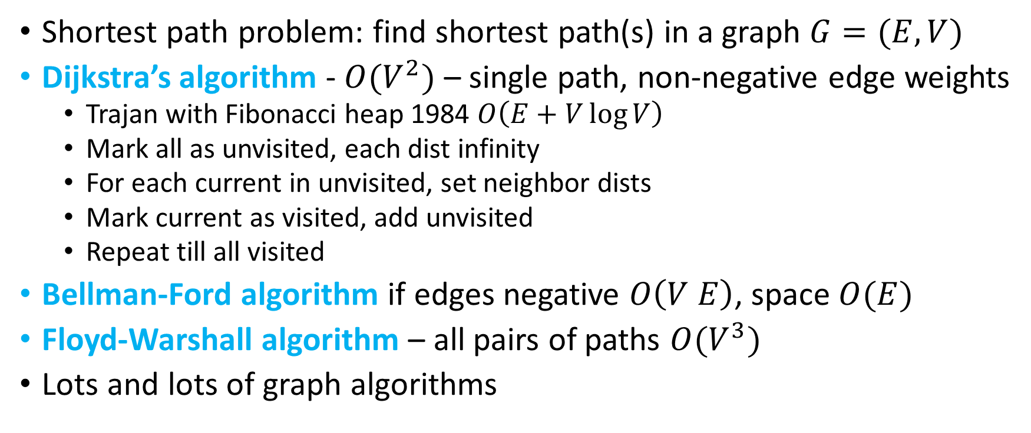
Graph
Shortest path problem: find shortest path(s) in a graph $G=(E,V)$
Dijkstra’s algorithm - $O(V^{2})$ – single path, non-negative edge weights
  Trajan with Fibonacci heap 1984 $O\left(E+V\log{V}\right)$
  Mark all as unvisited, each dist infinity
  For each current in unvisited, set neighbor dists
  Mark current as visited, add unvisited
  Repeat till all visited
Bellman-Ford algorithm if edges negative $O\left(V E\right)$, space $O(E)$
Floyd-Warshall algorithm – all pairs of paths $O(V^{3})$
Lots and lots of graph algorithms

Slide 22
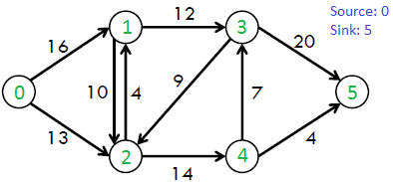
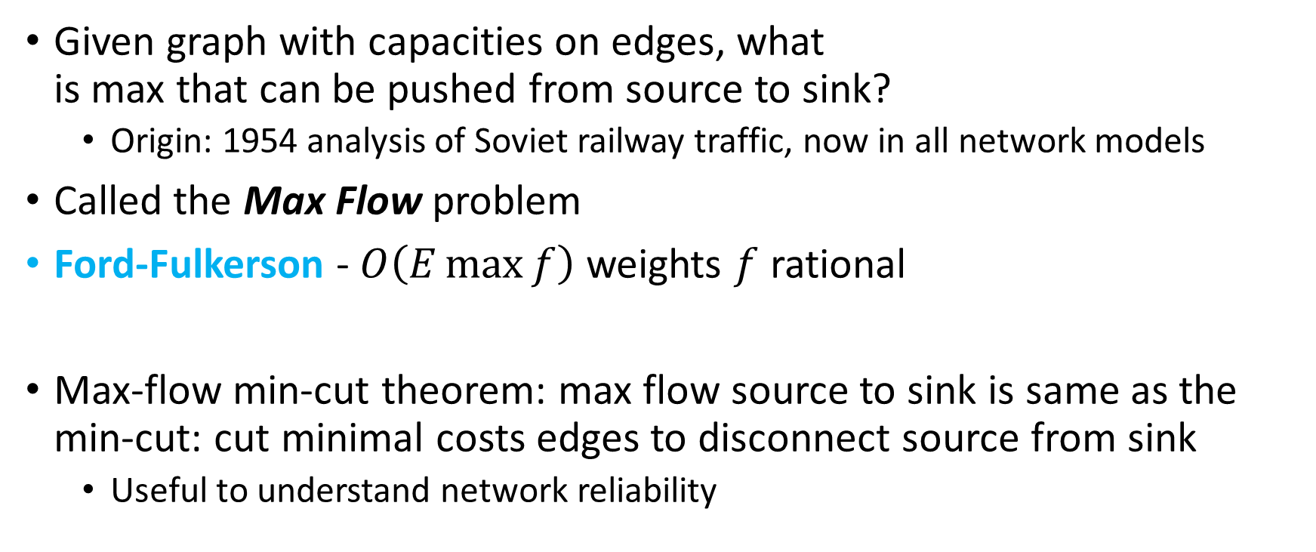
Graph
Given graph with capacities on edges, what
is max that can be pushed from source to sink?
  Origin: 1954 analysis of Soviet railway traffic, now in all network models
Called the Max Flow problem
Ford-Fulkerson - $O\left(E\max{f}\right)$ weights $f$ rational
Max-flow min-cut theorem: max flow source to sink is same as the min-cut: cut minimal costs edges to disconnect source from sink
  Useful to understand network reliability
Notes:
Tons of graph algorithms

Slide 23
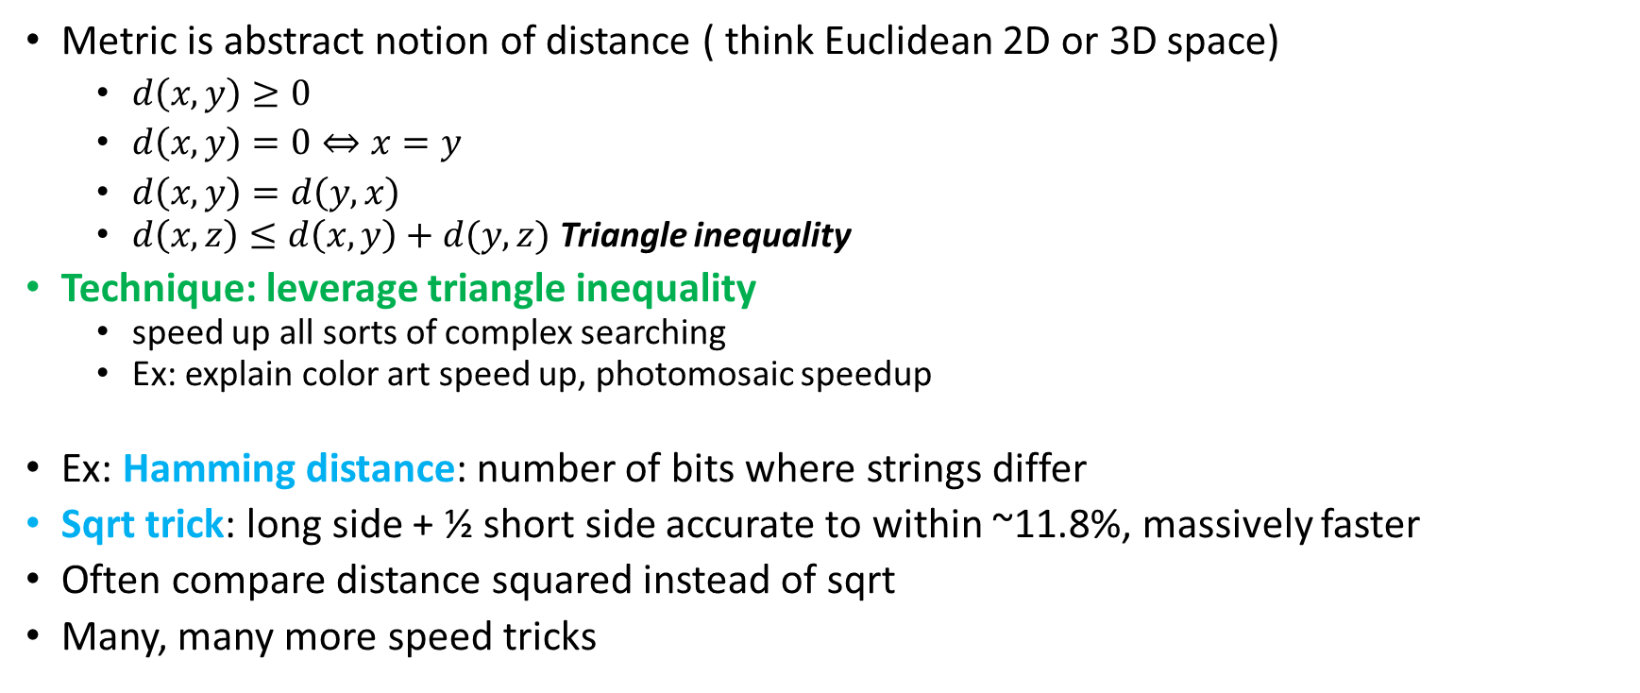
Metrics
Metric is abstract notion of distance ( think Euclidean 2D or 3D space)
  $d\left(x,y\right)≥0$
  $d\left(x,y\right)=0⇔x=y$
  $d\left(x,y\right)=d\left(y,x\right)$
  $d\left(x,z\right)≤d\left(x,y\right)+d(y,z)$ Triangle inequality
Technique: leverage triangle inequality
  speed up all sorts of complex searching
  Ex: explain color art speed up, photomosaic speedup
Ex: Hamming distance: number of bits where strings differ
Sqrt trick: long side + ½ short side accurate to within ~11.8%, massively faster
Often compare distance squared instead of sqrt
Many, many more speed tricks

Slide 24
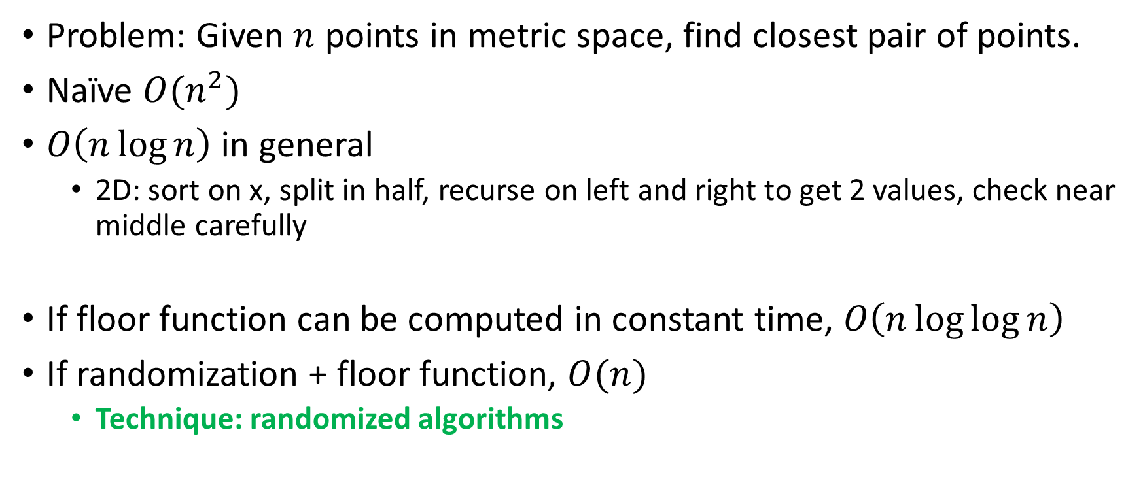
Closest points
Problem: Given $n$ points in metric space, find closest pair of points.
Naïve $O(n^{2})$
$O\left(n\log{n}\right)$ in general
  2D: sort on x, split in half, recurse on left and right to get 2 values, check near middle carefully
If floor function can be computed in constant time, $O\left(n\log{\log{n}}\right)$
If randomization + floor function, $O(n)$
  Technique: randomized algorithms
Notes:
https://rjlipton.wordpress.com/2009/03/01/rabin-flips-a-coin/

Slide 25
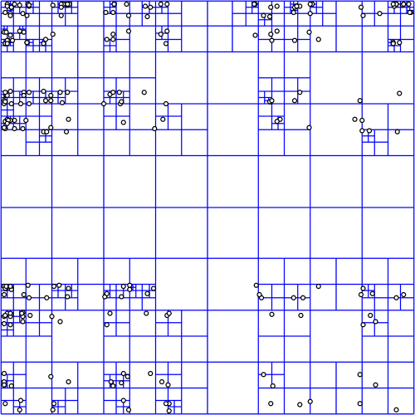
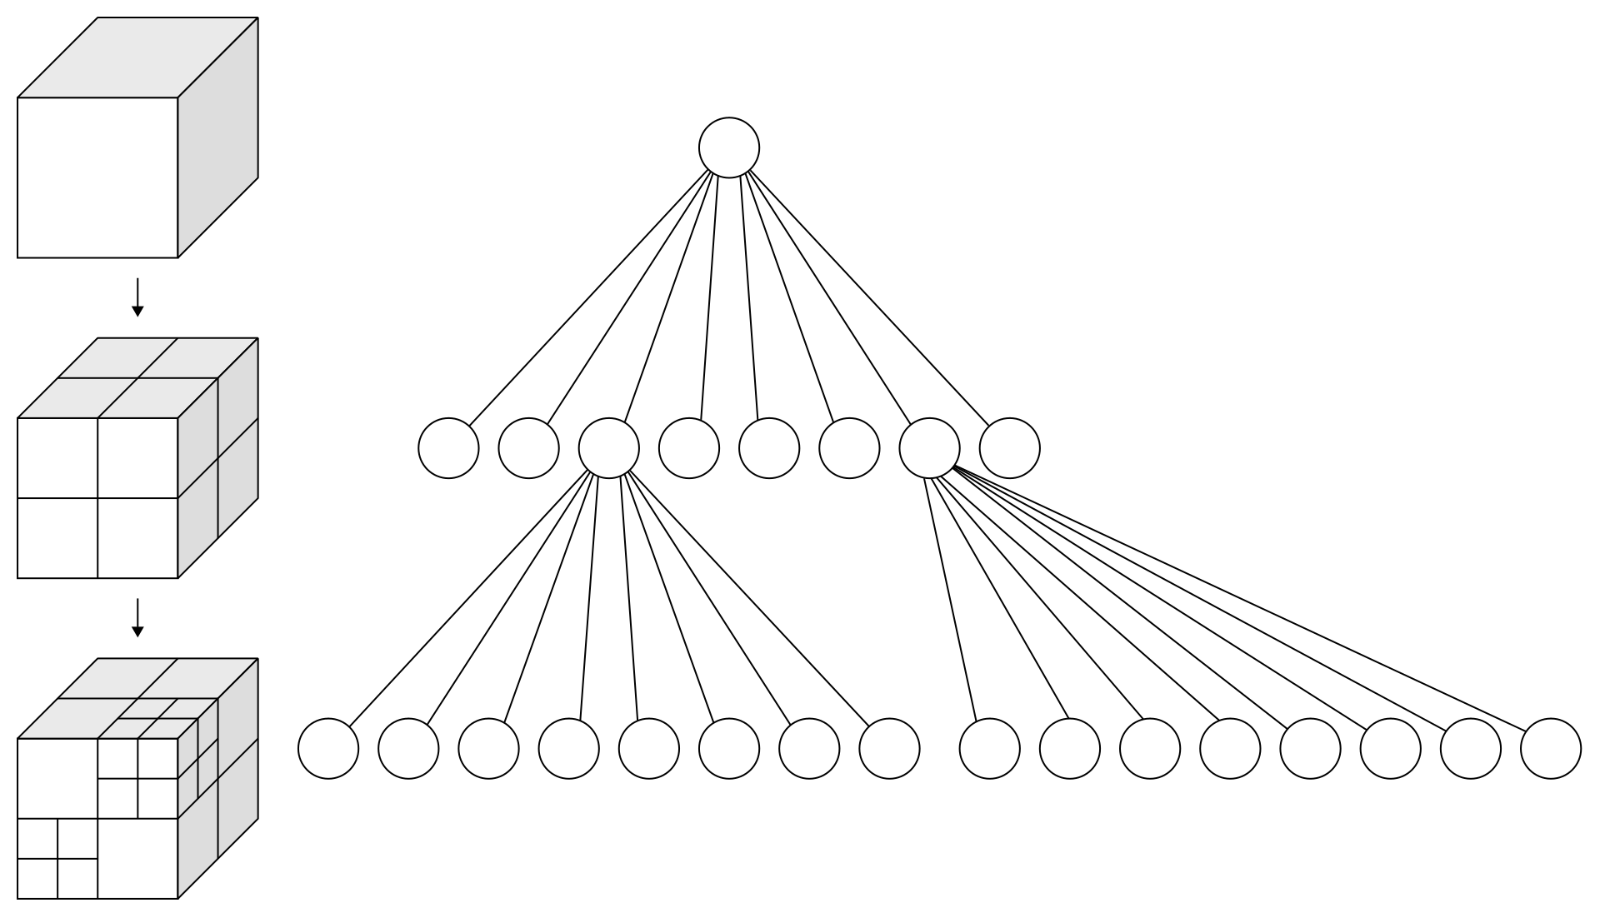
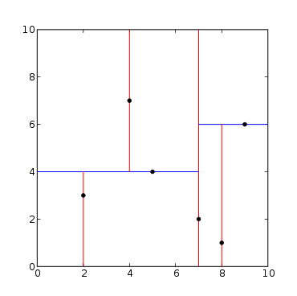
Partitioning
For looking up things and neighbor questions in metric space
2D Quadtree – each node has 4 children
3D Octree – each node has 8 children
K-d tree – each leaf is n dim point, creates splitting plane
Most suffer from “curse of dimensionality”
  High dimensional stuff “mostly on edges”, not “middles….”
  Ex: n sphere mostly on edge, same as hypercube
Many, many more (Ball tree, hybrid stuff….)
Notes:
Implementation often suffers from floating point errors…
https://en.wikipedia.org/wiki/Curse_of_dimensionality

Slide 26
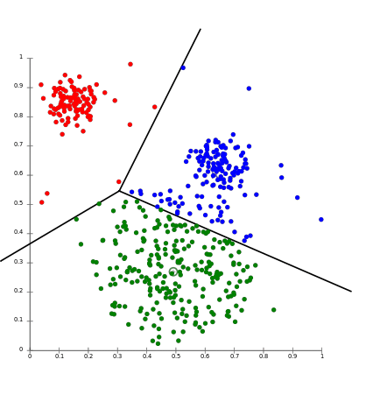
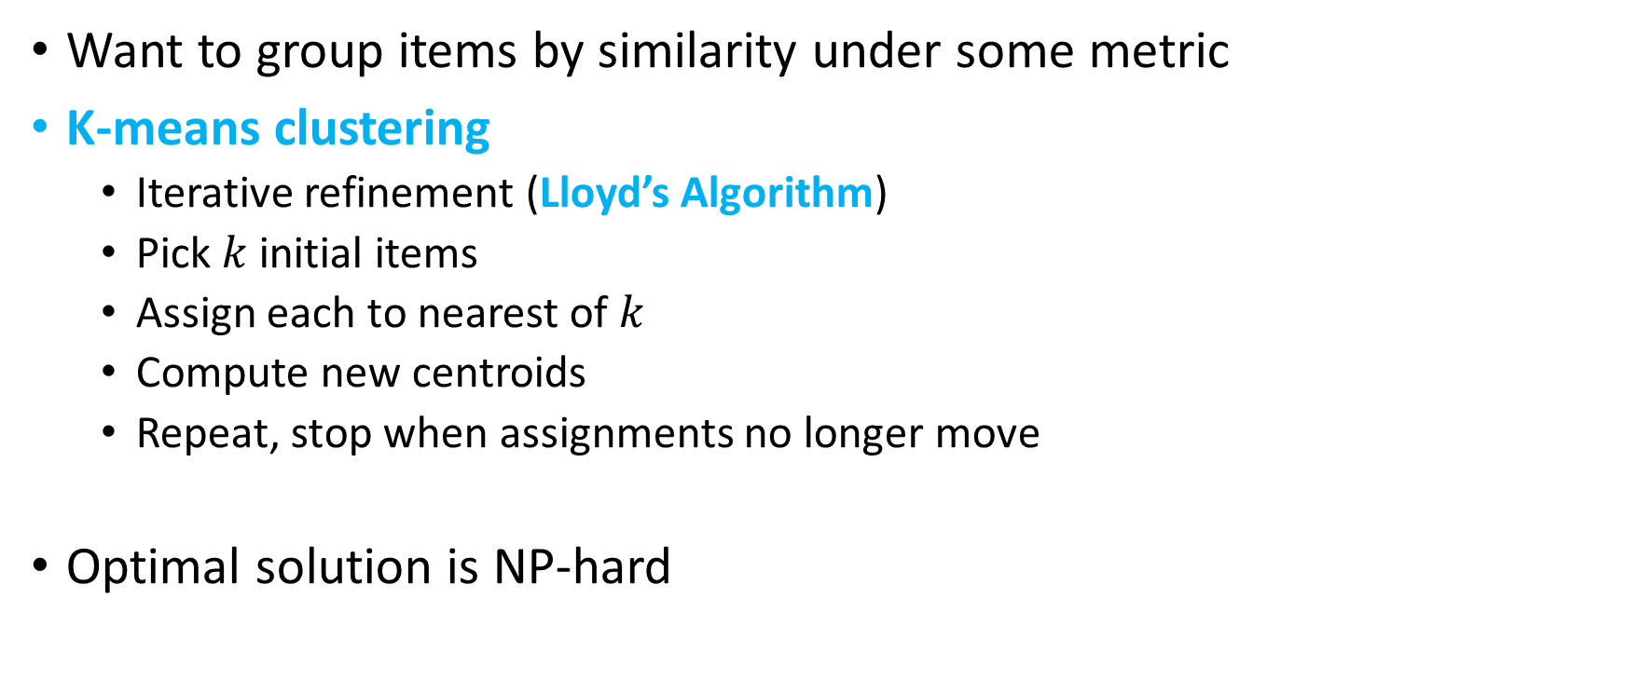
Clustering
Want to group items by similarity under some metric
K-means clustering
  Iterative refinement (Lloyd’s Algorithm)
  Pick $k$initial items
  Assign each to nearest of $k$
  Compute new centroids
  Repeat, stop when assignments no longer move
Optimal solution is NP-hard

Slide 27
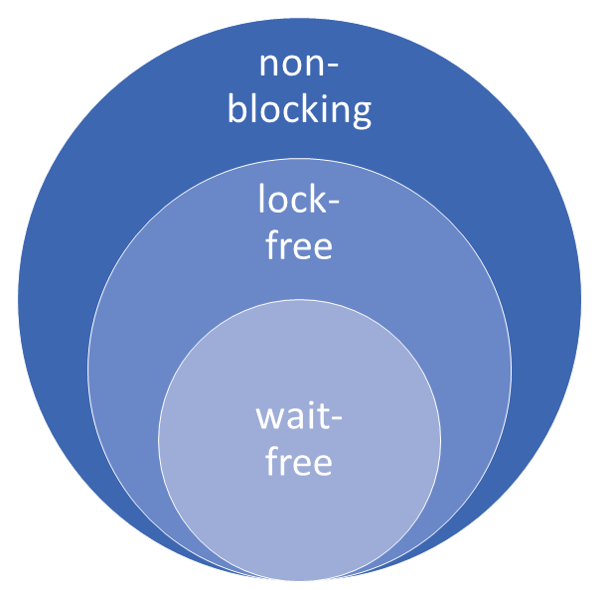
Concurrent Data Structures
Locks: deadlock, livelock, priority inversion, problems with interrupts
  Coarse grained locking loses parallelization opportunities, fine grained adds more locking overhead, hard to get correct.
Non-blocking: a stopped thread cannot block other progress
Wait-free (strongest): guaranteed systemwide progress, starvation free
Lock-free (middle): guaranteed systemwide progress, individual threads can starve
Obstruction-free (weakest): single thread guaranteed to make progress if all other obstructing threads suspended.
Implemented with read-modify-write primitive. CAS most common.
Examples:
  wait-free queue (2011), SRSW ring-buffer with only a memory barrier, linked lists, stack, …

Slide 28
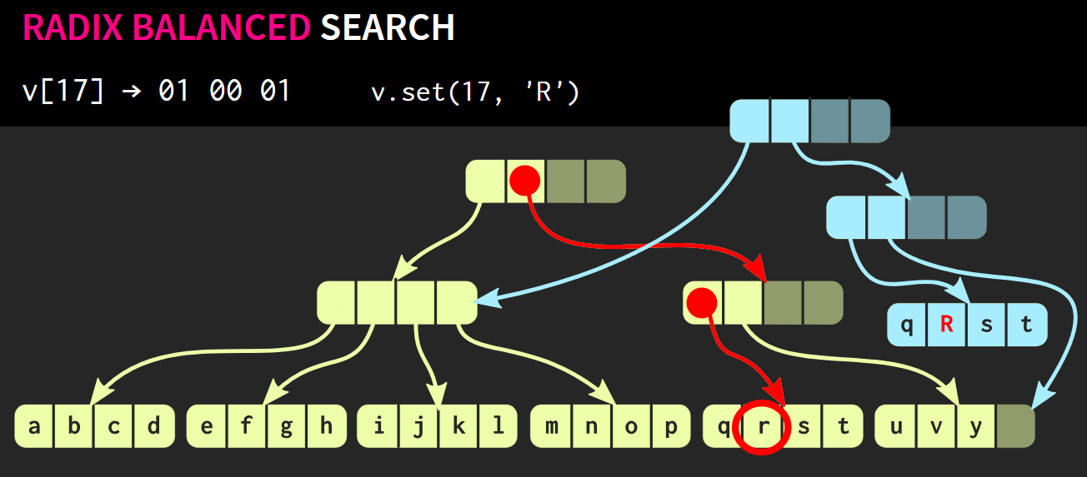
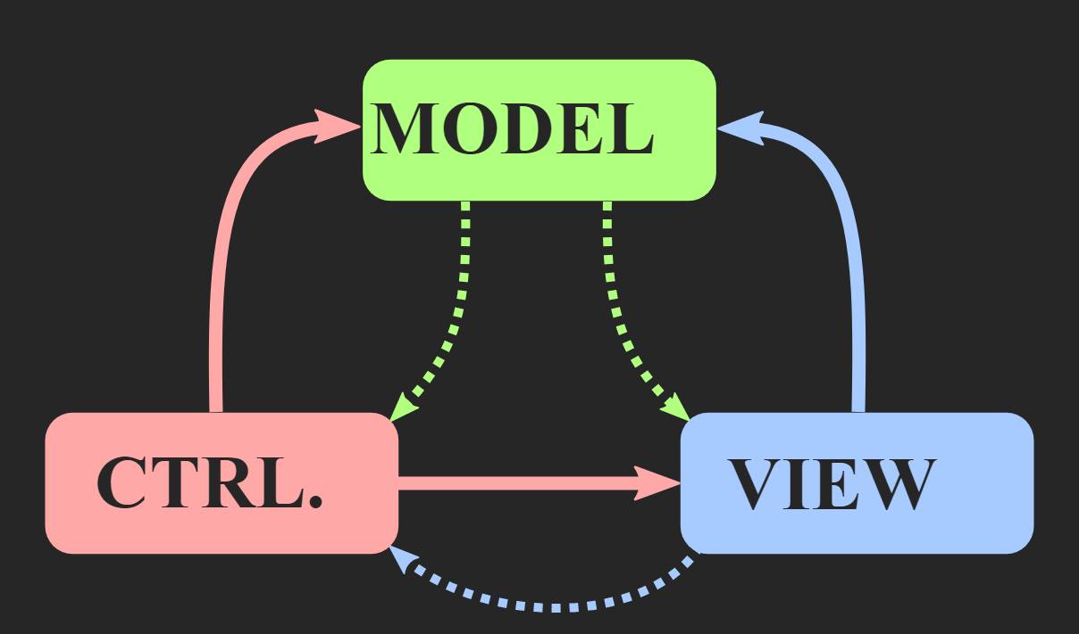
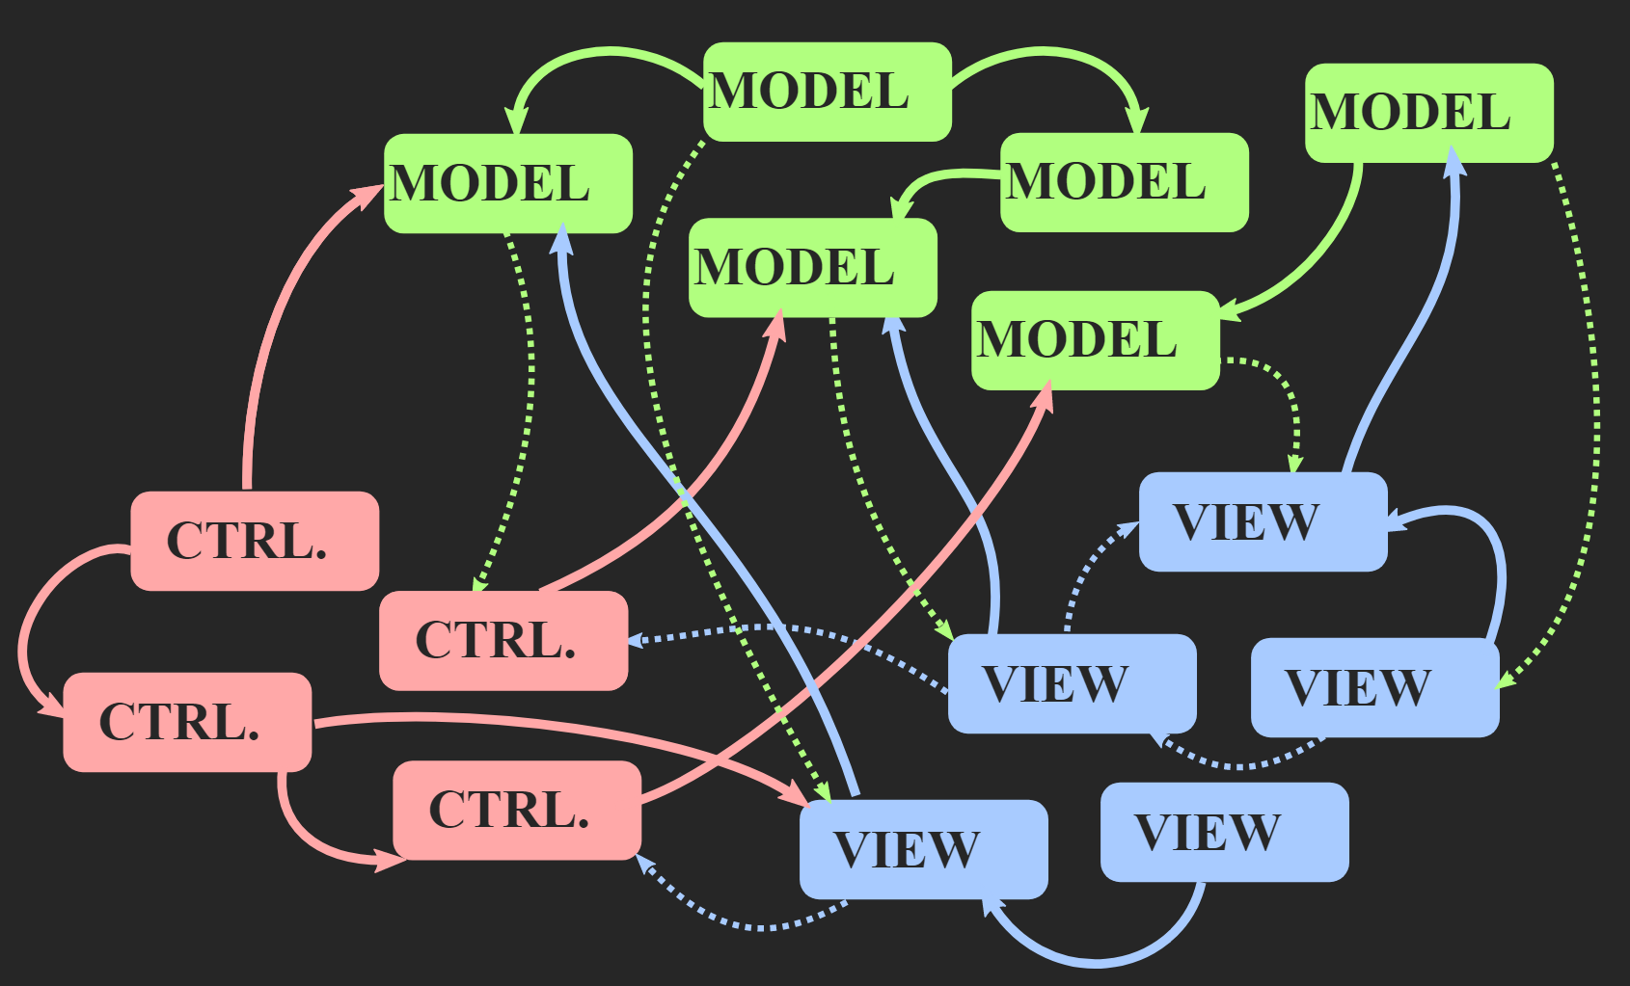
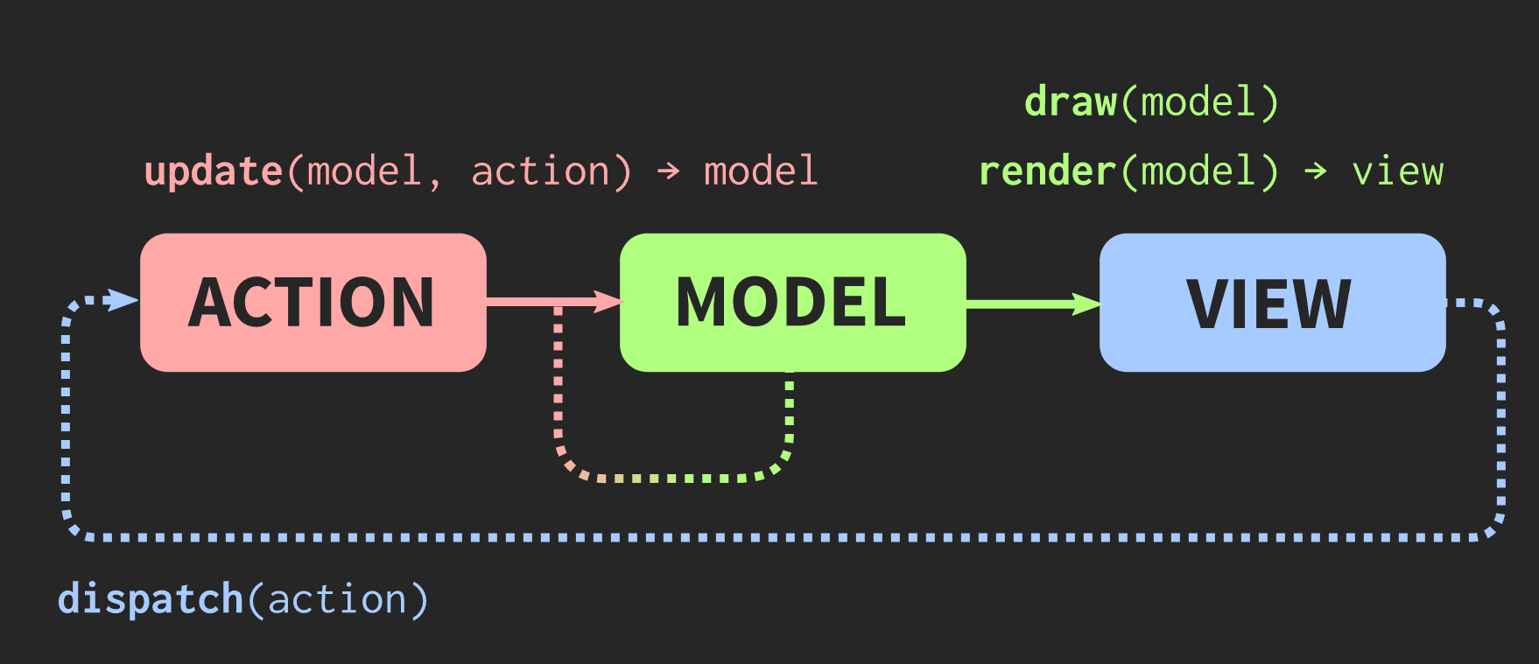

Immutable data structures
Needed as things become more parallel
Each update returns new view of item
  old views still valid
Relaxed Radix Balanced Trees (RRB Tree)
  Efficient immutable vector
  Random access, update, push back, slice right/left $\sim O\left(1\right)$
  Concat, insert, push front $O(\log{n})$
In many more modern languages (Clojure, Scala, more)
Immer library github C++: Persistent immutable data structures
Nicely performant
Many, many more avenues, research, algorithms, data structures
Technique: immutable data structure for parallelization
Notes:
https://infoscience.epfl.ch/record/169879/files/RMTrees.pdf;
https://sinusoid.es/talks/immer-cppcon17/#/12

Slide 29
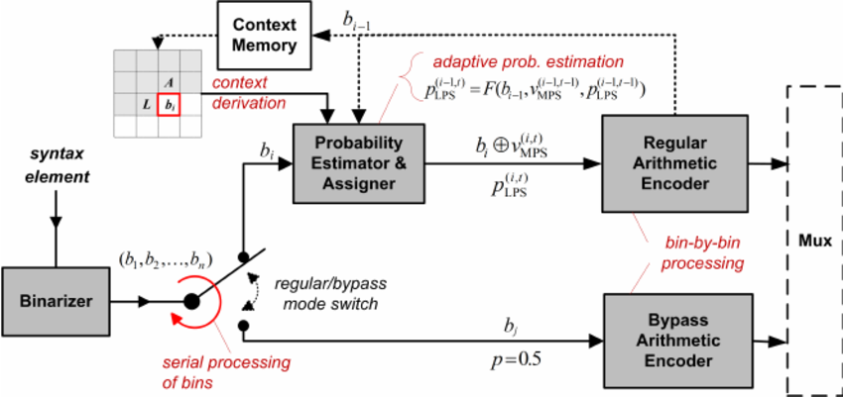
Data Compression
Lossless
  Run Length Encoding (RLE): AAAAAAA => 7A
  LZ77 – sliding window of history
  LZ78 – explicit dictionary
  Huffman – optimal for power of 2 probabilities
  Arithmetic – optimal for fixed probabilities, is “limit” of Huffman
  PPM – prediction by partial matching
  BWT – in bzip, novel invertible “sorting” transform
  Context-adaptive binary arithmetic coding (CABAC) – basis of most modern
Lossy
  Exploit perceptual bias
  Exploit temporal changes
  JPEG, MP3, H.265, Speex
Compressive Sensing (Tao, Candes, .., 2004)
  Massive breakthrough : proved cases where can reconstruct signal with exponentially fewer samples than Nyquist limit
  Design of radiating systems, radar through wall imaging, antenna design, MRI
Challenge: Implement a few of the first lossy versions

Slide 30
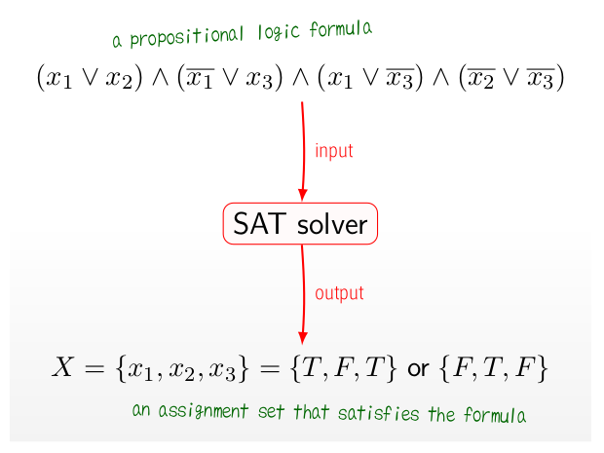
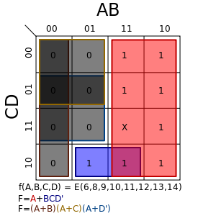
Boolean
SAT – Boolean Satisfiability
  Given a Boolean expression in k variables, does there exist a
  True/False assignment making the expression true?
  Fundamental, many real world problems can be cast into it.
  Essential part of EDA toolbox. Even Excel has decent ones built in
  Solvers called SAT solvers
    SAT solvers useful for many problems, despite NP hard
    Can often handle millions of variables in millions of clauses
    Knuth TAOCP chapter especially nice presentation
    Annual competition in the 2010s drove state of the art much higher
Boolean minimization
  Karnaugh Map, implemented as Quine-McClusky algorithm
  Faster evaluation
  Smaller circuits

Slide 31
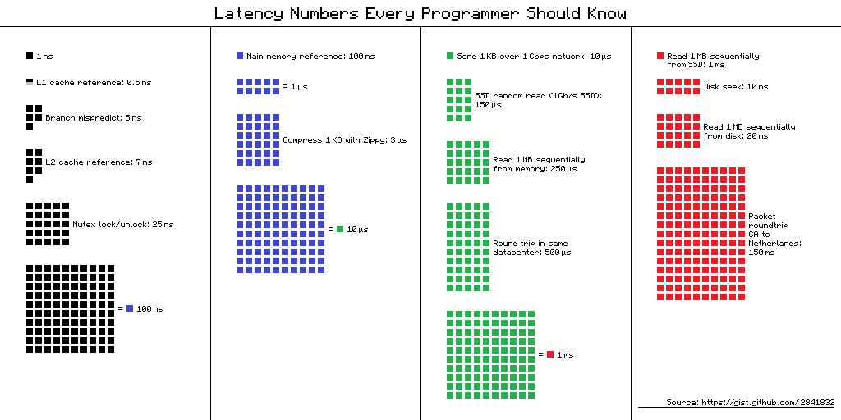


Cache aware
Being cache careful can give
10-100x performance speedups
Huge cache variety across machines
Naïve: compile per platform, carefully tune, costly and tricky, maintenance
Problem: Make cache aware code portable
Cache aware algorithms
  also called cache oblivious algorithms
  H. Prokop MIT Master’s Thesis (1999)
  Technique: break problem recursively into $2^{n}$ sizes
  One eventually fits in cache
Many exist: funnel sort, quicksort, matrix
transposition, array reversal, b-trees, priority queues
Notes:
https://en.wikipedia.org/wiki/Cache-oblivious_algorithm
https://0fps.net/2013/05/28/cache-oblivious-array-operations/

Slide 32



Control Theory
Sources of information, noisy, want to merge
  Sensor fusion (GPS, accelerometer, clock, compass, cameras,..)
  Robots
  Self-driving cars
  Industrial machines
  Phone
Kalman filter – algorithm to do sensor
fusion with uncertainty
  Extended Kalman Filter (EKF)
PID controller
  proportional–integral–derivative controller
  Drones
  Engines
  Industrial control
Challenge: make simple PID that tracks some value,
then poke at the value and see how the PID responds

Slide 33
The End
Questions?

Slide 34

Change Problem
How many ways to make change for $10.00?
Coins & bills = {1,5,10,25,50,100,200,500,1000} = 9 items, S0 to S8
$C(m,n)$ = number of ways to total $n$ with items $S0$ through $Sm$
Key insight: split computation to those using $Sm$ and those not
  Technique: split problem into mutually exclusive cases
$C(m,n)=C(m,n−Sm)+C(m−1,n)$
End cases:
  if n < 0 or m < 0 then C=0
  if n == 0 then C = 1
Dynamic programming or memorization: C(8,1000) = 3,237,135
Notes:
If time:

Slide 35
TODO
Highlight general techniques
Final slide with techniques for review
On final slide, list techniques one side, algo names other
Techniques: meet in middle (sqrt trick)

