Slide 1
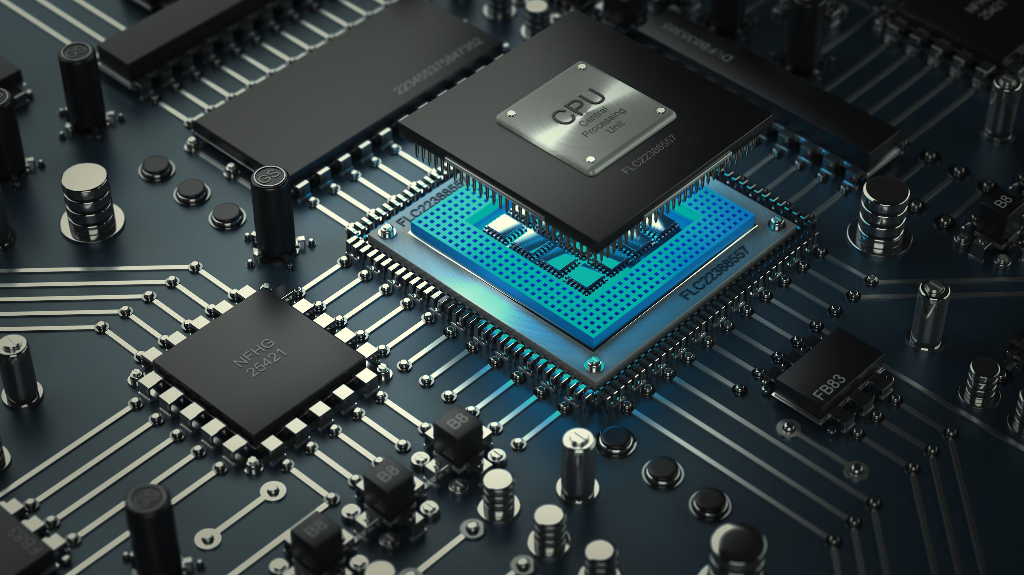
Modern CPU Architecture
----- With a View towards Meltdown and Spectre -----
Chris Lomont, PhD
Jan 2018

Slide 2
  Introduction: CPUs and Attacks
Architecture
Evolution
Attacks
We’ll use Intel CPUs as a specific architecture example.
All modern large CPUs (AMD, IBM, ARM) work similarly.
Architecture needs (cache, speculative execution, security levels) have increased complexity tremendously as CPUs went from 4 to 8, 16, 32, and 64 bit data sizes.
Complexity in CPU needs and features has driven exploits far into the corners of modern CPUs. Meltdown and Spectre are two large classes affecting nearly all modern, large processors as of 2018, affecting CPUs going back decades.
->NEEDS
->COMPLEX
->BINGO!
Free PowerPoint Templates

Slide 3
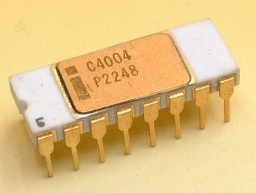
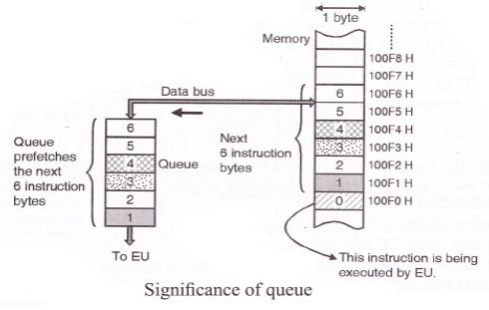
Early Intel CPUs
CPU | Year | D/A bits | Speed | Inst | trans/Feature
4004 | 1971 | 4/4 | 108 khz | 46 | 2300/10000nm | 1kb program, 4kb data, 16 4-bit regs, 12x4 stack
8008 | 1972 | 8/8 | 800 khz | 48 | 3500/10000nm | 16k address space, 6 8-bit regs, 17x7 stack
8080/8085 | 1974 | 8/8 | 2-3 Mhz | 80 | 6500/3000nm | 64kb address space, 6-8 bit regs, IO ports, stack pointer
8086/8088 | 1978/79 | 16/20 | 5 Mhz | 81 | 29000/3000 nm | All regs & addr lines 16 bits 6 byte prefetch queue
Instructions 1-6 bytes
8086+: Segmented memory (ES:AX style code)
Prefetch queue loaded bytes ahead of processor speed to address RAM/CPU
timing mismatch
Predecessor to adding L1/L2/L3 caches, which are central to Meltdown & Spectre

Slide 4
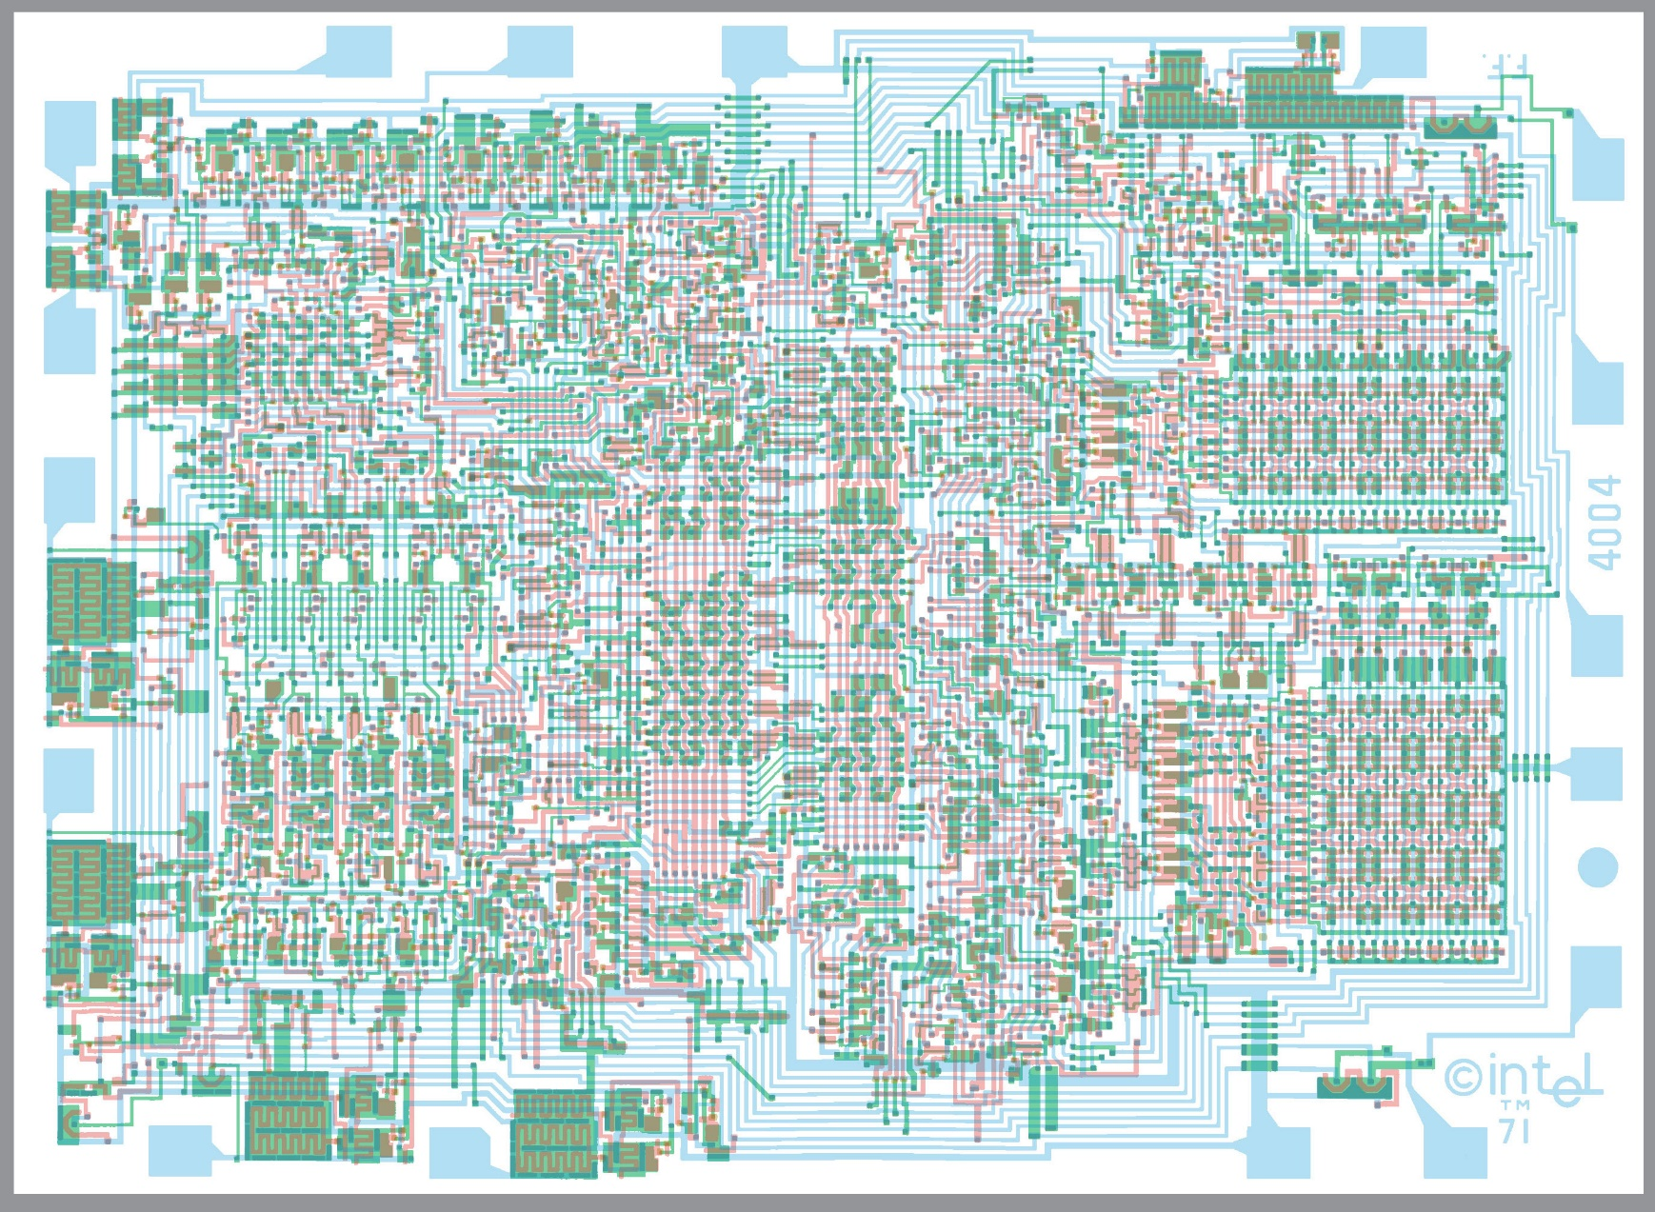

4004

Slide 5
1980s Intel CPUs
CPU | Year | D/A bits | Speed | Inst | trans/Feature
80186/188 | 1982 | 16/20 | 6 MHZ | 99 | 55000/1500 | Added clock, timer, interrupts
80286 | 1982 | 16/24 | 6-8 MHZ | 116 | 134K/1500 | MMU, Global and Local Descriptor Tables, protected mode
Memory management unit (MMU)
  Allows paging
  Virtual memory
  Each process has it’s own memory space

Slide 6
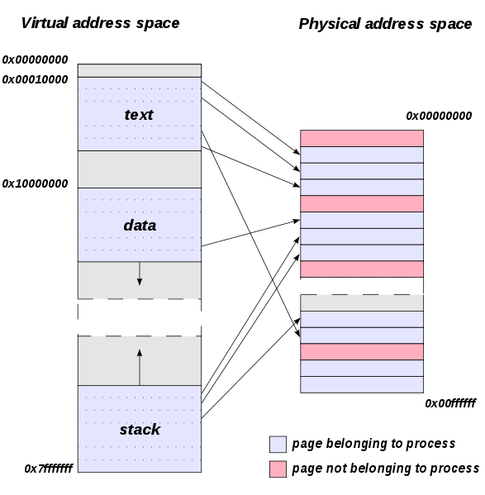
Virtual Memory
286/386 allowed multiple processes
Each needed own address space
Memory Management Unit (MMU)
  Divide physical memory into pages, assign to logical
  addresses per process
  Allows swapping pages to disk if needed
Page Table
  Contains mapping, changed for each process
  Page Table Entry (PTE): dirty bit, R/W, read only, security bits, etc.

Slide 7
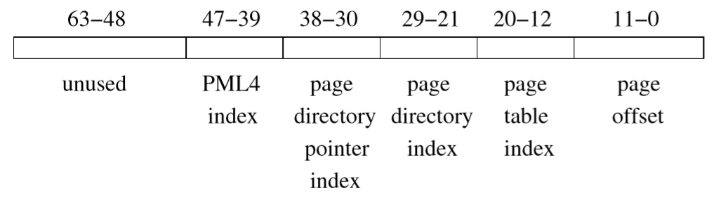
Virtual Memory (x64)
Page 4K (or 2MB or newer 1GB)
4 levels of tables:
  CR3 register points to root page table PML4
  16 bits of 64 unused (48 bits gives 262 TB)
  Each page holds 512 Page Table Entries (2^9)
  Address resolved by walking page tables
  Transition Lookahead Buffer (TLB) is cache to speed up address resolution
Meltdown fix causes performance hit because of need to rewrite these

Slide 8
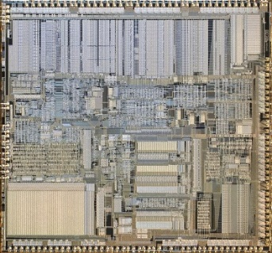
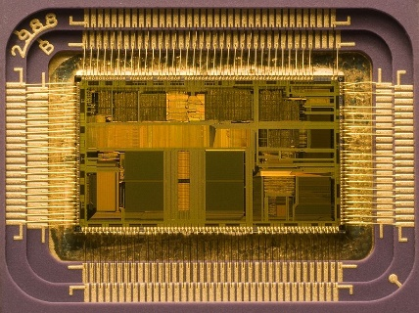
More 1980s Intel CPUs
CPU | Year | D/A bits | Speed | Inst | trans/Feature
80386 | 1985 | 32/32 | 12-88 MHZ | 142 | 275K/1000nm | Virtual modes for multitasking, external cache
i486 | 1989 | 32/32 | 50-100 MHZ | 150 | 1.2M/600nm | L1 cache, pipelining
386: Real mode, protected mode, virtual mode
  Real mode was a 4GB flat memory model
  Virtual mode allowed running one or more 8086 mode
  programs in a protected environment
  Added technical details to make it work well
i486
  Large transistor jump due to on chip cache and FPU
  Naming change: Court ruling made number trademarks unenforceable

Slide 9
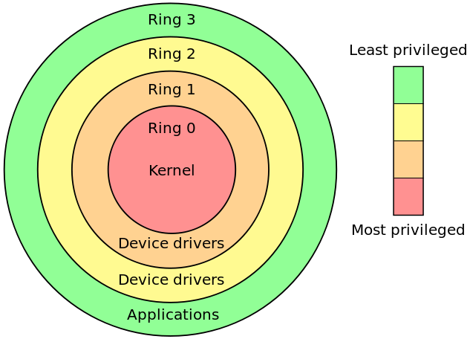
Process separation
286 added protected mode, not very usable
386 added technical details to make it work
Originally three “rings” of protection: 0 to 3
  Windows, Linux, more: Kernel is Ring 0, User is Ring 3
    Others not used (Paging only knows ring 012 vs 3 for security)
  More:
    1985: SMM (called “Ring -2” now), suspends normal CPU, runs special CPU
    2005: Intel VT-x (AMD-V) added virtualization hypervisor, “Ring -1”
    2008: Intel Management Engine (ME) (AMD PSP) added “Ring -3”
      Significant exploit found in 2017
    More?
Invalid access (page fault) traps to kernel
  Used for protection
  Used to load swapped out memory
  Used to grow stack, etc.

Slide 10
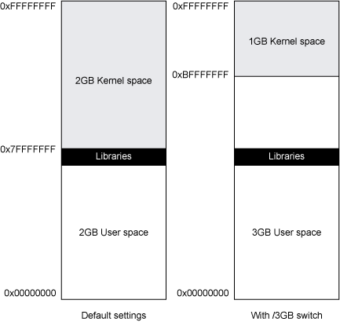
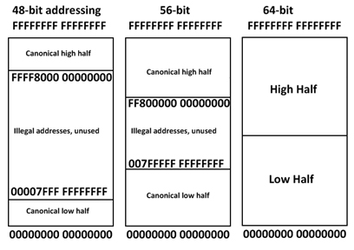
Process separation II
Windows 32 bit memory map
Kernel memory stores valuable things
  Usually mapped to high half of memory space
  Process switching involves setting up user page tables
User should not be able to read kernel memory
  Meltdown is flaw bypassing this
Intel 64 bit addressing

Slide 11
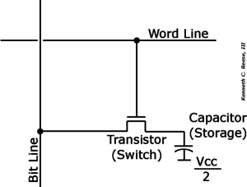
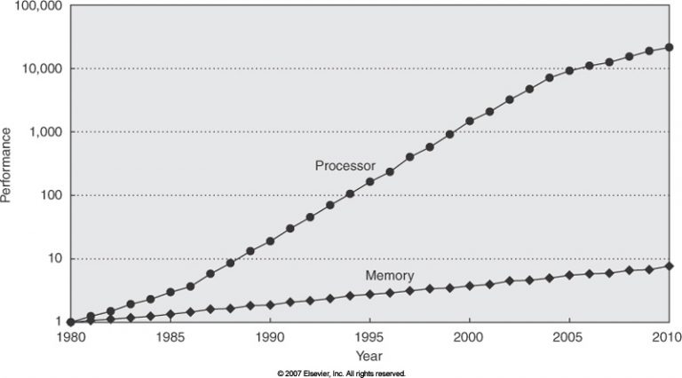
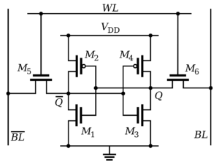
RAM vs CPU performance
DRAM
SRAM

Slide 12
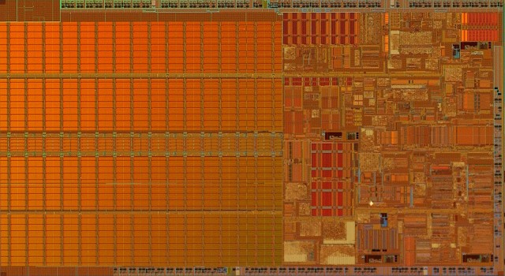
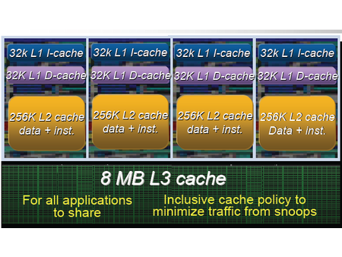
Cache
Starts as single cache
  Later split into data and instruction
Originally external
  Then internal, then Level 1 and 2
  Now L1,L2,L3, cache/core, shared
Feature | Dynamic RAM (DRAM) | Static RAM (SRAM)
Circuit | 1 capacitor | Flip-flop (6 transistors)
Transfer | Slower than CPU | Fast as CPU
Latency | High | Low
Density | High | Low
Energy | Low | High
Cost | Cheap | Expensive

Slide 13
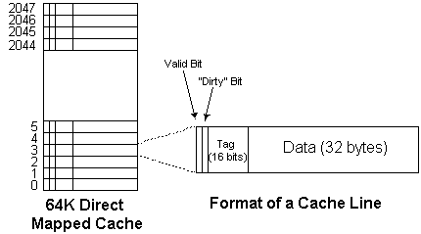
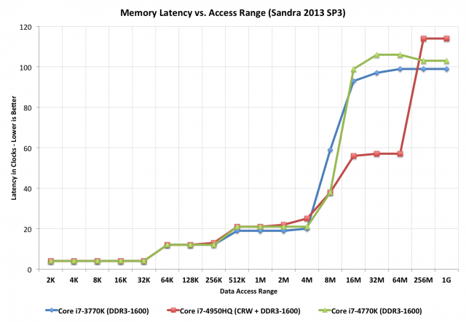
Cache details
Each line: valid bit, dirty bit, tag, data
  Tag: who is here?
Associative
  only some lines map to a fixed memory spot
  faster lookup – don’t need to search all cache
Coherence
Modern: 64 byte lines
Experiment: double loop order timing

Slide 14
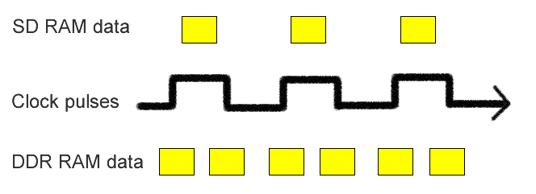
SDRAM details
CPU | Year | Bus clock MHZ | prefetch | Data Rate (MT/s) | Rate (GB/s) | Voltage (V)
SDR | 1996 | 100-166 | 1n | 100-166 | 0.8-1.3 | 3.3 | Single data rate
DDR |  | 133-200 | 2n | 266-400 | 2.1-3.2 | 2.5/2.6 | Double, rising + falling
DDR2 |  | 266-400 | 4n | 533-800 | 4.2-6.4 | 1.6 | Double clock speed
DDR3 | 2007 | 533-800 | 8n | 1066-1600 | 8.5-14.9 | 1.35/1.5 | 60% power, temp varies
DDR4 | 2014 | 1066-1600 | 8n | 2133-3200 | 17-21.3 | 1.2 | 4 transfers/clock
SDRAM = Synchronous Dynamic RAM, syncs to CPU timing, faster
Internal rate 100-166 MHZ for SDRAM, 133-200 MHZ for rest
Async timing
  RAS - delay between row strobe and column strobe
  CAS - delay between column strobe and data availability
Sync timing
  CL – cycles between column strobe to data acces
  T_{RCD} – cycles between opening a row and accessing columns
  T_{RP} – cycles between issuing precharge and opeing next row
  T_{RAS} – cycles between row active command and issuing precharge command
Notes:
https://www.transcend-info.com/Support/FAQ-296

Slide 15
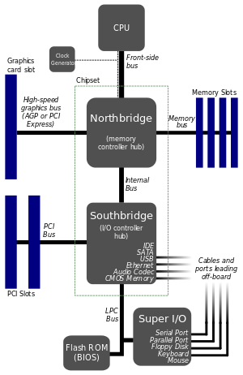
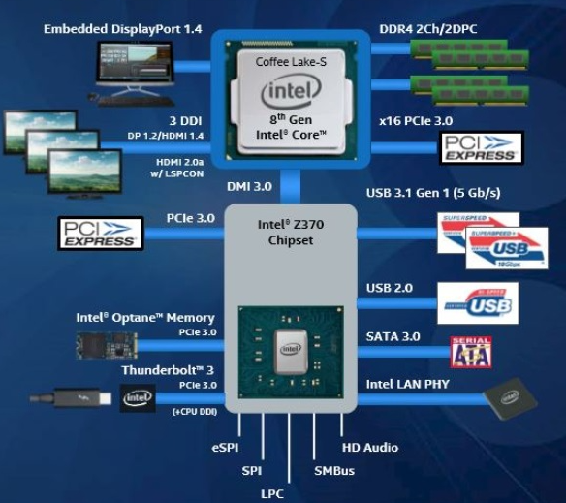
RAM and Architecture
Old PC (1990ish)
  Northbridge, Southbridge, Front Side Bus
Over time more things moved into CPU
  For speed
  Memory controller now in CPU
  Video decoder, driver in CPU
  GPU built in

Slide 16
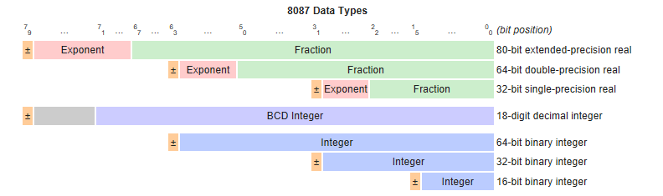
FPU aside
CPU | Year | Speed | Inst | trans/Feature
8087 | 1980 | 5 MHZ | 83 | 45,000/3000 nm | Not IEEE 754, 80 bit floating non std
80287 | 1983 | 6,8,10 MHZ | +1 | 1500 nm
80387 | 1986 | 16 MHZ | +12 |  | Added SIN, COS
80487 | 1991 | 25 MHZ | +0 | 1.19M/1000 nm | Contained full 486DX CPU, took over PC
Added +-*/ sqrt
8 level stack st0 - st7
20%-500% faster than CPU
50,000 FLOPS, 2.4 Watts
Led to IEEE 754, released 1985

Slide 17
Floating point performance – cycle counts
Chip | FADD | FMUL | FDIV | FXCH | FCOM | FSQRT | Max Clock (MHz) | Peak FMUL (millions/sec) | FMUL rel. 5 MHz 8087
8087 | 70…100 | 90…145 | 193…203 | 10…15 | 40…50 | 180…186 | 5 → 10 | 0.034…0.055 → 0.100…0.111 | 1 → 2× as fast
80287 (original) | 70…100 | 90…145 | 193…203 | 10…15 | 40…50 | 180…186 | 6 → 12 | 0.041…0.066 → 0.083…0.133 | 1.2 → 2.4×
80387 (and later 287 models) | 23…34 | 29…57 | 88…91 | 18 | 24 | 122…129 | 16 → 33 | 0.280…0.552 → 0.580…1.1 | ~10 → 20×
80486 (or 80487) | 8…20 | 16 | 73 | 4 | 4 | 83…87 | 16 → 50 | 1.0 → 3.1 | ~18 → 56×
Cyrix 6x86, MII | 4…7 | 4…6 | 24…34 | 2 | 4 | 59…60 | 66 → 300 | 11…16 → 50…75 | ~320 → 1400×
AMD K6(I,II,III) | 2 | 2 | 21…41 | 2 | 3 | 21…41 | 166 → 550 | 83 → 275 | ~1500 → 5000×
Pentium, P MMX | 1…3 | 1…3 | 39 | 1 (0*) | 1…4 | 70 | 60 → 300 | 20…60 → 100…300 | ~1100 → 5400×
Pentium Pro | 1…3 | 2…5 | 16…56 | 1 (0*) | 1 | 28…68 | 150 → 200 | 30…75 → 40…100 | ~1400 → 1800×
Pentium II / III | 1…3 | 2…5 | 17…38 | 1 (0*) | 1 | 27…50 | 233 → 1400 | 47…116 → 280…700 | ~2100 → 13000×
Athlon (K7) | 1…4 | 1…4 | 13…24 | 1 (0*) | 1…2 | 16…35 | 500 → 2330 | 125…500 → 580…2330 | ~9000 → 42000×
Athlon 64 (K8) | 1…4 | 1…4 | 13…24 | 1 (0*) | 1…2 | 16…35 | 1000 → 3200 | 250…1000 → 800…3200 | ~18000 → 58000×
Pentium 4 | 1…5 | 2…7 | 20…43 | multiple cycles | 1 | 20…43 | 1300 → 3800 | 186…650 → 543…1900 | ~11000 → 34000×

Slide 18
Other numerical additions
CPU | Year | Inst
MMX | 1997 | ~50 | 8 registers, overlays FPU registers, double performance, integer only
3DNOW! (AMD) | 1998
SSE |  | ~50 | 8(now 16) 128-bit registers, XMM0-15. Only FP32
SSE2 | 2001 | 144 | Adds FP64, I64, I32, I16, I8
SSE3 | 2004 | 13 | Horizontal and vertical register manipulation
SSSE3 | 2006 | 16 | 64 bit MMX or 128 bit XMM registers
SSE4 (4.1 / 4.2) | 2006 | 47/7 | POPCNT, LZCNT, CRC32, string and text
AVX | 2008 | 13 | 16 YMM registers (8 FP32, or 4 FP64)
AVX2 | 2013 | 30 | Integer command to 256 bits, 3 operand support, more
AVX-512 | 2015 |  | 512-bit register extensions, 4 operands
Notes:
AVX-512 support in GCC, Clang, MSVC 2017, more

Slide 19
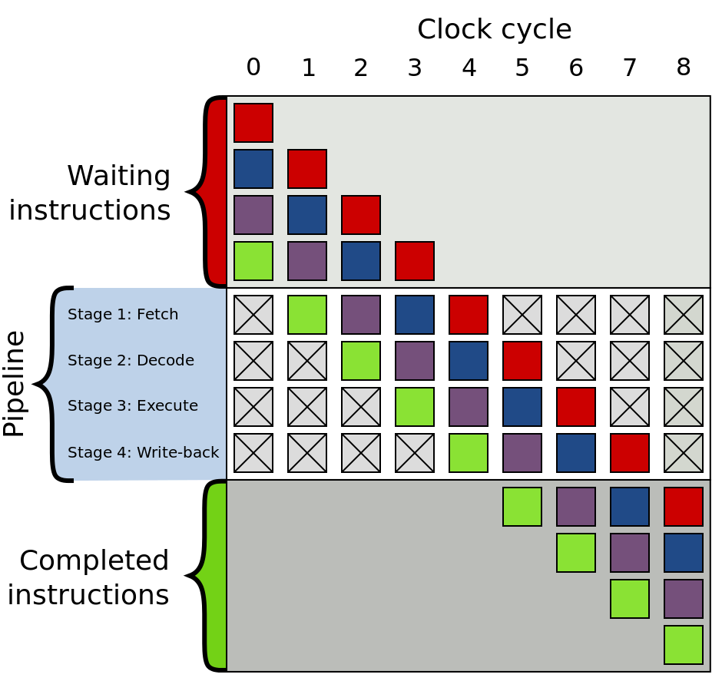
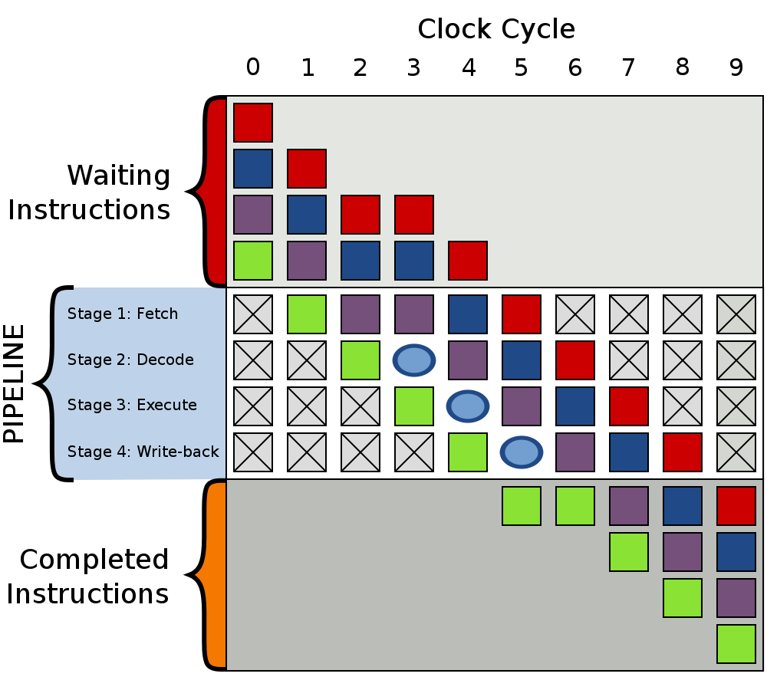
Pipelining
Process instructions in series
  Overlapping work in core to use all pieces
  simultaneously
Classic stages from 1956-61 IBM project
  Fetch
  Decode + register fetch
  Execute
  Memory access
  Register and memory writeback
AVR and PIC have 2 stages
Intel has up to 31 stages
Xelerated X10q has over 1000 stages!
Bubbles: caused by data dependencies, cache misses…
Notes:
From The i486 CPU: Executing Instructions in one clock cycle, Crawford

Slide 20
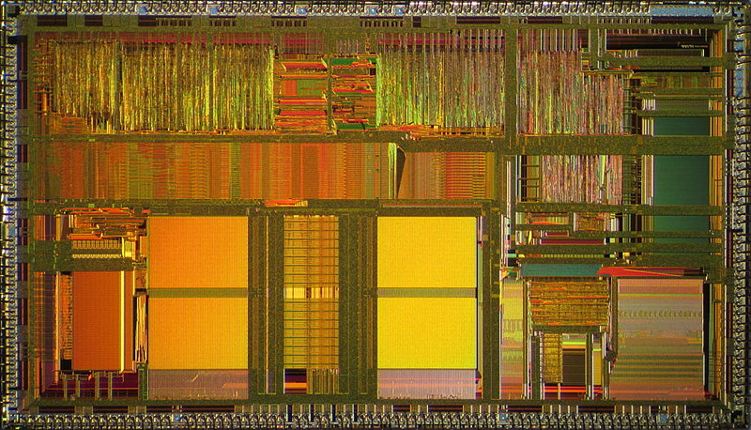
486 Pipelining details
486 had two decode cycles, allowing more complex decoding
Desired to get one instruction per clock
Needed cache to get data prepared
Pipeline:
  Fetch – when needed, get entire cache line
  Averages 5 instructions / 16 byte line
  Decode1 – process up to 3 instruction bytes
  Decode2 – finish decoding, compute addresses
  5 % of instructions need D2
  Execute – ROM microprogram executes instruction
  WriteBack – writeback to register file or RAM
Notes:
From The i486 CPU: Executing Instructions in one clock cycle, Crawford

Slide 21
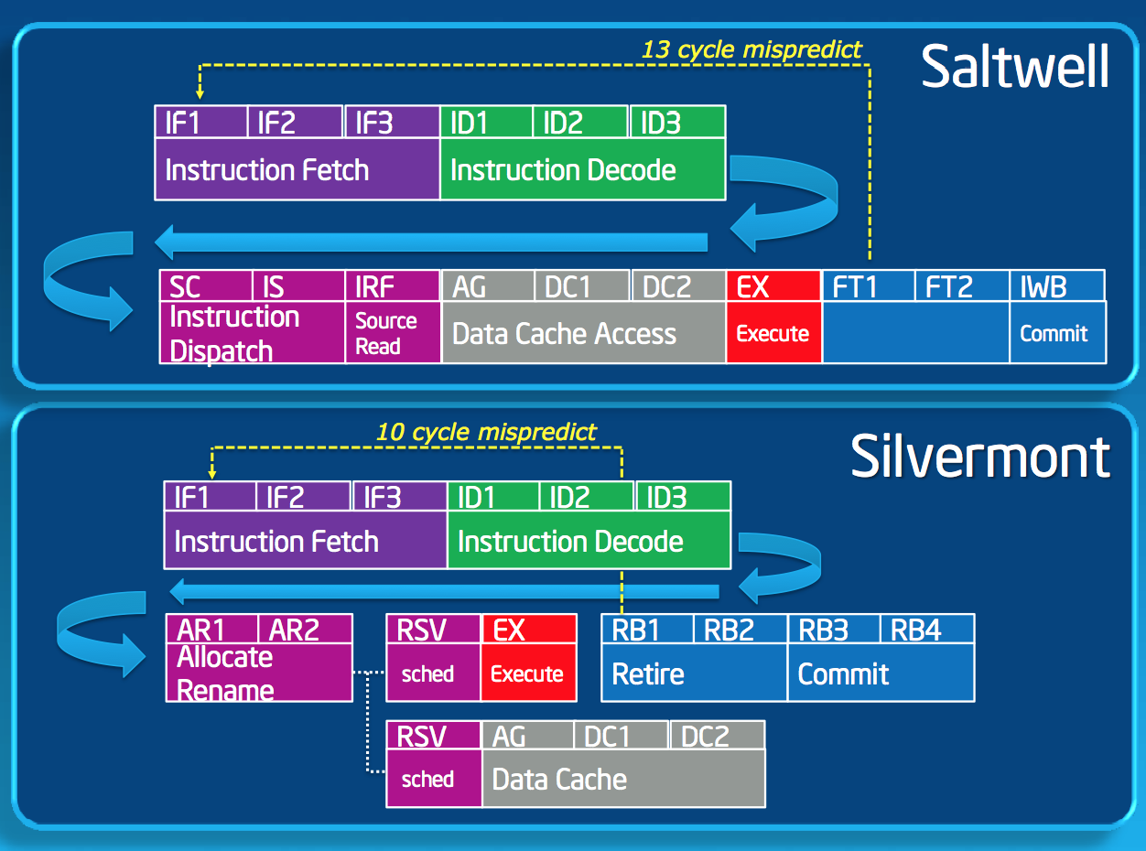
Modern pipelines
Pipelines getting longer (10-30 stages)
Branch prediction tries to keep
pipeline full by speculatively
executing code
Misprediction costly
  Must scrap work, refill pipeline

Slide 22
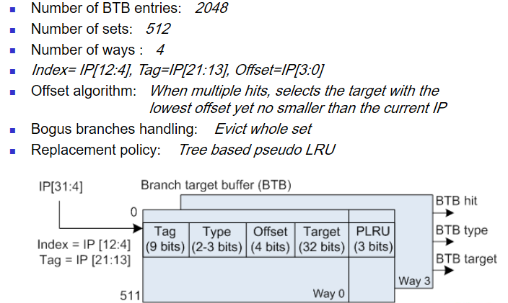
Branch prediction
To keep pipelines full, speculative execution via branch prediction
Branch Target Buffer (BTB) predicts where branch will go
Intel does not publish, people do reverse engineer via testing
One example:
Spectre attack tricks
the branch predictor
into leaking info
Notes:
Some details on reverse engineering them : https://xania.org/201602/bpu-part-three
http://slideplayer.com/slide/7969410/

Slide 23
1990s Intel CPUs
CPU | Year | D/A bits | Speed | trans/Feature
Pentium | 1993 | 32/32 | 60-300 M | 3.1M (4.5 MMX)/800nm | 1st superscalar design, dual integer pipelines, RDTSC, MSR, CUPID
Pentium Pro | 1995 | 32/36 | 200 MHZ | 5.5M / 350nm | Out of Order (OoO), 14 stage pipeline, 256KB L2 cache, conditional moves, PAE (64 GB RAM), microcode updatable, register renaming
Pentium II | 1997 | 32/36 | 450 MHZ | 7.5M / 350-180nm | 14 stage pipeline, MMX, Xeon, Celeron, 512 KB L2
Pentium III | 1999 | 32/36 | 1GHZ | 9.5-22M / 180nm | 10 stage pipeline, L2 on die
Single pipeline is scalar
Superscalar sends instructions through multiple parallel execution units
Out of order (OoO) – reorders (micro) ops on the fly to remove bubble adding dependencies from pipeline
  Both add to cost and complexity
Pentium FDIV bug led to Intel microcode update ability in following processors
Dual pipeline P5 had “U” and “V” integer pipelines. Certain instructions could only go in one,
and there were rules for pairing. Handwritten assembly was much faster than compilers.

Slide 24
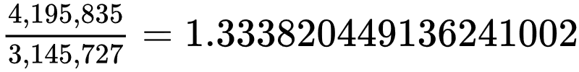
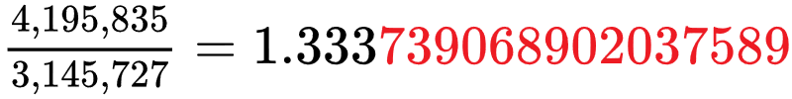
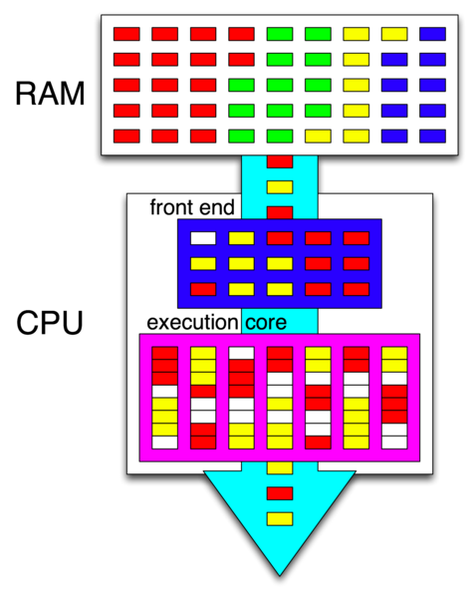
2000s Intel CPUs
Correct….
FDIV bug
CPU | Year | D/A bits | Speed | trans/Feature
Pentium 4 | 2000 | 32/36 | 2-3.2 GHZ | 42-188M / 180-90nm | 20 stages, Hyperthreading
Prescott (P4 variant) | 2004 | 64/48 |  | 125M/90nm | 64 bit, 31 stages
Pentium D | 2005 |  | 3.2 GHZ | 230M/65 nm | First dual core
Hyperthreading – Intel proprietary simultaneous multithreading
  OS sees two CPU cores where there is only one
  CPU core parallelizes performance via superscalar architecture
2005, Percival shows cache timing attacks between threads
First 64 bit x86 Intel chips
  Addresses 48 bit for now
  31 stages!
Instructions now 1 to 15 bytes in length! (well, technically, up to infinity length)
  Prefixes such as 0x66 (operand size override) can be repeated
  286 imposed 10 byte limit, 386 and higher impose a 15 byte limit
4 programs, 2 sending
Instructions, core executing
them as needed in multiple
virtual cores

Slide 25
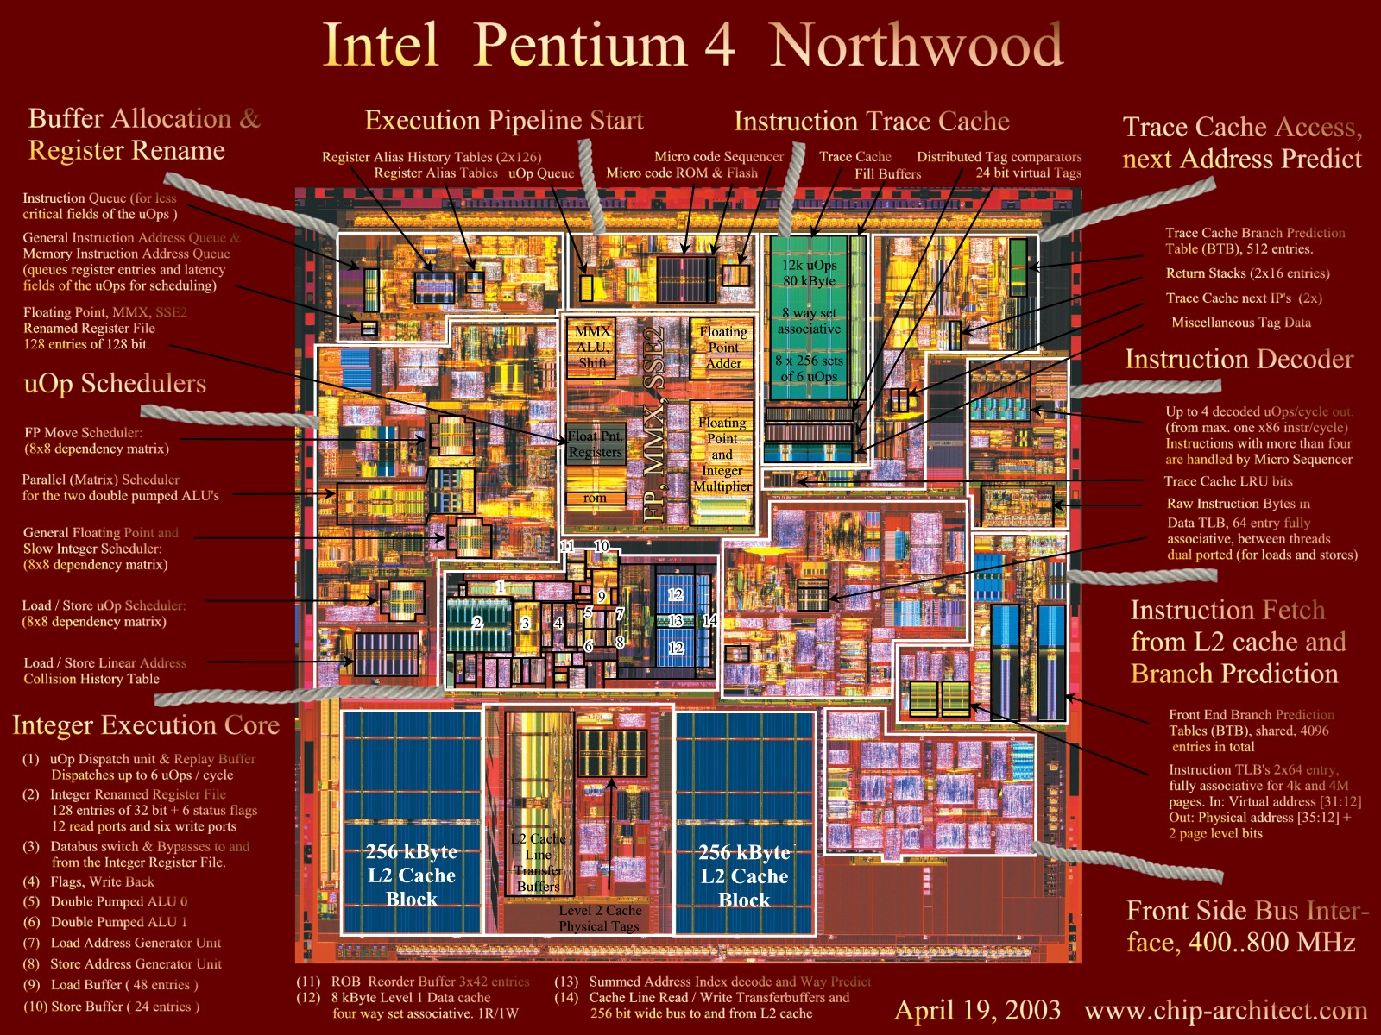

Slide 26
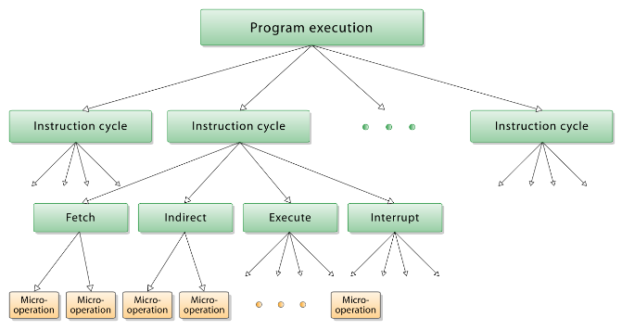
Intel Core i7
CPU | Year | D/A bits | Speed | trans/Feature
Nehalem | 2008 | 64/48 |  | 731M/45nm | First i7, 20-24 stage, DDR3, 4-12 MB L3 cache
Sandy Bridge | 2011 | 64/48 |  | 504M/32nm | 14-19 stages, 1500 decoded micro-op cache (instructions pass 5 stages if cached), added ring bus, most significant leap in 7 years
Skylake | 2015 | 64/48 |  | Billion?/14 nm TriGate | 1st to use DDR4
Coffee Lake | 2017 | 64/48 | 3.7 G(4.7 Turbo) | Billions+/14 nm TriGate
Instructions broken into micro-ops (uops) for reordering, execution
Ring bus: interconnect between Cores, Graphics, Last Level Cache, System Agent
  32 byte data ring, request ring, acknowledge ring, snoop ring
  Fully pipelined at core frequency
  Sophisticated distributed arbitration to handle coherency, ordering
  Each component has a “stop” on the ring bus
System Agent (houses traditional NorthBridge)
  PCI express, DMI, memory controller, Power control, thermal control
L3 cache 96 GB/s, ~30 cycles latency
Notes:
https://www.anandtech.com/show/3922/intels-sandy-bridge-architecture-exposed/4

Slide 27
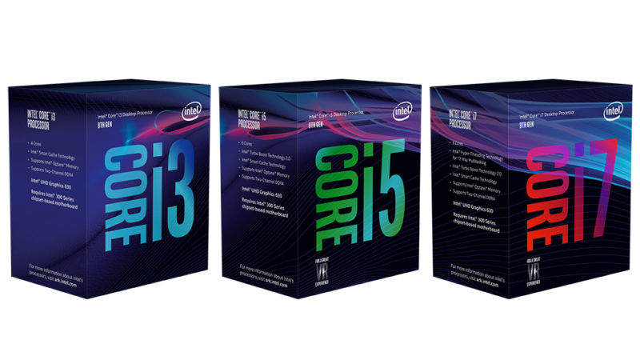
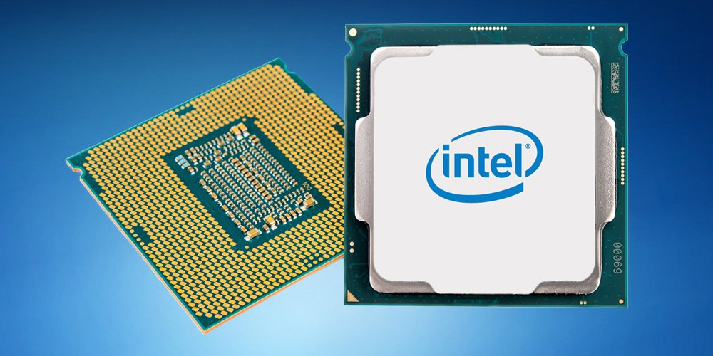
Oct 2017: Intel 8th gen 8700K
6 cores, 12 threads
MMX, AES-NI, CLMUL, FMA3, SSE, SSE2, SSE3, SSSE3, SSE4, SSE 4.1, SSE 4.2, AVX, AVX2, TXT, TSX, SGX, MPX, VT-x, VT-d
3.7 GHZ clock (4.7 G Turbo mode)
GPU 630 (1.2 GHZ, 24 units, 4K 60fps, H265, VP9, DP 1.2, HDMI 2.0, HDCP 2.2,Directx 12, OpenGL 4.5, 3 displays)
PCI Express 3.0, 1x16 or 2x8 or 1x8 + 2x4 lanes
L1 64 kB/core (32 Data, 32 Instruction), 8 way set assoc
L2 256 kB/core, 4 way set assoc
L3 12 MB shared, up to 16 way set assoc
L4 128 MiB (Iris Pro GPU only)
Bus 8 GT/s DMI3
95W
37.5x37.5 mm die size
DDR4-2666, up to 64 GB, 2 channels

Slide 28
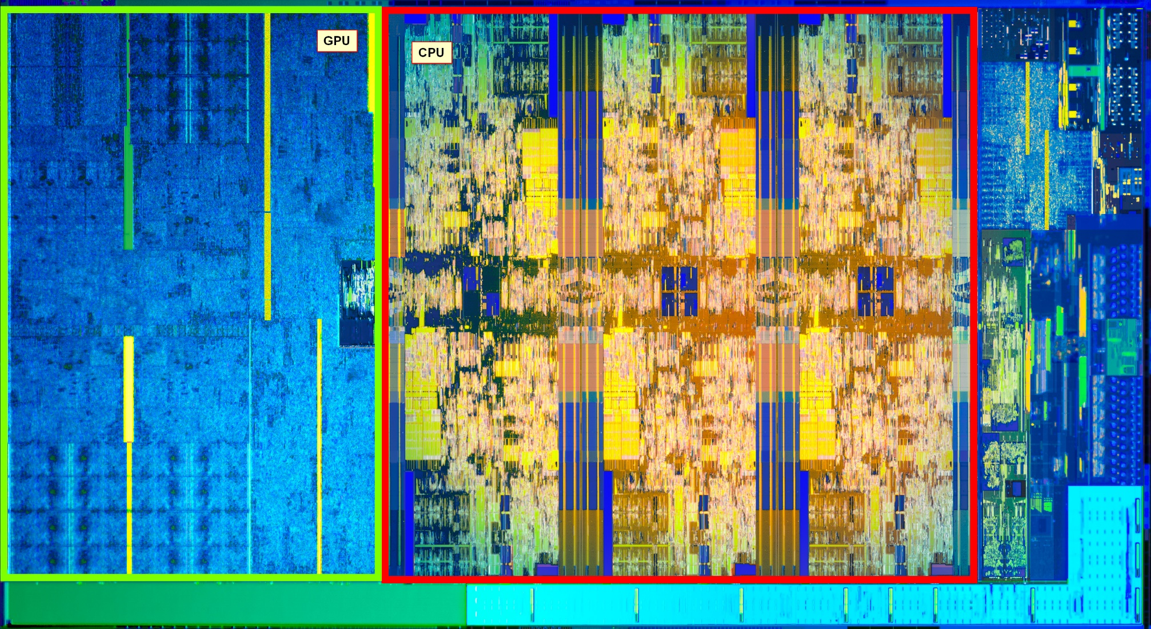
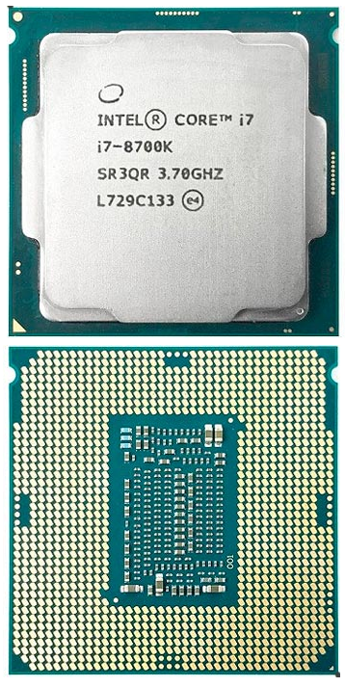
8700K

Slide 29
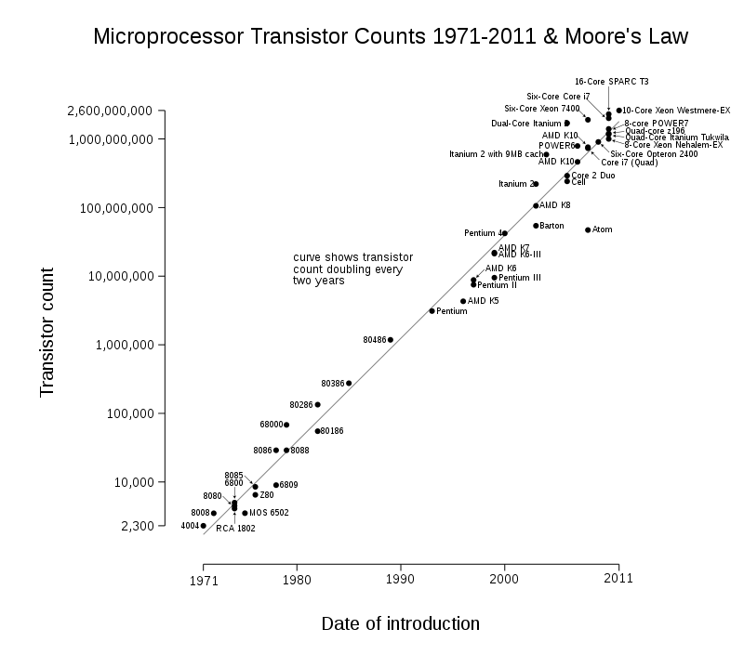

Slide 30
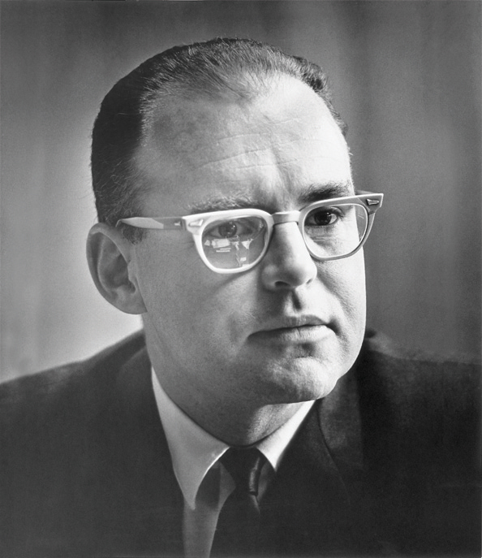
End of Moore’s law?
Plenty of good, accurate articles
  Scientific American, Wired
Physics:
  1985: 1000nm feature
  2018: 14 nm feature
  Silicon atom: 0.2 nm
  Quantum mechanics: smaller features “fuzzier”
  5 GHZ: light travels 6cm per clock tick, electricity ~80% of this in wire.
    Cannot have RAM too far from CPU
  CPU Die size ~ 400 mm^2, so light speed an issue for higher clocks
  Heat hard to remove, so lower voltage, moving to diamond substrates, etc…
Economics
  $8B for current fab plant.

Slide 31


Meltdown and Spectre
20 year old flaws in many, many chips,
  Intel, ARM, AMD, IBM, more
Found by researchers from four teams during 2017
  Intel, Google, Amazon, AMD, Microsoft, Apple, others
  working behind closed doors to fix
  Publicly disclosed early Jan 2018
Biggest chip security flaw probably ever
Will likely cost billions in liability for many companies
Technical read: https://googleprojectzero.blogspot.com/
Notes:
Good read https://googleprojectzero.blogspot.com/

Slide 32
Meltdown
“Melts” boundaries between hardware enforced security layers
User mode programs can read kernel mode data.
Affects:
  Software: Windows, Linux, iOS, macOS, cloud services, Android, others
  Hardware: Intel x86/64, most ARM, IBM Power, others
Not affected: CPUs not doing speculative execution
  Many Qualcomm, some ARM, Raspberry Pi
Not hard to do.
CVE-2017-5754 : rogue data cache load

Slide 33
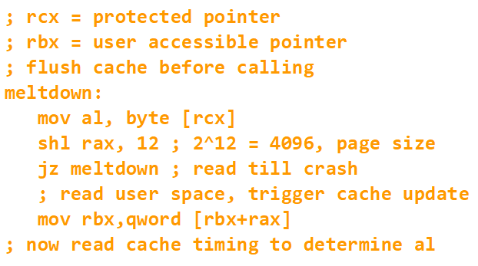
Meltdown details
Idea:
  Speculatively execute instruction reading protected memory
  Use speculative data to load cache line of unprotected memory
  Read fails, cache line still touched
  Look at cache timing to leak protected data

Slide 34
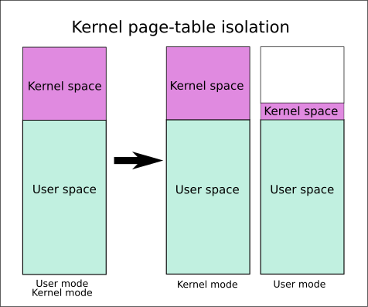
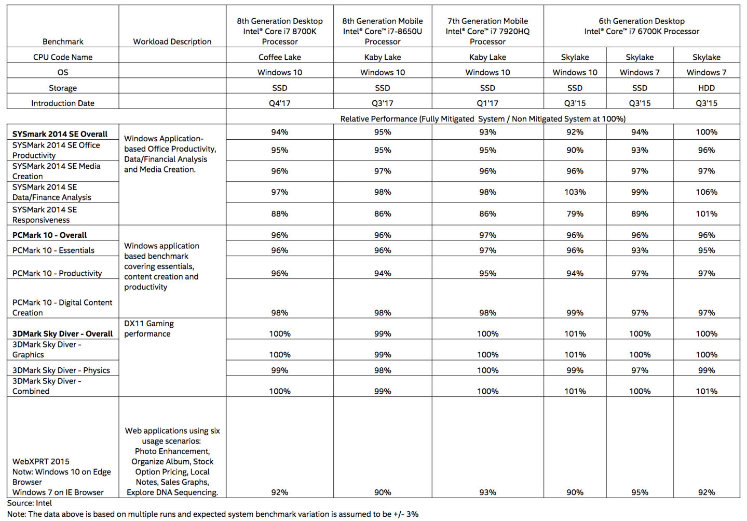
Meltdown fix
Requires kernel changes, isolating kernel
memory from user, KPTI
Context switch requires changing
page tables, incurs performance hit
Recent patches to Windows,
Linux, iOS, others
Intel microcode patch to help
mitigate
Speculation on performance
  Mostly negligible, depends on workload

Slide 35
Spectre
Breaks the isolation between applications
  Attacker can trick error-free programs into leaking their secrets
Affects:
  Software: Windows, Linux, iOS, macOS, cloud services, Android, others
  Hardware: Intel x86/64, AMD, most ARM, IBM Power, others
Not affected: CPUs not doing speculative execution
  Many Qualcomm, some ARM, Raspberry Pi
Hard to exploit, but also much harder to fix than meltdown.
  Requires careful code analysis and recompilation
CVE-2017-5753 : bounds check bypass
CVE-2017-5715 : branch target injection

Slide 36

Spectre details
Spectre: name from “Speculative Execution”, note branch
Tricks branch predictor to mispredict
safety check
Use mispredicted value to speculatively
read data, taint cache
Leaks data
Ironically, security checks in code made this easier to do
Proof-of-concept JavaScript exploit allowed browser to read user process data
Google patched Chrome to address it, other vendors patched also

Slide 37
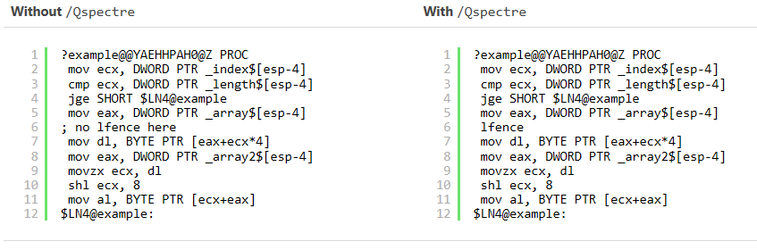
Spectre “fix”
Require code changes to insert “barriers” between
certain actions
Hardened browsers against JavaScript
LLVM patch, ARM speculation barrier header
MSVC has a fix, using /Qspectre switch
Notes:
In MSVC https://blogs.msdn.microsoft.com/vcblog/2018/01/15/spectre-mitigations-in-msvc/

Slide 38
Vendor Fixes
Intel
  Working on mitigations via microcode updates
Apple
  iOS, macOS High Sierre, tvOS, Safari on Sierra and El Capitan
  Addresses Meltdown, Spectre to some extent
Microsoft
  Windows 10, 8, Server 2012, Windows 7, Windows Server 2008
  X64 only?
  Meltdown and Spectre variant 1 only, not variant 2
Google
  Pushing “retpoline” binary modification to others to mitigate Spectre
Amazon
  Rolled out new, slower virtual machine infrastructure.
Linux
  Patches to 4.4 and 4.9 trees
  Addresses Meltdown only
Many others

Slide 39
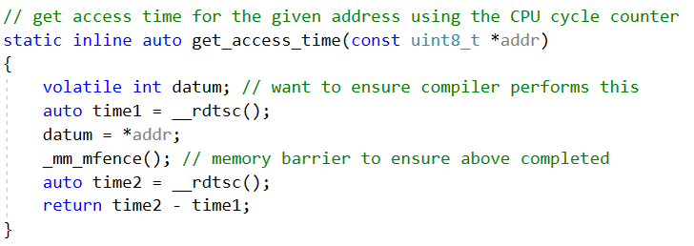
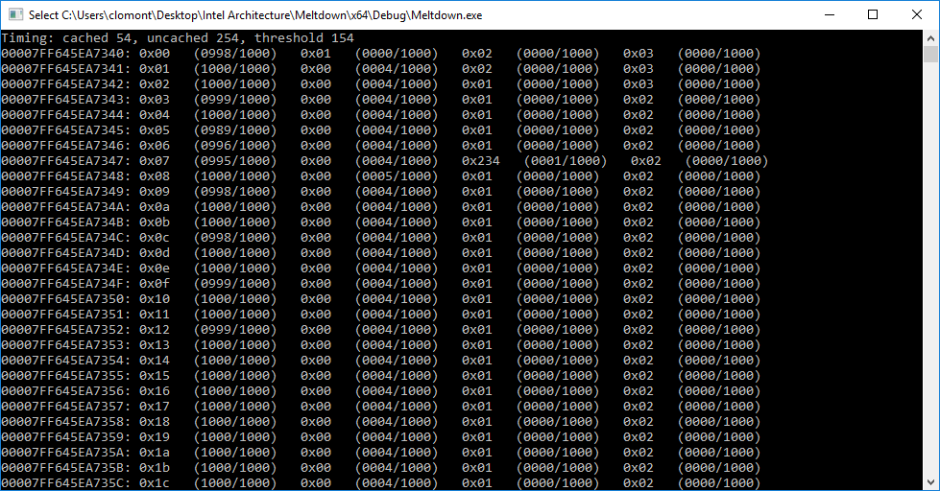
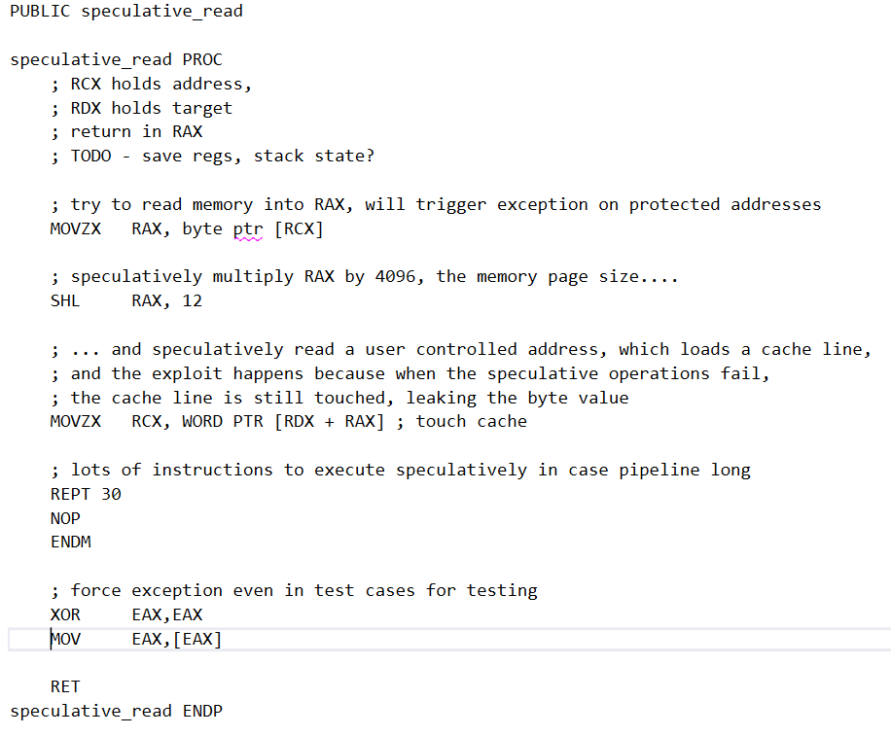
Meltdown demo
Steps:
Compute cached/uncached timing threshold
Prepare user memory
For each byte to test
  do ~1000 times:
    Flush cache
    Speculate
    Tally cache timing
  Pick most likely value for this byte
Code on GitHub: https://github.com/ChrisLomont/Meltdown

Slide 40
Questions?
Notes:
More sources
http://ssyes.com/ssyes/articles/intel_recent_history_of_intel_architecture.pdf
https://en.wikipedia.org/wiki/X86_instruction_listings

