Slide 1
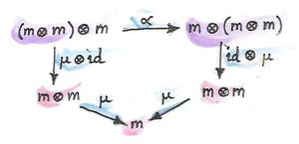


Introduction to Functional Programming using F#
Chris Lomont, PhD
Magic?
Senior Principal Engineer
Logikos Inc. Fort Wayne, IN
http://www.logikos.com
clomont@logikos.com
chris@lomont.org

Slide 2
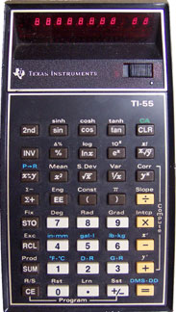
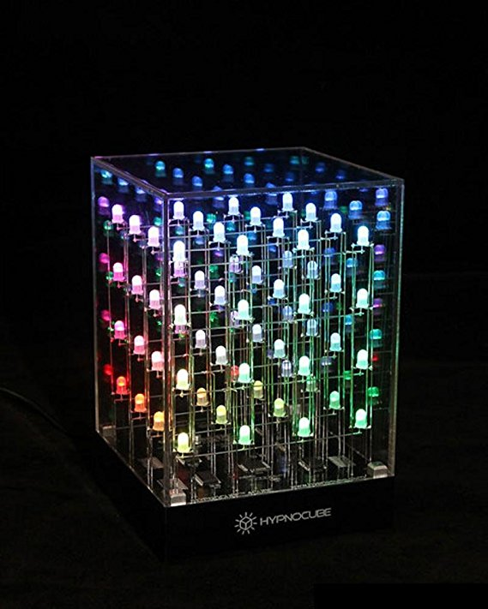
About me
Programming since 4th grade (TI-55!)
  Soon moved to TRS-80 Color Computer
Studied math, CS, physics, economics
Worked in too many areas to cover
  Some: 3D, games, science, DoD, security, algorithms
Co-founder of Hypnocube, LLC
Functional Programming since Mathematica 1.0 in 1988
Works for Logikos, Inc, Fort Wayne, IN

Slide 3

About Logikos
Software Services
  Fort Wayne, IN
  Founded 1978
Areas
  Embedded
  Desktop
  Web Applications and Design
  Mobile Applications
  Software Testing
Clients
  Automotive
  Commercial Services
  Consumer Electronics
  Govt and DoD
  Medical
  Retail
  Others

Slide 4
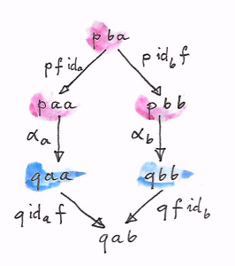
Talk Purpose
Illustrate the power of functional programming
Functional programming languages claim to be
  quicker for development
  less errors
  smaller code
  easily maintainable
Illustrate functional programming features via F# .NET

Slide 5
Talk Overview
I. Functional programming overview
II. F# syntax and examples
III. Mind-bending topics

Slide 6
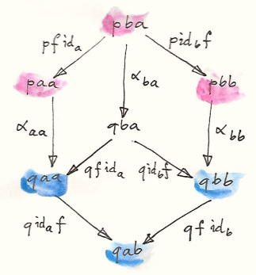
Functional Overview

Slide 7
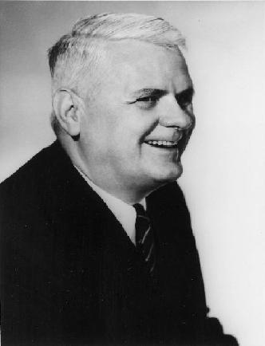
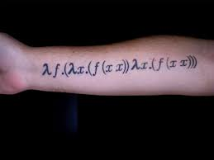

Theoretical Foundations
The Lambda Calculus
  Alonzo Church (1903-1995), 1930 “What is computable?”
  Simplifies math expressions into lambda expressions
  Church-Turing Thesis
    Any computation can be done Turing machine
    Any computation can be done with general recursive functions (in lambda sense)
Lambda functions (named from the $λ$)
  $λx.x+1$
  Means take x as input, output x+1
  Called pure functions
  Have no state
  Also known as anonymous functions
A very famous lambda function
defining recursion
Notes:
Church, Turing working on what is computable in response to Hilbert’s Problems

Slide 8
Functional Programming at a High level
Functional | OO, Imperative
Stateless functions | Functions mutable
No side effects | Side effects everywhere
Thread safe | Hard to make thread safe
Scalable | Harder to scale
Easy to test | Harder to test
Composable | Not designed to be composable
Higher order functions (functions as data) | Functions and data separate
Immutable data (persistent data structures) | Mutable items default
Evolved from pure functions
Goal: separate pure and impure parts of program

Slide 9
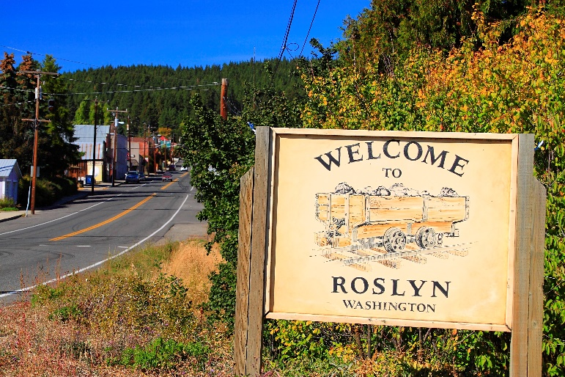
Example: Roslyn C# Compiler
C# compiler, written in C#
  https://github.com/dotnet/roslyn
Provides compiler as a service
Main data structures are functional programming based
Syntax Tree (red-green tree, from maker board colors used)
  Immutable
  Persistent – allows keeping most of tree when edit made to buffer
    https://blogs.msdn.microsoft.com/ericlippert/2012/06/08/persistence-facades-and-roslyns-red-green-trees/
Notes:
Child knows parent via nice trick. Two trees – one built bottom up, log n per edit. Oher built complete each pass top down to sync two

Slide 10
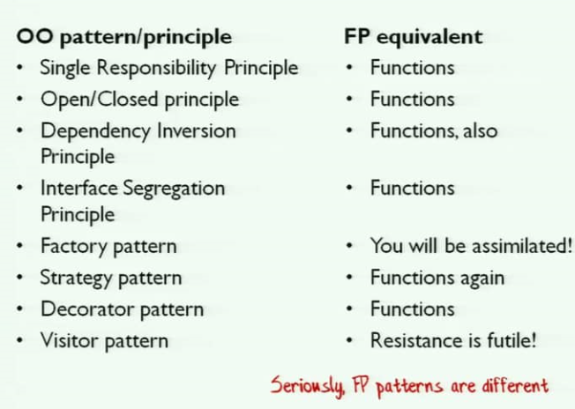
Example: Design Patterns
Gang of Four – 23 patterns
“Patterns are simply workarounds for C++ not being expressive” - Paul Graham ,2002
Peter Norvig demonstrated 16 of the 23 are simplified or eliminated in Lisp or Dylan
Scott Wlaschin

Slide 11
Functional Programming Languages
Functional languages
  Lisp, Haskell, SML, Clojure, Scala, Erlang, F#
Functional with OO features
  OCaml, F#, Scala
Imperative languages with functional features
  Python, Ruby, C#, Java
“Modern functional languages are nontrivial embellishments of the lambda calculus”
– Paul Hudak (1989)

Slide 12
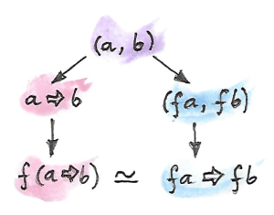
F# Syntax and Features

Slide 13
What is F#?
Statically typed functional first language
Took OCaml and added C# and .NET glue
Mixed Language
  Supports Functional, OO, Imperative
F# is to C# (CLR) what Scala is to Java (JVM)
module List =
let rec insertions x = function
| [] -> [[x]]
| (y :: ys) as l -> (x::l)::(List.map (fun x -> y::x) (insertions x ys))
let rec permutations = function
| [] -> seq [ [] ]
| x :: xs -> Seq.concat (Seq.map (insertions x) (permutations xs))

Slide 14
F# History
Created by Cambridge MS Research, led by Don Syme
(Benevolent Dictator for Life)
  Theorem proving => ML (Meta Language)
  ML => CAML
  CAML => OCaml
  OCaml + C# + .NET + ??? => F#
Versions
  1.0 VS2005, separate download
    Functional, types, modules
  2.0 VS2010, built in
    Active patterns, Units of Measure, async
  3.0 VS2012, built in
    Type Providers
  4.0 VS2015, built in
    printf interpolation
  4.1 VS2017, built in
    Struct tuples, numeric underscores
Notes:
Syme put generics into .NET and C# v2.0, without it, would have subpar Java generics

Slide 15

F# (and functional) Features Migrating to
C# and other languages
F# 1.0 implicitly typed locals (var in C# 3.0, auto in C++ 11, others)
F# 1.0 lambda functions added to C# v2.0, C++ 11, PHP 5.3.0, Delphi 2009
F# 2007 async workflows added to C# 2012
  Migrated to many languages since over since
Functionals
LINQ
Expression valued items
Pattern matching
Tuple construction/deconstruction in C # 7
Expression bodied members
Exception filters
Auto property initializers
Task Parallel Library
Non-nullable types (scheduled for C# 8.0?)

Slide 16
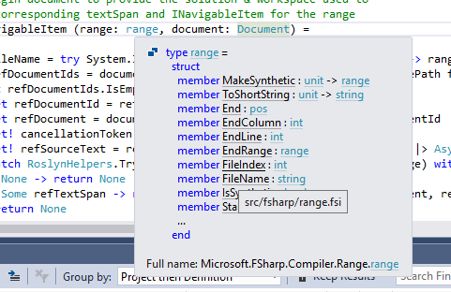
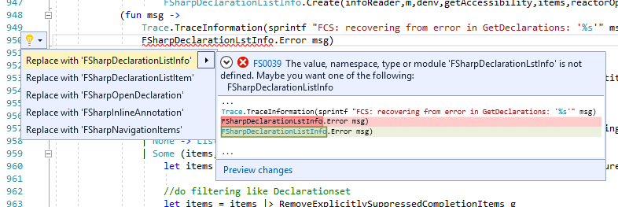
Why Use F#?
F# benefits
  Works well with .NET , easy to integrate
  Modern IDE
    Debugger support
    Intellisense
  F# REPL window in VS
Power of multicore
Notes:
Functional benefits
Smaller code
Correctness
Faster to develop
Time to market
Helps tame complexity

Slide 17
C# vs F# Example 1
C#
F#
namespace Math
{
public static class Helpers
{
public static int Add( int x, int y)
{
return x + y;
}
}
}
let add x y = x + y

Slide 18
C# vs F# Example 2 : Map / Reduce
// map / reduce C#
public static
IEnumerable<R> Map<T,R>
(this IEnumerable<T> xs, Func<T,R> f)
{
foreach (var x in xs)
yield return f(x);
}
public static R Reduce<T,r>
(this IEnumerable<T> xs, R init, Func<R,T,R> f)
{
var current = init;
foreach (var x in xs)
current = f(furrent,x);
return current;
}
// map / reduce F#
let map f xs = seq {
for x in xs do
yield f x
}
let reduce f init items =
let mutable current = init
for item in items do
current <- f current item
current
Notes:
Don’t iterate over lists – map and reduce

Slide 19
F# Syntax
(* comment between *)
// comment to end of line
/// XML doc comments here
Comments
Variables
  type inference
  immutable
let result = 1 + 8 // auto type inference
let s = "bob"
let pi = 3.14159265
let b : byte = 123 // can specify type
let a, b, c = 1.0, "text" , result*4

Slide 20
Lists and Arrays
let list1 = [ "a"; "b" ]
let list2 = "c" :: list1 // :: is prepending
let list3 = list1 @ list2 // @ is concat
let list4 = [] // empty list
let list5 = 2 :: [3; 5; 7; 11] @ [13; 17; 19; 23]
Lists
  Singly linked
  Immutable
Arrays
  Fixed size
  Mutable
let array1 = [| "a"; "b" |]
let first = array1.[0] // Indexed using dot
// slicing
let tenSquares = [| for i in 1..10 -> (i,i*i) |]
let firstHalf = tenSquares.[..5]
let secondHalf = tenSquares.[6..]
let mid = tenSquares.[2..6]

Slide 21
Sequences
Sequences
  Lazy
  Unbounded
  Enumerable
let seq1 = {1..10} // seq[1;2;3;...;10]
let seq2 =
seq {
yield 1 // adds element
yield! [5..10] // adds subsequence
}

Slide 22
Range and comprehensions
Range
  Start, stop
  Step size
Comprehension
  Construct list from function
let as = [ 5..8 ] // [5;6;7;8]
let xs = [ 1..2..9 ] // [1;3;5;7;9]
let ys = [| for i in 0..4 -> 2 * i + 1 |]
let zs = List.init 5 (fun i -> 2 * i + 1)

Slide 23
Tuples
Containers for a few things
Typed groups of values
Trivial to make and deconstruct
// Tuple construction
let wizard = ("Merlin",87)
// type is string * int
// deconstruction
let (name,age) = wizard

Slide 24
Records
// Declare a record type
type Person = { Name : string; Age : int }
// Create a value via record expression
let paul = { Name = "Paul"; Age = 28 }
// 'Copy and update' record expression
let paulsTwin = { paul with Name = "Jim" }
let isPaul person =
match person with
| { Name = "Paul" } -> true
| _ -> false
Named type
Sealed
Immutable
Patterns
Structural ==

Slide 25
Functions
// functions return the last item in the function
let negate x = x * -1
let square x = x * x
// functions have types
let add x y = x + y // type int -> int -> int
let add3 = add 3 // type int -> int
let sumSquares x y =
let sq z = z*z // local functions
sq x + sq y
Are values
Type inference
Composable

Slide 26
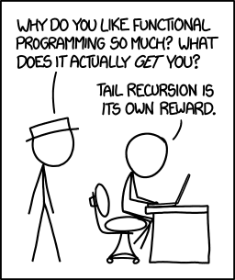
Recursive functions
let rec factorial x =
if x < 1 then 1
else x * factorial (x - 1)
Tail recursion
List example
let rec sum list = // decompose (::) operator
match list with // pattern matching
| [] -> 0
| x :: xs -> x + sum xs
XKCD #1270

Slide 27
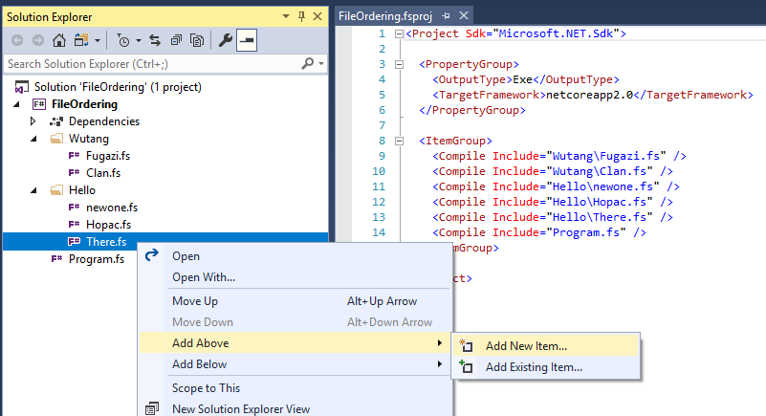
Type inference
Generic
Automagic
File order in compilation important
  Deduces types
  No circular dependencies
let pack a b = (a, b)
// type 'a -> 'b -> 'a * 'b

Slide 28
Options
option > nulls
Prevents ignoring bad return values
Compiler forces pattern matching to cover every case
// Built in 'option' widely used
type 'T option =
| None
| Some of 'T

Slide 29
Pattern Matching
Very powerful
  Switch statement on steroids
Complete! Cannot ignore None in an Option
let checkList lst =
match lst with
| [] -> printfn "Empty"
| [e] -> printfn "One element: %O" e1
| 1 :: xs -> printfn "Start with 1"
| _ :: x :: xs -> printfn "Second element %O" x
| _ -> () // do nothing

Slide 30
Active Patterns
Extend matching programatically
(* parameterized active patterns *)
let (|DivisibleBy|_|) by n =
if n % by = 0 then Some DivisibleBy else None
let fizzBuzz = function
| DivisibleBy 3 & DivisibleBy 5 -> "FizzBuzz"
| DivisibleBy 3 -> "Fizz"
| DivisibleBy 5 -> "Buzz"
| i -> string i

Slide 31
Discriminated Unions
type Tree<'T> =
| Tree of Tree<'T> * 'T * Tree<‘T>
| Leaf of 'T
let rec depth tree =
match tree with
| Tree(l, _, r) -> 1 + max (depth l) (depth r)
| Leaf(_) -> 1
let rec size = function
| Tree(l, _, r) -> 1 + size l + size r
| Leaf(_) -> 1
Disjoint unions

Slide 32
Pipeline, partial application, composition
Composes
functions
// pipe |>
let ``square, negate, then print`` x =
x |> square |> negate |> print
let sumOfLengths (xs : string []) =
xs
|> Array.map (fun s -> s.Length)
|> Array.sum

Slide 33
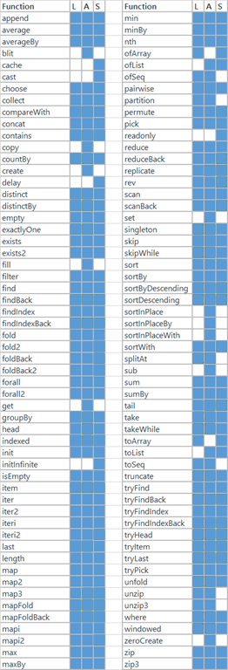
Useful list, array, seq functions
Rich set of (mostly) orthogonal helpers
  find, map, filter, partition, zip, reduce, exists, …
(* list, seq, array functions *)
let prod = [1..10] |> List.fold (*) 1
let vals = {1..10} |> Seq.map (fun x->x*x+1)
let odds = [1..10] |> List.filter (fun x-> (x%1) = 0)
let (o,e) = [1..10] |> List.partition (fun x-> (x%1) = 0)
let all = List.zip odds evens
Notes:
Grid at
https://blogs.msdn.microsoft.com/fsharpteam/2014/11/12/announcing-a-preview-of-f-4-0-and-the-visual-f-tools-in-vs-2015/

Slide 34
Conditionals
// bad
let f x =
if x = 1
then "a"
else "b"
// good
let f x =
match x with
| 1 -> "a"
| _ -> "b"
if/then/else
Don’t use ‘if’
  Use ‘match’

Slide 35
Loops
Loops
Use recursion
or functions
instead
let weirdo =
for i = 1 to 49 do
printfn "%d" i
let mutable j = 50
while j <= 100 do
printfn "%d" j
j <- j + 1

Slide 36
Exceptions
let divide x y =
try
try
(x+1) / y
finally
printf "this will always be printed"
with
| :? System.DivideByZeroException as ex ->
printfn "%s" ex.Message; 0
try/with/finally
Exception
filtering

Slide 37
Classes
Inheritance
Upcasting
  Compile time
Downcasting
  Run time
type Animal() =
member __.Rest() = ()
type Dog() =
inherit Animal()
member __.Run() =
base.Rest()
// upcasting :>
let dog = Dog()
let animal = dog :> Animal
// downcasting :?>
let shouldBeADog = animal :?> Dog

Slide 38
Example : Quicksort
let rec sort(lst: int list) =
match lst with
| [] -> lst
| [x] -> lst
| hd:tl -> let less,greater = List.partition ( (>=) hd ) tl
[sort(less)] @ [hd] @ [sort(greater)]

Slide 39
F# Features : Type Providers
Code generation
Working cleanly with structured data automatically
Hooks into the compiler and IDE
  Intellisense, code errors
  Static typing of items in the structure
Takes a while to see the power
Many existing
  CSV, HTML, XML, JSON, HTTP, Semantic Web, World Bank, web services, data markets, much more

Slide 40

F# Features : Units of Measure
Mars climate orbiter fail
  Failed to translate English units into metric
Units of Measure
  Enforces unit consistency
[<Measure>] type degC
[<Measure>] type degF
let convertDegCToF c =
c * 1.8<degF/degC> + 32.0<degF>
let f = convertDegCToF 0.0<degC>
// type float<degC> -> float<degF>

Slide 41
Performance
F# code performs similarly to C#
From https://benchmarksgame.alioth.debian.org

Slide 42
Dos and Don’ts
  Don’t use mutable keyword
  Don’t use for loops
    Use recursion instead
  Don’t use if then else
    Use pattern matching instead
  Don’t use dot notation
    Use little functions, pipes
  Don’t use classes
    Use tuples, records, unions
  Don’t rely on debugger
    Compiler finds more errors for you
  Do create little types
    Especially unions
  Do use list and seq types
    Learn fold and map well!
  Eventually replace recursion with fold
  Do use pipe |>
  Do use composition >>
  Do develop incrementally, using interactive window

Slide 43
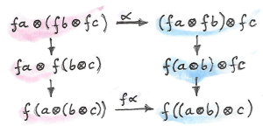
Mind Bending

Slide 44
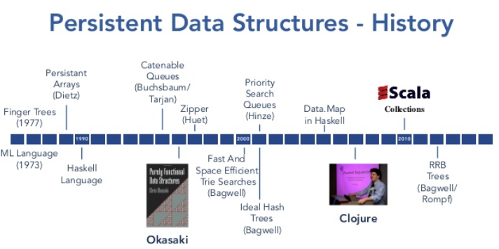
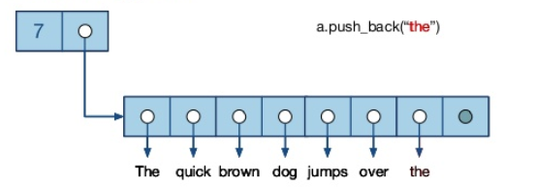
Data structures
How to make immutable lists? Trees?
Example: appendable vector
Want to push back, want immutable!
Idea: make a new one! (but slow, too much memory!)
Solution: Wizardry!

Slide 45
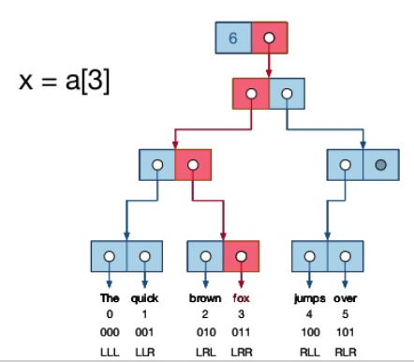
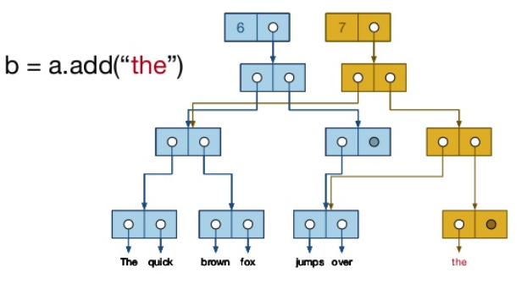

Data structures
Replace vector with tree:
But trees $O\left(\log{n}\right)$, not $O\left(1\right)$
Use 32-way trees, then
  $O\left(\log_{32}{n}\right)\sim O(1)$
  More tricks to make faster
    Local mutable, global immutable…
  No locking, parallelizable

Slide 46
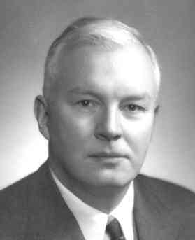

Currying
Converts function of multiple arguments into function of one argument
Then everything can be thought of as a function of one variable
Named from Haskell Curry (1900-1982)
$\left(x,y\right)⇒x+y$ curried into $x⇒(y⇒x+y)$
Allows reusing pieces in a much more
composable manner

Slide 47

Y-Combinator
Functional that recurses any function
Discovered by Haskell Curry
$$Y ≔λf.\left(λx.f\left(x x\right)\right)\left(λx.f \left(x x\right)\right)$$
$Yg=λf.\left(λx.f\left(x x\right)\right)\left(λx.f \left(x x\right)\right)g$ (1)
$=\left(λx.g\left(x x\right)\right)\left(λx.g \left(x x\right)\right)$ (2)
$=g\left(\left(λx.g\left(x x\right)\right)\left(λx.g\left(x x\right)\right)\right)$
$=g\left(Y g\right)$
$=g\left(Y g\right)=g\left(g\left(Y g\right)\right)…=g(…g\left(Y g\right)…)$
(1) apply function: $f$ gets replaced with $g$
(2) apply first function to second arg: get $g\left(x x\right)$ with $x⇒\left(λx.g \left(x x\right)\right)$
Let’s you write a Y-Combinator function, that recurses on any function fed to it

Slide 48
Contravariant/Covariant
C# uses the concepts of contravariance and covariance
How parameters do up/down casting, how assignments work
// type relations are an "arrow" : derived from, assignable
// allowed, object <- string
object obj = "string"
// covariance preserves arrows
// Allowed: IE<obj> <- IE<string>
IEnumerable<object> objects = List<string>
// ERROR! Disallowed! Cannot do IE<obj> -> IE<string>
IEnumerable<string> strings = List<obj>
// contravariace reverses arrows
Action<object> objAct = function taking object
Action<string> strAct = funtion taking a string;
// Allowed: A<obj> -> A<str>
strAct = objAct;
// ERROR! Disallowed! Cannot do A<obj> <- A<string>
objAct = strAct;

Slide 49
Covariant/Contravariant
cat
fish
IE<cat>
IE<fish>
IEnumerable<T>
animal
file
IE<animal>
IE<file>
object
IE<object>
Covariant = preserves arrows
cat
fish
A<cat>
A<fish>
Action<T>
animal
file
A<animal>
A<file>
object
A<object>
Contravariant = reverses arrows

Slide 50
Contravariant/Covariant
This leads to the concept of category theory
A category is a collection of things with arrows that compose
IEnumerable and Action are functors
  functors: map things with arrows to things with arrows
  Many, many things in programming are functors
Understanding some of this gives powerful tools to reason about systems
“Category theory is type theory” – Abraham Lincoln

Slide 51

Category Theory
Gives large expressive power if you build interfaces “correctly”
Example:
Monoids - set with binary operation and unit
  Integers, +, 0
  Integers, *, 1
  Strings, +, “”
  Lists, concat, []
  Generalized…..
Lots more terms ☺
  Duality, morphisms,
  Functors galore
  Products – simply a pair of items
  Coproducts – the “dual” of a product
  Monads
  Kliesi arrows
Railway Oriented Programming

Slide 52
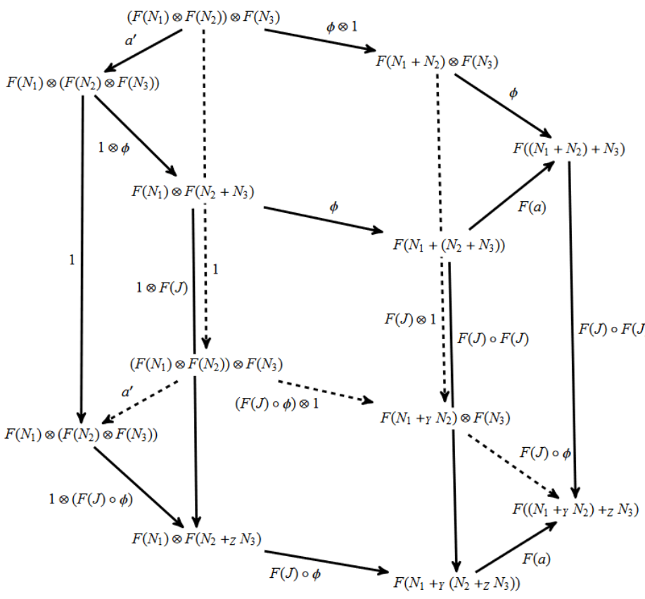
Questions?
A Bicategory of Decorated Cospans

Slide 53
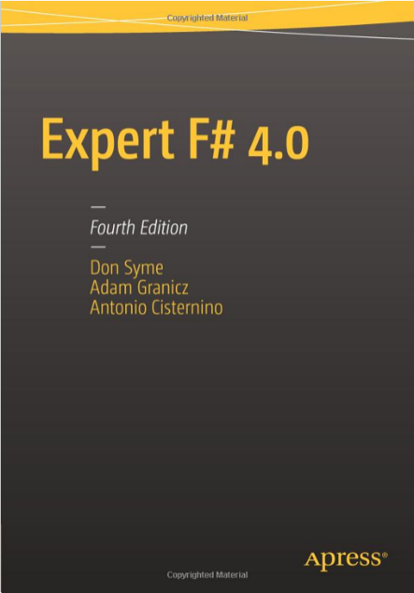
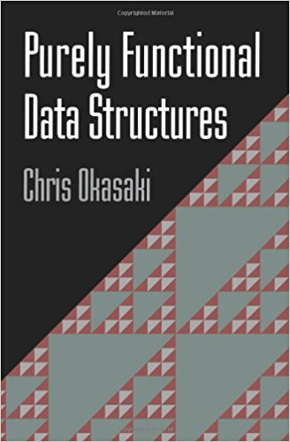
Sources and Resources
Good talk on F# : https://channel9.msdn.com/blogs/pdc2008/tl11
https://fsharpforfunandprofit.com/
Expert F# 4.0 – Don Syme book
Purely Functional Data Structures - Chris Okasaki book
Category Theory for Programmers – Bartosz Milewski https://bartoszmilewski.com/2014/10/28/category-theory-for-programmers-the-preface/
Railway Oriented Programming - Scott Wlaschin: https://www.slideshare.net/ScottWlaschin/railway-oriented-programming
Efficient Immutable Data Structures – Tom Faulhaber, https://www.slideshare.net/tomfaulhaber/efficient-immutable-data-structures-okasaki-for-dummies
Slide theme from SoftUni Team: http://softuni.bg

Slide 54
TODO – extra slides
Books and sources,
Add pics to slides (category stuff)
Example translating C# to F#
TODO if can find
Quick example of reducing C# code to F# by removing unnecessary syntax
Books, bring them
Data structures example
Explain how works (lists, trees, issues)

Slide 55
Examples : Perfect tic-tac-toe
let wins = [[1;2;3]; [4;5;6]; [7;8;9]; [1;4;7]; [2;5;8]; [3;6;9]; [1;5;9]; [3;5;7]]
let Contains number = List.exists (fun n -> n = number)
let ContainsList list = List.forall (fun n -> list |> Contains n)
let Except list = List.filter (fun n -> not (list |> Contains n))
let Available (p : int list) (o : int list) = [1..9] |> Except (List.append p o)
let IsWin (squares: int list) = wins |> List.exists (fun w -> ContainsList squares w)
let IsDraw player opponent = List.isEmpty (Available player opponent)
let rec Score (player: int list) (opponent: int list) =
if (IsWin player) then 1
else if (IsDraw player opponent) then 0
else
let opponentsBestMove = BestMove opponent player
let opponentsNewPosition = opponentsBestMove::opponent
- Score opponentsNewPosition player
and BestMove (player: int list) (opponent: int list) = Available player opponent
|> List.maxBy (fun m -> Score (m::player) opponent)
Notes:
// from http://www.fssnip.net/n2/title/Negamax-TicTacToe

Slide 56
Options
let people = [
("Adam", None),
("Eve" , None),
("Cain", Some("Adam", "Eve")),
("Abel", Some("Adam", "Eve"))
]
let showParents (name, parents) =
match parents with
| Some(dad, mom) ->
printfn "%s dad %s and mom %s" name dad mom
| None -> printfn "%s has no parents" name
Example

