Slide 1
Wireless Communications
July 2018
Chris Lomont
chris@logikos.com
chris@lomont.org

Slide 2
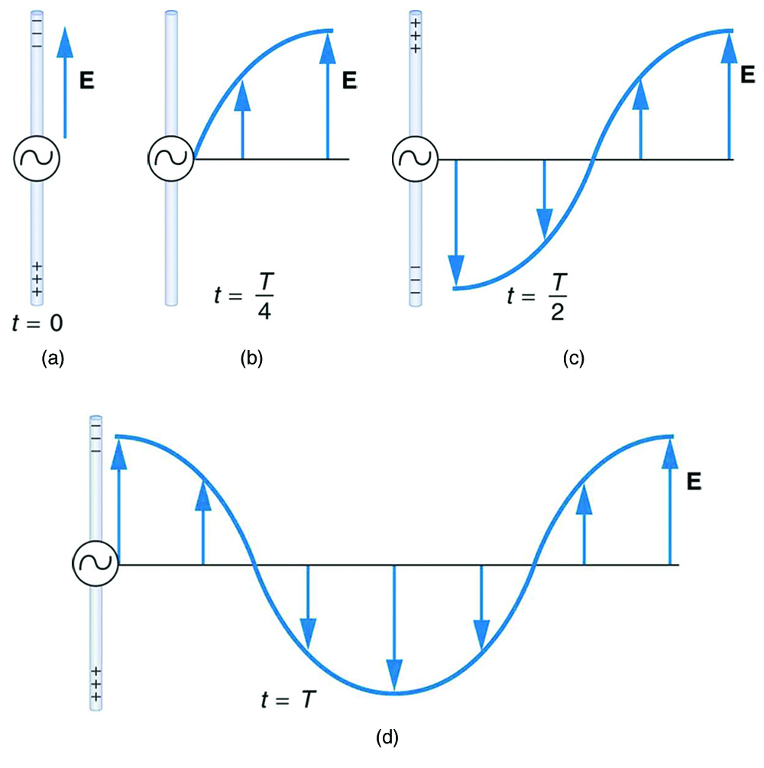
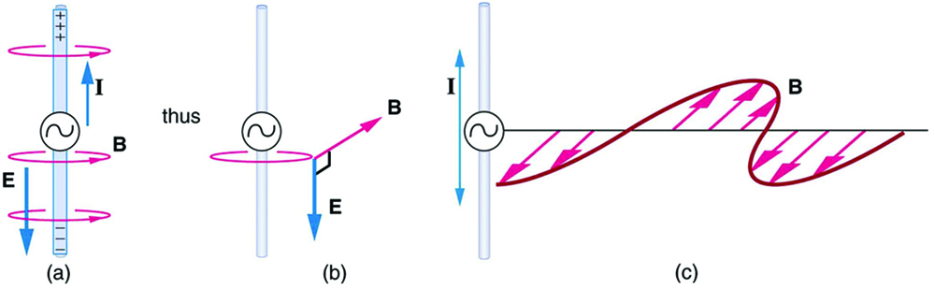
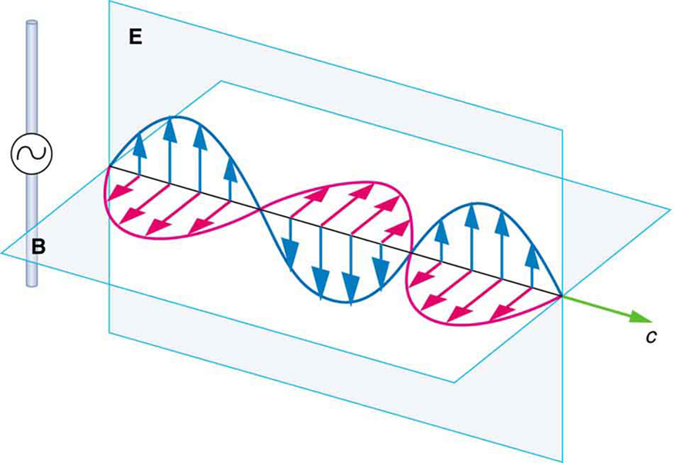
Basic physics
Voltage is a potential; it pulls/pushes charged items
Oscillating voltage makes electrons oscillate in conductors
Oscillating electrons create an
oscillating electric field
Changing electric fields makes a
changing perpendicular magnetic field
These create an electromagnetic wave

Slide 3
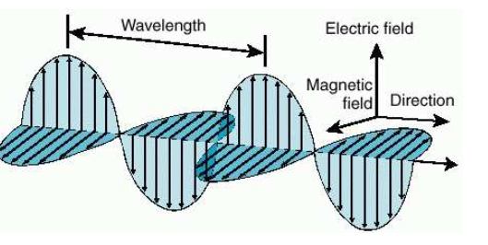

Electromagnetic Waves
Wave propagates at the speed of light
  Speed $c≈3×{10}^{8}$ m/s = $300$ m/us
  Wavelength $λ$ is distance between humps
  Frequency $f$ is how many times per second hump passes
  $λf=c$
  Amplitide is height (strength) of the wave
Inverse square law for static electric field: $E\left(x_{0}\right)=\frac{1}{4πε_{0}}\frac{q_{1}}{{\left(x_{1}−x_{0}\right)}^{2}}$
Liénard–Wiechert potential for moving charge
  Relativistically correct time-varying electromagnetic field for charge in motion
  $E\left(r,t\right)=\frac{1}{4πε_{0}}\left(\frac{q(n−β)}{γ^{2}{\left(1−nβ\right)}^{3}{\left|r−r_{s}\right|}^{2}}+\frac{qn×\left(\left(n−β\right)×\dot{β}\right)}{c{\left(1−nβ\right)}^{3}|r−r_{s}|}\right)$
  Note last term is not inverse square! Without this radio would be useless!

Slide 4
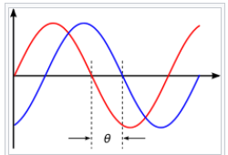
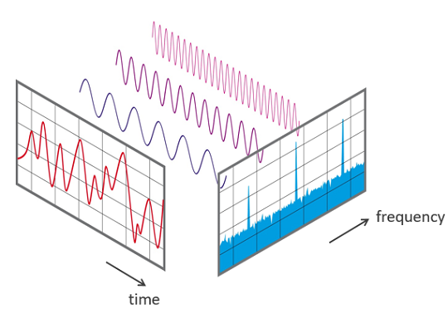
Electromagnetic Waves
Fourier: A complex wave can be represented as a sum
of (possibly shifted, called phase) sine waves
Fourier Transform: wave => frequencies
A signal can be manipulated in the frequency
or time domains

Slide 5
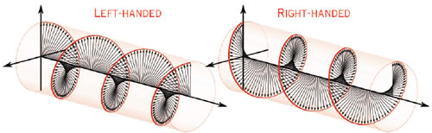
Electromagnetic Waves
Polarization – direction of electrical field
Electric field parallel to the conductor
What if the conductor turns 90 degrees?
Changes horizontal to vertical polarization
What if conductor spins?
  Left or right handed circular polarization
Can have two perpendicular antennas,
driving them in/out of phase
  Elliptical polarization, and/or all of above

Slide 6
Electromagnetic Waves
Wave properties used to send data:
  Frequency
  Amplitude
  Phase
  Polarization

Slide 7
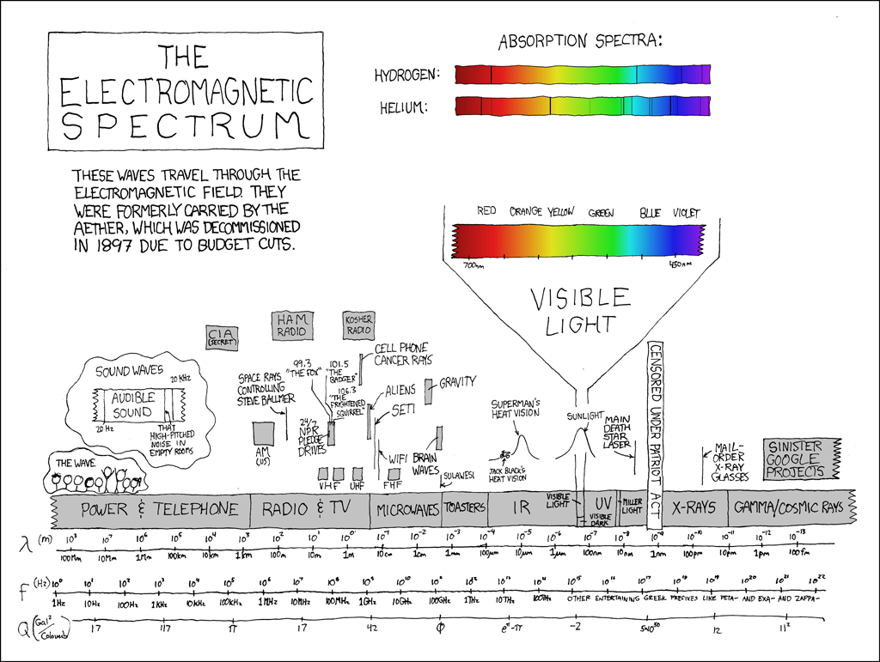
Radio Frequencies
Wireless uses 100kHz to 60 GHz
Three common unlicensed bands
  900 MHz: 902 to 928 MHz
  2.4 GHz band: 2.400 to 2.483 GHz
  (Japan extends to 2.495 GHz)
  5 GHZ: 5.150 to 5.350,
  5.725 to 5.825 MHz,
  (some countries + 5.350 – 5.825 GHz)
Visible light 400-900 THz
Notes:
Many bands for protocols, by country

Slide 8
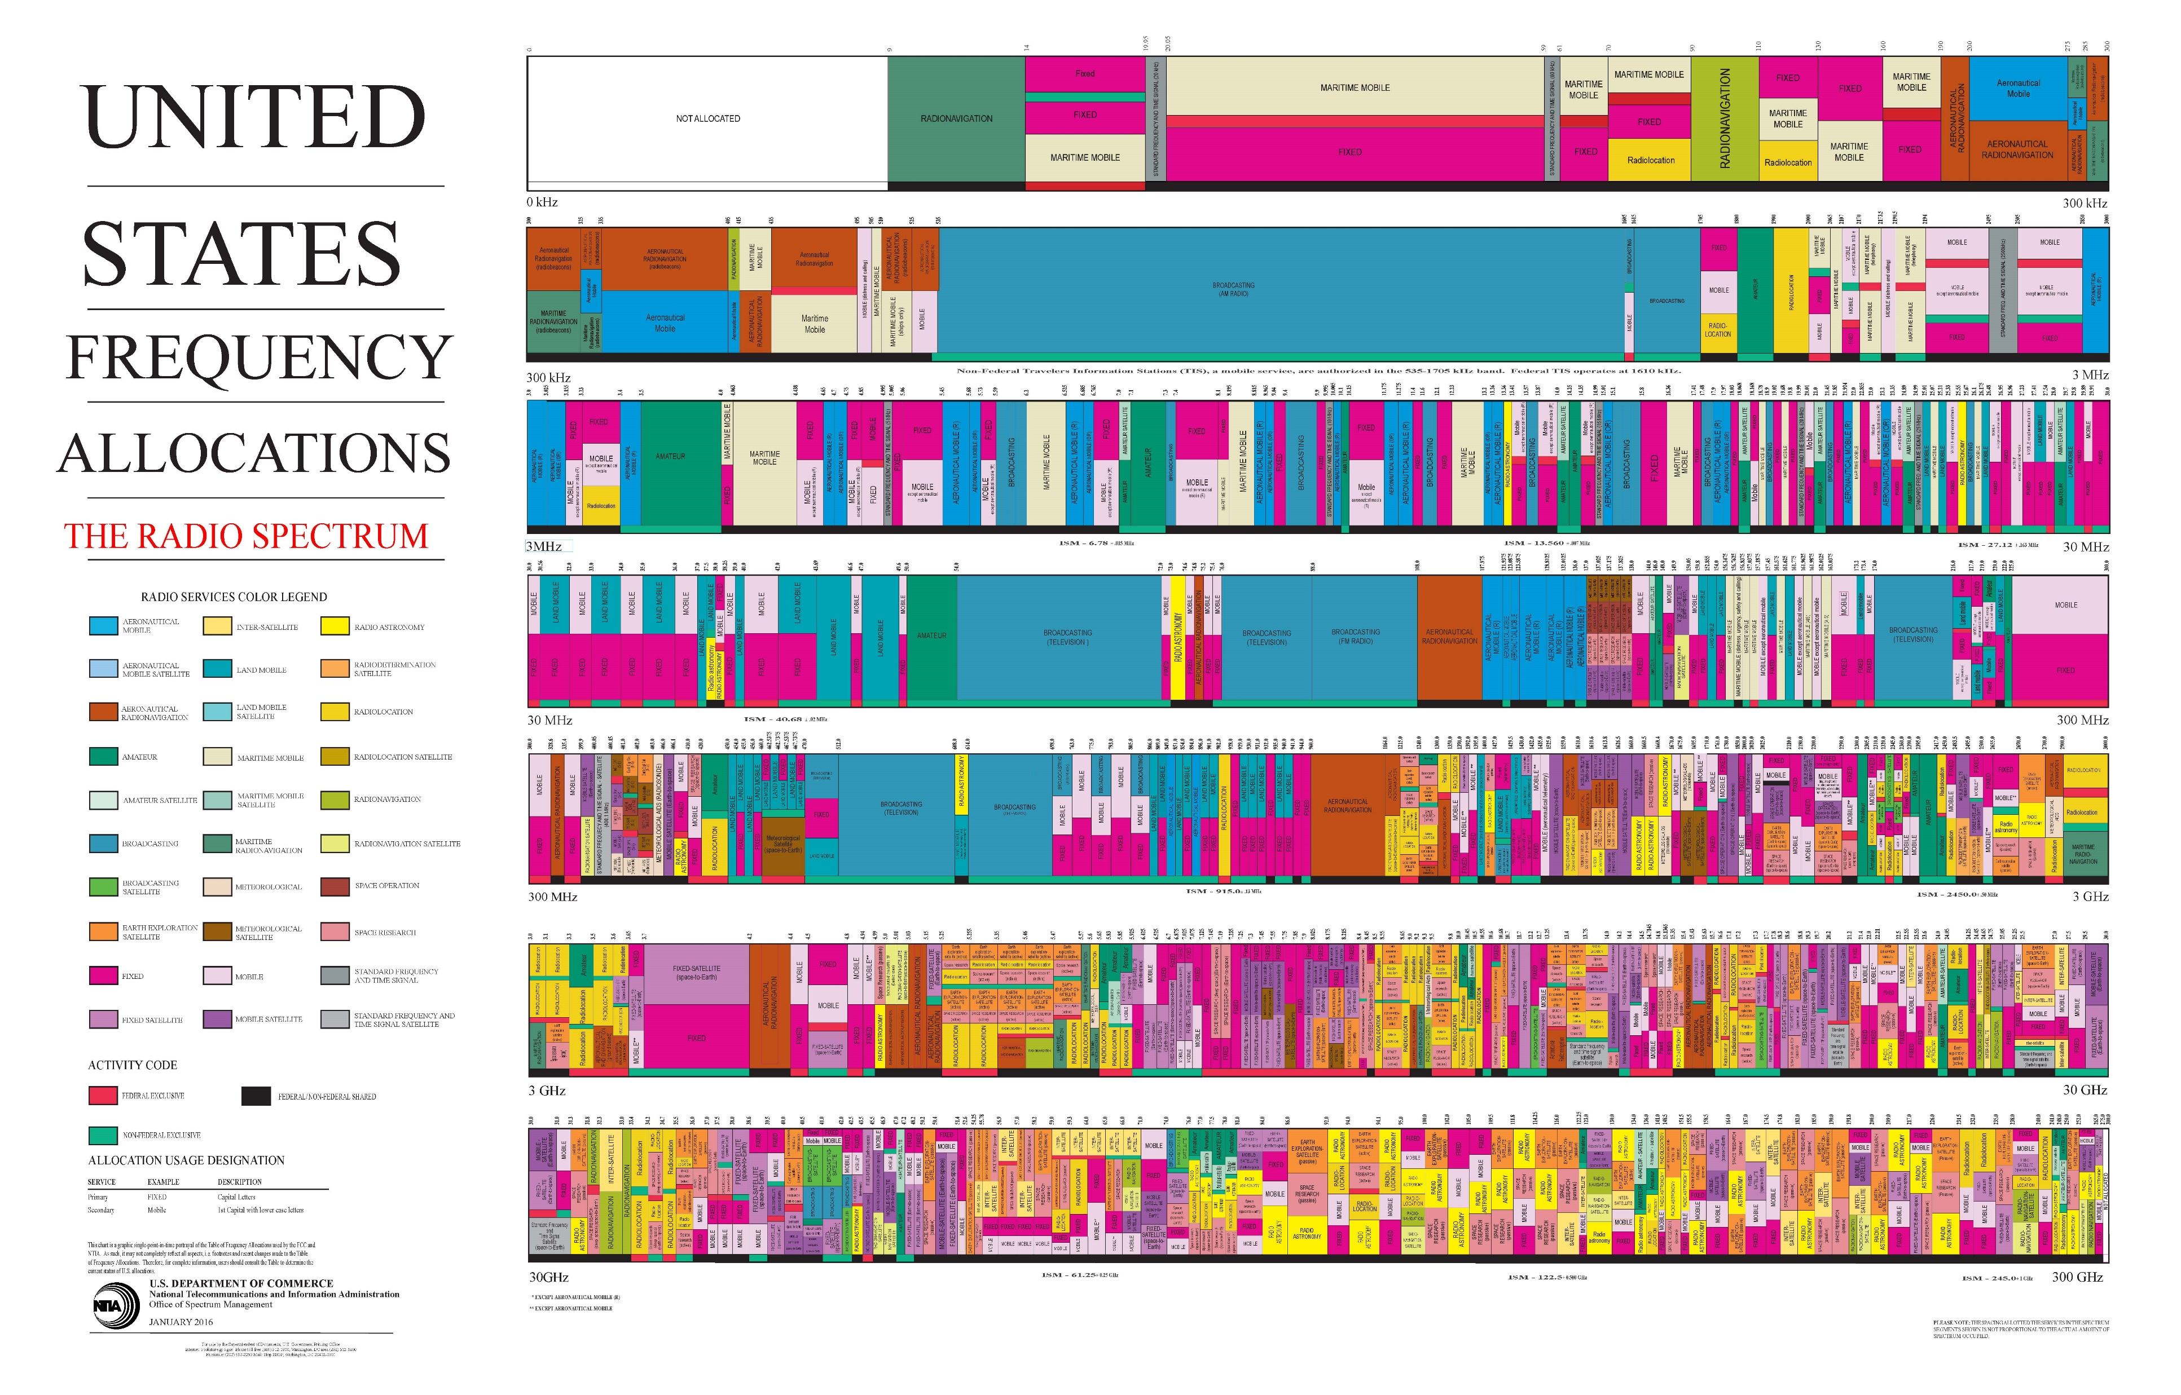
Radio Frequencies
Notes:
0-300GHz
9 kHz radio navigation

Slide 9
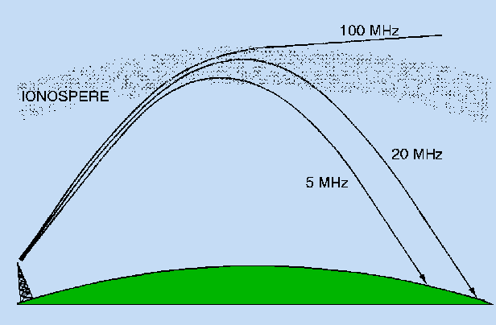

Wireless Propagation
Ground wave – follows earth contour, < 2MHz, AM radio
Sky Wave: signal reflected/refracted from ionosphere
  BBC world service, Voice of America
Line of sight: > 30 MHz. Density of atmosphere decreases with height, results in waves bending towards earth
Free space loss: signal disperses with distance
  Greater for lower frequencies (longer wavelengths)
Atmospheric absorption: water vapor and oxygen
  Water greatest at 22 GHz, less below 15 GHz
  Oxygen greater at 60 GHz, less below 0 GHz
  Rain and fog scatter radio waves
  Energy intensity in W/m^2 is $I_{avg}=c ε_{0}E_{0}^{2}/2$ where $E_{0}$ is max electric field of sin wave
Attenuation the loss in signal amplitude due to distance, material, other reasons
Notes:
Attenuation = loss

Slide 10
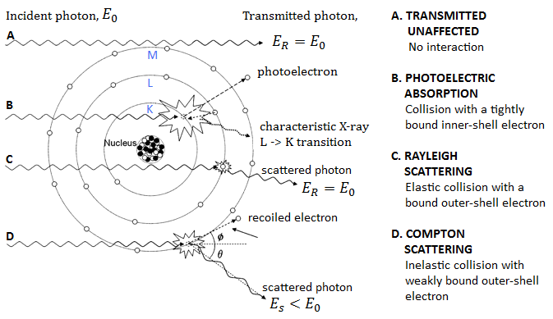
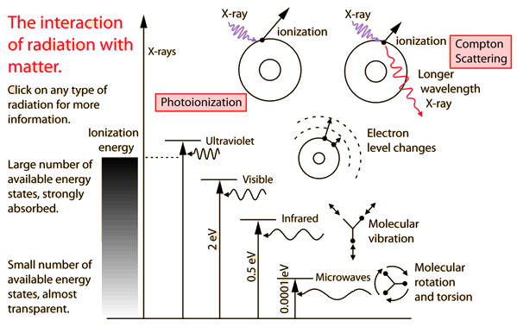
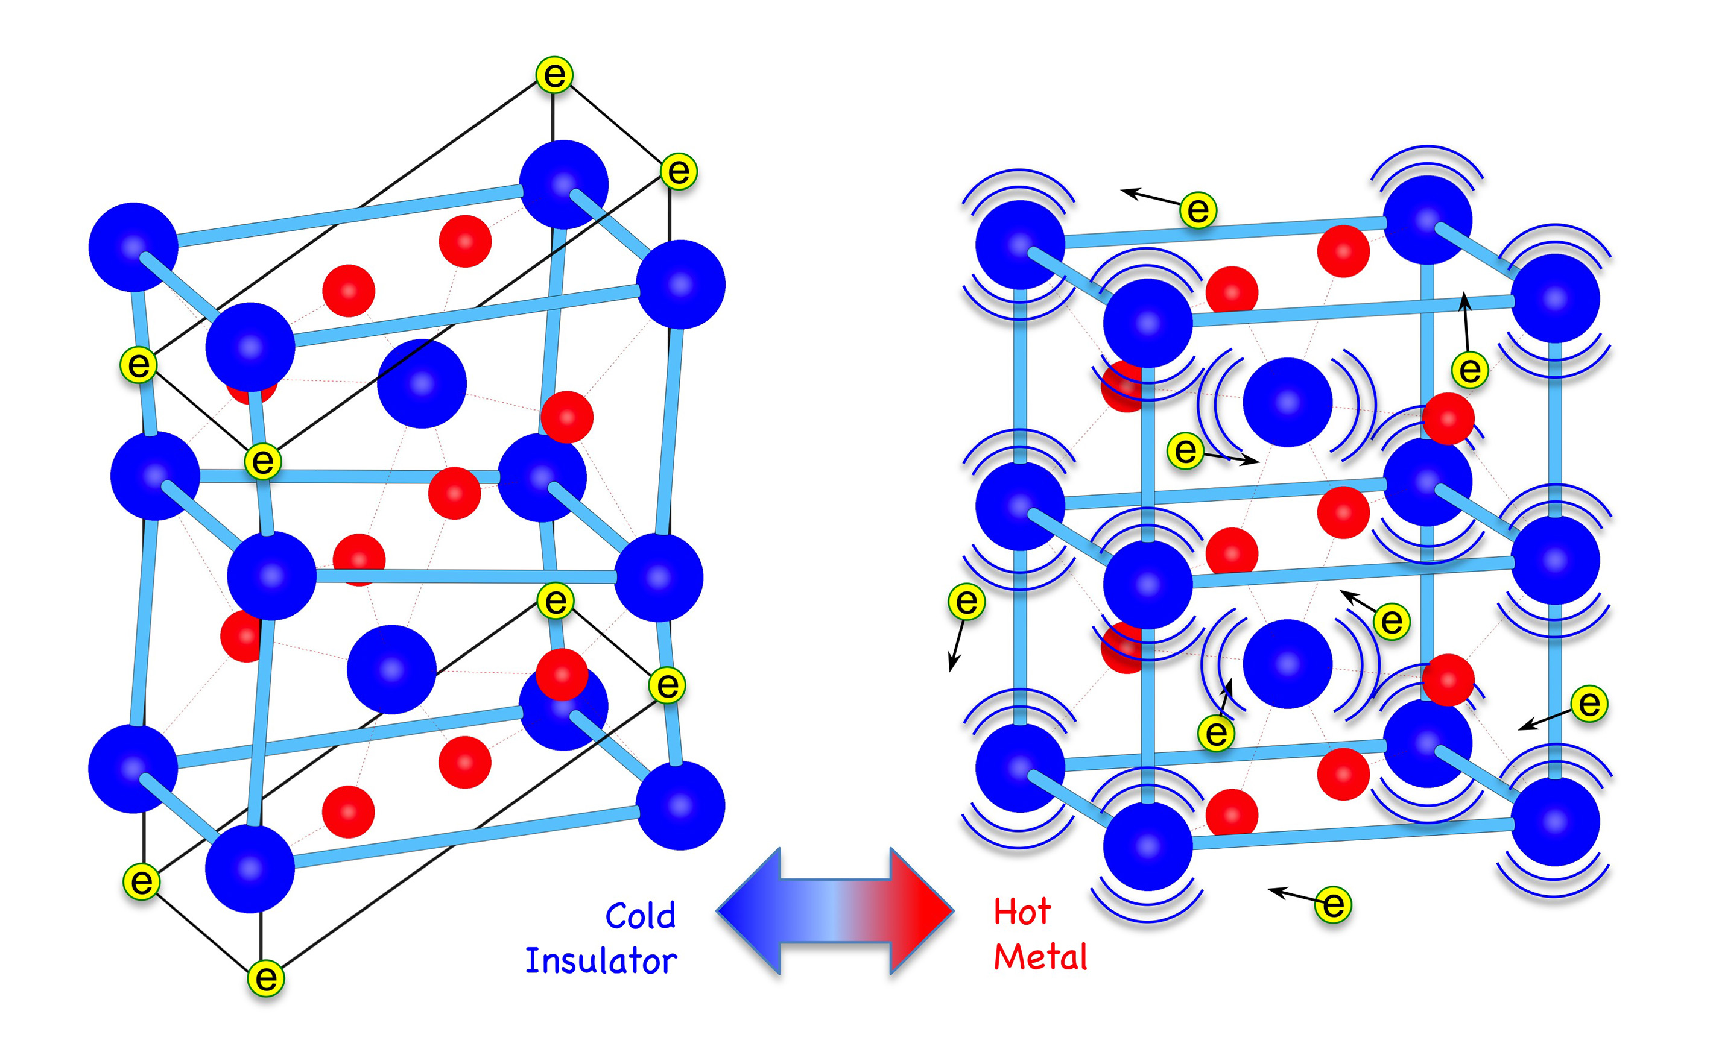
Interaction with materials
Wave causes electrons to vibrate
These then re-emit radio waves
  Causes refraction, reflection
Some increases atomic lattice vibrations
  Radio energy lost to heat
Metals have a lot of free electrons
  Absorb most
Tightly bound electrons, no resonance near
transmission, appears the most “clear”
Radio waves deflect like light when changing media

Slide 11
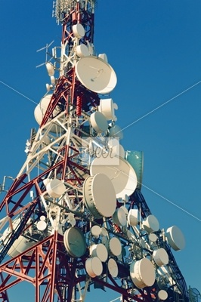
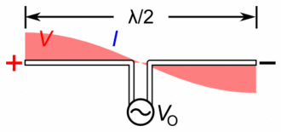
Antennas - Length
Converts between electrical energy
and electromagnetic waves
Radio wavelength = length of antenna
  Causes resonance, much better signal
  Electrons absorb, some reemit, some of those absorb, …
Half wave dipole antenna
  ½ also works via reflection of half wave at end
Quarter wave monopole antenna
  ¼ works with reflective ground plane at
  powered end via another mechanism
  Like a VHF antenna on a car or a metal plane on a PCB
  Most popular in portable devices
Band | Freq | Wavelength | ½ Length Antenna | ¼ Length Antenna
AM | ~1MHz | 300m | 150m | 75m
FM | ~100 MHz | 3 m | 150 cm | 75 cm
Television | ~75 MHz ~175MHz ~470-884 MHz | 4 m 0.33 m | 2m 0.15 m | 1m 0.08 m
Cellular | ~900 MHz | 33 cm | 15 cm | 8 cm
GPS | ~1.5 GHz | 20 cm | 10 cm | 5 cm
Wireless | ~2.4 GHz ~5 GHz | 12 cm 6 cm | 6 cm 3 cm | 3 cm 1.5 cm
W band | ~100 GHz | 3 mm | 1.5mm | 0.75mm

Slide 12

Decibels
Decibels measure a ratio of power between two things on a log scale
  $$dB=10×\log_{10}{\frac{P_{1}}{P_{0}}}$$
Use log since numbers vary by many orders of magnitude
Larger numbers are more power
Each 3dB is approximately a doubling (or halving) of power
For antennas and wireless, generally $P_{1}$ and $P_{0}$ measure power in Watts
Often a suffix tells what $P_{0}$ is
  dBm : $P_{0}$ = 1mW
  dBi : antenna gain versus an isotropic (uniform) antenna
  dBd: antenna gain versus a dipole antenna
Can add to get total gain/loss (attenuation)
801.11 network loss
Plasterboard | 3dB
Glass wall with metal frame | 6dB
Cinder block wall | 4dB
Office window | 3dB
Metal door | 6dB
Metal door in brick wall | 12dB

Slide 13
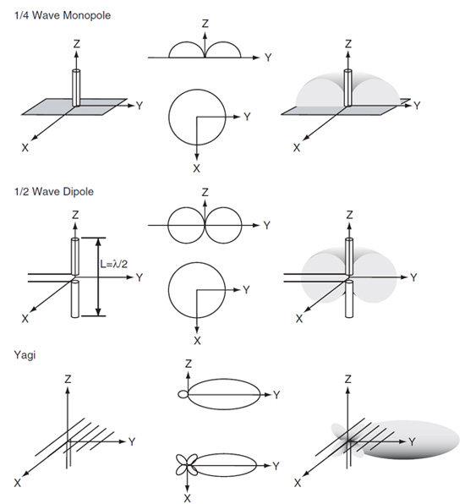
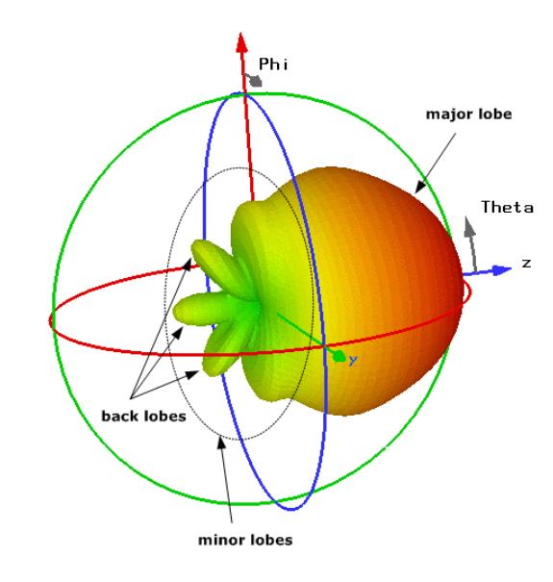
Antennas - Geometry
Isotropic antenna
  Ideal, uniform power spread
  in sphere
Directional
  Gains energy in some directions,
  loses in others
  Dipole
  Whip
  Helical
  Yagi
  Ceramic loop
  PCB trace
Ex: out of 360 degree, Grid is 7 degrees, Yagi is 36 degrees,
and the Panel is 34 degrees
Notes:
https://www.digikey.com/en/articles/techzone/2012/nov/selecting-antennas-for-embedded-designs

Slide 14
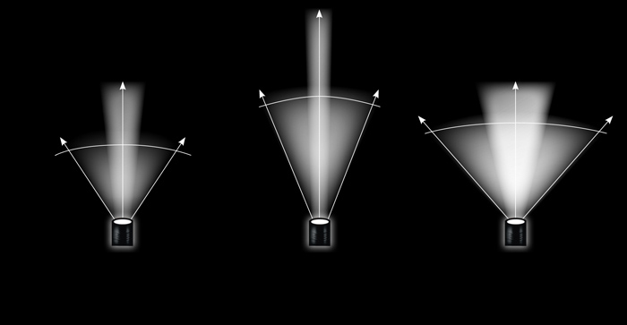
Antennas - GAIN
Gain : apparent increase in power given by an antenna
in a particular direction, often dBi
Increased gain implies decreased beamwidth

Slide 15
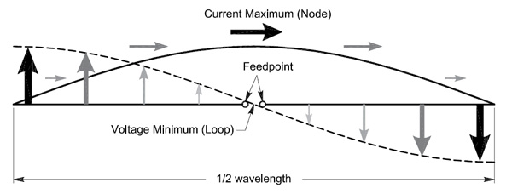
Antennas - Impedance
Impedance – measure of opposition to current when voltage applied (ohms)
  When voltage changes, current moves electrons,
  makes magnetic field, resists electron movement.
  Capacitance also affects
Antenna: impedance mismatch causes power loss in transmission
  Think: mismatch causes the wave to reflect before entering antenna
  Called an impedance mismatch
Impedance matching – antenna works like RC, need to balance

Slide 16
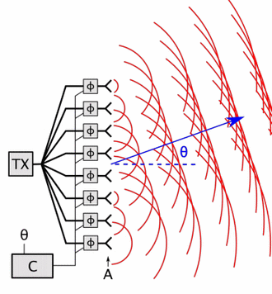
Antennas
Beam shaping via phase array
Reciprocity theorem
  The following are the same for a given antenna for
  transmitting and receiving
    Gain
    Radiation pattern
    Impedance
    Bandwidth
    Resonant Frequency
    Polarization

Slide 17
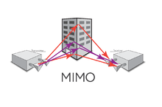
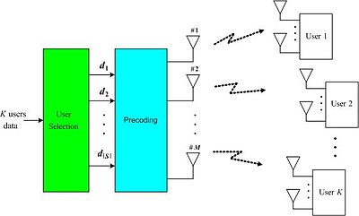
MIMO
Multiple-Input and Multiple-Output (MIMO)
  Exploit multipath propagation
  to multiply link capacity
  802.11n, WiMAX, LTE 4G, more
Multi-user MIMO (MU-MIMO)
  Complex signal processing handles
  multiple users
  3G, WiMAX

Slide 18
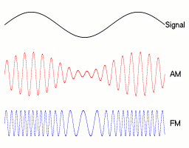
Modulation
Modulation: varying a periodic waveform called the carrier signal with another signal to encode information
modem = modulator/demodulator
AM = amplitude modulation
FM = frequency modulation
Data direction:
  Simplex : one way (TV)
  Half duplex : two way, alternate channel use (CB radio)
  Full duplex : two way using two channels (mobile phone)

Slide 19
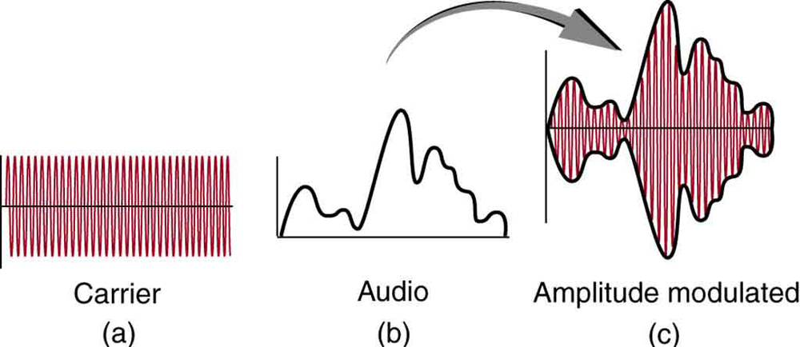
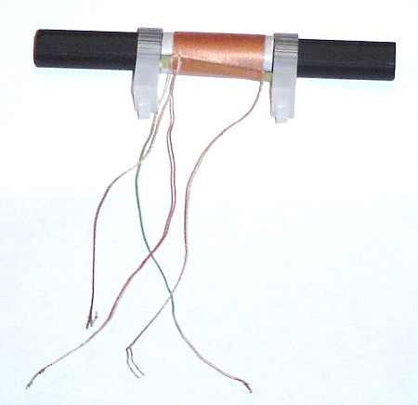
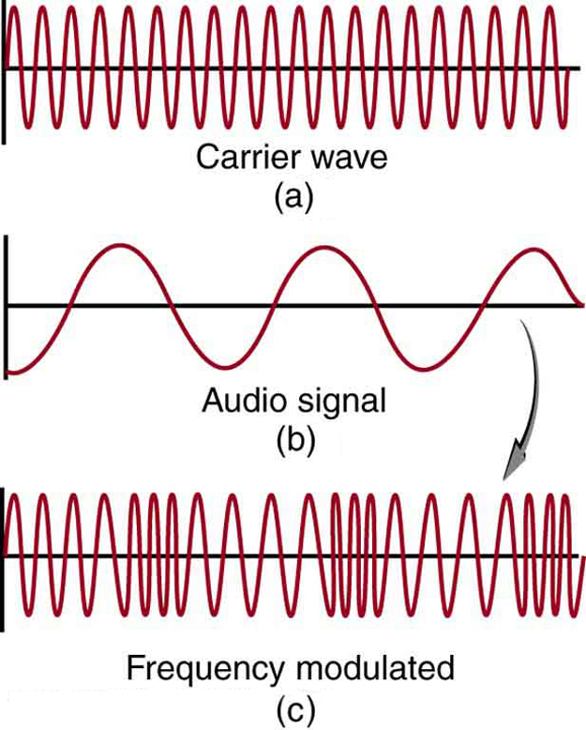
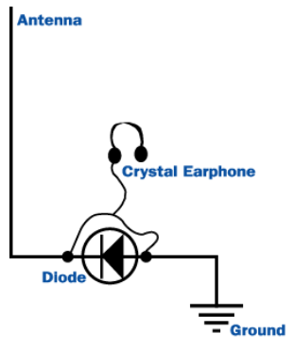
EX: Radio Signals
AM – magnetic antenna
  Wavelength 300m
  ¼ monopole antenna would be 75m!
FM – electric antenna
  Wavelength 3 m
  ¼ monopole antenna 75cm
Simple crystal radio – how works

Slide 20
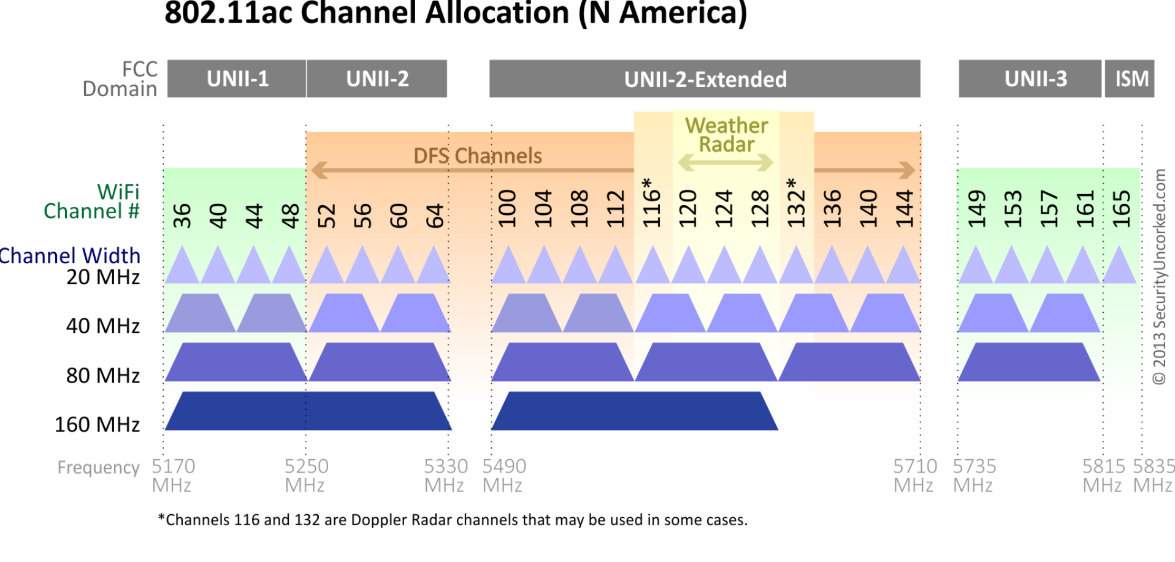
Spectrum
Communication given a frequency and bandwidth
Ex:
  FM radio channels are separated by 200 kHz, so channels “odd”: 97.1, 103.5
  200 kHz is the bandwidth

Slide 21
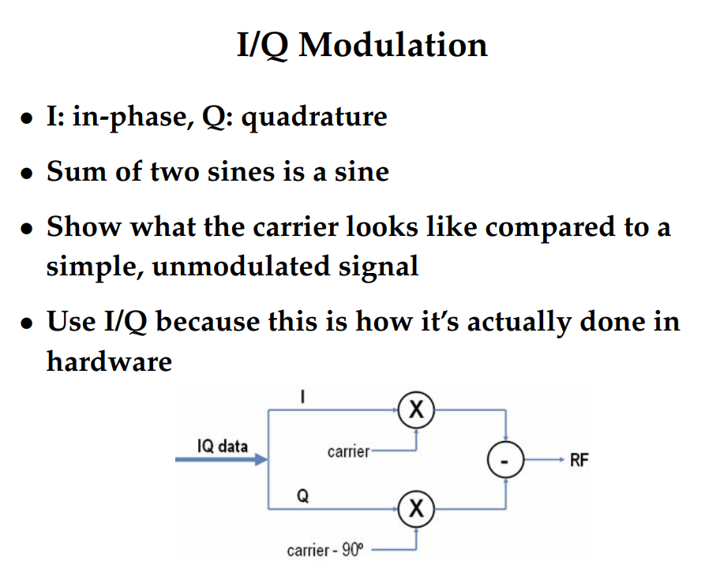
DIGITAL Modulation
In digital domain, modulation often called keying
Wave parameters: frequency, amplitude, phase, polarization
Some aspects susceptible to some errors while others not
  Changes by use case, domain, power, cost, etc.
In-phase (I) signal and quadrature (Q) signal
  Q is 90 degrees out of phase with I

Slide 22
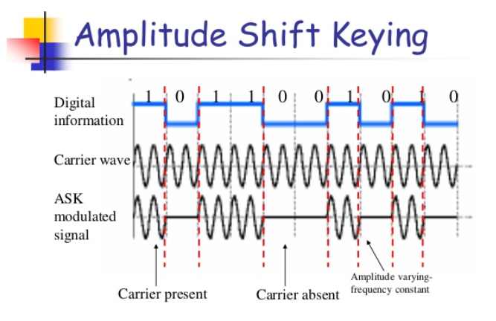
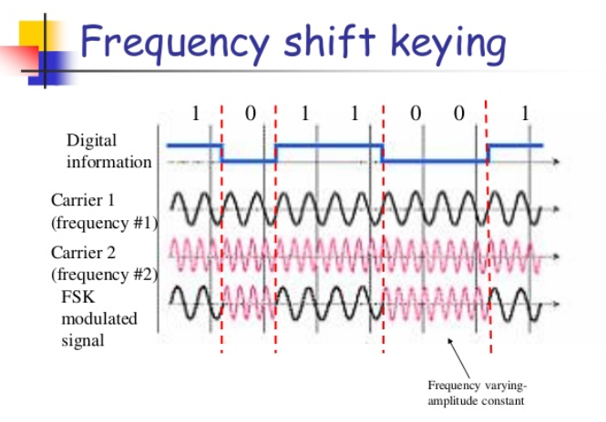
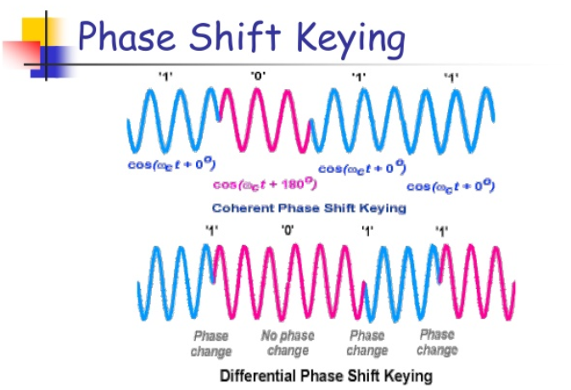
DIGITAL Modulation
Amplitude Shift Keying (ASK)
  Amplitude denotes symbols
Frequency Shift Keying (FSK)
  Frequency denotes symbols
  FSK less susceptible to errors than ASK (Keying)
  Used in 300-1200 bps voice grade lines
Phase-Shift Keying (PSK)
  Phase denotes symbols
  Exact phase requires clock syncing, so…
  Differential (DPSK): change in phase is symbol
  When 2 symbols, called Binary PSK (BPSK)
  When 4 symbols, Quadrature PSK (QPSK)
Notes:
https://www.slideshare.net/nnmaurya/digital-modulation-basicsnnm

Slide 23
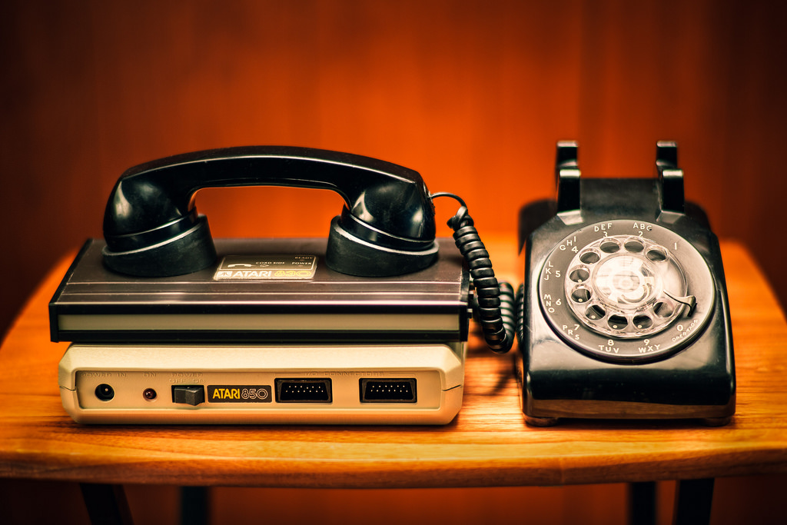
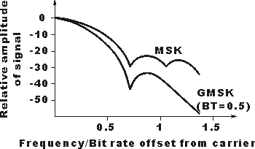
DIGITAL Modulation
Multi-level PSK (MPSK)
  9600 baud modems use PSK with 4 bits
Offset quadrature phase-shift keying (OQPSK)
  limited to 90 degree rotations
Gaussian Minimum Shift Keying (GMSK)
  Minimum shift for next symbol
  Gaussian filtered to remove sideband noise
  (square edges “ring”)
  Used in GSM cellular systems
Many, many more….

Slide 24
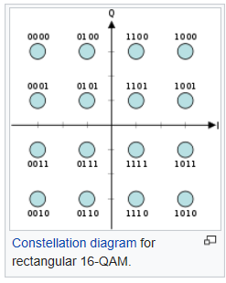
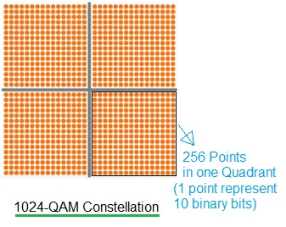
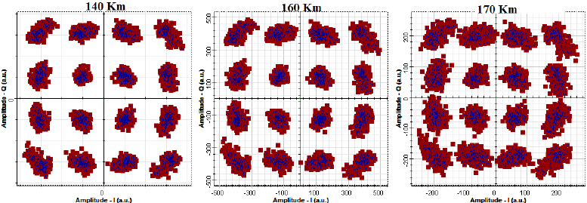
DIGITAL Modulation
Want more symbols: so mix phase and amplitude….
Quadrature Amplitude Modulation (QAM)
  QAM-4, QAM-16, QAM-64, QAM-256, …
  DOCSIS up to QAM-16384, Digital Video 65536, more ?
  QAM-4: same performance, twice the bandwidth efficiency of BPSK
  Used in DSL, wireless networks, many more
Notes:
https://en.wikipedia.org/wiki/Quadrature_amplitude_modulation

Slide 25

Spread spectrum
Send data over wider bandwidth
  Resistance it interference, noise jamming
  Prevent detection
  Limit flux density (satellite downlinks)
  Security
  Spreads power over wide spectrum -> spread spectrum
  Narrowband interference cannot jam
  Patented Hedy Lamarr

Slide 26
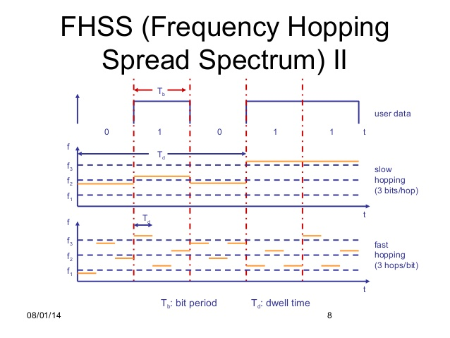
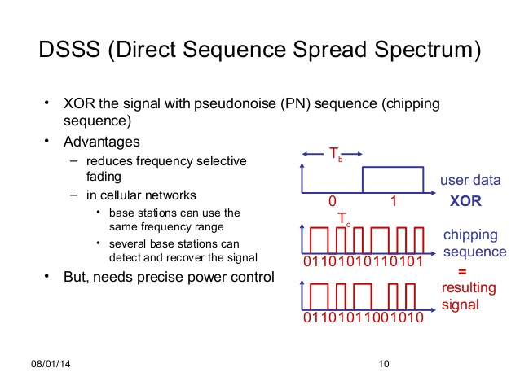
Spread spectrum
Frequency hopping spread spectrum (FHSS)
  Pseudo random frequency hopping, known to transmitter
  and receiver
  Bluetooth
Direct sequence spread spectrum (DSSS):
  Spreading factor: code bits/databit = 10-100 commercial
  (FCC min 10), 10,000 for military
  Signal bandwidth > 10x data bandwidth

Slide 27
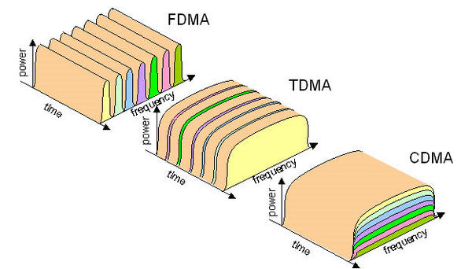
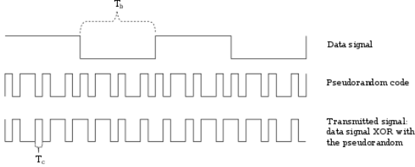
Division
Frequency Division Multiple Access (FDMA)
  Multiple users share channel bandwidth, each has very specific frequency
  Requires high performance hardware filters
Time Division Multiple Access (TDMA)
  Users share same channel, take turns split in time
  Used in 2G
Time Division Duplex (TDD)
  Allows duplex over single channel via time
  Used in many LTE deployments
Code Division Multiple Access (CDMA)
  Each user data XORed with unique pseudorandom code,
  all users transmit, decoder pulls out each signal
  8-15 times capacity of analog
  Spread spectrum single sideband

Slide 28
DIVISION
Orthogonal Frequency Division Multiplexing (OFDM)
  Splits channel into multiple frequencies
    Nearby subchannels encoded using methods to avoid crosstalk, “orthogonal”
    Orthogonal => peak of one is null of other
  Better able to cope with severe channel conditions
  Available band divided into 256 or more subbands
  Each carrier modulated BPSK, QPSK, 16-QAM, 256-QAM, …
    Selective frequency fading
  Used in 802.11a/g, 802.16, HDTV, ADSL, DOCSIS, WLAN, 802.11ax, more

Slide 29
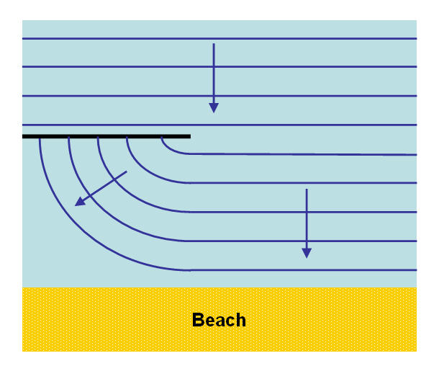
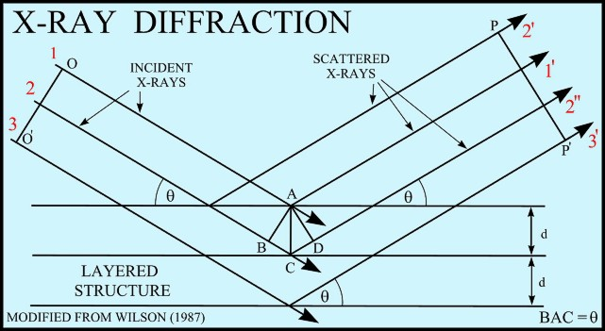
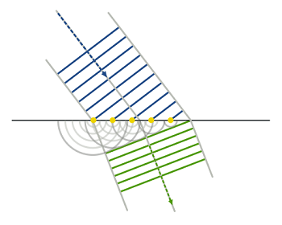
Noise
Reflection
  Large surface relative to wavelength
  May have phase shift
  May cancel original or increase it
Diffraction around edges
  Edge of impenetrable body large relative to wavelength
Scattering
  Obstacle on order of wavelength, like a lightpost
If no line of sight (LOS), diffraction and scattering are
primary means of reception

Slide 30
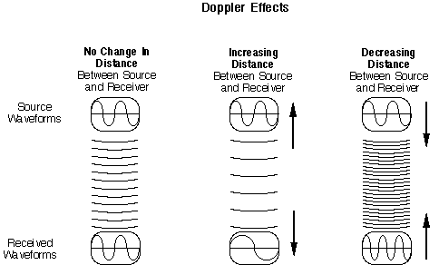
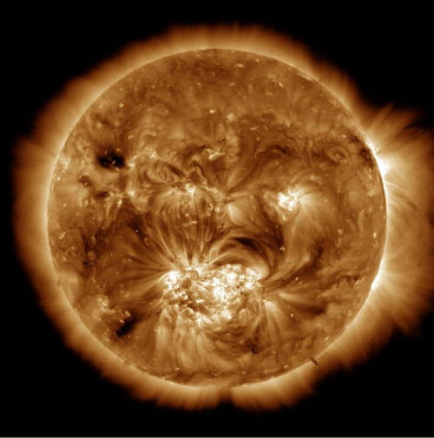
Noise
Doppler shift
  2.4 GHz, 120 km/hr => 267 hz difference
Doppler if moving
  2.4 ghz, moving 120km/hr, 267 hz change)
Intermodulation
Crosstalk
Impulse (spikes, short duration, high amplitude)
Sunspots mostly affect lower frequencies (under GHz)
Carrington event 1859
  damaged telegraph lines world wide,
  would cost US ~$1Trillion today

Slide 31

Thermal Noise
Thermal – heat is vibrating atoms, vibrating atoms emit radio waves
  antennas heat things, how microwave works
  Uniformly distributed, white noise
Thermal noise $=kT$ Watts/Hz
$k$ = Boltzmann constant = 1.38 x 10^-23 Joules/Kelvin
$T$ = absolute temperature in Kelvins
Ex: 10 MHz receiver at 21 degrees C
  Thermal noise = 1.38*10^-23 x (21+273.15) * (10*10^6)
  In dBW = 10log_10 of above = -133.9 dBW

Slide 32
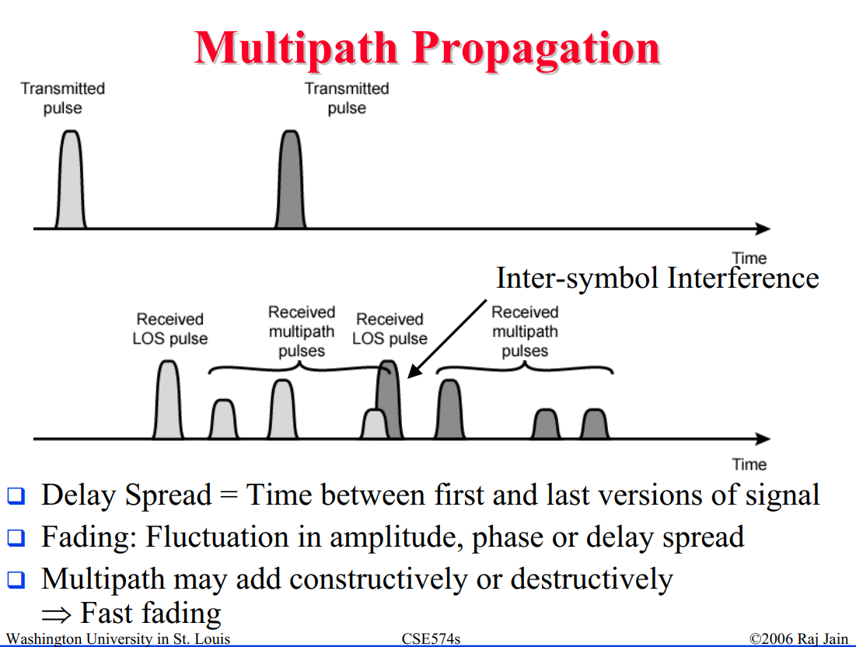



Multipath
Multipath issues
Fresnel zone
  Infinitely many
  Out of phase reduce signal, in phase reinforce
  Odd in phase, even out of phase
  First 3 most important
  Don’t block first when placing antennas
  Radius $F_{n}=\sqrt{\frac{nλd_{1}d_{2}}{d_{1}+d_{2}}}$ where $d_{i}$ are distances to end, $λ$ is wavelength

Slide 33

Channel capacity
Channel capacity: tight upper bound on rate at which information can be transmitted over a communication channel. Symbol is C
Nyquist rate: upper limit on symbol transfer rate, $≤$ 2* bandwidth B
  If symbol is a bit (bi-level encoding), then bit rate $≤2B$
  Multi-level encoding: bit rate $≤2B\log_{2}{M}$
Shannon-Hartley Theorem:
  Signal to noise S/N
  Capacity $C=B\log_{2}\left(1+S/N\right)$

Slide 34
Channel capacity
Shannon Hartley Theorem:
  Example old wired phones::
    Wire bandwidth 3100 hz, S/N = 30dB,
    10 log_10 S/N = 30 => S/N=1000
    Capacity = 3100 log_2(1+1000) = 30,894 bps
Spectral efficiency : bits/s/Hz
  Link spectral efficiency: Bit rate per hertz of bandwidth, net after error correction, etc.
  Modulation spectral efficiency: including error correction and other requirements
Ex: V.92 phone modem: phone 300-3400Hz, 56,000 bps down, 56000/3100=18.1 bps/Hz
Technology | Spectral efficiency
2G cellular | 0.5-1.3
3G | 0.07-2.5
4G | 2.7-7.3
WiFi a/g | 2.7
WiFi ac | 5-43

Slide 35

Error correction
Bit error rate
Error detection – checksums: CRC, MD5, etc.
Forward Error Correction (FEC)
  Add redundancy, allows bit correction at receiver
  Hamming distance: number of bits incorrect
Convolutional codes: k bit in, k+r out,
  designed for long bit streams
Classical FEC codes: 3dB below Shannon limit
Turbo codes : 0.5 dB below Shannon limit
  Developed in 1993
  2 codes with interleaver
  3rd gen cellular uses

Slide 36
Higher layers
Above physical layer are many more layers
  OSI model is a good reference
Error correction
Most advanced designs are packet networks, like IP
Security

Slide 37

Example: FM radio (US)
88-108 MHz
Each channel gets 200 kHz bandwidth
Digital : FM in-band on-channel (IBOC)
  Digital in sidebands of usual FM stations
  Increases interference for many older receivers
  57kHz subcarrier gives station name, GPS data for commercial receivers, radio text, at 1187.5 bps
  OFDM and proprietary compressed
  Gives 100, 112, 125, or 150 kbits/s data depending on power.
  Can split into multiple channels
Notes:
OFDM Orthogonal frequency-division multiplexing

Slide 38


Example: NTSC Television
Channels 2-6 (54-88 MHz), 7-13 (174-216 MHz),
14-51 (470-698MHz)
Each channel gets 6 MHz bandwidth
30/1.001 (~29.97) interlaced frames per second
  Audio and video “beats”
  rate scaled down 1.001 to remove the aliasing
262.5 scan lines per frame, total of 525 lines, 483 visible
  Vertical blanking lines allow synchronization and retrace
Luma (brightness) and chrominance (color) => RGB at TV
  Color subcarrier at 315/88 MHz
  uses QAM (I and Q) to encode chrominance
Audio FM modulated 4.5 MHz higher than base freq
Notes:
1953, North America

Slide 39


Example: RF remotes
433 MHz
  69 cm wavelength, antenna usually ¼ length at 17 cm,
  requires reflection plane
On-off keying (OOK), also called Amplitude (ASK)
No formal data format
Usually something like:
  0 bit = on for T, off for T; 1 bit = on got T, off for 5T; SYNC = on for T, off for 10T
  Sometimes short and long high pulses for 0,1
  Sometimes other symbols also encoded
Remote button press sends some number N of packets
Packet usually around 50 bits, often manufacturer prefix, then data for key pressed

Slide 40
Example: WIFI
Standard | Year | GHz | Bandwidth (MHz) | Modulation | Antenna |  | Range m indoor/ outdoor
802.11 | 1997 | 2.4 | 20 | DSSS,FHSS |  | 2 Mb/s | 20/100
802.11b | 1999 | 2.4 | 20 | DSSS |  | 11 Mb/s | 35/140
802.11a | 1999 | 5 | 20 | OFDM |  | 4 Mb/s | 35/120
802.11g | 2003 | 2.4 | 20 | DSSS,OFDM |  | 54 Mb/s | 38/140
802.11n | 2009 | 2.5, 5 | 20,40 | OFDM | MIMO | 900 Mb/s | 70/250
802.11ad | 2010 | 60 | 2160 | DSSS,OFDM, BPSK | Beamforming | 7.2 Gb/s | 3/120
802.11ac | 2013 | 5 | 40,80,160 | OFDM | (MU-)MIMO | 2 Gb/s | 35/120
802.11ax | 2019 | 2.4, 5 | 20,40,80,160 | OFDMA, 1024 QAM | (MU-)MIMO | 14 Gb/s | 35/120

Slide 41

Example: WIFI
2.4 GHz used by microwave, Bluetooth, ZigBee
5 GHz used by satellites and radar
Most wireless cards 32 mW output (+15dBm)
  ~ high power Light Emitting Diode
  Max power output 100 mW
3 dBi antenna common, 50 ohm impedance

Slide 42


Example: WIFI
2.4 band is channels each 22MHz wide.
  North America 11 channels, Europe 13, Japan 14.
  Only two non-overlapping
5 GHZ band 3 bands, each split into 4 channels, total 12 channels
802.11 a and g use OFDM
  Each 20 MHz wide carrier split into 52 subchannels, each 300 kHz wide.
  OFDM uses 48 for data and 4 for error correction
  BPSK for 125 kbps per channel = 6 Mbps
  QPSK doubles to 12 Mbps
  16-QAM for 24 Mbps
  64-QAM gives 54 Mbps
Notes:
Barker code – unaligned auto correlations have small coefficients. At 11 bit length, all correlations 0 or -1, except aligned is +11

Slide 43

Example: WIFI
802.11b uses Direct Sequence Spread Spectrum (DSSS)
  BPSK at 1 Mbps, QPSK for 2 Mbps, Complementary Code Keying
  (CCK) for 5.5 and 11 Mbps
  11 bit Barker code 1-2 Mbps
    unaligned auto correlations are -1 and 0, aligned is +11
  complementary code keying 5.5-11 Mbps
802.11n
  Channel bonding aggregates two 20 MHz channels into one 40 MHz channel
  MIMO (Multiple input/output) – uses multipath signals to the advantage of the receiver

Slide 44

Example: Bluetooth
2.4 GHz bands, Antenna
80 Channels, 1MHz spacing.
  Each channel shared by 8 devices
GFSK at first, DQPSK added later
Frequency Hopping Spread Spectrum
  800 hops per second,
Duplex via time division (TDD)
1/3 or 2/3 rate Forward Error Correction, or
Automatic Repeat Request (ARQ)
Packets exchanged on master clock
  312.5 us/tick
Class | mW | dBm | Range m
1 | 100 | 20 | ~100
2 | 2.5 | 4 | ~10
3 | 1 | 0 | ~1
4 | 0.5 | -3 | ~0.5

Slide 45


Example: Zigbee
10-20 m
250 kbit/s
2.4 GHz (+ other in some countries)
  16 channels, 5 MHz apart, 2MHz bandwidth
  Direct Sequence Spread Spectrum coding
  BPSK in 868 and 915 MHz bands
  OQPSK (2 bits per symbol) in 2.4 GHz band
  ¼ length antenna is 3.125 cm long
0-20 dbm (1-100 mW) transmit
Duty cycle for power savings
128 bit key for security

Slide 46

Example: Satellite Radio
Sirius XM uses 2.3200-2.3325 GHz
  Three 4MHz carriers, all decoded
XM radio uses 2.3325-2.3450 GHz
  Six 2MHz carriers, three decode by receiver
User level antennas ~40dB gain
OFDM QPSK signals
Each two-carrier group broadcasts ~100
8-kilobit-per-second streams in approximately
4 MHz of radio spectrum
  Audio compressed by proprietary methods

Slide 47


Example: GPS
1.57542 GHz (L1 signal), 1.2276 GHz (L2 signal)
  L3 at 1.38105 GHz used to report detected nuclear explosions to US
  L4 at 1.379913 GHz is for studying ionosphere
  L5 at 1.17645 is part of GPS modernization
24+ satellites, 20,000 km altitude, 4-12 visible at a time
  25.6 W transmitter, antenna gain 13 dBi gives 27 dbW
  free space loss 182 dBW, leaves -155 dBW
  Each has atomic clock with 1 nanosecond tick rate
  Want 20-30 ns accuracy on clock ticks at earth
GPS signals are Right Hand Circularly Polarized
  Less vulnerable to destructive interference due to reflections
  Difficult to read in small devices, which are usually vertically polarized

Slide 48

Example: GPS
Sends code known to receiver, alignment determines epoch
  Sends Time of Transmission
  Receiver measures 4 satellites, and from difference in times, computes receiver location
  Modern receivers can track 12-20 satellites at once for more accuracy
Transmits on L1 an L2 freqs, 50 bps, each message takes 750 seconds to complete (12.5 minutes)
Relativity – Special and General both apply
  Special relativity: Orbital speed 14,000 km/hr. Ground sees satellite clock as slower, adds about 7 ms per day.
  General relativity: Earth mass curves space, satellites tick faster than ground by 45 ms per day.
  Net is 45-7=38 ms per day needs added at ground, else off by 10km/day
Notes:
http://www.astronomy.ohio-state.edu/~pogge/Ast162/Unit5/gps.html

Slide 49

Example: Cellular
2G: 800 MHz, 850MHz, 1900 MHz
3G: 850, 1700, 1900, 2100 MHz
4G LTE : 600, 700, 850, 1700, 1800, 1900, 2100, 2300, 2600, 3600, 5200 MHz
Mobile 1G 1980s | Mobile 2G 1990s | Mobile 3G 2000s | Mobile 4G LTE 2010s
AMPS, NMT, TACS | D-AMPS, GSM/GPRS, cdmaOne | CMDA2000/EV-DO, WCDMA/HSPA+, TD-SCDMA | LTE, LTE Advanced
N/A | <0.5 Mbps | 63 Mbps | 300+ Mbps
Analog voice | Digital voice + Simple data | Mobile Broadband | Faster and better
Large freq gap between users | > 1 user per channel via TDMA | ~14x user capacity per channel | 1st global standard

Slide 50

Example: Cellular
Modulation formats:
  FDMA, CDMA, TDMA, TDD (LTE), GMSK (GSM)
Cellular tower structure
  Cell –basic geographic unit of a cellular system
    Channels
    Coverage area called a footprint
  Cluster – group of cells, no channels reused in cluster
  Frequency reuse – each cell assigned some subset of channels different from neighbors
Cell splitting – as cell gets too many users, needs split and more cells added
Handoff – mobile, moving between cells. Cell network hands cell new channels as it moves
Channels, antenna

Slide 51
Example: Cellular
Components:
  Public Switched Telephone Network (PSTN)
    Global backbone, wiring, local networks long-haul networks
  Mobile Telephone Switching Office (MTSO)
    Controls calls, tracks billing, locates subscribers
  Cell site and antenna
  Mobile Subscriber Unit (MSU). 3 types:
    Mobile telephone (trunk of car style): typical transmit power 4.0 watts
    Portable (hand held): 0.6 watts
    Transportable: (1.6 watts)

Slide 52
Example: Cellular 3G
1998
384 kbs – 21.6 Mbps (“3.5G”)
Evolving encoding: UMTS, CMDA2000 and revisions…
CMDA2000 Rev C
  QPSK, 8-PSK, 16-QAM
  SNR required -12 to 9.7 (slow to fast)

Slide 53
Example: Cellular 4G
2009
MIMO, MU-MIMO
OFDM, OFDMA, Single Carrier FDMA (SC-FMDA)
Turbo codes for error correction
Adaptive modulation and error correction
All IP packet switched network
100 Mbps high mobility, 1 Gbps low mobility
Link spectral efficiency 15 bit/s/Hz downlink, 6.75 uplink
LTE peak download 1Gbps, upload 500 Mbps

Slide 54
Example: Cellular 5G
First wave ~2021, trials 2018-2019
9 GHz of unlicensed spectrum at 60 GHz (current cellular has ~800 MHz of spectrum). Some current testing at 15 GHz
Want
  10-100x data rate,
  1000x network capacity (10^6 devices / km^2) using smaller cells
  10x energy efficiency,
  10-20x lower latency (1ms)
20 Gbps throughput

Slide 55




Example: Embedded Design
Process for PCB antenna
  Build PCB
  Test with spectrum analyzer
  GOTO 1 until works
  FCC testing, fail
  GOTO 1 again
External antennas
Chip antenna – blue chip at right
  High permittivity constant sets up standing wave in tiny space
  Smaller than traditional antenna
Notes:
http://colinkarpfinger.com/blog/2010/the-dropouts-guide-to-antenna-design/
http://www.ti.com/lit/an/swra161b/swra161b.pdf
https://electronics.stackexchange.com/questions/243341/how-does-a-chip-antenna-work

Slide 56



Experiment: Software Defined Radio
Cheap RTL-SDR dongle ~$25
  Receive 500kHz - 28.8MHz signals
HackRF One ~ $300
  Transmit/receive 1MHz – 6 GHz
  TX/RX not simultaneous (?)
Open source GNU Radio, gqrx
Know laws to transmit
Notes:
http://www.radioforeveryone.com/p/group-ads-b-test-19-dongles.html

Slide 57
Security issues
Protocol holes
Snooping
Leaks
Blocking
Physical layer (def of hardware, encoding and signaling, transmission and reception, topology)
Breaks galore!

Slide 58
Questions ?
THE END

