Slide 1
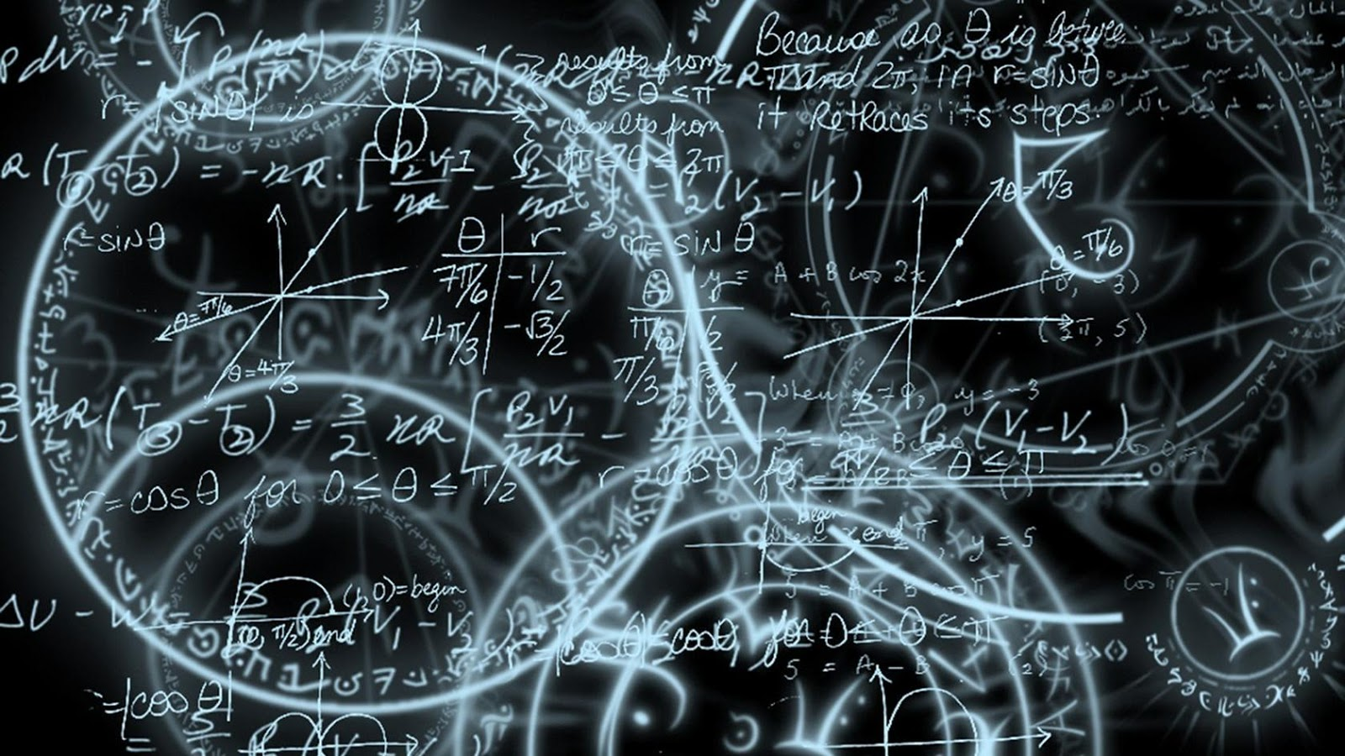
Cryptography Best Practices
Chris Lomont, PhD
Logikos, Apr 2018

Slide 2

HELLO!
I am Chris Lomont
You can find me at
clomont@logikos.com
Chris@Lomont.org

Slide 3

About Logikos
Software Services
  Fort Wayne, IN
  Founded 1978
Areas
  Embedded
  Desktop
  Web Applications and Design
  Mobile Applications
  Software Testing
Clients
  Automotive
  Commercial Services
  Consumer Electronics
  Govt and DoD
  Medical
  Retail
  Others

Slide 4
Encryption
Cryptography (noun)
- the practice and study of techniques for secure communication in the presence of adversaries
“Few false ideas have more firmly gripped the minds of so many intelligent men than the one that, if they just tried, they could invent a cipher that no one could break.”
-- David Kahn, in "The Codebreakers"

Slide 5
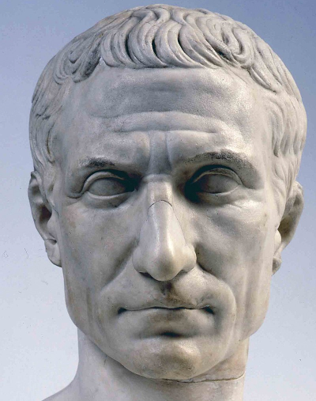
Substitution ciphers
Caesar cipher (used by Julius Caesar with a shift of 3)
A B C D E F G H I J K L M N O P Q R S T U V W X Y Z
D E F G H I J K L M N O P Q R S T U V W X Y Z A B C
Encrypt: substitute letters in row 2 for letters in row 1
  Encrypt(COMPUTER) gives FRPSXWHU
Decrypt: substitute letters in row 2 for letters in row 1
  Decrypt(Encrypt(COMPUTER))= Decrypt(FRPSXWHU) = COMPUTER

Slide 6
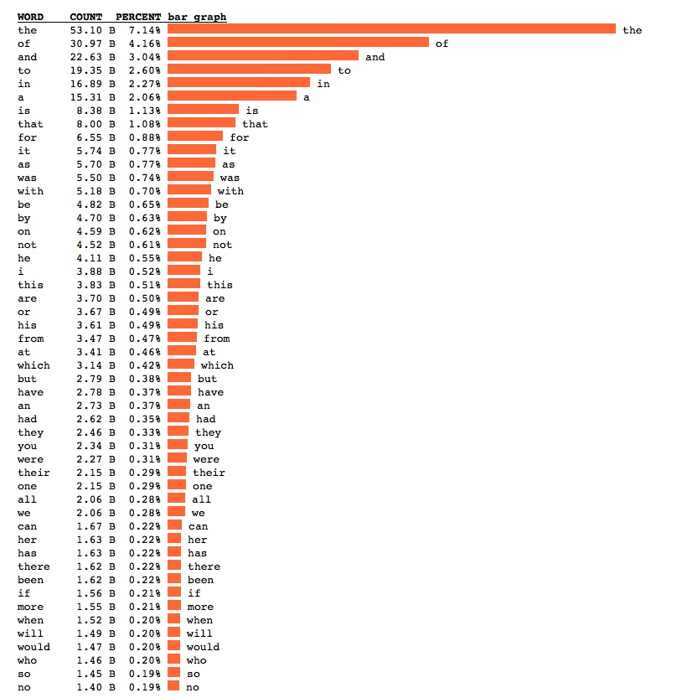
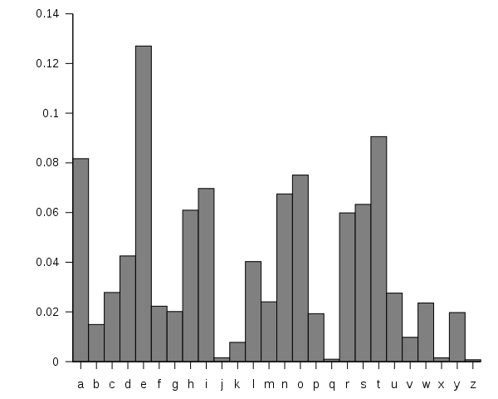
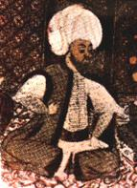
Breaking simple ciphers
Broken by frequency analysis
  ‘e’ and ‘t’ most common letters
  Common 2 and 3 letter words give more info
First known recorded explanation of
frequency analysis
  9th century, “A Manuscript on Deciphering Cryptographic Messages”
  by Arab Al-Kindi
  First writing of any kind of cryptanalysis
English word and letter frequencies
Notes:
Word distribution usually follow Zipf law: frequency inversely proportion to rank in frequency table, reasons not fully understood

Slide 7
Block ciphers
an n bit block cipher is a function E: {0, 1}^{n} x {0, 1}^{k} → {0, 1}^{n}, such that for each key K ∈ {0, 1}^{k}, E(x, K) is an invertible mapping from {0, 1}^{n} to {0, 1}^{n}
DES, AES, hundreds more
Message m broken into n bit chunks, each encrypted.
  Last may need padded
k bit key
…
E
n bit input
…
…
n bit output

Slide 8
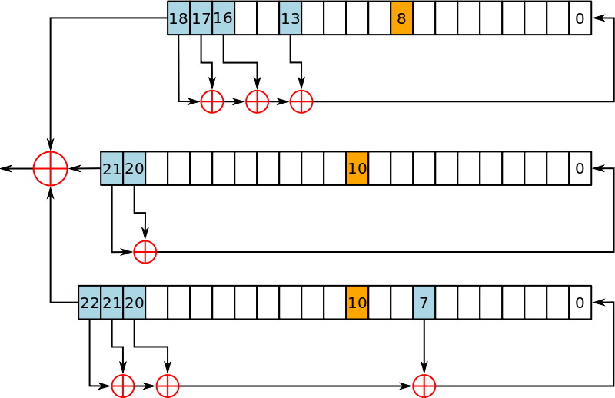
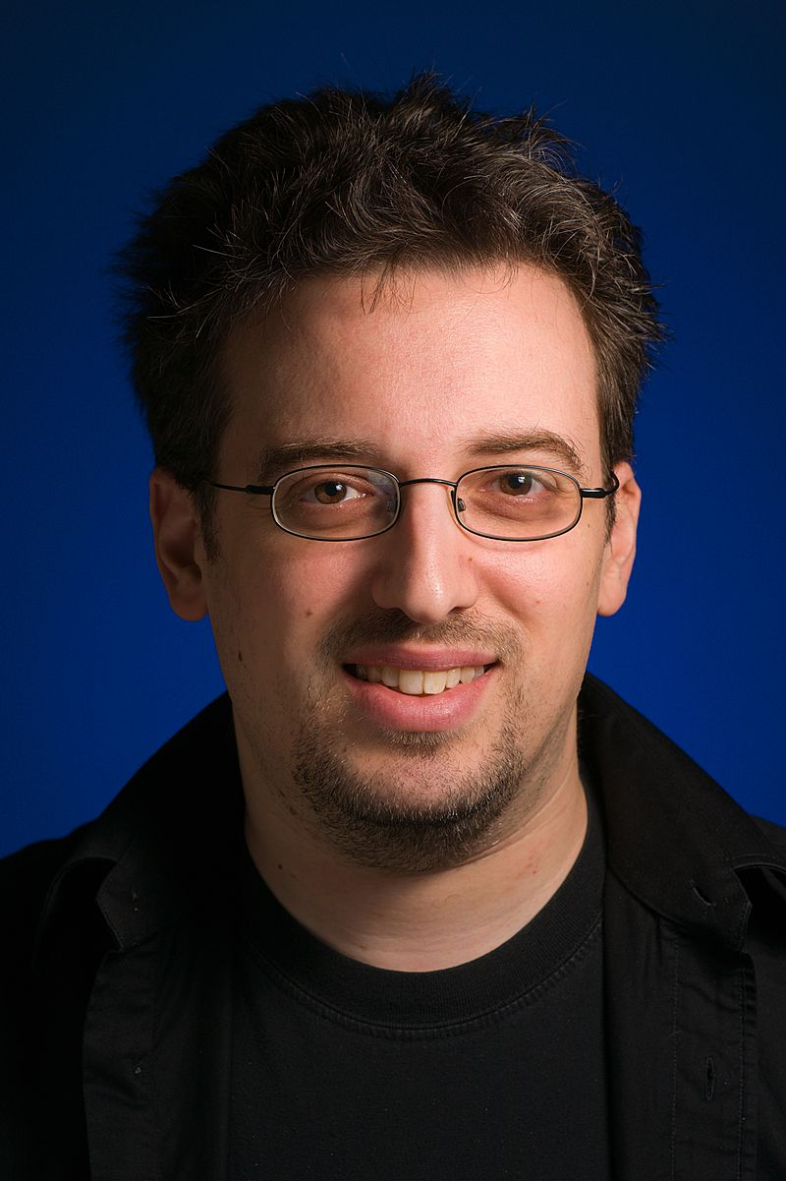
Stream ciphers
Similar to a one-time-pad
Alice creates a “stream” of “random” values,
  Must be reproducible by listener Bob
  XOR with message at both ends
Examples
  RC4 (Rivest, designed 1987, leaked 1994)
    Bad usage led to break in WEP
    2015: speculation some state agencies can break when used with TLS
    RFC 7465 prohibits use of RC4 in TLS
  ISAAC (Jenkins 1993) – minor weaknesses, still ok to use
    Used in UNIX shred to wipe data
  Salsa20 (Bernstein, 2007)
    Best known attacks break 8 of the 12 or 20 rounds, still usable
  ChaCha (Bernstein 2008)
    Selected by Google to replace RC4 in TLS
    Used in OpenSSH, OpenBSD, NetBSD
    Linux kernel uses for /dev/urandom
Keystream generator for A5/1, used to encrypt GSM mobile phones, weak/broken

Slide 9
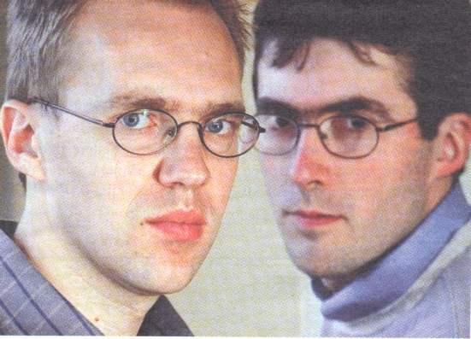
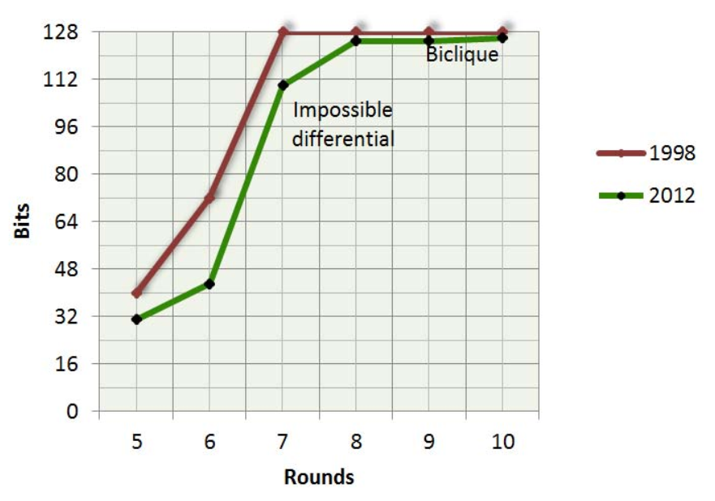
Advanced Encryption Standard (AES)
NIST sponsored competition, started 1997,
needed to replace 3DES
AES wins (Vincent Rijmen, Joan Daeman)
  Federal Standard in 2002
  Only publicly available cipher allowed for
  Top Secret data
Modern, strong, fast
Key is 128, 192, or 256 bits
  10, 12, or 14 cipher rounds
  Lots of hardware support
Attacks so far not very effective
Rounds | AES-128 | AES-192 | AES-256
8 | 125.4
10 | 126.2
12 |  | 189.7
14 |  |  | 254.2
Notes:
NIST = National Institute of Standards and Technology

Slide 10
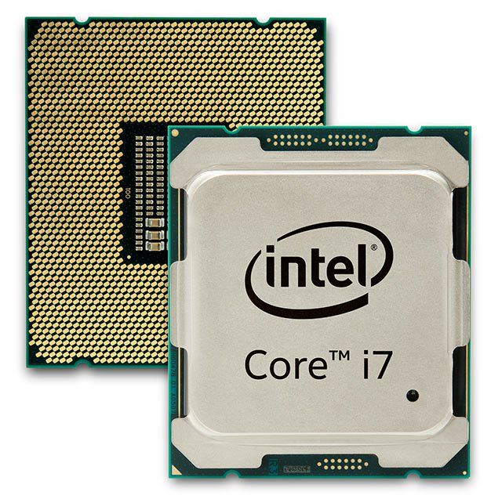
AES hardware and performance
Hardware support common
  Many servers spend significant time performing cryptography, speeds up greatly
  Intel AES-NI on x86 chips most commonly used
    7 instructions, AESENC does one round
  VIA PadLock
  SPARC T3,4,5 and later
  IBM Power7+
  IBM z9 and later mainframes
Example: Crypto++ (security library) AES-CGM
  throughout from 28.0 -> 3.5 cycles per byte

Slide 11

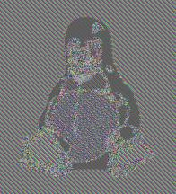

Importance of chaining
Doing each block of message independently leads to this:
Leads to chaining one block to next during encryption/decryption
Simple block by block called Electronic Codebook (ECB) chaining
Common method is called Cipher Block Chaining (CBC, 1976)
  AES-CBC is how you denote a block encryption algorithm and chaining mode
Example of DES on picture with no chaining (source Wikipedia)

Slide 12
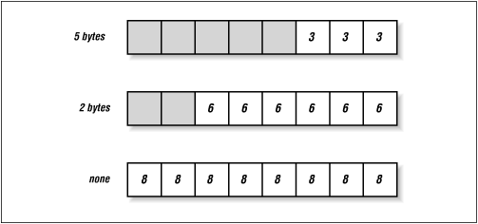
Padding modes
Done incorrectly leaks information
  OpenSSL prior to v0.9.6c had timing
  attacks in CBC-MAC
Often done to make receiver able to remove padding easily
Some methods
  Single 1 bit, rest 0 bits (ISO/IEC 9797-1)
  Last bit complemented and filled (Trailing Bit Complement)
  PKCS#5 and PKCS#7: last byte is copy of number n of n bytes added
  ISO 7816-4 Append 0x80, then all 0x00
  ISO 10126-2: # of pad bytes, then random bytes
  ANSI X9.23: 0x00 until last byte, then # of pad bytes
  All 0's (fragile)

Slide 13
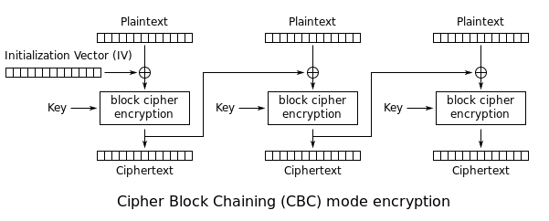
Cipher Block Chaining (CBC)
XOR one block output to next block input
First block requires initialization vector (IV)
  Guards against repeated initial data attacks
  Must be generated securely, never reused
Most used chaining mode
Drawbacks
  Encryption must be sequential
  Message needs padded
Notes:
Explain how works

Slide 14
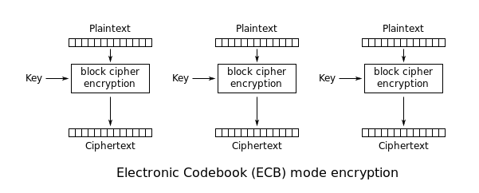
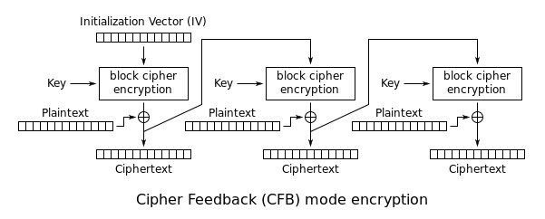
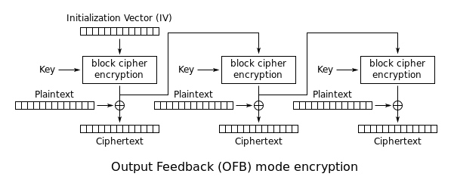
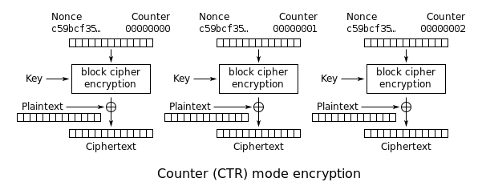
Common chaining modes
Electronic Codebook | ECB | Block by block (fast, parallel, weak)
Cipher Block Chaining | CBC | Cipher XOR with next plaintext (stronger, not parallel)
Cipher Feedback | CFB | Plaintext XOR into cipher blocks (strong, parallel, slower than OFB)
Output Feedback | OFB | Similar to CFB (encrypt/decrypt same, IV caution)
Counter | CTR | IV and counter, XOR plaintext (parallelizable, strong, IV caution)
Galois/Counter mode | GCM | Encrypt counter, XOR plaintext (Fast, strong, gives integrity)

Slide 15
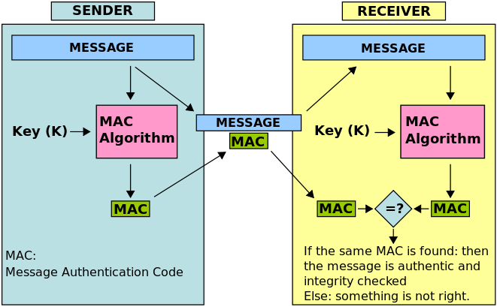
Message Authentication Code (MAC)
Also known as a “tag”
A short piece of data used to authenticate a message
  Authenticity: confirm the message came from the stated sender and has not been changed
  MAC protects both a message’s
  data integrity as well as its
  authenticity
  Allowing verifiers to detect any
  changes to the message content
  using shared secret key

Slide 16
Poly1305
Poly1305 (RFC 7539) : a modern message authentication code (MAC)
Computes a 16-byte authenticator of a message of any length
  16-byte nonce (unique message number)
  32-byte secret key
  breaking Poly1305 requires breaking AES
Details:
  message treated as 128 bit coefficients of a polynomial
    over ﬁnite ﬁeld field Z/(2^130−5)
  excellent performance without precomputation
  Important details in key format and message padding

Slide 17
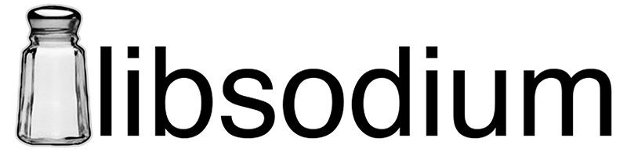
NaCl / libsodium
Networking and Cryptography Library: NaCl
  pronounced “salt”
  created by Daniel J. Bernstein
    Creator of Chacha, Curve25519, Poly1305, much more
  Main goal "avoid various types of cryptographic disasters suffered by previous cryptographic libraries".
  C, bindings in many languages, very permissive license

Slide 18
Guidelines I: Symmetric Encryption
Use authenticated Encryption (AEAD)
  ChaCha20-Poly1305 is faster in software than AES-GCM.
  AES-GCM will be faster than ChaCha20-Poly1305 with AES-NI.
  Poly1305 is also easier than GCM for library designers to implement safely.
  AES-GCM is the industry standard.
Use: (ordered by preference):
  The NaCl/libsodium default
  Chacha20-Poly1305
  AES-GCM
Avoid:
  AES-CBC, AES-CTR by itself
  Block ciphers with 64-bit blocks such as Blowfish
  OFB mode
  RC4, which is comically broken

Slide 19

Symmetric/Asymmetric key cryptography
Symmetric key (also called private key) methods – Alice and Bob have same, pre-shared key
  Above methods like this
Asymmetric key (also called public key) methods – Alice and Bob have different keys, usually not pre-shared
  Diffie and Hellman’s paper opened the door to a new kind of cryptography
  Biggest advance in cryptography in 3000 year history
Public key methods
  Each user has a private key K as before, and a public key denoted K⁻¹
  Public key known to all, used to encrypt by anyone
  Private key only known to listener, used to decrypt
Methods require it is hard (computationally infeasible) to compute K (private) from K⁻¹ (public)
  Computational complexity another interesting talk!
Public key used in S/MIME, GPG, PGP, Internet key exchange, SSL, TSL, SSH, Bitcoin, others
Notes:
Ask who knows P!=NP problem, what P or NP means, anyone know other classes?

Slide 20
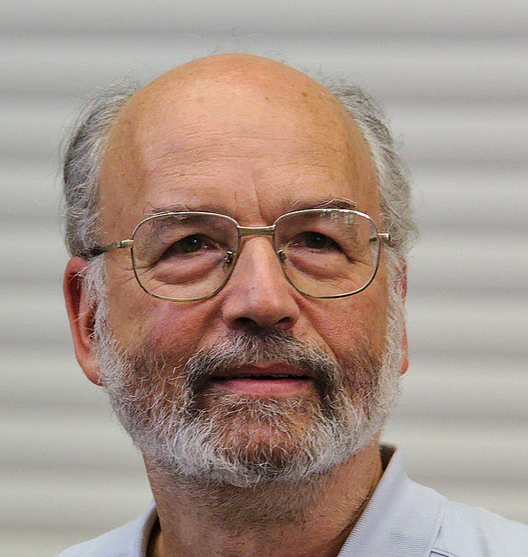
RSA
RSA = Rivest, Shamir, Adelman, 1977
  Currently most commonly used public key system
  Based on: multiplication fast, factoring slow
Key generation
  Generate 2 primes
  ~1000 bits each
Encryption
  Done by anyone with the public key
Decryption
  Only done with knowledge of private key
Requires large key sizes (2048-4096 bits common)
Various attacks require care in using
  300 bit number factored in 20 minutes on i7
  1999 factoring RSA-512 took 8400 MIPS years over 7 months
  2009 a RSA-512 key factored in 73 days by PC
  2010 a RSA-768 key factored (1500 CPU years)
  Inserting proper random padding into the message
  Cannot pick “bad” primes else key weak
  Timing attacks
  Adaptive chosen plaintext attacks (requires better message padding)
  Side channel: branch prediction exploited to attack RSA
Notes:
Cover this slide in depth – anecdote about Fermat (last theorem), Euler (most prolific in history, ~70 quarto volumes for collected works), went blind, claimed “I will now have fewer distractions,” and became more prolific (e.g., averaged a paper a week in 1775)

Slide 21
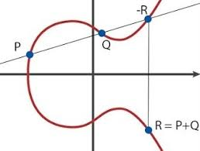
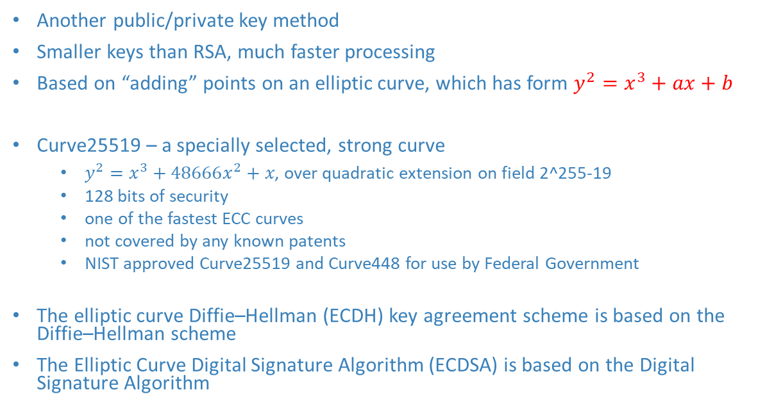
Elliptic-curve cryptography
Another public/private key method
Smaller keys than RSA, much faster processing
Based on “adding” points on an elliptic curve, which has form $y^{2}=x^{3}+ax+b$
Curve25519 – a specially selected, strong curve
  $y^{2}=x^{3}+48666x^{2}+x\text{, }\text{over} \text{quadratic} \text{extension} \text{on} \text{field}\text{ 2^255−19}$
  128 bits of security
  one of the fastest ECC curves
  not covered by any known patents
  NIST approved Curve25519 and Curve448 for use by Federal Government
The elliptic curve Diffie–Hellman (ECDH) key agreement scheme is based on the Diffie–Hellman scheme
The Elliptic Curve Digital Signature Algorithm (ECDSA) is based on the Digital Signature Algorithm

Slide 22
Guidelines II: Asymmetric Encryption
Use:
  ECC
  NaCl/libsodium
Avoid:
  RSA
    Attacks progressing faster than on ECC
    ECC much faster
  ElGamal
  OpenPGP, OpenSSL, BouncyCastle, etc.
  Do not implement your own – full of pitfalls
Notes:
It's time to stop using vanilla RSA, and start using NaCl/libsodium. Of all the cryptographic "best practices", this is the one you're least likely to get right on your own. NaCl/libsodium has been designed to prevent you from making stupid mistakes, it's highly favored among the cryptographic community, and focuses on modern, highly secure cryptographic primitives.
It's time to start using ECC. Here are several reasons you should stop using RSA and switch to elliptic curve software:
Progress in attacking RSA --- really, all the classic multiplicative group primitives, including DH and DSA and presumably ElGamal --- is proceeding faster than progress against elliptic curve.
RSA (and DH) drag you towards "backwards compatibility" (ie: downgrade-attack compatibility) with insecure systems. Elliptic curve schemes generally don't need to be vigilant about accidentally accepting 768-bit parameters.
RSA begs implementors to encrypt directly with its public key primitive, which is usually not what you want to do: not only does accidentally designing with RSA encryption usually forfeit forward-secrecy, but it also exposes you to new classes of implementation bugs. Elliptic curve systems don't promote this particular foot-gun.
The weight of correctness/safety in elliptic curve systems falls primarily on cryptographers, who must provide a set of curve parameters optimized for security at a particular performance level; once that happens, there aren't many knobs for implementors to turn that can subvert security. The opposite is true in RSA. Even if you use RSA-OAEP, there are additional parameters to supply and things you have to know to get right.
If you have to use RSA, do use RSA-OAEP. But don't use RSA. Use ECC.

Slide 23
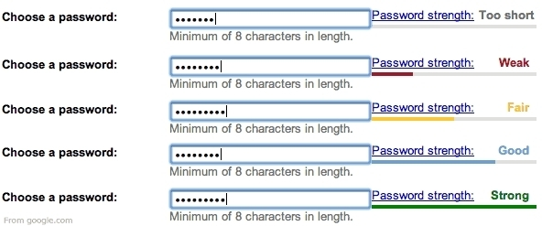
Key length for symmetric algorithms
Usually measured in bits, denoted n
Gives upper bound on algorithm security
Attacks often weaken security to lower number of bits
128 considered decent (until quantum computers common)
NSA requires 256 bits AES for Top Secret classified data
2015: NIST disallows key strength of 112 bits or lower

Slide 24
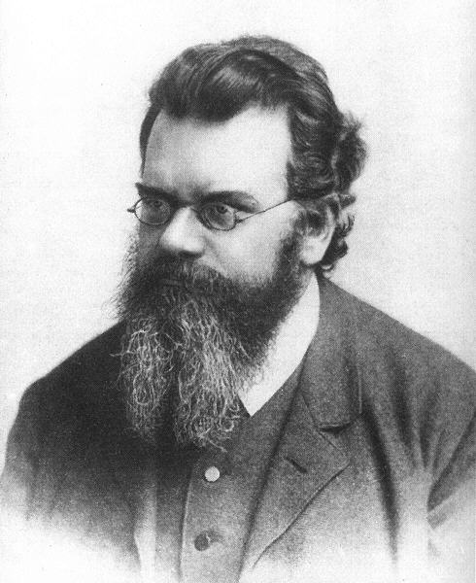
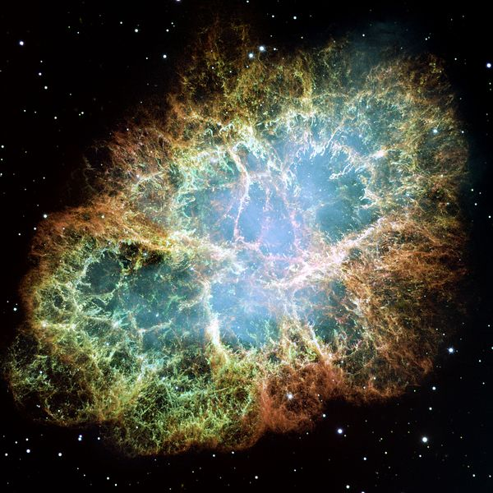
Thermodynamics limits
Landauer’s Principle : To set or clear a bit requires no less than kT ln(2)
  k is the Boltzman constant (1.38*10⁻²³ J/ºK)
  T is the absolute temperature of the system in degrees Kelvin
  ln(2) is natural log of 2, ~0.69
  (Aside – can do reversible computation with zero energy!)
Assuming T = 2.73 degrees K (ambient temperature of universe)
  kT ln(2) = 2.6*10⁻²³ J per bit change
  1J = amount of energy needed to lift average tomato up 1 meter
Annual energy generation on earth 6*10²⁰ J = cycle a 144 bit counter
Annual energy output of the sun 1.2*10³⁴ J = cycle a 188 bit counter
Supernova produces in the neighborhood of 10⁴⁴ J = cycle a 221-bit counter
Notes:
relating the average kinetic energy of particles in a gas with the temperature of the gas, as fundamental as speed of light c or gravitational constant G
Landauer’s Principle has modern challenges – read the literature
Counters assume Gray code (1 bit change per new value)

Slide 25
Key length revisited
Key size for public systems are not comparable with key sizes for private systems
  Public systems usually have more mathematical “structure”, making them weaker per bit of key size
  NTRU hard to compare, very strong, between Symmetric and ECC
Larger key sizes require more storage and transmission space, usually result in more computation to use
Symmetric (AES, DES, etc.) | 80 | 128 | 256
RSA | 1024 | 3072 | 15,360
ECC | 160 | 256 | 512
Notes:
Explain why structure weakens key length

Slide 26
Guidelines III: Key lengths
Symmetric algorithm (AES, …) key lengths
  Use:
    128 bit minimum key length, preferred 256
    AES key is far less likely to be broken than your public key pair
  Avoid:
    Constructions with huge keys (slow, usually nonsense)
    Cipher "cascades"
    Key sizes under 128 bits
Public key lengths (RSA, ECC, …)
  NOTE public keys usually much larger than symmetric keys
  Use:
    256-bit minimum for ECC/DH Keys , preferred 512 bit
    2048-bit minimum for RSA/DH Group, preferred 4096
  Avoid:
    Anything smaller
Notes:
As with symmetric encryption, asymmetric encryption key length is a vital security parameter. Academic, private, and government organizations provide different recommendations with mathematical formulas to approimate the minimum key size requirement for security. See BlueKcrypt's Cryptographyc Key Length Recommendation for other recommendations and dates.
To protect data up through 2020, it is recommended to meet the minimum requirements for asymmetric key lengths:
See also the NSA Fact Sheet Suite B Cryptography and RFC 3766 for additional recommendations and math algorithms for calculating strengths based on calendar year.
Personally, I don't see any problem with using 2048-bit RSA/DH group and 256-bit ECC/DH key lengths. So, my recommendation would be:

Slide 27
Passwords
Break all the things!
“Cryptography is typically bypassed, not penetrated” -- Adi Shamir

Slide 28
Hashing
Hashing takes arbitrary length bit-string into fixed length n bits
Useful to protect files from tampering
Collisions unavoidable
A secure hash makes finding collisions hard
Message m is hashed by hash function h as h(m)
message of arbitrary length
hash
function
fix length
hash value / message digest / fingerprint

Slide 29
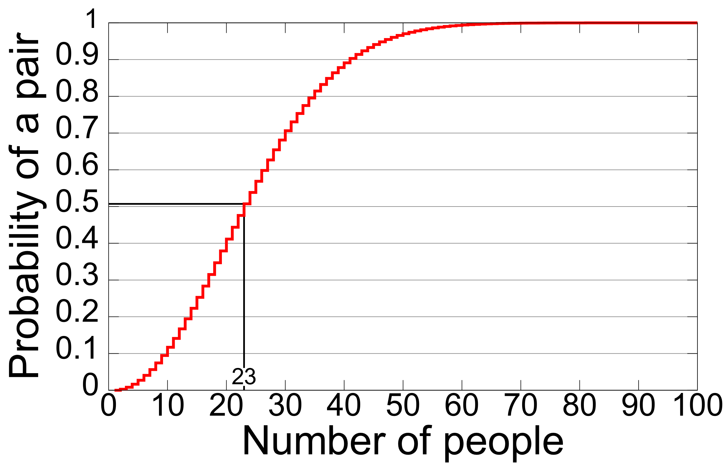
Hashing
Desires:
  Efficient: given m, h(m) easy to compute
  Weak collision resistance: given m, hard to find m’ so h(m)=h(m’)
  Strong collision resistance: hard to find m, m’ so h(m)=h(m’)
  One-way: given hash value y, hard to find x so that h(x)=y
Avalanche effect: changing a single bit of input changes each output bit with 50% probability (SHA-3)
  SHAKE128("The quick brown fox jumps over the lazy dog", 256)
  f4202e3c5852f9182a0430fd8144f0a74b95e7417ecae17db0f8cfeed0e3e66e
  SHAKE128("The quick brown fox jumps over the lazy dof", 256)
  853f4538be0db9621a6cea659a06c1107b1f83f02b13d18297bd39d7411cf10c
Birthday paradox
  Likely collision in few items
  For n-bit hash, if there are 2^{n/2} hashes, there is a likely collision
  160-bit or higher recommended for most applications
Notes:
Birthday Paradox – 23 people in room gives > 50% of matching birthday (assuming uniform 1/365 dist) – see who knows, ask others to guess
99.9% chance with only 70 people (out of 366 possible birthdays)

Slide 30
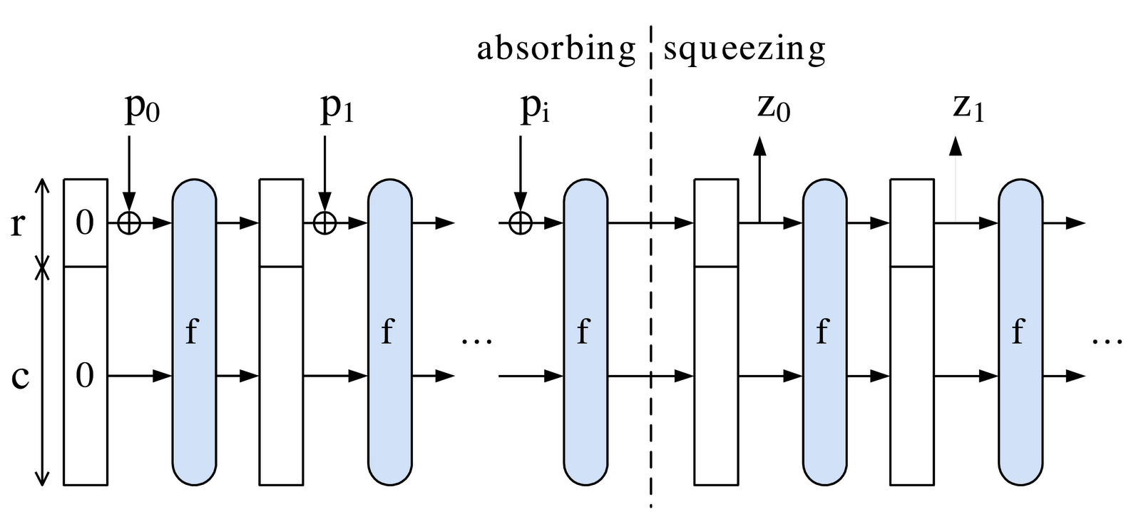
SHA-3
Bertoni, Daeman (AES), Peeters, Assche
Novel “sponge” construction
  Data “absorbed” into subset of state via XOR
  State transformed via efficient permutation function f
  Hash “squeezed” out from same state subset, blocks alternate with f
  Extra internal state prevents length extension attack
    Lets hacker compute H(message1 + message2) given H(message1)
    Attack possible on SHA-2, SHA-1, MD5, others
Internal state 1600 bits (5x5x64), 24 rounds, Padding is 10*1
Defines two arbitrary output length streams (stream ciphers)
  SHAKE128 and SHAKE256
Fast in hardware, slow in software (2x over SHA-2, 3x over SHA-1)

Slide 31
SHA-3
  SHA-3 sizes and bit security, cycles per byte on Intel Skylake
 | SHA3-224 | SHA3-256 | SHA3-384 | SHA3-512 | SHAKE128 | SHAKE256
Output bits | 224 | 256 | 384 | 512 | d (any) | d (any)
Block size | 1152 | 1088 | 832 | 576 | 1344 | 1088
security | 112 | 128 | 192 | 256 | Min(d/2,128) | Min(d/2,256)
Qc security | 74 | 85 | 128 | 170 | Min(d/3,128) | Min(d/3,128)
Skylake cpb | 8.12 | 8.59 | 11.06 | 15.88 | 7.08 | 8.59

Slide 32
Guidelines IV: Hashing / HMAC
Use:
  Hash with truncated output (sidesteps length extension attacks)
  SHA3-512
  SHA3-256
  HMAC-SHA-512/256
Avoid:
  HMAC-MD5,HMAC-SHA1, MD6
  Custom "keyed hash" constructions
  Complex polynomial MACs
  Encrypted hashes
  Anything CRC
Notes:
As with symmetric encryption, asymmetric encryption key length is a vital security parameter. Academic, private, and government organizations provide different recommendations with mathematical formulas to approimate the minimum key size requirement for security. See BlueKcrypt's Cryptographyc Key Length Recommendation for other recommendations and dates.
To protect data up through 2020, it is recommended to meet the minimum requirements for asymmetric key lengths:
See also the NSA Fact Sheet Suite B Cryptography and RFC 3766 for additional recommendations and math algorithms for calculating strengths based on calendar year.
Personally, I don't see any problem with using 2048-bit RSA/DH group and 256-bit ECC/DH key lengths. So, my recommendation would be:

Slide 33
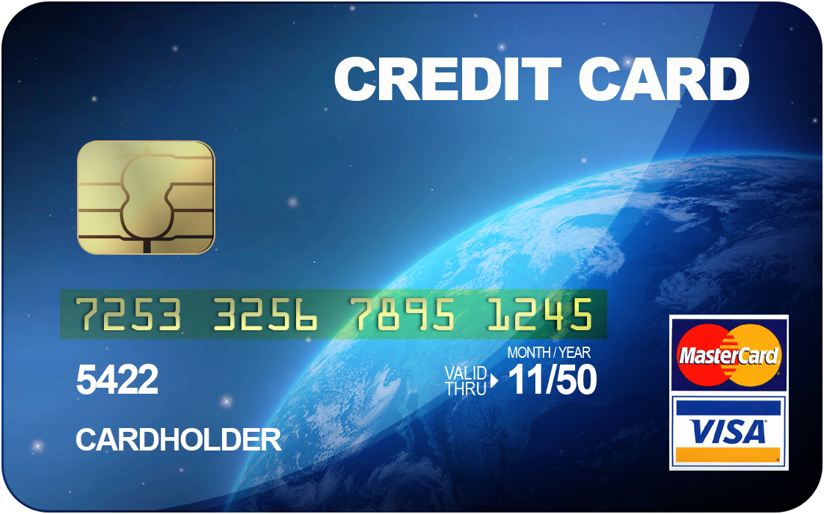

Password background I
THIS IS NOT THE FINAL ANSWER – DO NOT DO THIS!
Computer systems requiring password authentication should not store a list of passwords (same for credit cards, etc.)
  Such a list, if stolen, allows access, making it a target
First idea: hash the password, store the hash
  To authenticate user, get password, hash it, compare
  Stops attacker from using stolen (hash of) password file, since she cannot enter the password.
How to break this?

Slide 34
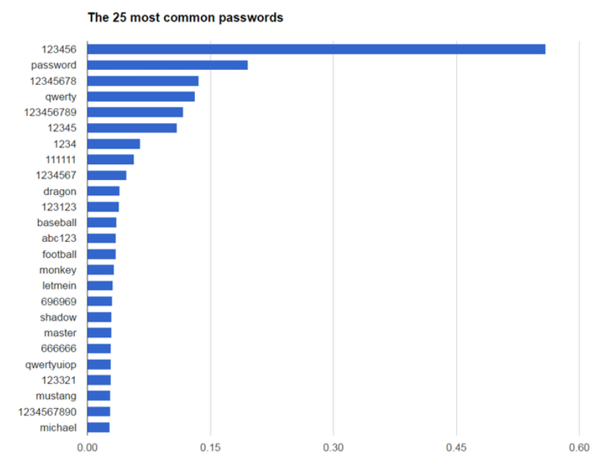

Password background II
Users choose poorly
  many passwords common, not much entropy
Attacker steals list of hashed passwords
  Assumes weak passwords exist
  Hashes most frequent passwords
  Can find matches, use to access
Making list only needs done once, can be used to attack many places efficiently
So how about storing 37th hash? Or 101st hash? Now attacker needs new tables
  Attacker tables grow unwieldy
Rainbow tables
  Rainbow table: for each common password, hash N times, store password and last hash.
  Give unknown hashed password, hash it N times, check table each time.
  If a hit, then the password is most likely the one starting the chain.
  Breaks places that store hashed passwords as long as table computed to higher N than stolen password
  Many other flavors of rainbow tables used to attack different things
Notes:
Common other use: R is reduction function of hash to some text, then store chains of
password->H=hash->R=another pwd->H=another hash->… Store start and end pwd, now given hash, repeat process, looking for pwds in table, when hit, recompute chain

Slide 35
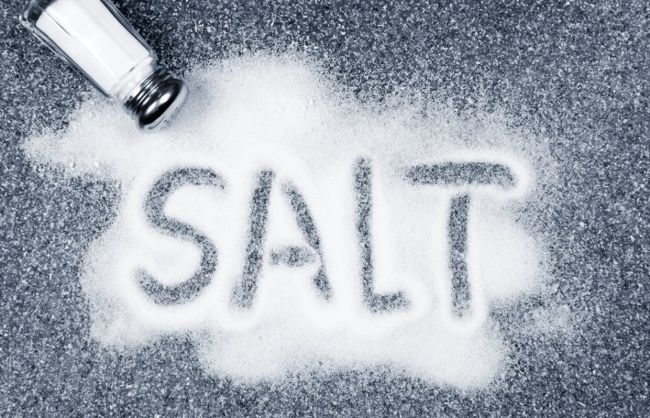
Password background III
Rainbow table protection
  Mix in some randomness so table is useless
  Random “salt” is added: store salt and hash(concat(salt,password))
  Authentication then gets user password, looks up salt, hashes, checks
Salt
  Must be generated in cryptographically
  secure, random manner
  Must never be reused
    Each password and password change
    generates a new one

Slide 36
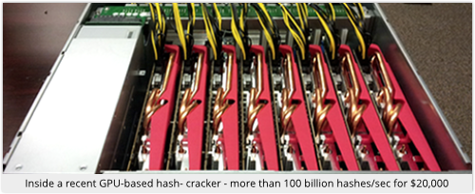
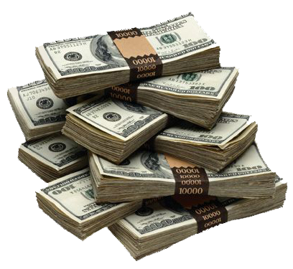
Password background IV
Still possible to brute force a password
  Brute force (ever had to crack a zipfile?)
Given stolen, salted, hashed password list
  For each possible or common password, run algorithm on it, check list
  Can be massively parallelized (CUDA, AWS, FPGA, ASIC, etc.)
Make this more expensive!
  Iterations: more iterations of slow hash functions
  forces attacker to use more time to check
  Entropy: larger space of passwords makes attacker
  search longer

Slide 37
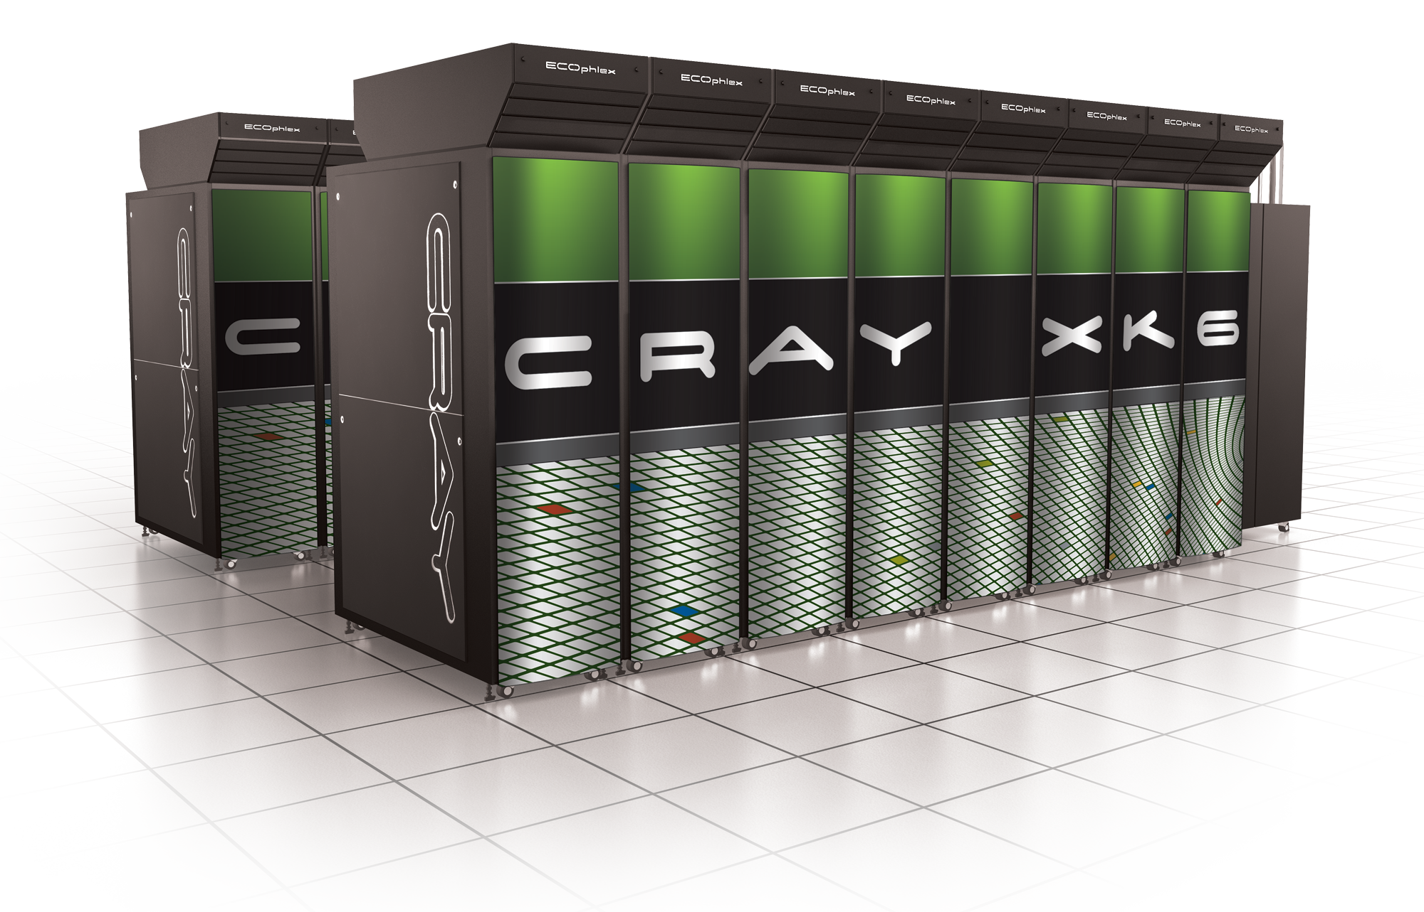
Password background V
Entropy – size of password space
  More letters: require upper+lower
  Add numbers, symbols
  Make longer
More efficient to simply use longer passwords
  10 char upper+lower is weaker than 13 long lowercase only 52¹⁰ < 26¹³
  10 char upper+lower+digits+symbols is weaker than 14 long lowercase only 72¹⁰ < 26¹⁴
Doubling iteration count (cheap) doubles computational power (expensive) needed for brute force

Slide 38
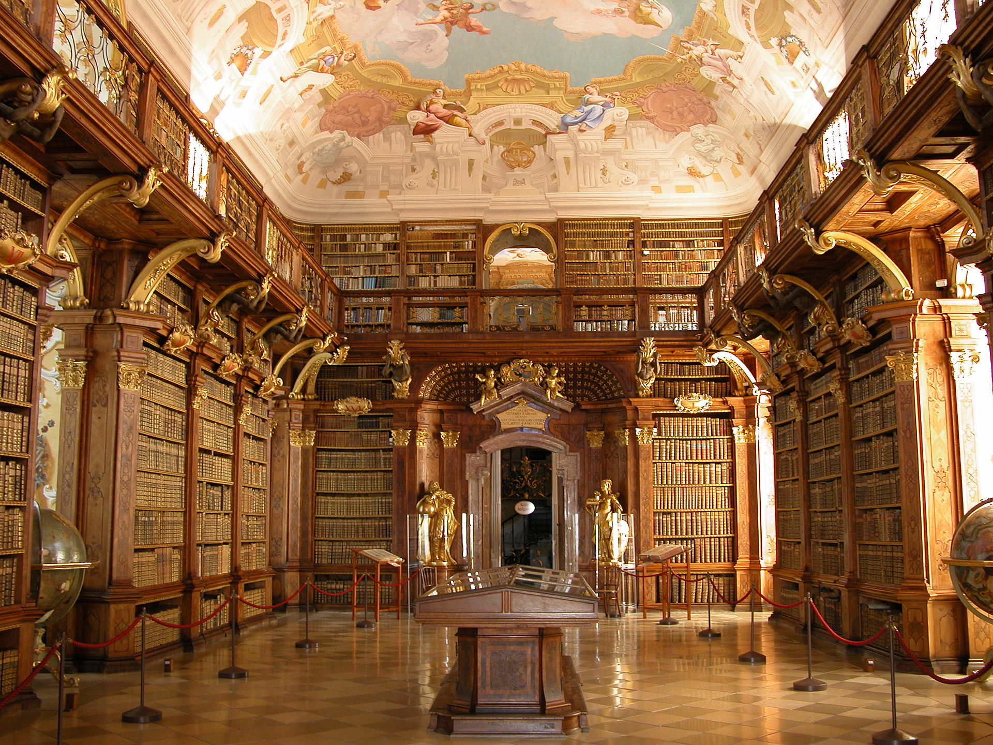
Password background VI
Many good libraries/protocols for this
  All use iteration count and above knowledge
  PBKDF2
    RSA designed, still recommended
    Takes any hash function
    Small hardware footprint makes it cheaper to attack with hardware
  bcrypt (1999)
    Blowfish based
    Slower than PBKD, uses lots of RAM to make ASIC attacks harder
  scrypt (2009, RFC 7914) – newer
    Newer = riskier, slower
    Uses exponential time and RAM to push back hardware attacks
    Most hardware attack resistant
Over time, increase iteration count to make stronger
  Simply store iteration count with salt and hash

Slide 39
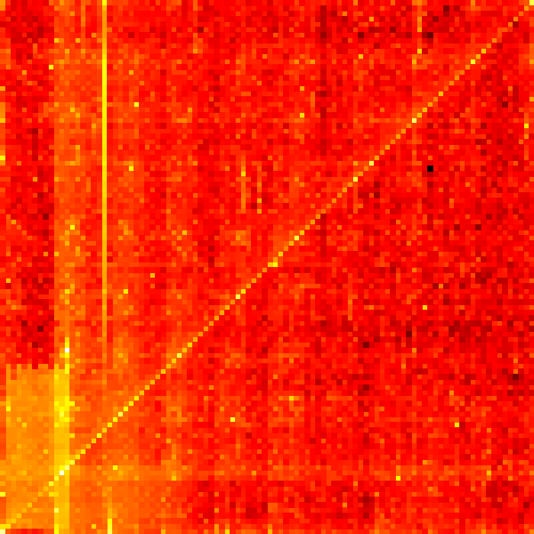
Password/passphrase evidence
2012, Bonneau & Shutova
  Attacked passphrase dataset that was leaked.
  Found ~8,000 phrases using 20,000 phrase dictionary (1% of passphrases)
  Computed that this is 20 bits security for attacking 1% of accounts
  Standard passwords provide 10 bits against 1% of account attacks
  Need to rate limit password/passphrase attempts!
PIN heatmap
  3.4 million PINs
  Top 20 most common are ~20% of all
    1234 = 10%, 1111 = 6%, 0000 = 1.8%, 1212 = 1.2%
  What are the bright specks/lines/blocks?
Notes:
Nice article on PIN heatmap here http://www.datagenetics.com/blog/september32012/
Heatmap: X is 2 leading digits, Y is second 2 digits
From 3.4 million leaked PINs
Most popular 1234 (10%), 1111 (6%), 0000 (1.8%), 1212 (1.2%)
20% consist of just 20 PINs
Common geometry: 2580 is #22, is straight down a usual 10 digit pad
Repeated couplets are 17.8% of all
Diagonal is repeated couplets: 0404, 9292, etc.
Vertical bar is birth year (with 2000s at bottom)
Vague grid pattern is from selecting close pairs 67, 43, etc.
Lower left bias is start with 0 or 1
Lower block is birthdays MMDD
Bright specks are runs: 1234, 5678, etc

Slide 40
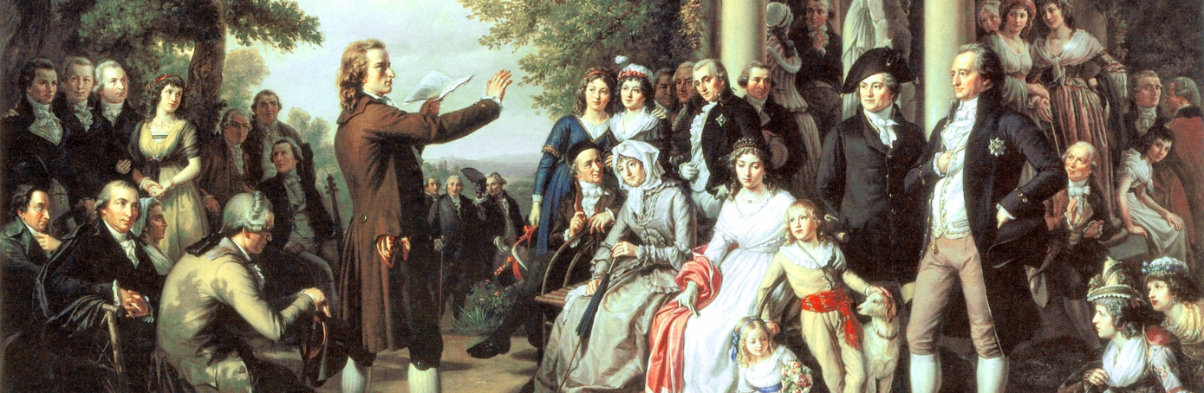
Password enlightenment I
In summary:
Salt: never reuse, new for each password and password change, length >= hash block length
Hash: MD5 bad, SHA-1 bad, SHA-2 usable, SHA-3 good.
(MD5, SHA-1, SHA-2 allows length extension attacks)
Iterations: 50K or more, check current recommendations when implementing
Library: scrypt, bcrypt, or PBKDF2
Store: iteration count, salt, and hash (and maybe hash algorithm, allowing future changes) in database.
Increase: iteration count over time as hardware speeds improve
(Optional)
  Key: add extra key used in hash, hide that key, helps protect
  Erase: don’t keep things around in memory you don’t need, never keep passwords in memory longer than needed, or on swap files, or anywhere!
  Multi-factor: use multi-factor authentication when possible

Slide 41
Password enlightenment II
Good password hygiene
  Large entropy: longer is better than more variety, 14+ chars pretty good, 20+ excellent
  Keep weird – don’t use common phrases
  Avoid predictability – if required to use special chars, mix them, not simply at end or beginning
  Never reuse passwords – use a password manager to manage many
NIST released new guidelines (Jun 22, 2017, SP 800-63-3)
  Remove periodic password change requirements – multiple studies show this to be counterproductive
  Drop required password character complexity: no more required upper/lower + digits + symbols. This results in worse passwords.
  Require screening of new passwords against common words and phrases
As result – best practices is now long, unique passphrases, no needed rotation, no special characters required.
  Maybe a sentence, not a common or cultural phrase.

Slide 42
Guidelines V: Passwords
Use, in order of preference:
  scrypt
  bcrypt
  sha512crypt
  sha256crypt
  PBKDF2
Avoid:
  Plaintext
  Naked SHA-2, SHA-1, MD5
  Complex homebrew algorithms
  Any encryption algorithm
Notes:
As with symmetric encryption, asymmetric encryption key length is a vital security parameter. Academic, private, and government organizations provide different recommendations with mathematical formulas to approimate the minimum key size requirement for security. See BlueKcrypt's Cryptographyc Key Length Recommendation for other recommendations and dates.
To protect data up through 2020, it is recommended to meet the minimum requirements for asymmetric key lengths:
See also the NSA Fact Sheet Suite B Cryptography and RFC 3766 for additional recommendations and math algorithms for calculating strengths based on calendar year.
Personally, I don't see any problem with using 2048-bit RSA/DH group and 256-bit ECC/DH key lengths. So, my recommendation would be:

Slide 43
Other needed protocols
Secure all the things!
“If you think cryptography is going to solve your problem, you don't understand cryptography and you don't understand your problem.” -- Roger Needham

Slide 44
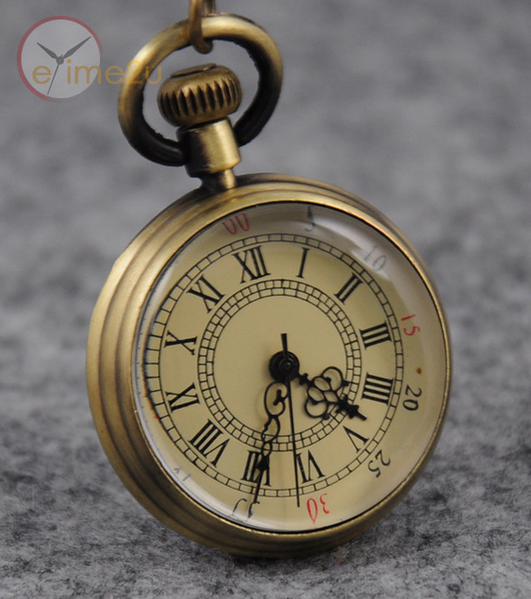
Speed
Private key much faster than public key
From Crypto++ library timings
  Fedora release 25 (x86_64)
  6th gen Skylake CPU, 3.1GHZ
If you invent a secure public key
method as fast as private, you’ll
be a billionaire
Algorithm | MiB/s
AES-CBC (256 bit) | 806
MD5 | 493
ChaCha20 (256 bit) | 499
DES-CTR (64 bit) | 78
RSA 2048 Encryption | 7.8
RSA 2048 Decryption | 0.23
ECC (ECIES) 256 | 0.22
NTRU | ~40

Slide 45
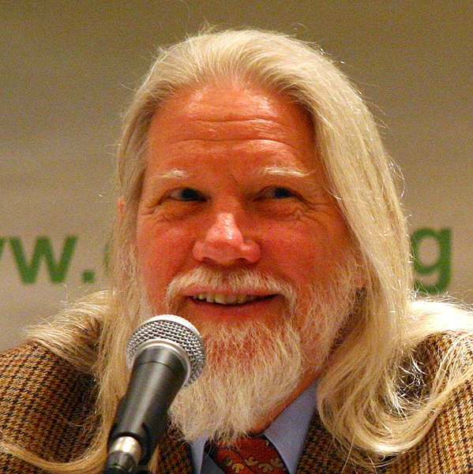
Key exchange
To be a useful encryption method, must have a good way for users to agree on keys
Diffie-Hellman (1976) published the Diffie-Hellman key exchange
  Based on fact (gª) ^{b} = (g^{b}) ª = g^{ab}
    Computed mod p
    Everyone knows p and g, including attackers
    a = Alice secret choice
    b = Bob secret choice
    After exchange, Alice and Bob agree on value of k=g^{ab} as secret key
    Based on fact raising to power is computationally easy but taking root is computationally hard
    Only transmitted items are gª and g^{b}, from which attackers cannot easily compute a or b
  Doesn’t do authentication: man in the middle possible
Often called Diffie-Hellman-Merkle to recognize Merkle’s contribution
Notes:
Paper was “New directions in cryptography”

Slide 46
Guidelines VI: Key Exchange (Diffie Hellman)
Use, in order of preference:
  NaCl/libsodium
  2048-bit Diffie-Hellman Group #14
  Curve25519 – heavily analyzed and tested
Avoid:
  conventional DH
  SRP
  J-PAKE
  Handshakes and negotiation
  Elaborate key negotiation schemes that only use block ciphers
  srand(time())
  Implementing your own – very hard to get right

Slide 47
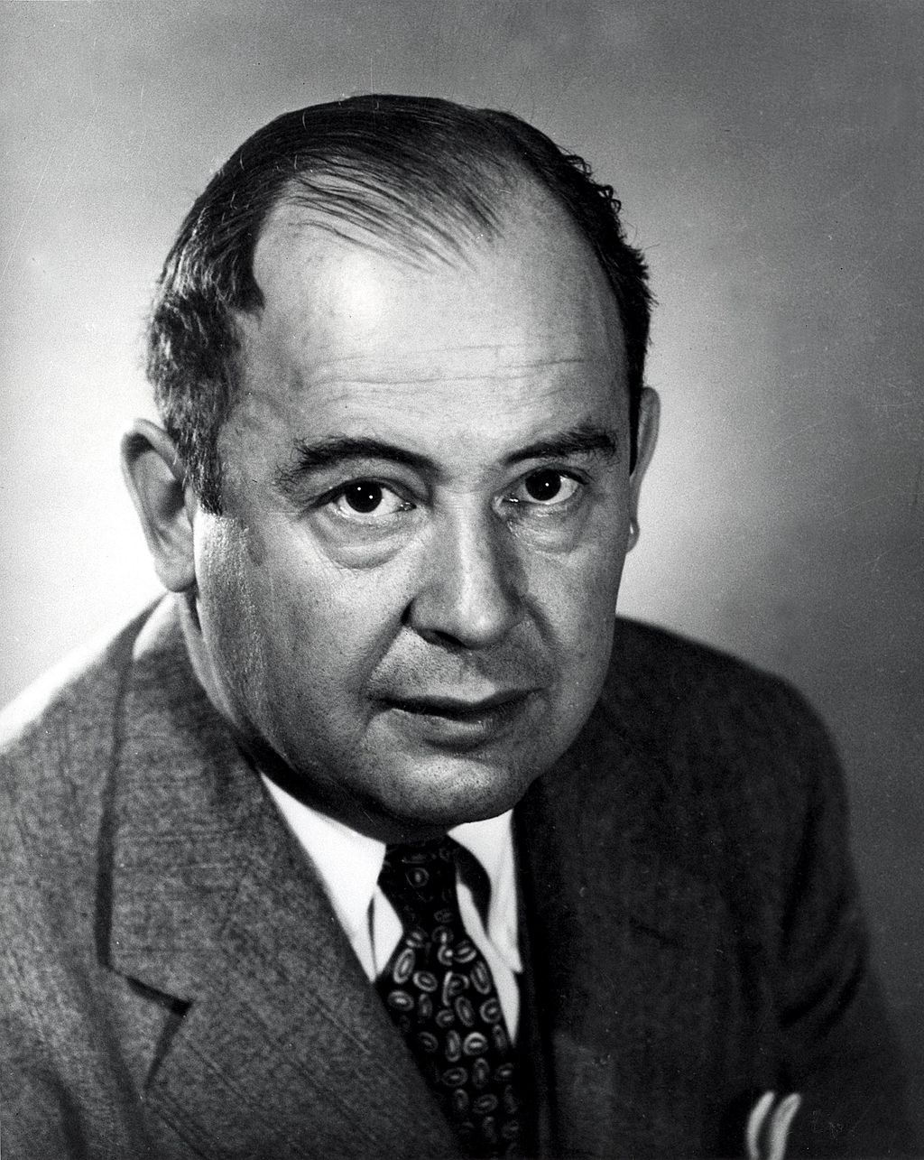
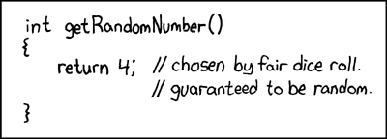
Random number generators (RNGs)
Random: cannot be predicted by an observer before generated.
Pseudo-random number generator (PRNG) creates “random” looking numbers from deterministic algorithm
  PRNGs are entire field
  “Anyone who attempts to generate random numbers by
  deterministic means is, of course, living in a state of sin.”
  - John von Neumann
Crypto needs lots of them
  Key generation, one-time-pads, salts (later in talk), initialization vectors, more
Cryptographically secure pseudo-random number generator (CSPRNG)
  Passes statistical randomness tests
  Next-bit security: given k bits, no polynomial time algorithm gives k+1 bit
  State compromise resistance: knowing some state doesn’t give more state
  Hold up under other attack as needed
  Do not use normal PRNG when CSPRNG needed!
Obligatory XKCD
Notes:
John von Neumann – explain him

Slide 48
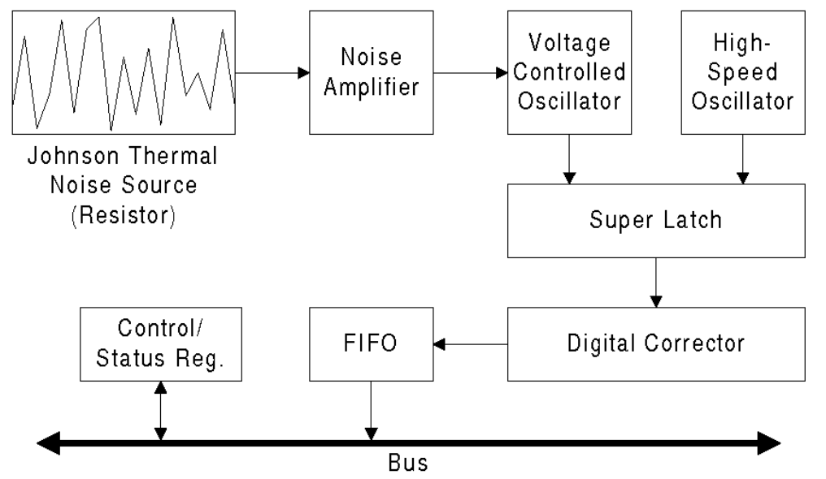
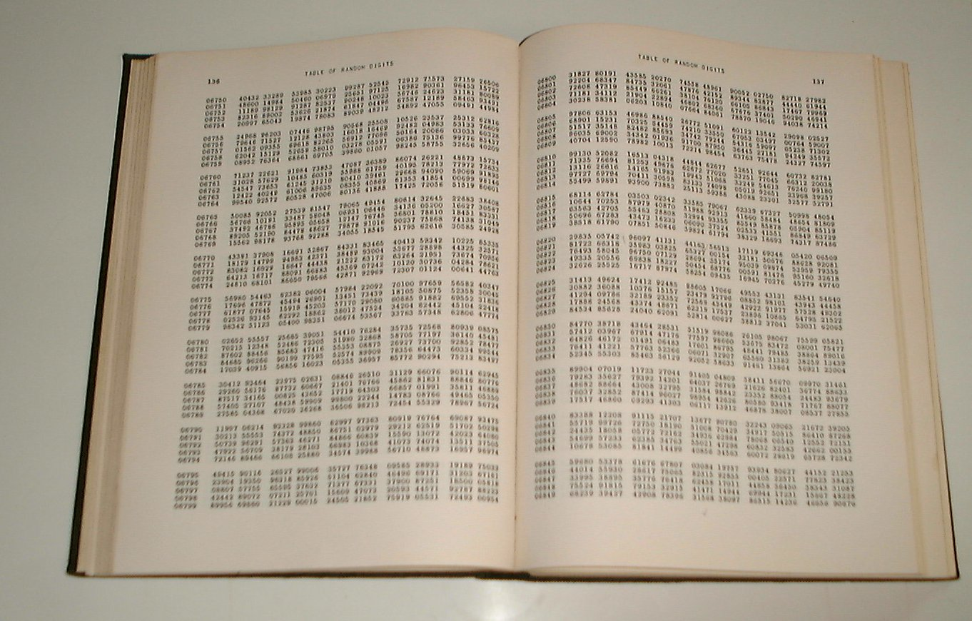
Random number generators (RNGs)
Steps:
  Get entropy from environment
    Network, keyboard, mouse, electrical noise,
    radioactive decay, system state
  Apply proper mixing to remove bias (called whitening)
Many CPUs now support in hardware
  Intel has RDRAND instruction taking 117 cycles for 64 bit value
  AMD has similar, takes ~2500 cycles
  Theodore T’so resisted using RDRAND in Linux /dev/random after NSA caught trying to weaken encryption
“A Million Random Digits with 100,000 Normal Deviates” (1955)
  A 400 page book with 10⁶ random digits produced by a roulette wheel
  Many humorous reviews on Amazon
Random.org – online generation from
weather noise.
Intel RNG

Slide 49
Guidelines VII: Random numbers
Use:
  Cryptographically secure numbers
  /dev/urandom
  CryptGenRandom
  Create: 256-bit random numbers
Avoid:
  Userspace random number generators
  /dev/random
  Anything vanilla C/C++

Slide 50
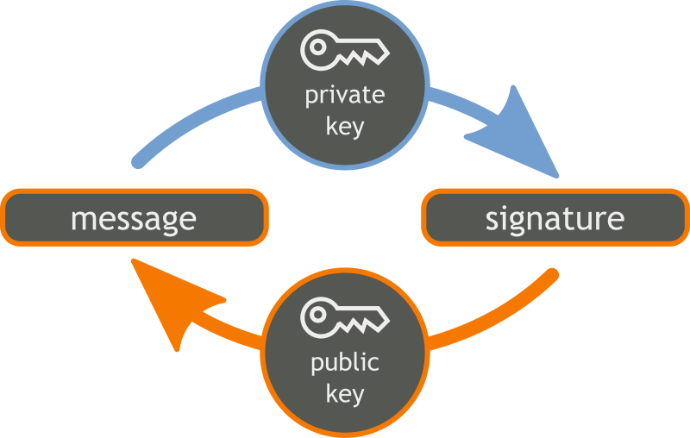
Digital signatures
Used for message authentication and
non-repudiation of origin
  Can prove (legally) that someone signed a
  document digitally
Based on public key crypto
  Sign with private E(m,k)=s
  Verify with public V(m,k’) = true if E(m,k)=s, else false
Slow public key methods:
  Hash message with fast hash, sign the hash with slow public key method
  Others cannot fake the signature, but can verify it
Methods:
  RSA
  Digital Signature Algorithm (DSA) (ElGamal based)
  ECDSA (Elliptic Curve DSA) (elliptic curve based, 320+bits)

Slide 51
Guidelines VIII: Digital signatures
Use, in order of preference:
  NaCl/libsodium (as usual!)
  Ed25519
  RFC6979 (deterministic DSA/ECDSA)
Avoid:
  RSA-PKCS1v15
  RSASSA-PSS with MGF1+SHA256
  Really, anything RSA
  Vanilla ECDSA
  Vanilla DSA

Slide 52
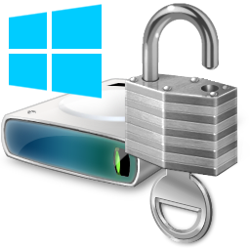
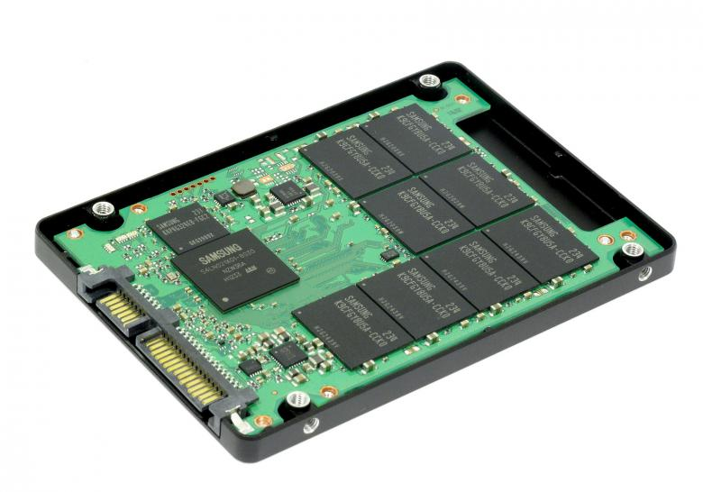


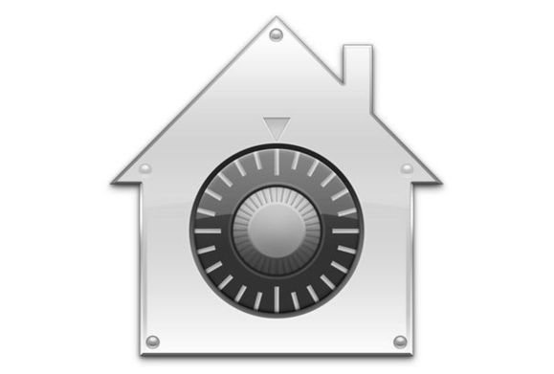
Filesystems
Full Disk Encryption (FDE)
  Most PC drives support
  SSDs vs platter
  Software: MBR (often) unencrypted
    Ex: VeraCrypt (TrueCrypt fork)
  Hardware: all encrypted
FileVault (2003+, Mac)
  AES-CBC
  FileVault2 AES-XTS
BitLocker (2004+, Windows)
  AES-CBC, 128 or 256 bit key
  Win10 adds FIPS compliant AES-XTS
iOS
  Was considered very secure
  Elcomsoft claims iOS 11 introduces many weaknesses
  11.1 broken one day after release
Android
  Mandatory in Marshmallow 6.0+ if hardware allows
    AES-XTS, AES-CBC-ESSIV
  FDE on some earlier phone models
Notes:
Classified reqs
platter: degauss, then shred to 2mm or smaller particles
SSD: cannot degauss,
https://blog.elcomsoft.com/2017/11/ios-11-horror-story-the-rise-and-fall-of-ios-security/

Slide 53
THANKS!
Any questions?
You can find me at:
clomont@logikos.com
Chris@Lomont.org
“If you think cryptography is going to solve your problem, you don't understand cryptography and you don't understand your problem.” -- Roger Needham
Notes:
From template:
Colors: Pastel green #d3ebd5 · Green #80bfb7 · Teal #0b87a1 · Navy #01597f · Dark navy #003b55
Special thanks to all the people who made and released these awesome resources for free:
Presentation template by SlidesCarnival
Photographs by Unsplash

Slide 54
Sources
AppA-Crypto
  Appendix A: Introduction to cryptographic
  algorithms and protocols, 2007 Levente Buttyán and Jean-Pierre Hubaux, http://secowinet.epfl.ch/, Security and Cooperation in Wireless Networks
Computer Science Illuminated, 4th ED, Chapter 12, Erin Chambers edited slides
Crypto benchmarks http://bench.cr.yp.to/
Wikipedia
TODO more
Standards agencies
  FIPS, ANSI, ISO, IEEE, IETF, NSA, GCHQ

Slide 55
Modern Cryptography
Science replaces the invent-break-tweak loop
“One must acknowledge with cryptography no amount of violence will ever solve a math problem.” -- Jacob Appelbaum, “Cypherpunks: Freedom and the Future of the Internet”

Slide 56
Two Factor Authentication
TODO – why?
List attacks
Banks do it ☺
There are three types of authentication:
Something you know: a password, PIN, zip code or answer to a question (mother's maiden name, name of pet, and so on)
Something you have: a phone, credit card or fob
Something you are: a biometric such as a fingerprint, retina, face or voice

Slide 57
Hashing
Lots of hash functions
  SHA, MD5, Cubehash, Tiger, Whirlpool, hundreds more
Like PRNGs, some hash functions not secure.
  Use a cryptographic hash function
Over time many, many weak or broken
  2004: SHA-0, RIPEMD, MD5 shown weak
  2005: SHA-1 reduced in strength from 2^80 to 2^59
  2009: most popular MD5 and SHA-1
  2008: successful MD5 attack breaks TLS
  2017: Google announces SHA-1 collision
NIST held new has competition starting in 2006
  2012: Winner called SHA-3
  SHA-3 and BLAKE2 both considered secure today
  SHA-2 still ok, but on way out

Slide 58
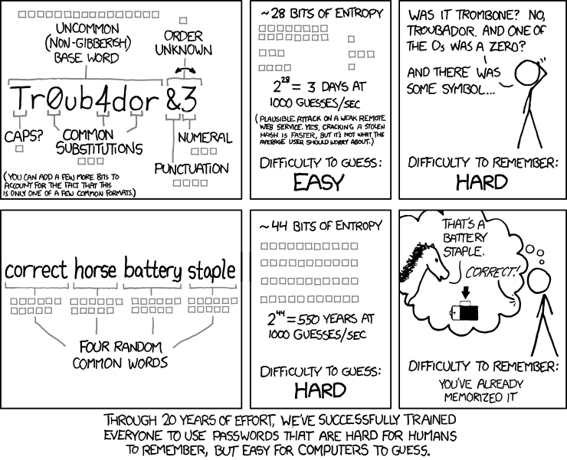
Password enlightenment XKCD

Slide 59
Advanced Topics
More math, more quantum
“How long do you want these messages to remain secret?[...]
I want them to remain secret for as long as men are capable of evil.”
― Neal Stephenson, “Cryptonomicon”

Slide 60
Website security
By "website security", we mean "the library you use to make your web server speak HTTPS". Believe it or not, OpenSSL is still probably the right decision here, if you can't just delegate this to Amazon and use HTTPS elastic load balancers, which makes this their problem not yours.
Use:
  OpenSSL, LibreSSL, or BoringSSL if you run your own site
  Amazon AWS Elastic Load Balancing if Amazon does
Avoid:
  PolarSSL
  GnuTLS
  MatrixSSL

Slide 61
Client-server application security
  What happens when you design your own custom RSA protocol is that 1-18 months afterwards, hopefully sooner but often later, you discover that you made a mistake and your protocol had virtually no security. A good example is Salt Stack. Salt managed to deploy e=1 RSA.
  It seems a little crazy to recommend TLS given its recent history:
  The Logjam DH negotiation attack
  The FREAK export cipher attack
  The POODLE CBC oracle attack
  The RC4 fiasco
  The CRIME compression attack
  The Lucky13 CBC padding oracle timing attack
  The BEAST CBC chained IV attack
  Heartbleed
  Renegotiation
  Triple Handshakes
  Compromised CAs
Here's why you should still use TLS for your custom transport problem:
  Many of these attacks only work against browsers, because they rely on the victim accepting and executing attacker-controlled Javascript in order to generate repeated known/chosen plaintexts.
  Most of these attacks can be mitigated by hardcoding TLS 1.2+, ECDHE and AES-GCM. That sounds tricky, and it is, but it's less tricky than designing your own transport protocol with ECDHE and AES-GCM!
  In a custom transport scenario, you don't need to depend on CAs: you can self-sign a certificate and ship it with your code, just like Colin suggests you do with RSA keys.
Use: TLS
Avoid:
  Designing your own encrypted transport, which is a genuinely hard engineering problem;
  Using TLS but in a default configuration, like, with "curl"
  Using "curl"
  IPSEC

Slide 62
Other security needs
Authentication. Verifying validity of a form of identification.
Integrity checking. Ensures data not tampered with or corrupted.
Digital Signatures. Electronically sign documents in unforgeable way.
Non-repudiation. Allows one to prove authorship of some piece of data.
Zero-knowledge proofs. Alice proves to Bob that she earns <$50K without Bob learning her income.
Privacy-preserving data mining. Bob holds DB. Alice gets answer to one query, without Bob knowing what she asked.
Playing poker over the net. Alice, Bob, Carol and David can play poker over the net without trusting each other or any central server.
Distributed systems. Distribute sensitive data to 7 servers s.t. as long as <3 are broken, no harm to security occurs.
Electronic auctions. Can run auctions s.t. no one (even not seller) learns anything other than winning party and bid.
Secure voting. Provably strong method to ensure votes count, can check yours, no one else can.
More

Slide 63
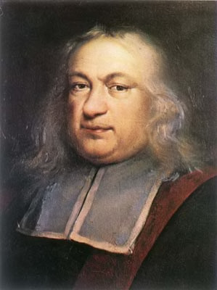
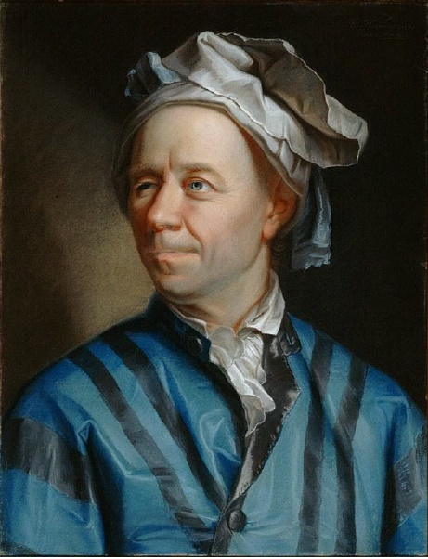
RSA
RSA = Rivest, Shamir, Adelman, 1977
  Currently most commonly used public key system
  Based on: multiplication fast, factoring slow
Key generation
  select p, q large primes (about 500-1000 bits each)
  Let n = p q, let φ = (p-1)(q-1)
  Select e such that 1 < e < φ and gcd(e, φ) = 1
  Compute d such that e d = 1 mod φ
    this is easy if φ is known
  Public key is (e, n)
  Private key is d
Encryption
  Done by anyone with the public key
  Represent the message as an integer m in [0, n-1]
  Compute ciphertext c = m^{e} mod n
Decryption
  Only done with knowledge of d
  Compute m = c^{d} = m^{ed} mod n
  Last works based on number theory
    (Euler’s generalization of Fermat’s Little Theorem)
Notes:
Cover this slide in depth – anecdote about Fermat (last theorem), Euler (most prolific in history, ~70 quarto volumes for collected works), went blind, claimed “I will now have fewer distractions,” and became more prolific (e.g., averaged a paper a week in 1775)

Slide 64
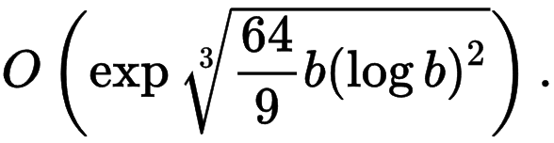
RSA
Requires large key sizes (2048-4096 bits common)
  Currently can factor 300 bit number in around 20 minutes on i7
  1999 factoring RSA-512 took 8400 MIPS years over 7 months
  2009 a RSA-512 key factored in 73 days by PC
  2010 a RSA-768 key factored (1500 CPU years)
Various attacks require care in using
  Inserting proper random padding into the message
  Cannot pick “bad” primes else key weak
  Timing attacks
  Adaptive chosen plaintext attacks (requires better message padding)
  Side channel: branch prediction exploited to attack RSA
Notes:
Formula is runtime for b-bit number for General Number Field Sieve factoring

Slide 65
Hard problems
So the search was on for such public and private key relations
  (complexity classes P, NP, etc., for another talk!)
Diffie-Hellman problem (1976)
  given a prime p, a generator g of Z_{p}*, and elements g^{x} mod p and g^{y} mod p, find g^{xy} mod p
Factoring problem (RSA, 1978)
  given a positive integer n, find its prime factors
Discrete logarithm problem (ElGamal, 1985)
  given a prime p, a generator g of Z_{p}*, and an element y in Z_{p}*, find the integer x, 0 ≤ x ≤ p-2, such that g^{x} mod p = y
For all three, the true complexity is unknown
  Believed not in P, the class of efficiently solvable problems
Notes:
Offer talk on complexity theory
P!=NP worth $1M (once thought I had a proof – screwed up!)

Slide 66
Modern AES attacks
Some implementations have side-channel attacks
  2005 Bernstein uses a cache-timing attack to break a custom OpenSSL server, required 200M chosen plaintexts
  2005 Shamir et. al. user mode gets root mode key in 65ms from timing attacks
2009+: many small, non-practical attacks
  reducing the keyspace
  by factor of 4, for example
Many attacks work on the round
key generation
  It’s too simple
Rounds | AES-128 | AES-192 | AES-256
8 | 125.4
10 | 126.2
12 |  | 189.7
14 |  |  | 254.2

Slide 67
TODO – abstract: Most developers have heard the statement: “never invent your own cryptography,” and most don’t fall into that trap, yet even using well designed libraries can land you in hot water, through misunderstanding, using them incorrectly, or only using them in a few of the many places you need security. This talk will cover many common errors and how to avoid them, and will increase your knowledge of how to avoid the mistakes that routinely leaks user data. We will cover data at rest, password management and best practices, two factor authentication, and more.
Data at rest
Password management
2-factor authentication
Get quotes from old section breaks

Slide 68

Modern crypto basis
Kerckhoffs’s Principle (1883): A cryptographic system should be secure even if everything about the system, except the key, is public knowledge.
Shannon’s maxim: “The enemy knows the system”
Provable security breaks “invent-break-tweak” cycle
  Perfect Security (Shannon)
  Vast improvement on generating “random” numbers
  One-way functions thwart massive computational power
Math and techniques climb to bewildering complexity
Claude Shannon
Started Information Theory
Introduced the word ‘bit’
Notes:
Developed Information Theory, proved one-time-pad unbreakable, proved treating space as 27th letter actually lowers message entropy, developed information entropy and redundancy, introduced the term ‘bit’

Slide 69
Digital envelope
Private key much faster than public key
Public key methods used to encrypt private key, private key used to encrypt, called a digital envelope
plaintext message
generate random
symmetric key
symmetric-key
cipher
(e.g., in CBC mode)
bulk encryption key
asymmetric-key
cipher
public key
of the receiver
digital envelope

Slide 70


Attacks (Part I – Differential Cryptanalysis)
Studies how differences in inputs can affect differences of outputs
  Biham and Shamir in late 1980s
    Used to attacks various ciphers and hashes
  Later found IBM and NSA knew about it earlier
  Usually a chosen plaintext attack
DES designed (secretly) to be resistant to this
(2^55 plaintexts to crack 56 bit key)
Did break FEAL, another cipher
  Original FEAL, 4 rounds, broken with 8 chosen plaintexts
  31 round FEAL susceptible
Used to attack (not break) DES
  Successful at 2^47 chosen plaintexts
Adi Shamir
Notes:
Adi Shamir is the S in RSA, born 1952, Israeli, Turing Award 2002
Change one bit, see what happens, try many times, get some bias in outputs
NSA and IBM knew about differential Cryptanalysis and ket it secret

Slide 71

Attacks on DES
In 1997, broken by Internet in a few months.
In Jul 1998, Deep Crack
  Specialized machine built by the EFF
  Cost $250K, took 6-8 months to build, cracks message in a few days
In 1999 above combined to break in 22 hours
Currently FPGA devices break it regularly in around a day at low (~$10K) cost
Deep Crack had 1856 custom chips

Slide 72

TripleDES
Salvage DES by repeating DES three times with
3 keys (168 bit key)
  Result called Triple DES (1998)
Cons
  Key Option 1: due to the meet-in-the-middle
  attack (later in talk), the effective security it
  provides is only 112 bits
  Key Option 2: effective security 80 bits, easily broken today
  OpenSSL removed 3DES in 2016, calling it “weak”

Slide 73

Modern cipher design
Need good key management
  Else key schedule attacks
Need good data mixing/substitution
  Else frequency analysis
  P-box, S-box combinations
Need high throughput in software and/or
hardware
  Leads to lots of tradeoffs, analysis
Leads to the modern Advanced Encryption Standard

Slide 74

Attacks and breaks
We’ll split into
  Direct crypto attacks – attacks on the cipher directly
  Software and hardware attacks – implementation errors or leaks
  Other side channel attacks
Direct attack terminology – what attacker has
  ciphertext only – access only to a set of ciphertexts
  chosen ciphertext – decryptions of some chosen ciphertexts
  known plaintext – access to plaintext and ciphertext pairs, attacks key
  chosen plaintext – ciphertexts for arbitrary (attacker chosen) plaintexts
Most breaks on modern crypto done not to the main algorithm, but to side issues

Slide 75

Direct attacks
Brute Force Attack (also see password section)
  Trying many passwords or passphrases with the
  hope of eventually guessing correctly
  Who has tried to brute force an encrypted zip file?
  Incredibly powerful machines built to do this
  NSA?
  Many tools:
    Aircrack-ng, Cain and Abel, Crack, DaveGrohl, John the Ripper, L0phtCrack
1995: Netscape SSL cracked by bad RNG
2008: OpenSSL in Debian/Ubuntu flawed

Slide 76
Differential cryptanalysis
Eli Biham and Adi Shamir 1980s
Exploit how differences in plaintext relate in ciphertext
Exploits asymmetry to deduce key
Primarily for block ciphers, less so for stream ciphers and hash functions
Don Coppersmith (IDM DES team) published in 1994 that IBM knew of differential in 1974
  "After discussions with NSA, it was decided that disclosure of the design considerations would reveal the technique of differential cryptanalysis, a powerful technique that could be used against many ciphers. This in turn would weaken the competitive advantage the United States enjoyed over other countries in the field of cryptography."
Breaks FEAL after 4 rounds with 8 chosen plaintexts, even breaks 31 round FEAL
DES with ~2^47 plaintexts

Slide 77
Higher order differential cryptanalysis
Xuejia Lai, in 1994, laid the groundwork by showing that differentials are a special case of the more general case of higher order derivates
Lars Knudsen, in the same year, was able to show how the concept of higher order derivatives can be used to mount attacks on block ciphers
Used to break KN-Cipher, a cipher which had previously been proved to be immune against standard differential cryptanalysis.

Slide 78

Meet-in-the-middle attack
Tempting to encrypt data several times using
multiple keys
MITM is a generic time-space tradeoff
  Stores intermediate encryption and/or decryptions values, speeds up brute force
  Find keys using both the range (ciphertext) and domain (plaintext) of the composition of several functions (or block ciphers) such that the forward mapping through the first functions is the same as the backward mapping (inverse image) through the last functions, meeting in the middle
  Is why Double DES (116 bits of key) not used - broken with 2^57 ops
  Is why Triple DES (168 bit) brute forced in 2^56 speed, 2^112 ops
Multidimensional MITM (MD-MITM)
  several simultaneous MITM-attacks at once for multiple layers

Slide 79
Related key attack
Attacker observes operation of cipher operating with different, yet related, keys
1994: Biham
Breaks KASUMI (successor to A5/2)
  8 round, 64-bit block, 128-bit key
  Was basis of 3G confidentiality and integrity algorithms
Wired Equivalent Privacy (WEP) used in WiFi wireless routers
  Released 1997,
  Based on RC4 stream cipher with too weak 24-bit IV should not be used on repeated traffic
  24-bit IV implies for 5000 packets, have 50% chance of IV repeating (Birthday Paradox)
  2003: Replaced by interim Wi-Fi Protected Access (WPA)
  2004: Replaced by more secure WPA2
  See KRACK in replay attack section

Slide 80

XSL attack
eXtended Sparse Linearization (XSL) attack is a method of cryptanalysis for block ciphers. The attack was first published in 2002 by researchers Nicolas Courtois and Josef Pieprzyk
XSL attack relies on first analyzing the internals of a cipher and deriving a system of quadratic simultaneous equations. These systems of equations are typically very large, for example 8,000 equations with 1,600 variables for the 128-bit AES
Still NP-Hard
My roommate Jiun-Ming Chen from grad school
(we had same advisor T.T.Moh) works on this
Unlike other forms of cryptanalysis, such as differential and linear cryptanalysis, only one or two known plaintexts are required.

Slide 81

Software attacks
Timing Analysis – exploit timing differences
  Why is this code bad?
  Execution time for “square-and-multiply algorithm” used in modular exponentiation linearly on the number of '1' bits in the key
  2003: Boneh , Brumley demonstrated practical network-based timing attack on SSL-enabled web servers, based on a different vulnerability having to do with the use of RSA with Chinese remainder theorem optimizations. The actual network distance was small in their experiments, but the attack successfully recovered a server private key in a matter of hours
Cache leaks
  monitoring cache timing allows one to attack things in shared environments like VMs, cloud computers, etc.
  2005: Bernstein used cache timing for successful AES attacks, 2^27 to recover 128 bit key
Data remanence leaks
  items need wiped in RAM and disk (and be careful about swap files, etc.!)
  SSD page balancing: leaves pages with data if not very careful

Slide 82
Software attacks
Implementation failures common
  Software errors abound: buffer overflows, integer overflows, return oriented programming, etc.
Nice when happens to malware
  CryptoDefense - early ransomware, stored key locally
  Nuclear Exploit Kit – used a key of 0 in Diffie-Hellman, doing nothing
  Nemucod – claimed RSA1024, used file renaming! (Bluffware?!)
  Linux.encoder – used srand(time()) instead of srand(md5(time())), last file time allowed decryption

Slide 83

Source code safety?
What if you don’t trust a binary?
  “I'll build it from source"
  But what about the compiler?
  Build it from source.
  But why trust that compiler???
1984: Ken Thompson, “Reflections on Trusting Trust”
  Thompson: UNIX, B predecessor to C, UTF-8, ed, Plan 9, Go programming language at Google)
  Puts a backdoor into a login (or any code) so that there is no source code trace of it!
  Determine changes needed in compiler source code so it recognizes when it’s compiling the target and inserts the backdoor. No code changes made here.
  Change compiler source to recognize it’s compiling itself and inserts the code changes from step 1.
  Build the compiler with itself.
  Remove the code from steps 2. There is now no code trace of the hack in either the compiler or target. Compiler will now build poisoned compilers.
  Now any time the compiler is used to compile itself or the target, the hack continues. Neither of them have it in the source code!

Slide 84

Hardware attacks
Van Eck Phreaking – electromagnetic emanations leak information
  1985: Used on CRTs to read info
  Works on LCDs too – proof of concept cost around $2K
  2009: used to read voting ballots
  Declassified NSA TEMPEST attack
Power analysis
  Different operations require different power
  Simple power analysis (SPA) graphs electrical activity over time.
  Differential power analysis (DPA) computes intermediate values within cryptographic computations by statistically analyzing data collected from multiple cryptographic operations.
  1998: Paul Kocher, Joshua Jaffe and Benjamin Jun introduce SPA and DPA
  Used to attack smart cards, extract keys. One example breaks 128 bit ASIC AES in 3 minutes

Slide 85
Symmetric key encryption
Alice & Bob want to communicate securely
They agree in advance on 3 components
  Encryption algorithm: E
  Decryption algorithm: D
  Secret key: k
To encrypt plaintext m, Alice sends c = E(m,k) to Bob
To decrypt a cyphertext c, Bob computes m’ = D(c,k)
A scheme is valid if m’=m
Secure if eavesdropper can not learn m from c,
  even knowing E and D

Slide 86

Data Encryption Standard (DES)
Well known, early symmetric key encryption standard
Adopted in 1977 by National Bureau of Standards (now NIST)
Break message into 64 bit chunks, key size 56 bits
Main idea: XOR them together
Widespread, e.g., used by HBO for TV scrambling in 1986

Slide 87

DES
X
(64)
Initial Permutation
(32)
(32)
F = Feistel network
Horst Feistel worked at
IBM on Lucifer cipher
1970s
 | Bits
Input size | 64
Output Size | 64
Key size | 56
Rounds | 16
+
F
(48)
K₁
+
F
(48)
K₂
Key Scheduler
(56)
F
K
+
(48)
K₃
…
+
F
(48)
K₁₆
Initial Permutation⁻¹
Y
(64)
Notes:
Explain symbols, XOR is +, etc
Note that decoding is very similar, so add inverse perm at end to make chaining reverse the process – simplifies hardware

Slide 88
DES
Substitution-permutation networks introduced by Shannon in 1949
Si – Substitution box (S-Box)
P = Permutation box (P-box)
key
injection
+
+
+
+
+
+
+
+
+
+
+
+
+
+
+
+
+
+
+
+
+
+
+
+
+
+
+
+
+
+
+
+
+
+
+
+
+
+
+
+
+
+
+
+
+
+
+
+
S1
S2
S3
S4
S5
S6
S7
S8
P

Slide 89


Hardware attacks
Cold boot: 2008 Ed Felten
  DRAM/SRAM maintains data without power,
  slow decay, running computer cold-booted with
  special OS, copies RAM, gets data
  Alternatively, machine stolen, frozen in liquid NO2,
  ram chips pulled and read later
Rowhammer: 2014
  Write DRAM repeatedly and quickly:
  ~400k times in 64ms
  Can flip bits in neighboring physical memory row
  2015: Google demonstrates x86-64 exploits
  in NaCl and Linux
  2015: Proof of concept in JavaScript and Firefox 39

Slide 90

Hardware attacks
Can have backdoors in hardware such as CPUs
  DARPA runs program for Trusted Foundries
  Hardware trojans
    Could remove NX protection after code sequence
    Could weaken hardware RNG (see Intel discussion under RGN section)
2008: Sam King adds 1400 gates to SPARC, inserts Linux backdoor
2014: Kumar, Jovanovic, et. al. Doping level attacks
  Change chemical composition of gates to modify behavior
  Needs no gate changed or added
  Demonstrates weakening of a cipher by fault injection
Fault attacks
  Lower voltage to cause hardware hiccups, get info
  High temperatures to cause hiccups, exploit timing, others
  Over clocking

Slide 91

Other side-channel attacks
Black bag
  steal keys via burglary, keyloggers, social
  engineering, credit card skimmer, fake ATM
Man-in-the-middle (physical version)
  Authentication and tamper detection used to prevent
  2011: security breach at Dutch certificate authority DigiNotar resulted in fraudulent certificates, which were used for MITM attacks
  2017: Equifax withdrew mobile phone apps following man-in-the-middle vulnerabilities
  AT&T – Room 641A, NSA room in building, started 2003, exposed 2006
  NSA impersonation of Google: document leaked by Edward Snowden diagrams how a "man in the middle attack" involving Google was apparently carried out

Slide 92



Other side-channel attacks
Replay attack
  Vehicle key-fob usually hardened against
  replay attacks, but vulnerable to buffered
  attacks:
  RF jammer blocks legit attempts, records
  message, then when new attempts made,
  plays old one, storing one ahead for later use.
  Text-dependent speaker verification
  Oct 2017: KRACK exploits hole in WPA2 protocol
    Windows, macOS, iOS, Linux, OpenBSD,….
    Repeatedly resend handshake to gather info
    Some vendors offer patch to hide the hole
Rubber hose – torture to get the key
Physical insertion of devices
  USB, FireWire extremely susceptible
  Safe hacking
$11 car stealing device

Slide 93
Breaks
Block cipher Madryga proposed 1984, not widely used, found susceptible to cipher-only attacks in 1998
GOST, developed in 1970s, published 1989 (Soviet Russian), 256 bit key size, 64 bit block, 2007-2012 breaks in 2^178
FEAL-4 proposed as DES replacement in 1987, destroyed by range of practical attacks by 1990.
DES - broken 1990 Biham+Shamir, 2^47, 1998 brute force cracked single-DES (EFF DES Cracker),
Old 40-bit “export strength” crypto broken in make cases
DVD Content Scrambling System (CSS) 1996 released, cracked 1999
SHA-0 - made 1993, revised immediately due to flaw to SHA-1, 1998 attack, 2008 boomerang collisions down to 2^33
SHA-1 - made 1995, weakened from 2005 (2^69) to 2017 (2^63)
A5/1 (made in 1987, broken 2000), A5/2, CMEA, DECT used in phones, broken in hours, minutes, or seconds
Stream cipher RC4 (designed 1987, broken in stages 1994-2013) used in SSL, TSL, WEP, WPA.
WEP broken because of weaknesses in RC4 and poor design allowing related-key attacks, replaced by WPA then WPA2
MD5 - designed 1991, collision 5 years later, 2009 reduced to 2^39 (from 2^128)
2008, MD5 weaknesses and poor certificate issuer practices allowed collision attacks on hash functions. Issuer fixed practices

Slide 94
Advanced Encryption Standard (AES)
NIST sponsored competition, started 1997
Needed to replace 3DES
Finalists: MARS, RC6, Rijndael, Serpent, Twofish
AES wins (Vincent Rijmen, Joan Daeman)
  subset of Rijndael
  AES has fewer block and key sizes
  Federal Standard in 2002
  Only publicly available cipher allowed for
  Top Secret data
Modern
Strong, fast
Now has lots of hardware support
Notes:
NIST = National Institute of Standards and Technology

Slide 95

AES
Key is 128, 192, or 256 bits
Corresponds to 10, 12, or 14 rounds of cipher
Bytes treated as entries in finite field
  Addition is XOR
  Byte 0b1001_0111 is polynomial x⁷ + x⁴ + x² + x + 1
  Multiplication as polynomial multiplication taken
  as remainder of x⁸ + x⁴ + x³ + x +1
AES S-Box
  Invert byte in AES finite field GF256, then ->
Designed to resist linear and differential attacks

Slide 96




AES
Stage 1: Substitute
  Invert byte in GF2^8
  Apply S-box
Stage 2: Shift rows
  Each row cyclically shifted 0,1,2,3
Stage 3: Mix columns
  Each column treated as polynomial
  Multiplied by fixed polynomial
  Result taken mod x^4+1
Stage 4: XOR round key
  Round key derived from main key
  Uses pieces of rest of algorithm for simplicity
Notes:
AddRoundKey – key schedule makes expands key from round to round

Slide 97

AES key schedule
RotWord
  Rotates 32 bit word 8 bits to left
SubWord
  Apply S-box to each of 4 bytes
Rcon
  On leftmost byte, compute 2^{round #},
  treat as polynomial in GF256 as before
128 bit key example
Notes:
AddRoundKey – key schedule makes expands key from round to round

Slide 98
Modern AES attacks
Some implementations have side-channel attacks
  2005 Bernstein uses a cache-timing attack to break a custom OpenSSL server, required 200M chosen plaintexts
  2005 Shamir et. al. user mode gets root mode key in 65ms from timing attacks
2009+: many small, non-practical attacks
  reducing the keyspace by factor of 4, for example
Many attacks work on the round key generation – too simple

Slide 99
Progress TODO
Basics (9 slides)
simple ciphers
frequency analysis
making ciphers
examples
unbroken
Modern Crypto (AES, RSA, key length, RNGs…) (40 slides)
Other Uses (Hashes, Passwords, Stego, Law…) (25 slides)
Attacks and Breaks (Math, Software, Hardware, Famous) (25 slides)
Advanced Topics (Zero knowledge, Quantum, Post quantum) (5 slides)
Notes:
Overview – time is probably 2-3 days of 1 hour talks

Slide 100
Modern AES attacks
  Bits of security
Rounds | AES-128 | AES-192 | AES-256
8 | 125.4
10 | 126.2
12 |  | 189.7
14 |  |  | 254.2

Slide 101



Terminology
Alice & Bob want to communicate securely
eavesdropping
adversary
E
D
m
plaintext
D(c,K’) = m
K
encryption key
K’
decryption key
c = E(m,k)
ciphertext
Notes:
Alice and Bob Invented by Ron Rivest, Adi Shamir, and Leonard Adleman (RSA) in their 1978 paper "A method for obtaining digital signatures and public-key cryptosystems
Sometimes others, e.g., Carol is 3rd person in multi-party communication
Note Shamir will be all over this talk ☺
Alice and Bob invented 1978 paper, Rivest, Shamir, Adelman (RSA)

