Slide 1
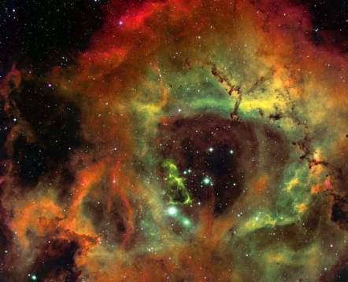
The Cosmic Distance Ladder
Slides by Terence Tao (UCLA)
Modified by Chris Lomont for Nov 21, 2017 Logikos Talk

Slide 2
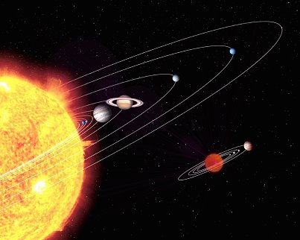
Astrometry
An important subfield of astronomy is astrometry: the study of positions and movements of celestial bodies (sun, moon, planets,stars, etc.).
Typical questions in astrometry are:
• How far is it from the Earth to the Moon?
• From the Earth to the Sun?
• From the Sun to other planets?
• From the Sun to nearby stars?
• From the Sun to distant stars?

Slide 3
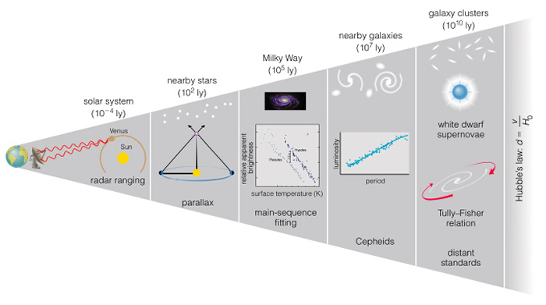
These distances are far too vast to be measured directly.
Nevertheless, we have several ways of measuring them indirectly.
These methods are often very clever, relying not on technology but rather on observation and high school mathematics.
Indirect methods control large distances in terms of smaller distances. One then needs more methods to control these distances, until one gets down to distances that one can measure directly. This is the cosmic distance ladder.
1 light year is exactly 9,460,730,472,580,800m ~ 10 trillion km ~ 6 trillion miles ~ 12 United States wide for each person in the United States
Notes:
Comments on shooting Tom Thumb in Idaho
Light year = 9.5 trillion km = 5.9 trillion miles (~ 10 trillion km, 6 trillion mi for ease)

Slide 4
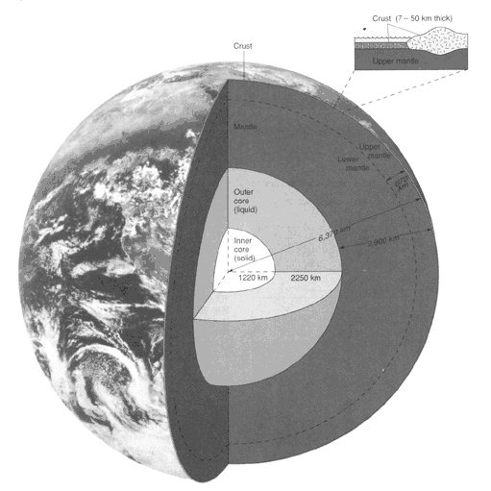
First Rung: The Radius of the Earth
Nowadays, we know that the earth is approximately spherical, with radius 6378 kilometers at the equator and 6356 kilometers at the poles. These values have now been verified to great precision by many means, including modern satellites.
But suppose we had no advanced technology such as spaceflight, ocean and air travel, or even telescopes and sextants. Would it still be possible to convincingly argue that the earth must be (approximately) a sphere, and to compute its radius?

Slide 5
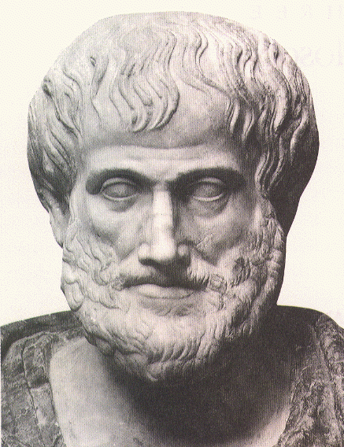
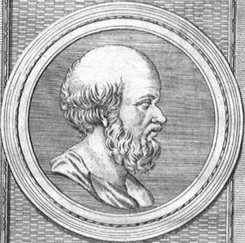
The answer is yes - if one knows geometry!
Aristotle (384-322 BCE) gave a simple argument demonstrating why the Earth was a sphere (which was asserted by Parmenides (515-450 BCE)).
Eratosthenes (276-194 BCE) computed the radius of the Earth at 40,000 stadia (about 6800 kilometers). As the true radius of the Earth is 6376-6378 kilometers, this is only off by eight percent!
(Middle Ages Flat Earth belief is a myth started in the 19th century!)

Slide 6
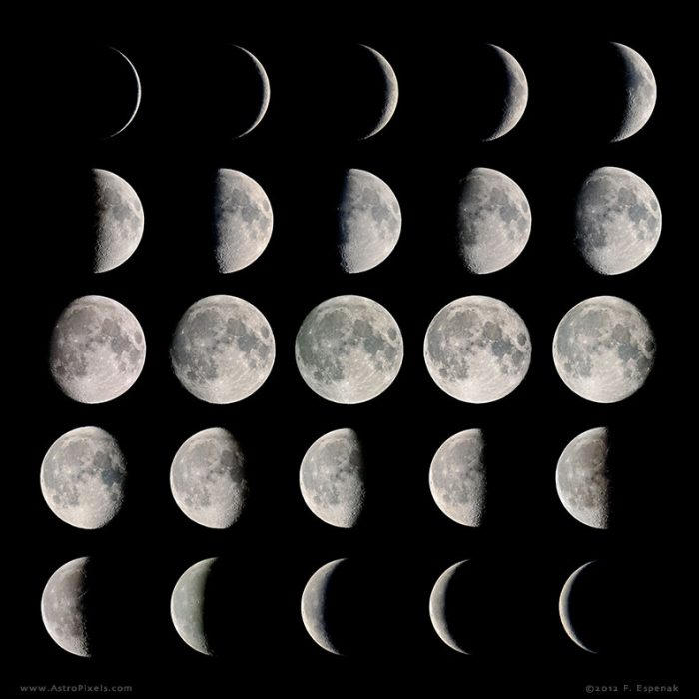
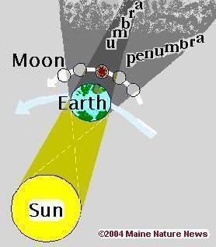
Aristotle’s Argument
He reasoned lunar eclipses were caused by the Earth’s shadow falling on the moon. This was because at the time of a lunar eclipse, the sun was always diametrically opposite the Earth (this could be measured by using the constellations as a fixed reference point).
Aristotle also observed that the terminator (boundary) of this shadow on the moon was always a circular arc, no matter what the positions of the Moon and sun were. Thus every projection of the Earth was a circle, which meant that the Earth was most likely a sphere. For instance, Earth could not be a disk, because the shadows would be elliptical arcs rather than circular ones.
He also argued that the Earth’s radius could not be incredibly large, because some stars could be seen in Egypt, but not in Greece, and vice versa.

Slide 7
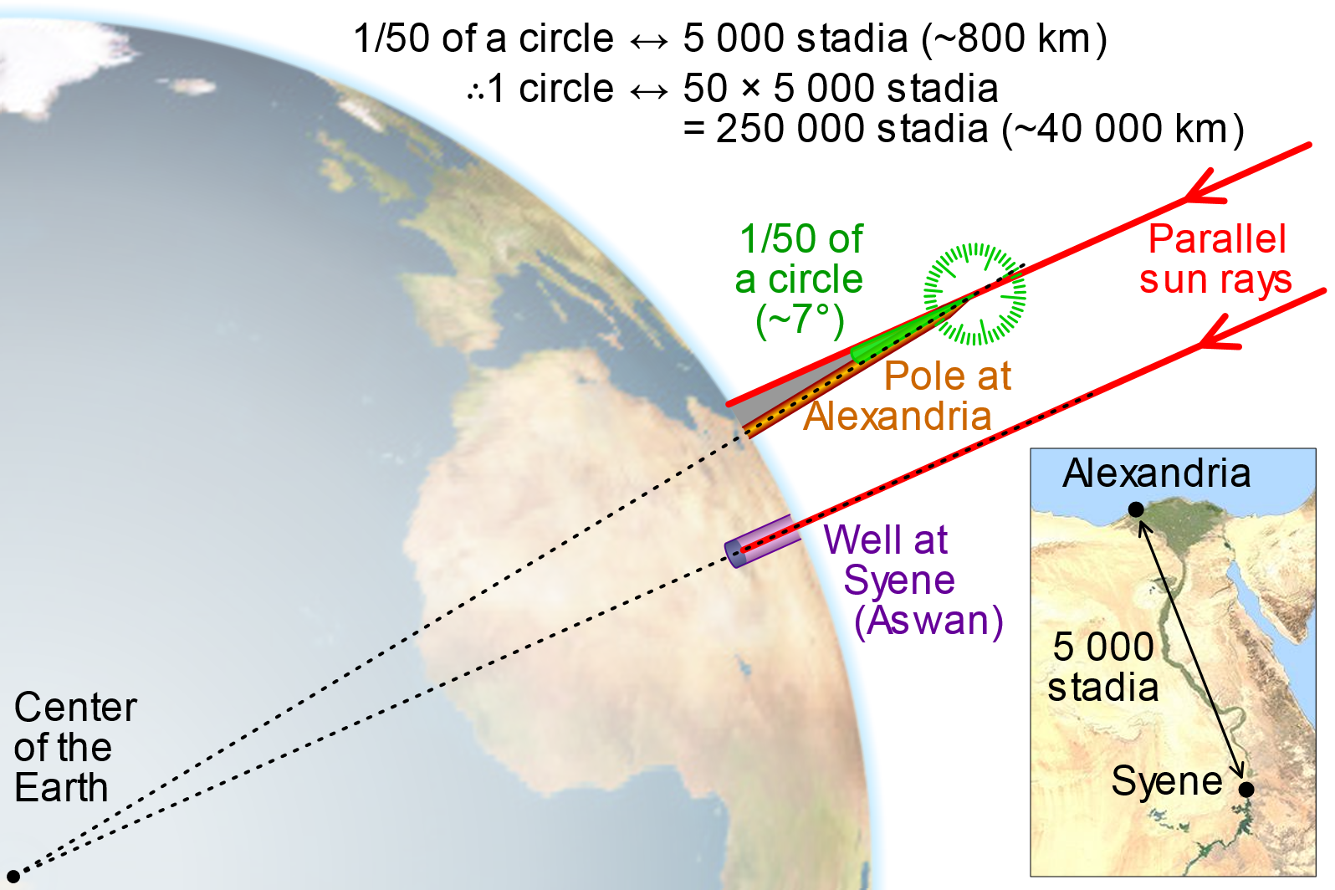
Eratosthenes’ Argument
Eratosthenes gave a more precise argument. He had read of a well in Syene, Egypt which at noon on the summer solstice (June 21) would reflect the sun overhead. (This is because Syene happens to lie almost exactly on the Tropic of Cancer.)
Eratosthenes then observed a well in his home town, Alexandria, at June 21, but found that the Sun did not reflect off the well at noon. Using a gnomon (a measuring stick) and some elementary trigonometry, he found that the deviation of the Sun from the vertical was 7º.
Notes:
Anecdote about drilling hole in Mexico temple

Slide 8
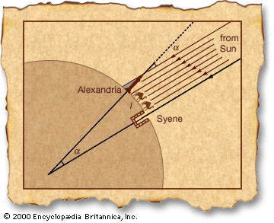
Information from trade caravans and other sources established the distance between Alexandria and Syene to be about 5000 stadia (about 740 kilometers). This is the only direct measurement used here, and can be thought of as the “zeroth rung” on the cosmic distance ladder.
Eratosthenes also assumed the Sun was very far away compared to the radius of the Earth (more on this in the “third rung” section).
High school trigonometry then suffices to establish an estimate for the radius of the Earth.

Slide 9
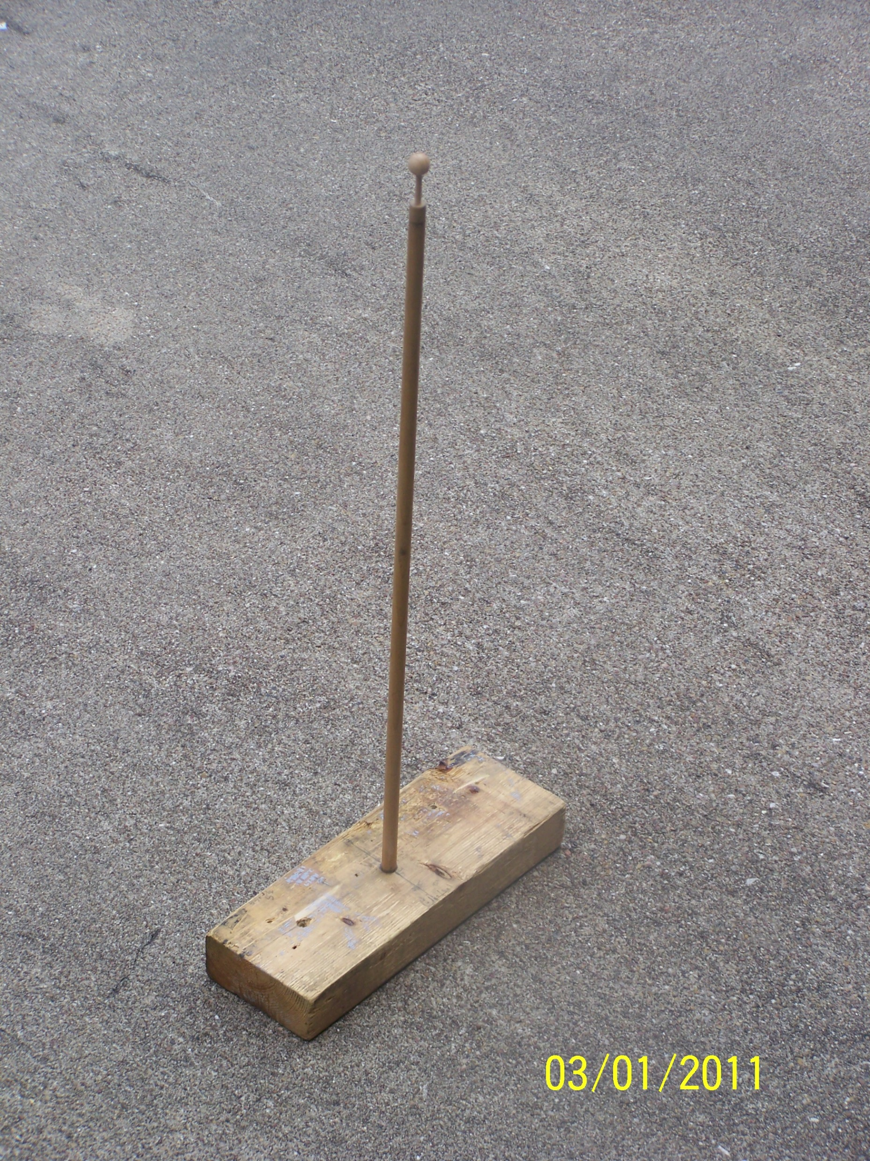
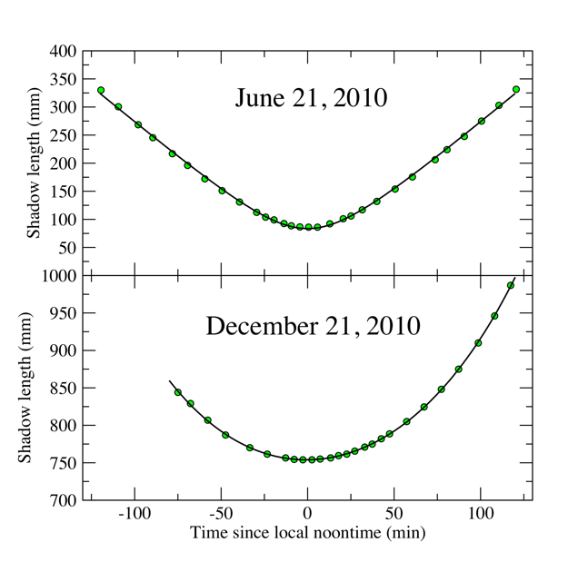
Do it yourself
Use gnomon to measure shadow length on 2 key days
Geometry/trig gives angle of sun above horizon
90º minus the average of these two values gives us the latitude
Get two of them some miles apart, do math, get answer!
Done in South Bend, IN and College Station, TX, 940 miles apart, yielded 13.78 degrees apart => 24,557 miles, 1.4% too small

Slide 10
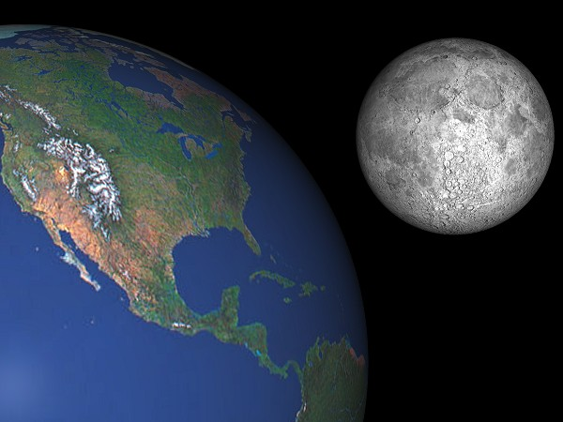
Second rung: shape, size and location of the moon
What is the shape of the moon?
What is the radius of the moon?
How far is the moon from the Earth?

Slide 11
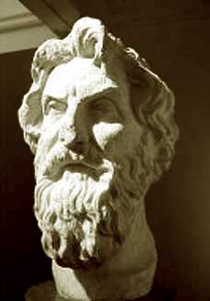
Again, these questions were answered with remarkable accuracy by the ancient Greeks.
Aristotle argued that the moon was a sphere (rather than a disk) because the terminator (the boundary of the Sun’s light on the moon) was always a circular arc.
Aristarchus (310-230 BCE) computed the distance of the Earth to the Moon as about 60 Earth radii. (indeed, the distance varies between 57 and 63 Earth radii due to eccentricity of the orbit).
Aristarchus also estimated the radius of the moon as 1/3 the radius of the Earth. (The true radius is 0.273 Earth radii.)
The radius of the Earth, of course, is known from the preceding rung of the ladder.

Slide 12
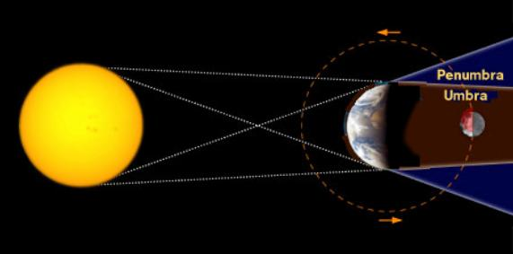
Aristarchus knew that lunar eclipses were caused by the shadow of the Earth, which would be roughly two Earth radii in diameter. (This assumes the sun is very far away from the Earth; more on this in the “third rung” section.)
From many observations it was known that lunar eclipses last a maximum of three hours.
It was also known that the moon takes one month to make a full rotation of the Earth.
From this and basic algebra, Aristarchus concluded that the distance of the Earth to the moon was about 60 Earth radii.

Slide 13
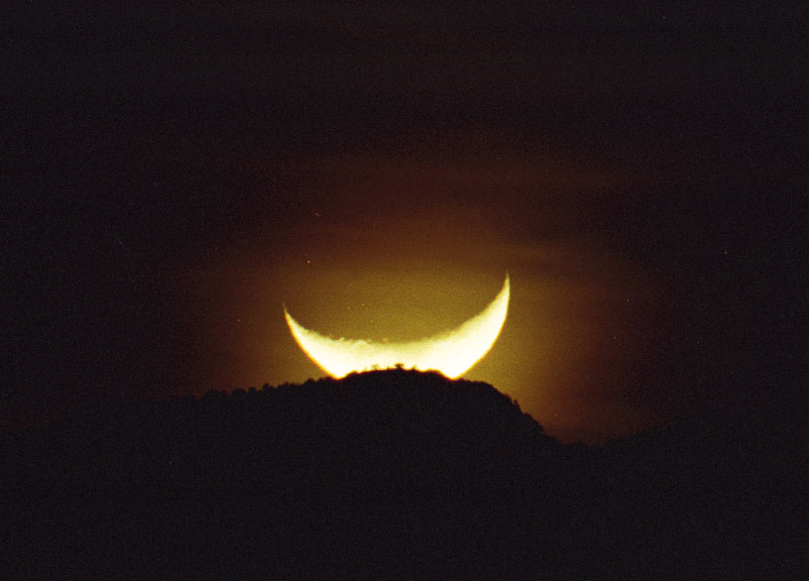
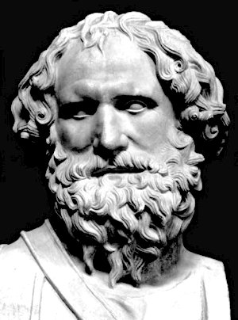
The moon takes about 2 minutes (1/720 of a day) to set. Thus the angular width of the moon is 1/720 of a full angle, or ½º.
Since Aristarchus knew the moon was 60 Earth radii away, basic trigonometry then gives the radius of the moon as about 1/3 Earth radii. (Aristarchus was handicapped, among other things, by not possessing an accurate value for π, which had to wait until Archimedes (287-212 BCE) some decades later!)

Slide 14
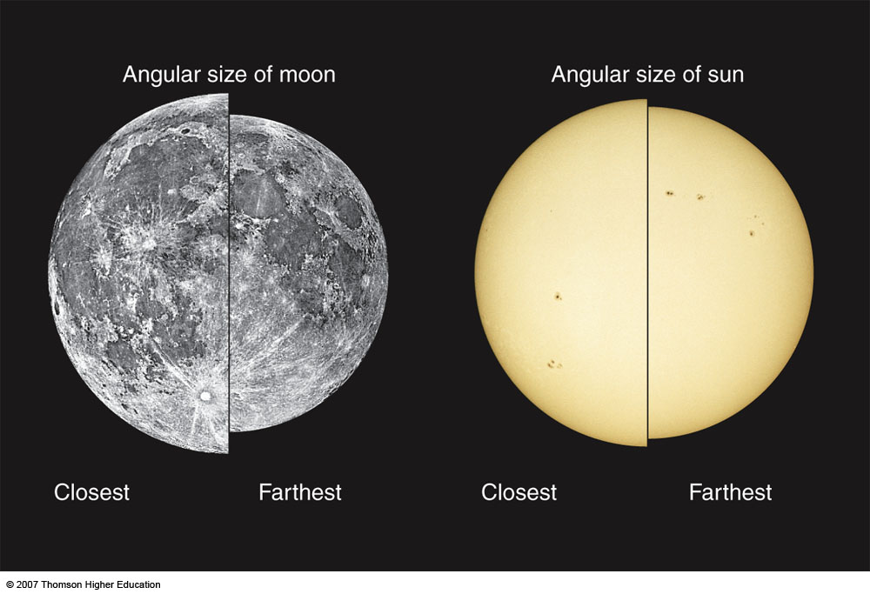
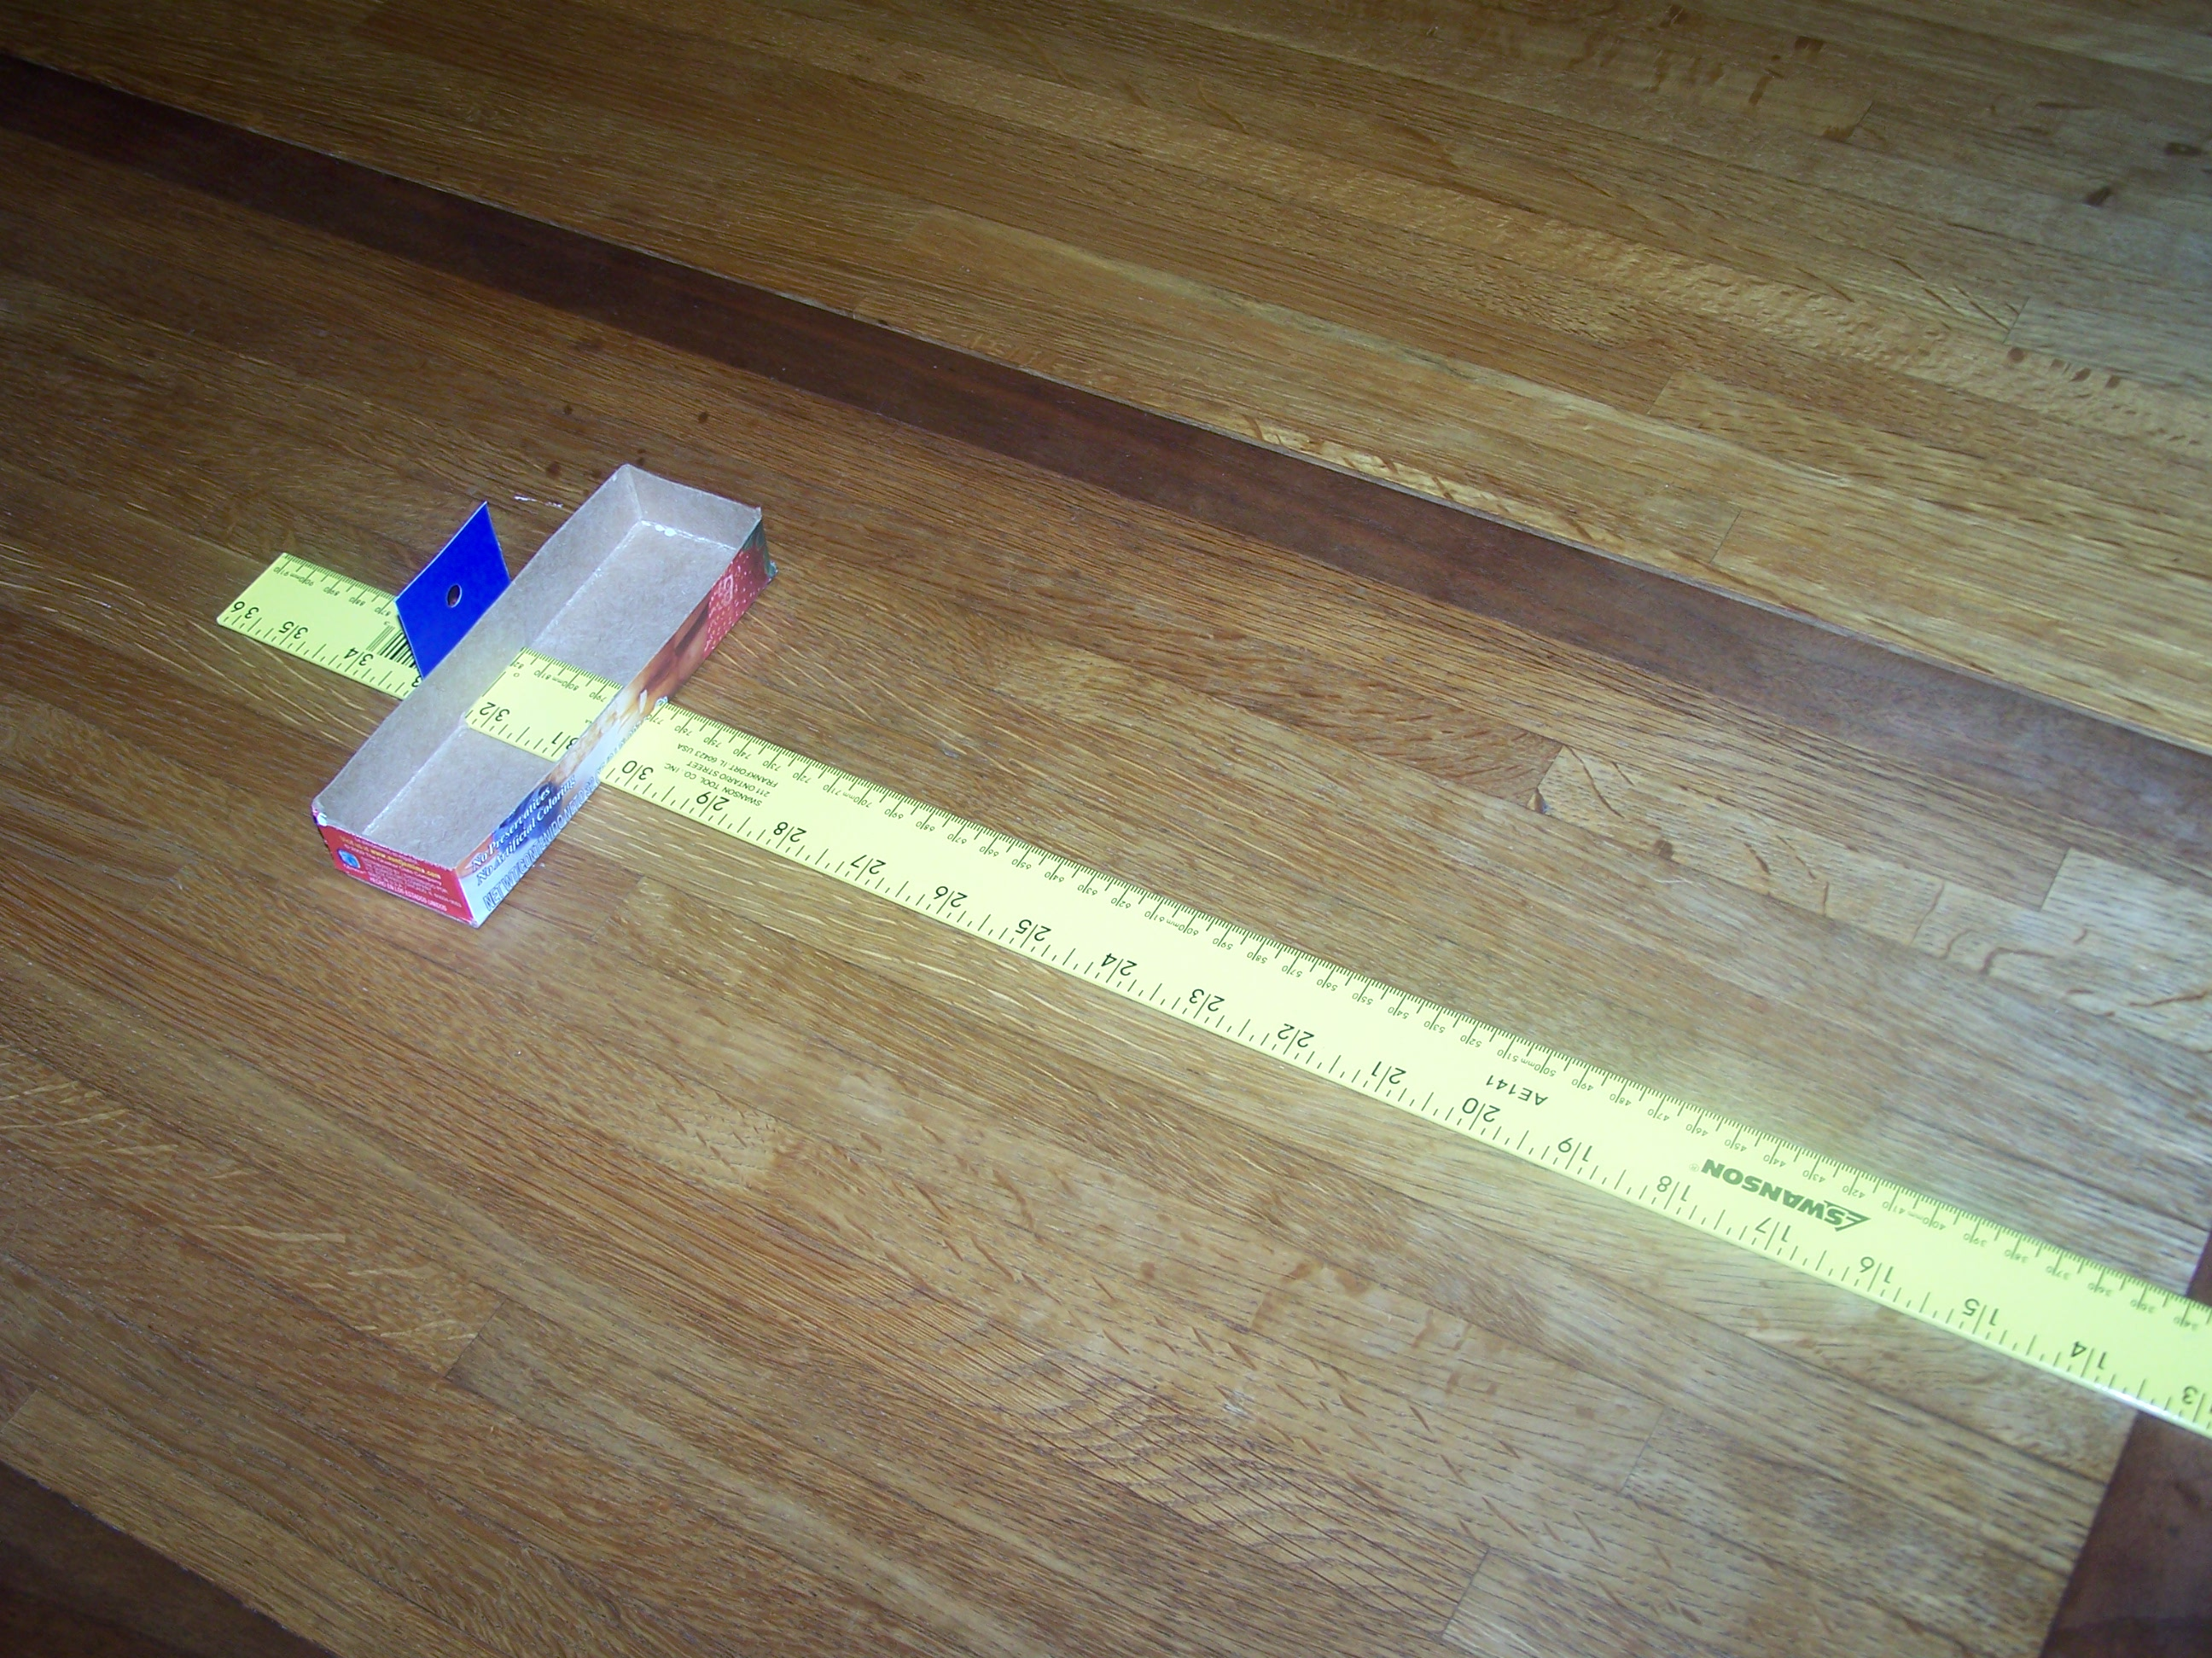
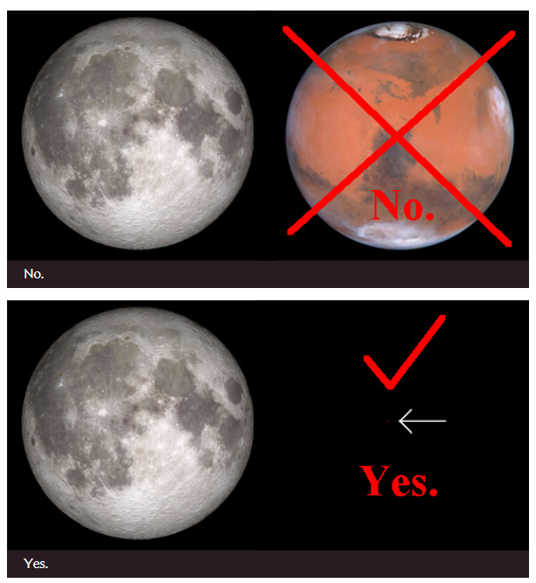
For fun:
  Moon orbit not circular
  Sun orbit not circular
  So sizes change
  Simple way to check
Note moon on horizon is not larger!
  An illusion!
  Check with pinky nail on extended arm
Mars never as big as the moon!

Slide 15
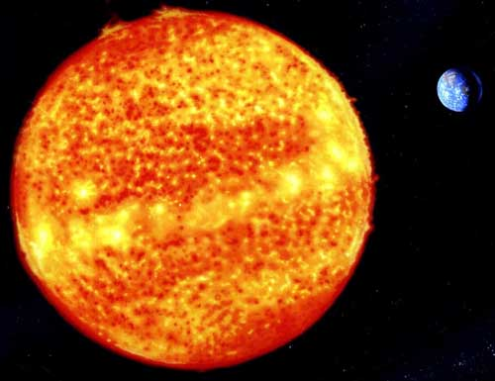
Third Rung: size and location of the sun:
What is the radius of the Sun?
How far is the Sun from the Earth?

Slide 16
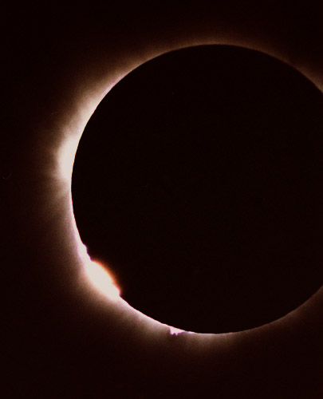
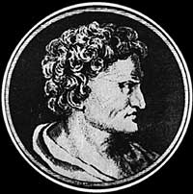
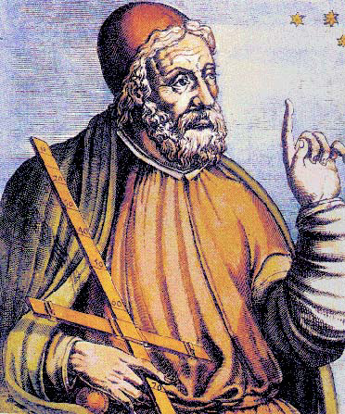
Once again, the ancient Greeks could answer this question!
Aristarchus already knew that the radius of the moon was about 1/180 of the distance to the moon. Since the Sun and Moon have about the same angular width (most dramatically seen during a solar eclipse), he concluded that the radius of the Sun is 1/180 of the distance to the Sun. (The true answer is 1/215.)
Aristarchus estimated the sun was roughly 20 times further than the moon. This turned out to be inaccurate (the true factor is roughly 390) because the mathematical method, while technically correct, was very un-stable. Hipparchus (190-120 BCE) and Ptolemy (90-168 CE) obtained the slightly more accurate ratio of 42.
Nevertheless, these results were enough to establish that the important fact that the Sun was much larger than the Earth.

Slide 17
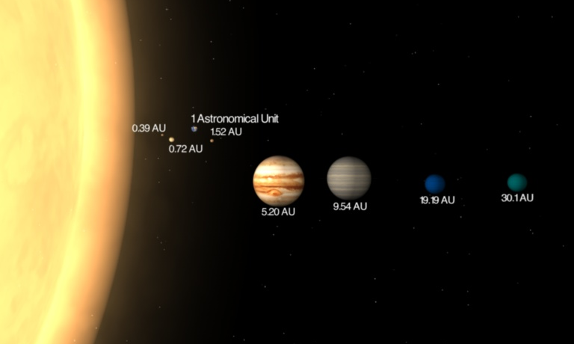
Because of this, Aristarchus proposed the heliocentric model more than 1700 years before Copernicus! (Copernicus credits Aristarchus for this in his own, more famous work.)
Ironically, Aristarchus’s heliocentric model was dismissed by later Greek thinkers, for reasons related to the sixth rung of the ladder. (see below).
Since the distance to the moon was established on the preceding rung of the ladder, we now know the size and distance to the Sun. (The latter is known as the Astronomical Unit (AU), and will be fundamental for the next three rungs of the ladder).

Slide 18
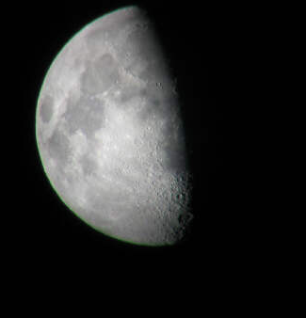
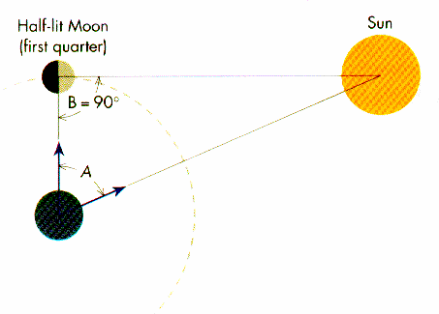
How did this work?
Aristarchus knew that each new moon was one lunar month after the previous one.
By careful observation, Aristarchus knew that a half moon occurred slightly earlier than the midpoint between a new moon and a full moon; he measured this discrepancy as 12 hours. (Alas, it is difficult to measure a half-moon perfectly, and the true discrepancy is ½ an hour.)
Elementary trigonometry then gives the distance to the sun as roughly 20 times the distance to the moon.

Slide 19
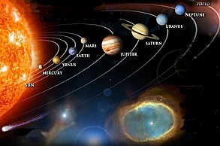
Fourth rung: distances from the Sun to the planets
Now we consider other planets, such as Mars. The ancient astrologers already knew that the Sun and planets stayed within the Zodiac, which implied that the solar system essentially lay on a two-dimensional plane (the ecliptic). But there are many further questions:
How long does Mars take to orbit the Sun?
What shape is the orbit?
How far is Mars from the Sun?

Slide 20
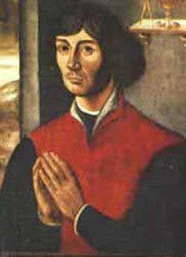
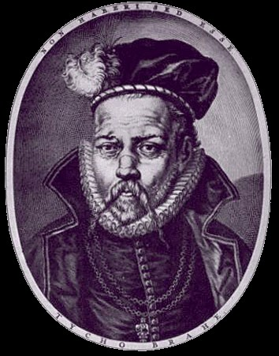
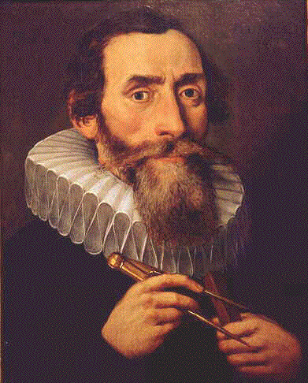
These answers were attempted by Ptolemy, but with extremely inaccurate answers (in part due to the use of the Ptolemaic model of the solar system rather than the heliocentric one).
Copernicus (1473-1543) estimated the (sidereal) period of Mars as 687 days and its distance to the Sun as 1.5 AU. Both measures are accurate to two decimal places. (Ptolemy obtained 15 years (!) AND 4.1 AU.)
It required the accurate astronomical observations of Tycho Brahe (1546-1601) and the mathematical genius of Johannes Kepler (1571-1630) to find that Mars did not in fact orbit in perfect circles, but in ellipses. This and further data led to Kepler’s laws of motion, which in turn inspired Newton’s theory of gravity.

Slide 21
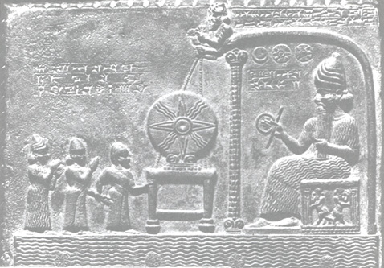
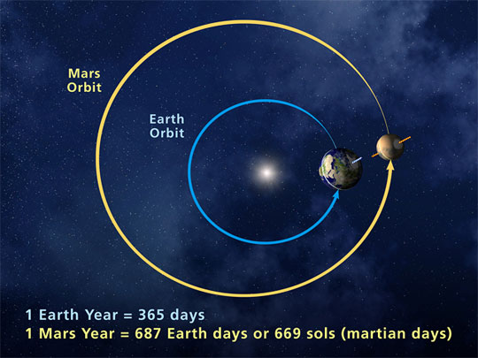
How did Copernicus do it?
The Babylonians already knew that the apparent motion of Mars repeated itself every 780 days (the synodic period of Mars).
The Copernican model asserts that the earth revolves around the sun every solar year (365 days).
Subtracting the two implied angular velocities yields the true (sidereal) Martian period of 687 days.
The angle between the sun and Mars from the Earth can be computed using the stars as reference. Using several measurements of this angle at different dates, together with the above angular velocities, and basic trigonometry, Copernicus computed the distance of Mars to the sun as approximately 1.5 AU.

Slide 22
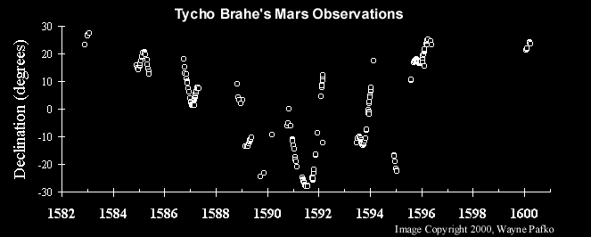
Kepler’s problem
Copernicus’s argument assumed that Earth and Mars moved in perfect circles. Kepler suspected this was not the case - It did not quite fit Brahe’s observations - but how do we find the correct orbit of Mars?
Brahe’s observations gave the angle between the sun and Mars from Earth very accurately. But the Earth is not stationary, and might not move in a perfect circle. Also, the distance from Earth to Mars remained unknown. Computing the orbit of Mars remained unknown. Computing the orbit of Mars precisely from this data seemed hopeless - not enough information!

Slide 23
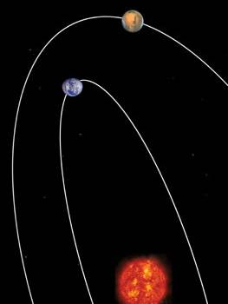
To solve this problem, Kepler came up with two extremely clever ideas.
To compute the orbit of Mars accurately, first compute the orbit of Earth accurately. If you know exactly where the Earth is at any given time, the fact that the Earth is moving can be compensated for by mathematical calculation.
To compute the orbit of Earth, use Mars itself as a fixed point of reference! To pin down the location of the Earth at any given moment, one needs two measurements (because the plane of the solar system is two dimensional.) The direction of the sun (against the stars) is one measurement; the direction of Mars is another. But Mars moves!

Slide 24
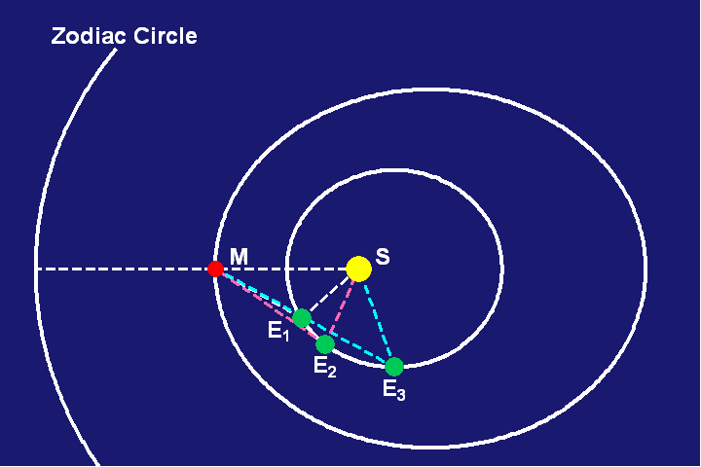
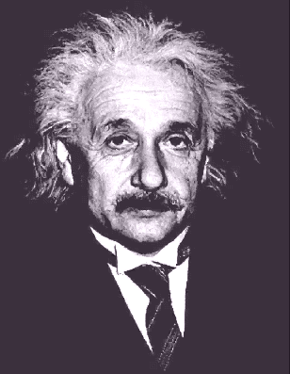
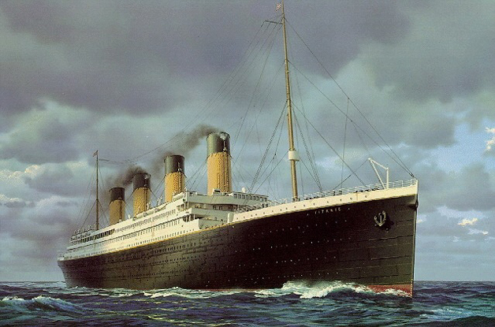
Kepler’s breakthrough was to take measurements spaced 687 days apart, when Mars returns to its original location and thus serves as a fixed point. Then one can triangulate between the Sun and Mars to locate the Earth. Once the Earth’s orbit is computed, one can invert this trick to then compute Mars’ orbit also.
Albert Einstein (1879-1955) referred this idea of Kepler’s as “an idea of pure genius.”
Similar ideas work for other planets. Since the AU can be computed from previous rungs of the ladder, we now have distances to all the planets (in AU, which we don’t know!).
By 1900, when travel across the Earth become easier, parallax methods (e.g. timing the transits of Venus across the sun from different locations on the Earth – a method first used in 1771!) could compute these distances more directly and accurately, confirming and strengthening all the rungs, so far, of the distance ladder.

Slide 25
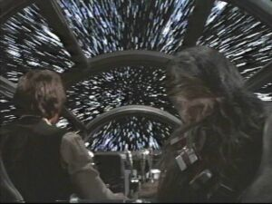
Fifth rung: the speed of light
Technically, the speed of light is not a distance. However, one of the first accurate measurements of this speed came from the fourth rung of the ladder, and knowing the value of this speed is important for later rungs.
Empedocles (c. 490–430 BC) was the first to propose a theory of light and claimed that light has a finite speed.
Ole Rømer (1644-1710) and Christiaan Huygens (1629-1695) obtained a value of 220,000 km/sec, close to but somewhat less than the modern value of 299,792km/sec, using Io’s orbit around Jupiter.
“It’s the ship that made the Kessel run in less than twelve parsecs.”
Notes:
Much argument about light infinite of finite: Bacon (13th C) argued finite, Kepler (17th C) infinite, Descartes () infinite, Fermat finite,
1629: Beeckman tried reflection of light from a cannot shot over a mile off a mirror
1638: Galileo tried uncovering a lantern at some distance and timing it
(note light travels 1 mile in ~5 microseconds delay – too fast for them)
1704: Newton, in Opticks, uses Romer to compute light from sun to earth to take 7 or 8 minutes. Modern value 8 minutes, 19 seconds
Speed of light is now exactly 299,792,458 m/s since we defined the meter length in 1983

Slide 26
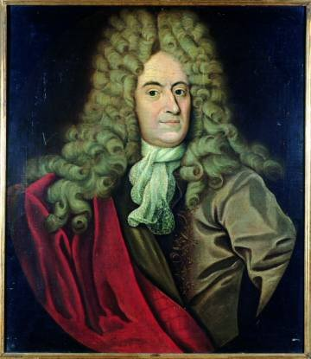
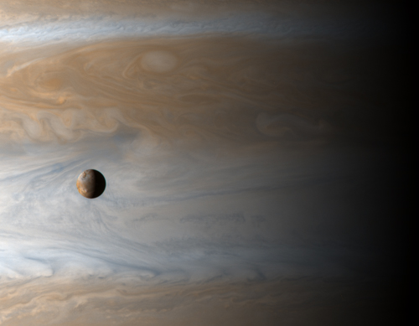
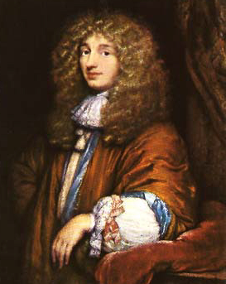
How did they do it?
Rømer observed that Io rotated around Jupiter every 42.5 hours by timing when Io entered and exited Jupiter’s shadow.
But the period was not uniform; when the Earth moved from being aligned with Jupiter to being opposed to Jupiter, the period had lagged by about 20 minutes. He concluded that light takes 20 minutes to travel 2 AU. (It actually takes about 17 minutes.)
Huygens combined this with a precise (for its time) computation of the AU to obtain the speed of light.
Now the most accurate measurement of distances to planets are obtained by radar, which requires precise values of the speed of light. This speed can now be computes very accurately by terrestrial means, thus giving more external support to the distance ladder.

Slide 27
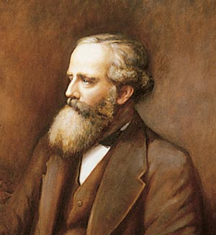
The data collected from these rungs of the ladder have also been decisive in the further development of physics and in ascending higher rungs of the ladder.
The accurate value of the speed of light (as well as those of the permittivity and permeability of space) was crucial in leading James Clerk Maxwell to realize that light was a form of electromagnetic radiation. From this and Maxwell’s equations, this implied that the speed of light in vacuum was a universal constant c in every reference frame for which Maxwell’s equations held.
Einstein reasoned that Maxwell’s equations, being a fundamental law in physics, should hold in every inertial reference frame. The above two hypotheses lead inevitably to the special theory of relativity. This theory becomes important in the ninth rung of the ladder (see below) in order to relate red shifts with velocities accurately.

Slide 28
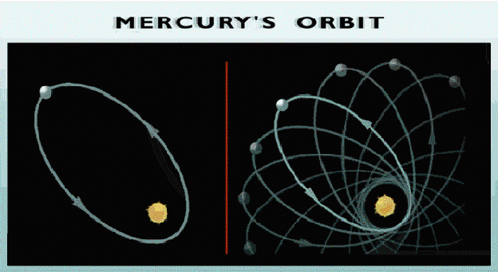
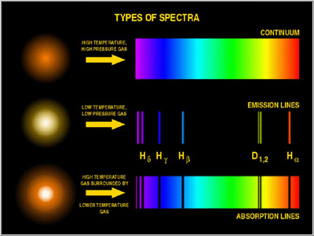
Accurate measurements of the orbit of Mercury revealed a slight precession in its elliptical orbit;this provided one of the very first experimental confirmations of Einstein’s general theory of relativity. This theory is also crucial at the ninth rung of the ladder.
Maxwell’s theory that light is a form of electromagnetic radiation also helped the important astronomical tool of spectroscopy, which becomes important in the seventh and ninth rungs of the ladder (see below).
Notes:
This anomalous rate of precession of the perihelion of Mercury's orbit was first recognized in 1859 as a problem in celestial mechanics, by Urbain Le Verrier. His reanalysis of available timed observations of transits of Mercury over the Sun's disk from 1697 to 1848 showed that the actual rate of the precession disagreed from that predicted from Newton's theory by 38″ (arc seconds) per tropical century (later re-estimated at 43″ by Simon Newcomb in 1882)
Precession effects: 532 from other bodies gravitational tugs, 43 from relativity

Slide 29
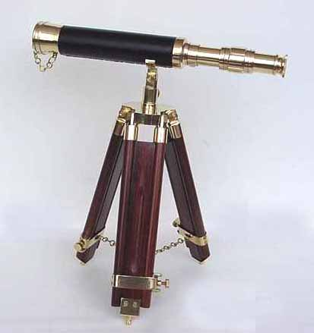
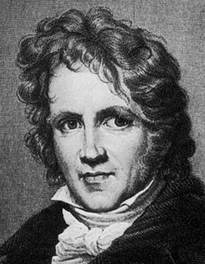
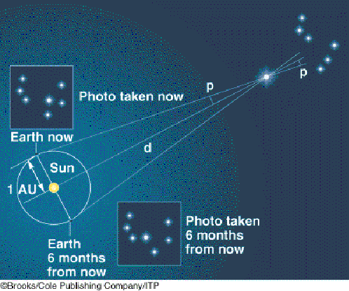
Sixth rung: distance to nearby stars
By taking measurements of the same star six months apart and comparing the angular deviation, one obtains the distance to that star as a multiple of the Astronomical Unit. This parallax idea, which requires fairly accurate telescopy, was first carried out successfully by Friedrich Bessel (1784-1846) in 1838.
It is accurate up to distances of about 100 light years (30 parsecs). This is enough to locate several thousand nearby stars. (1 light year is about 63,000 AU.)
Ironically, the ancient Greeks dismissed Aristarchus’s estimate of the AU and the heliocentric model that it suggested, because it would have implied via parallax that the stars were an inconceivably enormous distance away. (Well…they are.)

Slide 30
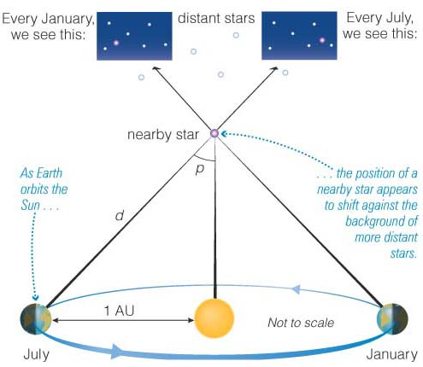

Slide 31
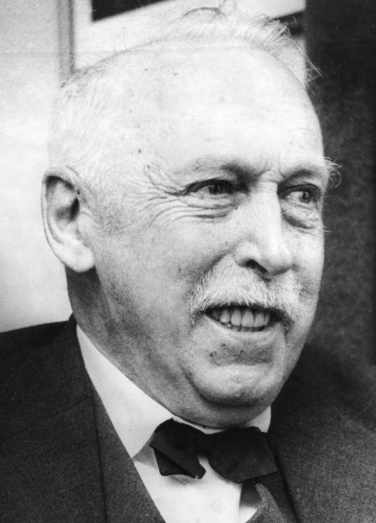

Seventh rung: distances to moderately distant stars
Twentieth-century telescopy could easily compute the apparent brightness of stars. Combined with the distances to nearby stars from the previous ladder and the inverse square law, one could then infer the absolute brightness of nearby stars.
Ejnar Hertzsprung (1873-1967) and Henry Russell (1877-1957) plotted this absolute brightness against color in 1905-1915, leading to the famous Hertzsprung-Russell diagram relating the two. Now one could measure the color of distant stars, hence infer absolute brightness; since apparent brightness could also be measured, one can solve for distance.
This method works up to 300,000 light years! Beyond that, the stars in the HR diagram are too faint to be measured accurately.

Slide 32


Slide 33

An HR diagram showing many well known stars in the Milky Way galaxy.

Slide 34


Eighth rung: distances to very distant stars
Henrietta Swan Leavitt (1868-1921) observed a certain class of stars (the Cepheids) oscillated in brightness periodically; plotting the absolute brightness against the periodicity she observed a precise relationship. This gave yet another way to obtain absolute brightness, and hence observed distances.
Because Cepheids are so bright, this method works up to 13,000,000 light years! Most galaxies are fortunate to have at least one Cepheid in them, so we know the distances to all galaxies out to a reasonably large distance.
Beyond that scale, only ad hoc methods of measuring distances are known (e.g. relying on supernovae measurements, which are of the few events that can still be detected at such distances).

Slide 35

Notes:
Classical Cepheids (also known as Population I Cepheids, type I Cepheids, or Delta Cepheid variables) undergo pulsations with very regular periods on the order of days to months
Classical Cepheids are Population I variable stars which are 4–20 times more massive than the Sun, and up to 100,000 times more luminous. These Cepheids are yellow bright giants and supergiants of spectral class F6 – K2 and their radii change by (~25% for the longer-period I Carinae) millions of kilometers during a pulsation cycle.
Type II Cepheids (also termed Population II Cepheids) are population II variable stars which pulsate with periods typically between 1 and 50 days.^{[14][15]} Type II Cepheids are typically metal-poor, old (~10 Gyr), low mass objects (~half the mass of the Sun). Type II Cepheids are divided into several subgroups by period. Stars with periods between 1 and 4 days are of the BL Her subclass, 10–20 days belong to the W Virginis subclass, and stars with periods greater than 20 days belong to the RV Tauri subclass
A group of pulsating stars on the instability strip have periods of less than 2 days, similar to RR Lyrae variables but with higher luminosities. Anomalous Cepheid variables have masses higher than type II Cepheids, RR Lyrae variables, and our sun. It is unclear whether they are young stars on a "turned-back" horizontal branch, blue stragglers formed through mass transfer in binary systems, or a mix of both
A small proportion of Cepheid variables have been observed to pulsate in two modes at the same time, usually the fundamental and first overtone, occasionally the second overtone.^{[24]} A very small number pulsate in three modes, or an unusual combination of modes including higher overtones.^{[25]}
The accepted explanation for the pulsation of Cepheids is called the Eddington valve,^{[44]} or κ-mechanism, where the Greek letter κ (kappa) denotes gas opacity. Helium is the gas thought to be most active in the process. Doubly ionized helium (helium whose atoms are missing both electrons) is more opaque than singly ionized helium. The more helium is heated, the more ionized it becomes. At the dimmest part of a Cepheid's cycle, the ionized gas in the outer layers of the star is opaque, and so is heated by the star's radiation, and due to the increased temperature, begins to expand. As it expands, it cools, and so becomes less ionized and therefore more transparent, allowing the radiation to escape. Then the expansion stops, and reverses due to the star's gravitational attraction. The process then repeats.

Slide 36


Ninth rung: the shape of the universe
Combining all the above data against more precise red-shift measurements, together with the known speed of light (from the fifth rung) Edwin Hubble (1889-1953) formulated the famous Hubble’s law relating velocity (as observed by red shift) with distance, which led in turn to the famous “Big Bang” model of the expanding universe. This law can then be used to give another (rough) measurement of distance at the largest scales.
These measurements have led to accurate maps of the universe at very large scales, which have led in turn to many discoveries of very large-scale structures which would not have been possible without such good astronomy (the Great Wall, Great Attractor, etc.)

Slide 37


For instance, our best estimate (as of 2004) of the current diameter of the observable universe is now at least 78 billion light-years.
The mathematics becomes more advanced at this point, as the effects of general relativity has highly influenced the data we have at this scale of the universe. Cutting-edge technology (such as the Hubble space telescope and WMAP) has also been vital to this effort.
Climbing this rung of the ladder (i.e. mapping the universe at its very large scales) is still a very active area in astronomy today!

Slide 38


CMB: Cosmic Microwave Background
  Space filled with low-temp radiation
Alpher, Hermann – 1948 – predicted background radiation at 5 degrees K from Hubble observational data
Penzias, Wilson – 1964 – Bell Labs. Working on satellite communication, discovered 4.2 degrees K extra antenna temperature, concluded it was CMB, won Physics Nobel Prize 1978
Harrison, Peebles, Yu – 1970, 72 - predicted inhomogeneity of 10^-4 degrees K
Notes:
CMB has near perfect black-body spectrum, very faint isotropies, predicted by Big Bang

Slide 39



NASA Cosmic Background Explorer
  COBE, 1989-1993
  Smoot & Mather confirmed anisotropies in 1994, Nobel Prize in 2006
WMAP - COBE successor
  2001-2010
  mission's determination of the age of the universe to better than 1% precision
Plank successor to WMAP (2009-2013)
  higher resolution and sensitivity
  provided the most accurate measurements of several key cosmological parameters, including the average density of ordinary matter and dark matter in the Universe.
Prediction from Big Bang Theory vs COBE
data, ruled out steady state universe
Notes:
COBE – Cosmic background Explorer, 1989 – 1993,
WMAP – Wilkinson Anistropy Probe
Planck was from European Space Agency

Slide 40





Gravitational waves
  1916 Einstein predicted as solution to General Relativity field equation:
  Exist because field equations have periodic moving solutions, in the same way Maxwell’s equations for electromagnetism have periodic moving solutions, which give light:
1974 - existence indirectly confirmed
  observations of the binary pulsar PSR 1913+16 showed orbital decay (energy loss) matching gravitational radiation predictions
  Hulse, Taylor - 1993 Nobel Prize for this discovery
But how to measure directly?
  Interferometry!
  Incredibly precise measurements needed

Slide 41





Rainer Weiss – 1967 – published interferometer analysis and initial construction of measuring device (terminated before completion)
  Pioneering work on CMB and gravitational waves
Kip Thorne – 1968 – started Caltech Group to do theory and organize funding groups, becomes LIGO
  Co-wrote Bible on gravitation, Gravitation, 1973
  The driving science force behind Interstellar movie
  Worked on gravitational waves for decades
Laser Interferometer Gravitational-Wave Observatory (LIGO)
  Funding for LIGO started 1986
  Construction of first part completed 1997
  Competing with Virgo (Pisa, Italy) and GEO (Germany)
Thorne, Weiss, Barish - 2017 Nobel Prize
  Barry Barish – 1994 – became LIGO Director, oversaw funding and construction

Slide 42



LIGO
  Two locations: Livingston, LA and Richland, WA
  Collected data 2002-2010 – no results
  2010-2015 - 5 year, $200M overhaul, 4x sensitivity
  2016: 1,000 scientists, 75 institutions in 15 countries
  Strain sensitivity:
    2002: 10^-19
    2010: 1.5x10^-22
    2015: 7x10^-23
    30x improvement still in works
  Can detect change in 4km mirror spacing of less than 1/10,000th of the charge diameter of a proton
    Like measuring distance to Proxima Centauri (4 lyr.) to width of human hair
  Largest, most ambitious NSF project to date: $ 1.1B USD
Results
  Sep 14, 2015 – detects signal from two ~30 solar mass black holes merging about 1.3 billion light-years from Earth
  26 Dec, 2015 – black holes merger, 14.2 and 7.5 solar masses
  4 Jan, 2017 – black holes merger - 31.2 and 19.4 solar masses
  14 Aug 2017 – black holes merger - 30.5 and 25.3 solar masses
  17 Aug 2017 – two neutron stars merge, optical seen in normal telescopes, also seen by Virgo, event named GW170817
Notes:
Ear sensitivity – sensitive to amplitudes as small as proton or hydrogen?

Slide 43





LIGO results vs. theory for one event
LEGO LIGO

Slide 44

Summary
  Distances and methods
Other physics talks
  Spacetime
  Grand Unified Theory
  Particle Physics and Higgs Boson
Questions?

Slide 45

Acknowledgements
(From Terry Tao):
Thanks to Richard Brent for corrections and comments.
Much of the data here was collected from various internet sources (usually starting from Wikipedia and then branching out to more primary source material).
Thanks to Charisse Scott for graphics and PowerPoint formatting.

Slide 46
Other talks:
Computers
  Cryptology (starts next week)
  Floating point tricks
  Bit twiddling hacks
  RNGs
  Quaternions and Geometric Algebra for Graphics
  Quantum Computing
  Math in technology
  Amazing Security Holes
Science
  Intro to Special Relativity
  A Simple Derivation of Space-time
  Theory of Everything
  Quantum field theory

